Slide 1
Report Writing
Write a non-chronological report about a giraffe.
(Shared Writing)

Slide 2
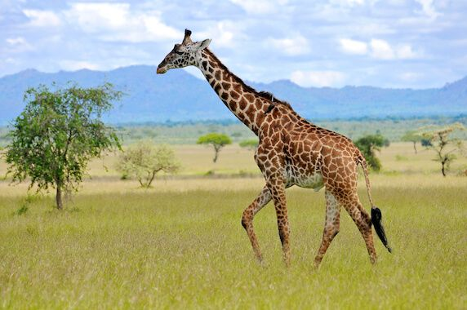
Introduction:
tallest animal in the world
long legs
a very long neck patterned coats
different markings
Diet:
herbivores
very long tongue to help them reach leaves and twigs from trees and shrubs
spend almost all day eating
drink mostly from the leaves they eat
Habitat:
live in African savannahs, grasslands, open forests
Predators:
can be attacked by lions
strong legs to kick predators
height and good eyesight help them
to look out for danger
Interesting facts:
They meet up in small groups known as ‘towers’.
They can grunt, snort and even hiss.
Female giraffes give birth standing up and a newborn calf will drop about 1.5 metres to the ground when it is born.

