Slide 1
Lesson 5: Literature Topic: Entertainment Year: 4

Slide 2
Lesson Objectives:
I will:
read a poem silently and aloud.
listen to the poem being read aloud.
answer questions about the poem.

Slide 3
Download these resources:
Poem Handout
Poem Worksheet
Answers Handout
Post-Task Worksheet

Slide 4
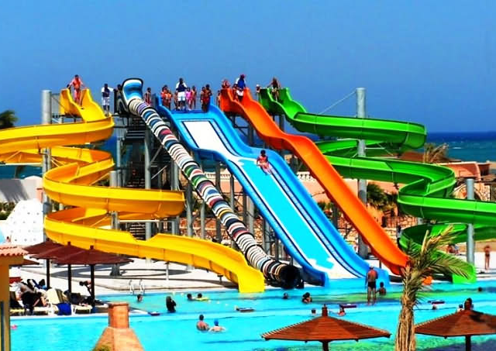
Have you ever been to an amusement park?
If so, with whom did you go?
Was it in Malta or abroad?
Did you enjoy it?
How did you feel when riding the rides?
Would you like to go again?
If you have never been to an amusement park, would you like to go?
Which rides would you like to try out?

Slide 5
New Vocabulary:
expected = something that most probably will happen
vomit = throw up
homicidal = the killing of one person by another
jerked = a quick, sharp, pull or twist
sharply = alert/quick
hurl = to throw with force
nauseous = sick / unwell

Slide 6
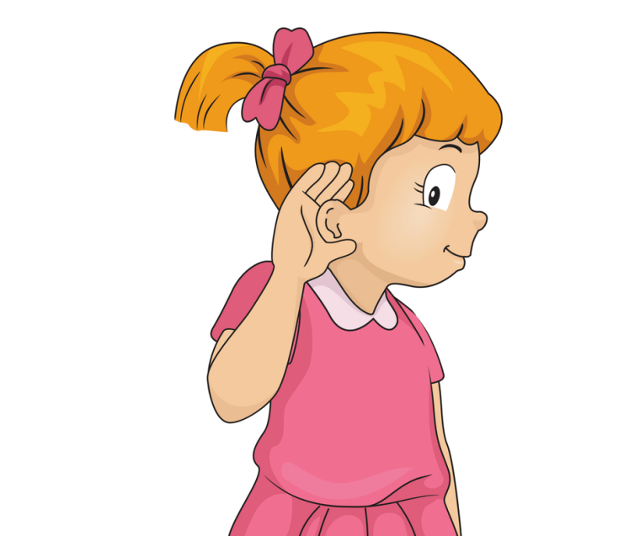
Step 1: Listen to the poem.
What is the poem about?

Slide 7
Step 2:
Read the questions
on your worksheet.

Slide 8
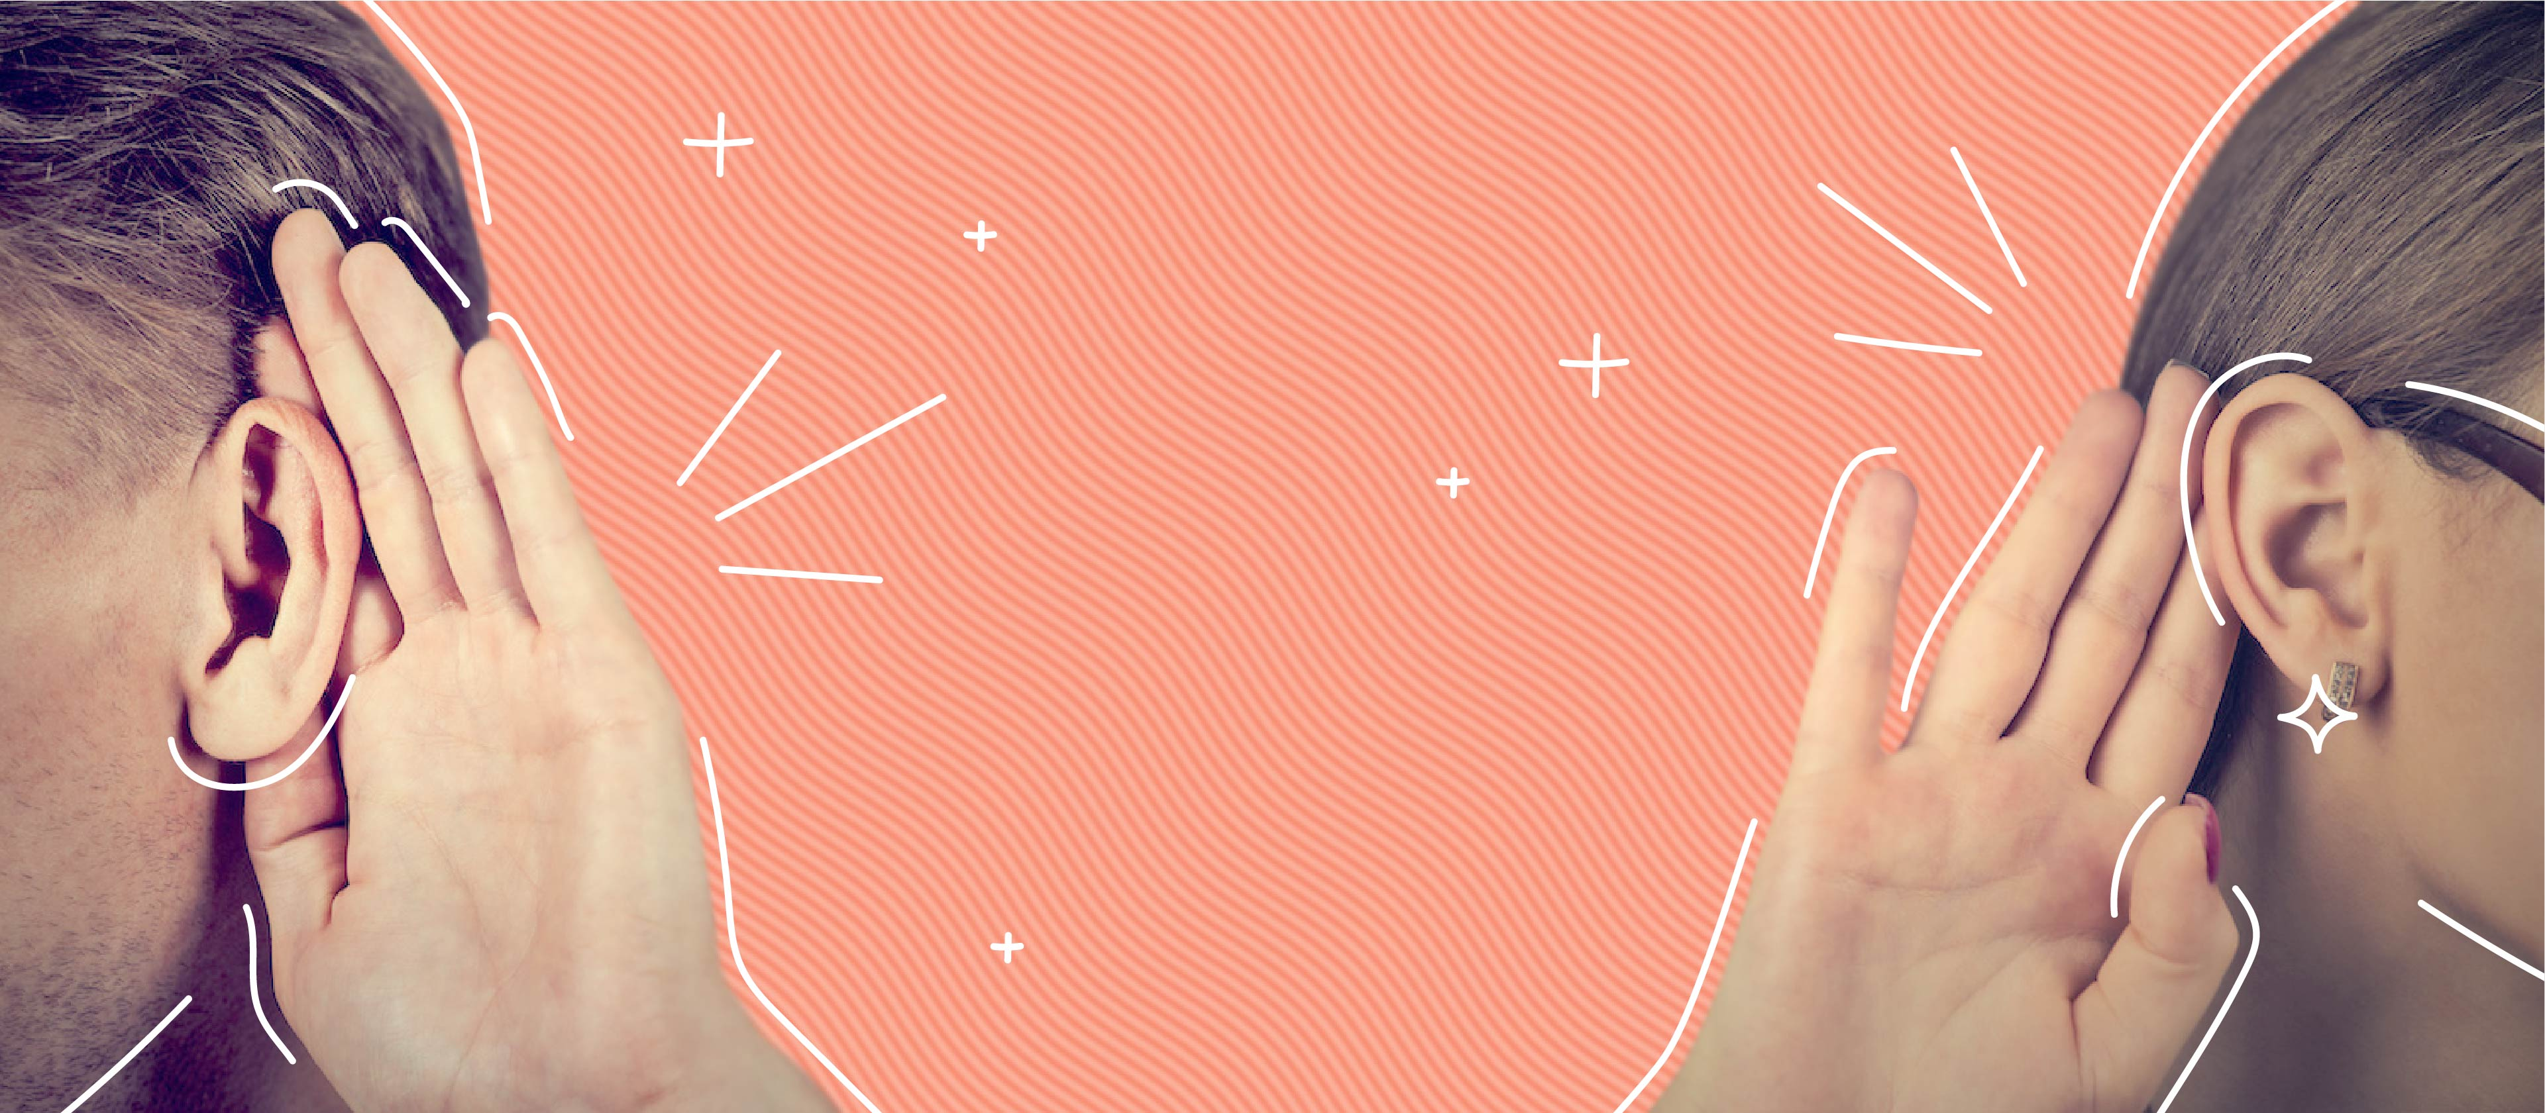
Step 3:
Listen to me read the poem and the questions.
You can follow from your handout and worksheet.

Slide 9
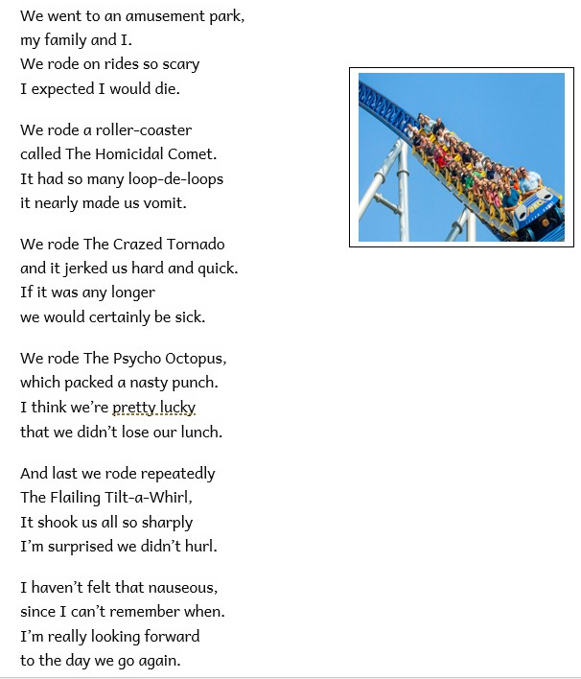

Slide 10
Step 4:
READ the poem silently on your handout.
Try to ANSWER the following questions.
Why is the poem called ‘Abusement Park’?
Why do you think, a ride is called ‘Homicidal Comet’?
What is the name of the ride which jerks the riders hard and quick?
What does the phrase in the fourth stanza ‘lose our lunch’ mean?

Slide 11
Step 5: Let’s answer the questions.
1. Why is the poem called ‘Abusement Park’?
The word ‘abusement’ is a word invented by the poet derived from the word 'abused'. Instead of being sources of amusement, certain rides are so scary that they aren't amusing at all.
2. Why do you think a ride is called ‘Homicidal Comet’?
'Homicidal Comet' is a dangerous and scary ride.
3. What is the name of the ride which jerks the riders hard and quick?
It’s called ‘The Crazed Tornado’.
4. What does the phrase in the fourth stanza ‘lose our lunch’ mean?
It means that one can get sick and throw up their lunch.

Slide 12
Step 6:
READ the poem and then ANSWER all the questions.

Slide 13
Step 7:
When you answer all the questions, REVISE your answers.

Slide 14
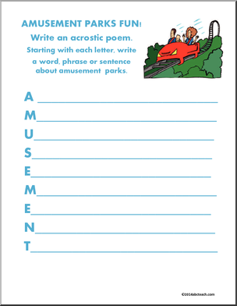
Post- Task:

