Slide 1
Staying Healthy
Lesson 3: Literature

Slide 2
Notes for the Educator
This lesson is pegged directly to Learning Outcome 6.2.3. Demonstrate ability to integrate and adapt their reading strategies when reading difficult or unfamiliar text; 6.2.6 Participate in shared reading experiences and 6.2.8 Read and understand unfamiliar text.
Teachers are to refer to the Scheme of Work where each lesson is explained in more detail.
Effects are included to make the presentation more interactive. Please present the PowerPoint in Slideshow mode.
Wherever possible we have included the use of online apps to enhance the teaching and learning experience.
The Notes section underneath the slides may contain some further points which can be developed during the lesson.
Teachers are encouraged to adapt this PowerPoint presentation to meet the learners’ language needs.
Audio files or links to websites may be included.
Tasks included in the PowerPoint presentation are also being shared as handouts.
For any comments, feedback or suggestions please email us at: marie-claire.camilleri@ilearn.edu.mt; urieth.attard@ilearn.edu.mt; mary.jude.camilleri@ilearn.edu.mt. You may also call the office on: 25983683.

Slide 3
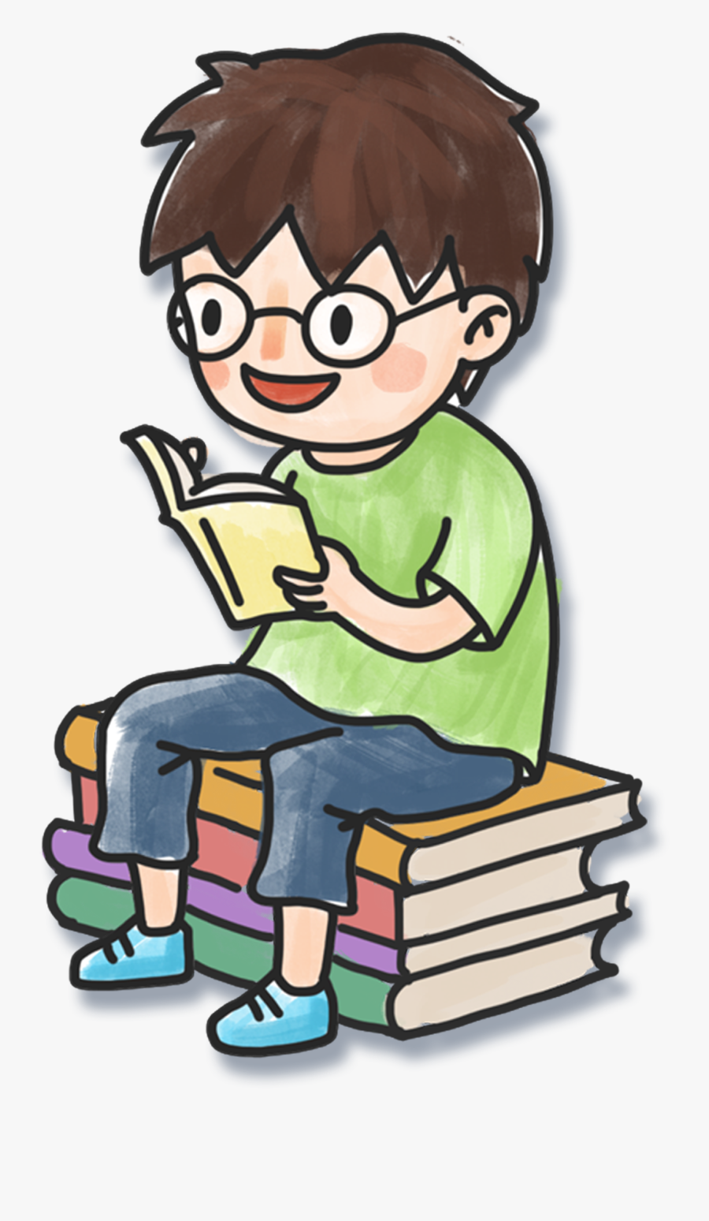
I am learning to read and respond to unfamiliar text.
I can read an excerpt from a story to enjoy myself.
I can make inferences based on the information in the text.
I can talk about figurative language such as similes and onomatopoeia.

Slide 4
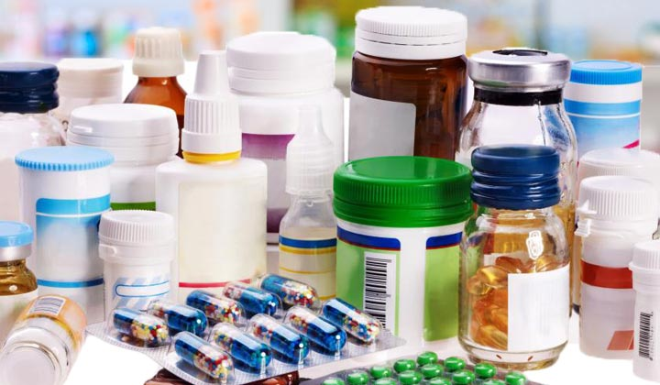
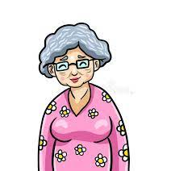
Notes:
So, I would like you to look carefully at the pictures on the screen. What are you seeing? How are these two pictures related? And how are these pictures related to our literature lesson today?

Slide 5
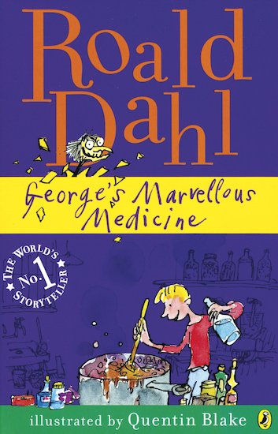
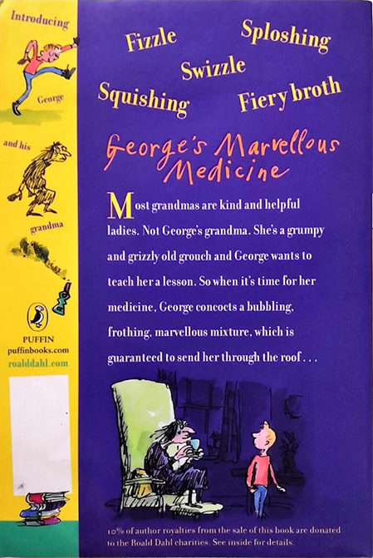
Who is on the front cover? What are they doing?
Who is the story going to be about? How do you know?
Which characters were you introduced to in the blurb?
What do you think might happen in the story?
Have you ever read anything else by Roald Dahl?
Notes:
So let’s take a look at the book sleeve. Here you can see the front cover of the book and the back cover where there is the blurb. Let’s think about the following questions.
George is on the cover, stirring the medicine. Up here, we can also see his grandma – who seems to be a rather nasty sort of person.
The boy on the cover is stirring a large pot of something and he is smiling. There are lots of different containers with potions that are going into the pot, so it looks like he is making something.
This story is going to be about George and his grandma. He is making something which I assume is a medicine. I can see clues from the picture of the front cover and from reading the blurb.
In the blurb we are introduced to the characters of George and Grandma.
The story is obviously centred about a boy called George making medicine for his horrible grandma. She seems mean and revolting. We know that George decided to make her some of his own medicine. I hope that this means she will either be turned into a nice grandma, or that she will be punished for her unpleasant behaviour towards George.
Roald Dahl is famous for many other children’s books – Charlie and the Chocolate Factory, Matilda, the BFG, the Enormous Crocodile and many more.

Slide 6
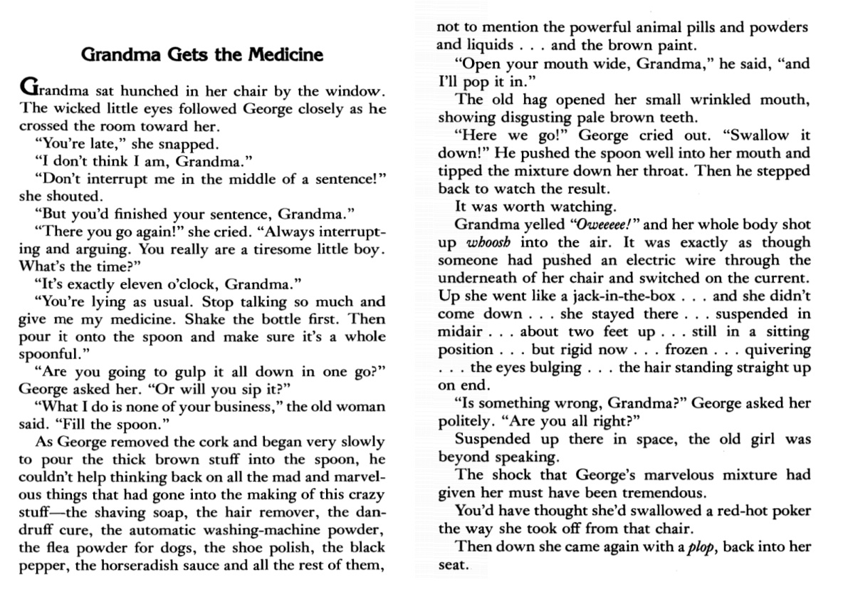
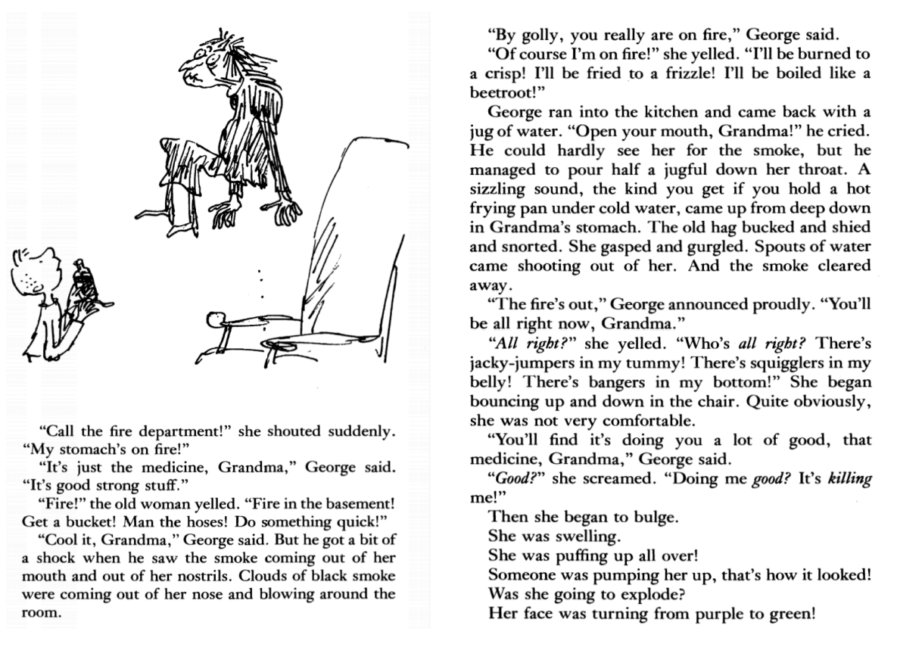
Notes:
Now, I would like you to refer to the extract that is available with this lesson. Take some time to read the extract to yourself and afterwards we will read it again together.

Slide 11
Deeper Reading
What is happening in this story?
Who are the characters?
Where is the story taking place?
Who is telling the story?
What impression does the author give us about Grandma?
Notes:
The narrator is telling this story, so we could describe this as Roald Dahl. The story is told from George’s perspective though.
The author gives us the impression that Grandma is deeply unpleasant and is both deliberately mean and strange.

Slide 12
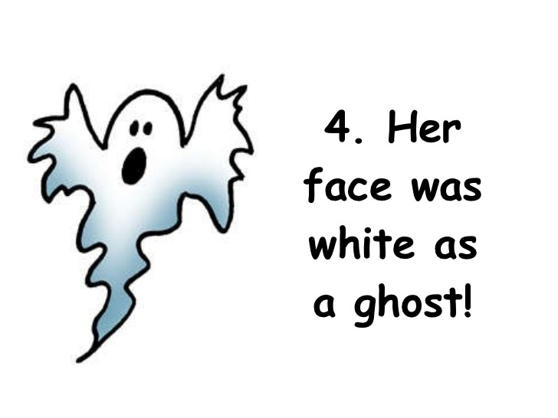
Similes
comparing two things using…
like
as
Notes:
You might have noticed some similes in the text. Do you know what a simile is? A simile compares two things using the words ‘as’ or ‘like’. They create imagery – they paint instant pictures in our heads. Give some examples e.g. ‘he was as brave as a lion’, ‘she was as white as a ghost’, ‘he slept like a log’. Can you think of any others?

Slide 13
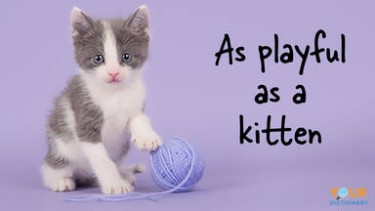
Similes
Notes:
Can you find the similes in the text?

Slide 14
Notes:
The first one is ‘up she went like a jack in the box’. This shows us the way that she was pushed upwards, kind of like a jack in the box does, when you open the lid.
The second one is ‘boiled like a beetroot’. A beetroot is a reddish coloured root vegetable that can be eaten either raw or roasted or boiled.

Slide 15
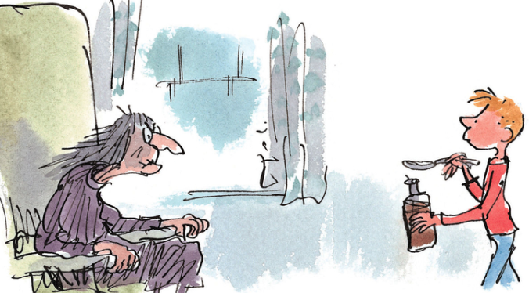
How does Roald Dahl build excitement in his writing?
Notes:
Take some time to think about the following questions. Read the extract again and note down how Roald Dahl brings the writing alive…

Slide 16
Direct Speech
Onomatopoeia
Exciting Punctuation: Ellipsis (…); Exclamation mark, italics
Shorter sentences
Different use of verbs for Grandma and George
How does Roald Dahl build excitement in his writing?
Notes:
So, I wonder if you have thought of the following techniques…shorter sentences create a ‘heart-beat’ effect which generates excitement.
Onomatopoeia – words that make the sound it describes
Look at the differences between the verbs used for Grandma and George: George said but Grandma yelled. The author wants us to see that George’s behaviour is calm which makes Grandma’s panic even more pronounced.

Slide 17
Direct Speech | “You’re late,”
Onomatopoeia | “Plop” “ Frizzle”
Ellipsis | “Up she went like a jack in the box…”
Exclamation mark | Man the hoses! Do something quick!
Notes:
Let’s look in the text to find examples of each technique. (rather than “the old woman was on fire”)

Slide 18
Italics | “Doing me good? It’s killing me!”
Shorter sentences | “Then she began to bulge. She was swelling. She was puffing up all over.
Different use of verbs | Grandma: shouted/ yelled / snapped/ cried / screamed George: said / asked politely
Notes:
If you would like to listen to this part of the story, I invite you to listen to Rik Mayall’s reading of George’s Marvellous Medicine is an excellent example and is available on YouTube. He makes use of various techniques such as facial expression, funny voices, props and sound effects, to bring the story to life.

Slide 19
Notes:
So, before we end our lesson, let’s go back to the pictures I showed you at the beginning lesson. Can you explain the link between the two pictures, now? How are these two related in the extract that we just read? Why would Roald Dahl write a story about medicines? What is he trying to teach us about medicines? Are you allowed to help yourselves to medicines at home? Why not?
Medicines are only safe if taken responsibly and under adult supervision. It is very important that when taking medicine you follow the correct dosage instructions, that is the exact amount the doctor tells you to take. You should also be careful to never take out-of-date medicine or medicine which has been prescribed for somebody else.

Slide 20
what we can do…
Read an extract from a story and enjoy it.
Make inferences based on what is happening in the text.
Talk about different techniques the author uses to create excitement in the story.
Notes:
Let’s see what we accomplished in this lesson.

Slide 21
Thank you for using this resource. Check out our latest resources below.

