Slide 1
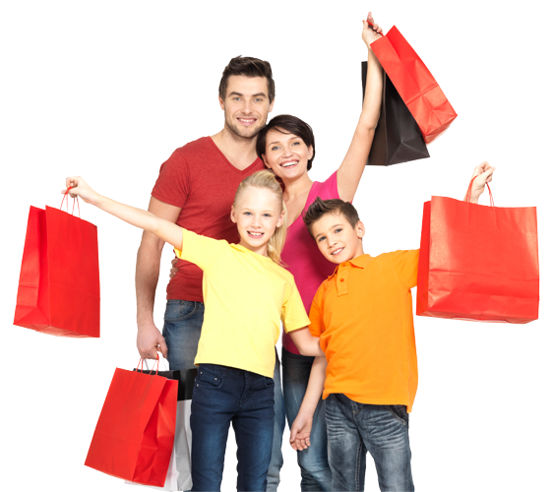
Lesson 2:
Reading
Topic:
Shopping and
Services
Year:
4
This Photo by Unknown author is licensed under CC BY-NC.

Slide 2
Lesson Objectives:
During this lesson I will:
learn the meaning of new words.
listen to a text being read aloud.
read a text silently and aloud.
answer questions about the text.

Slide 3
Download these resources:
Reading Text Handout
Questions Worksheet
Answers Handout

Slide 4
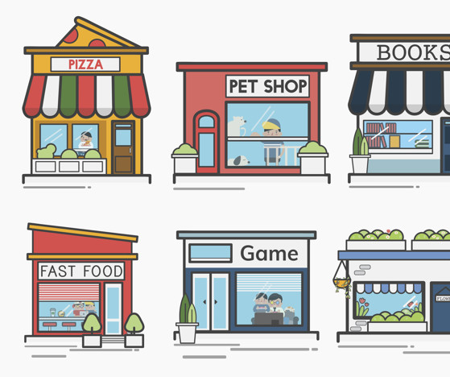
Different shops in the community

Slide 5
Antique
Shop
a shop that
sells valuable
old items
and collectables

Slide 6
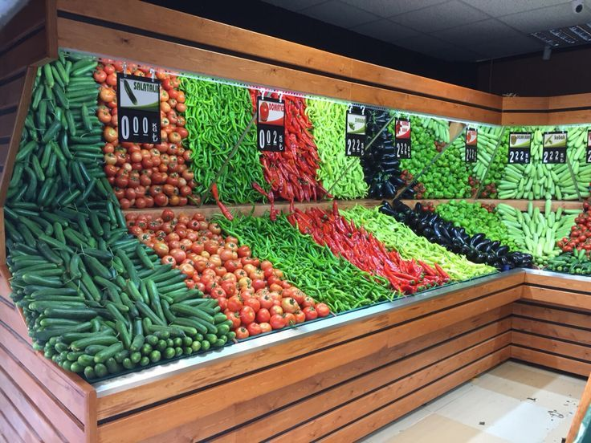
Greengrocer
a shop where you can buy fruit and vegetables

Slide 7
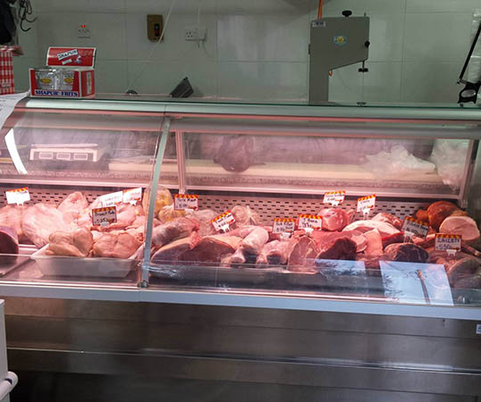
Butcher
a shop that sells meat

Slide 8
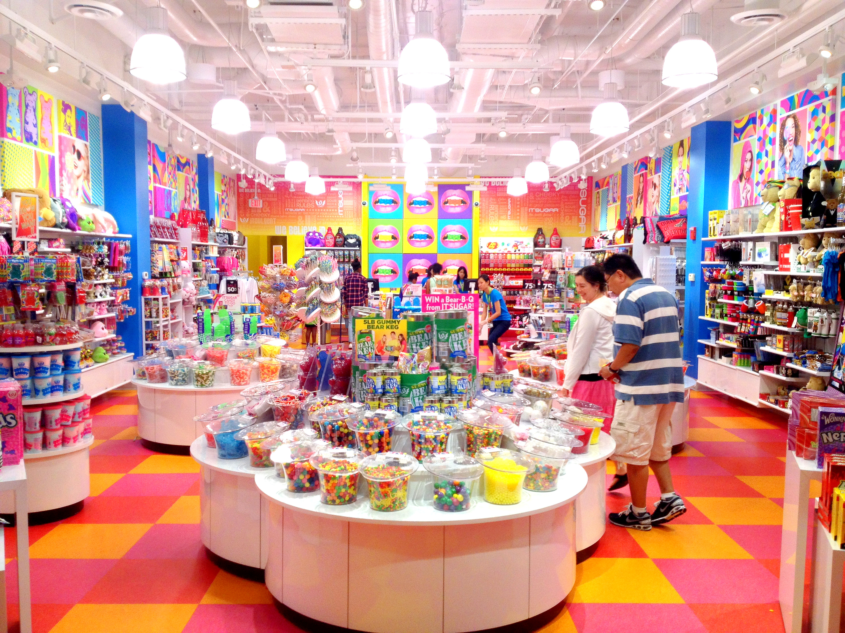
Candy Shop
a shop that sells various kinds of sweets and chocolates

Slide 9
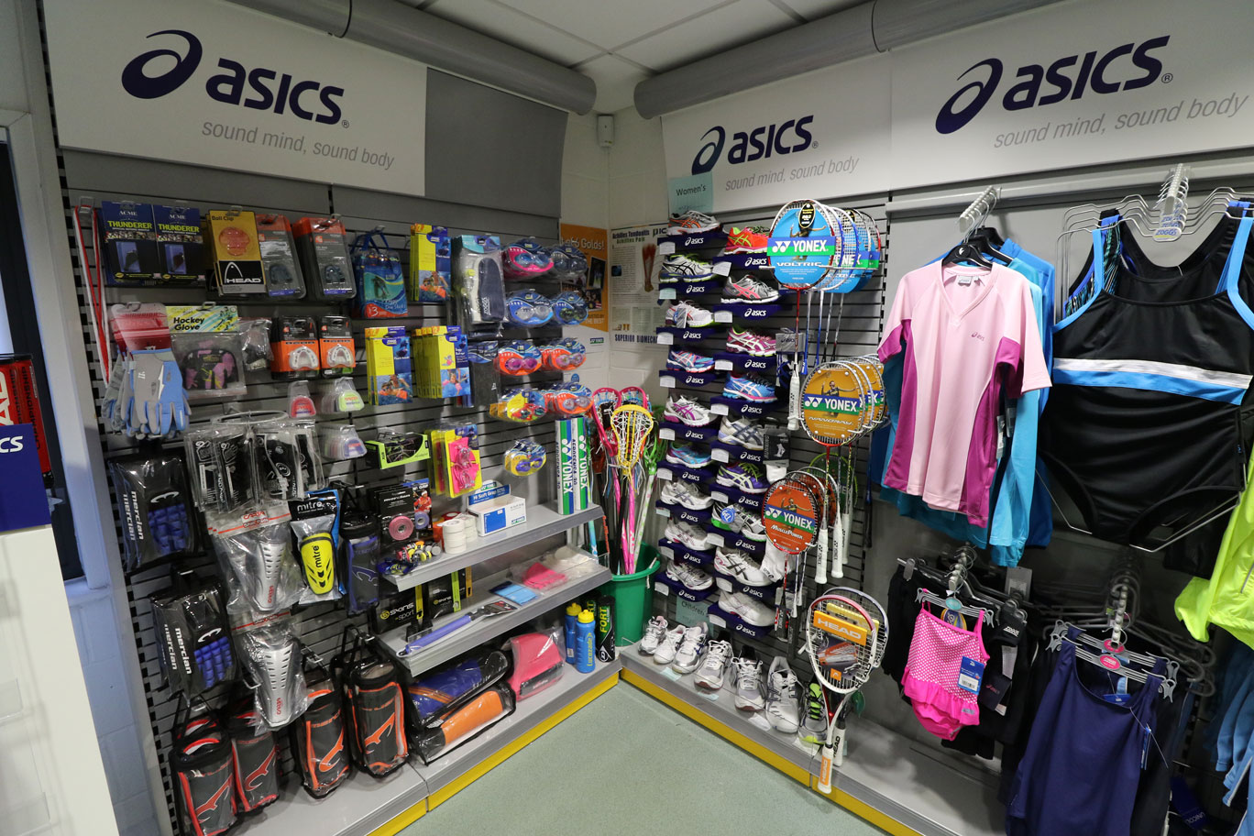
Sports Shop
a shop that sells sportswear and sports equipment

Slide 10
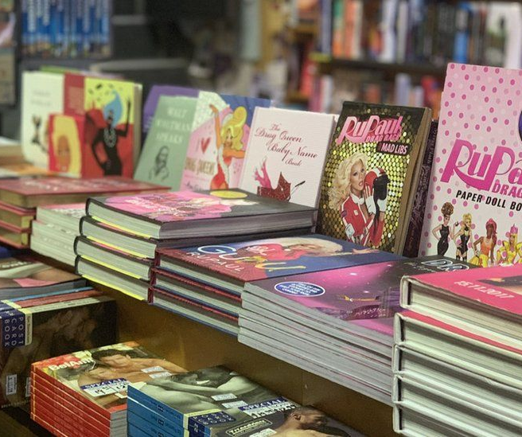
Book Shop
a shop that sells books

Slide 11
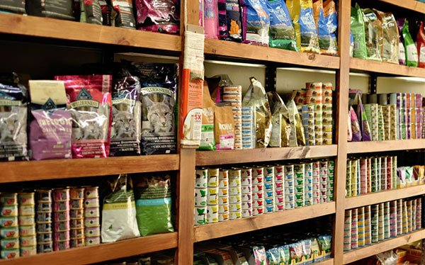
Pet Shop
a shop that sells pet animals, such as cats, dogs and birds and their supplies

Slide 12
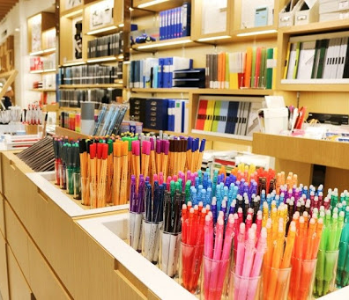
Stationery Shop
a shop that sells stationery and related things

Slide 13
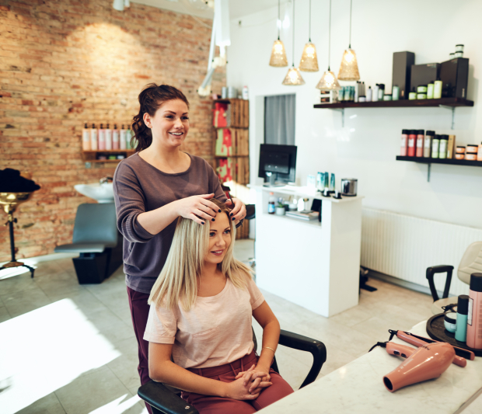
Hairdresser Salon
a business which offers hairdressing services

Slide 14
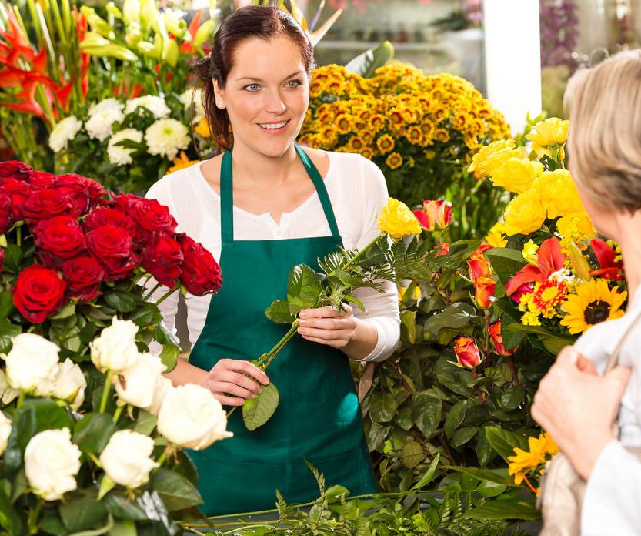
Florist
a shop that
sells flowers

Slide 15
Beauty Salon
a business which offers beauty treatments

Slide 16
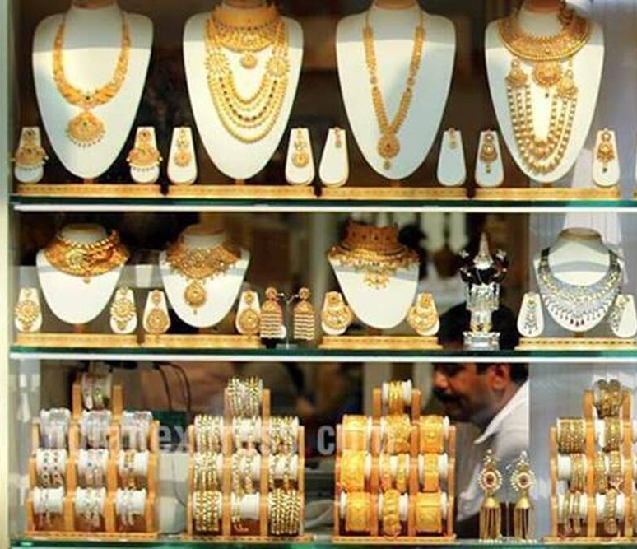
Jewellery Shop
a shop that sells watches and jewellery

Slide 17
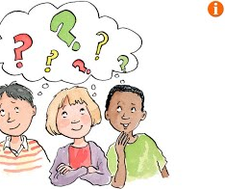
What is a Department Store?
What is a mall?

Slide 18
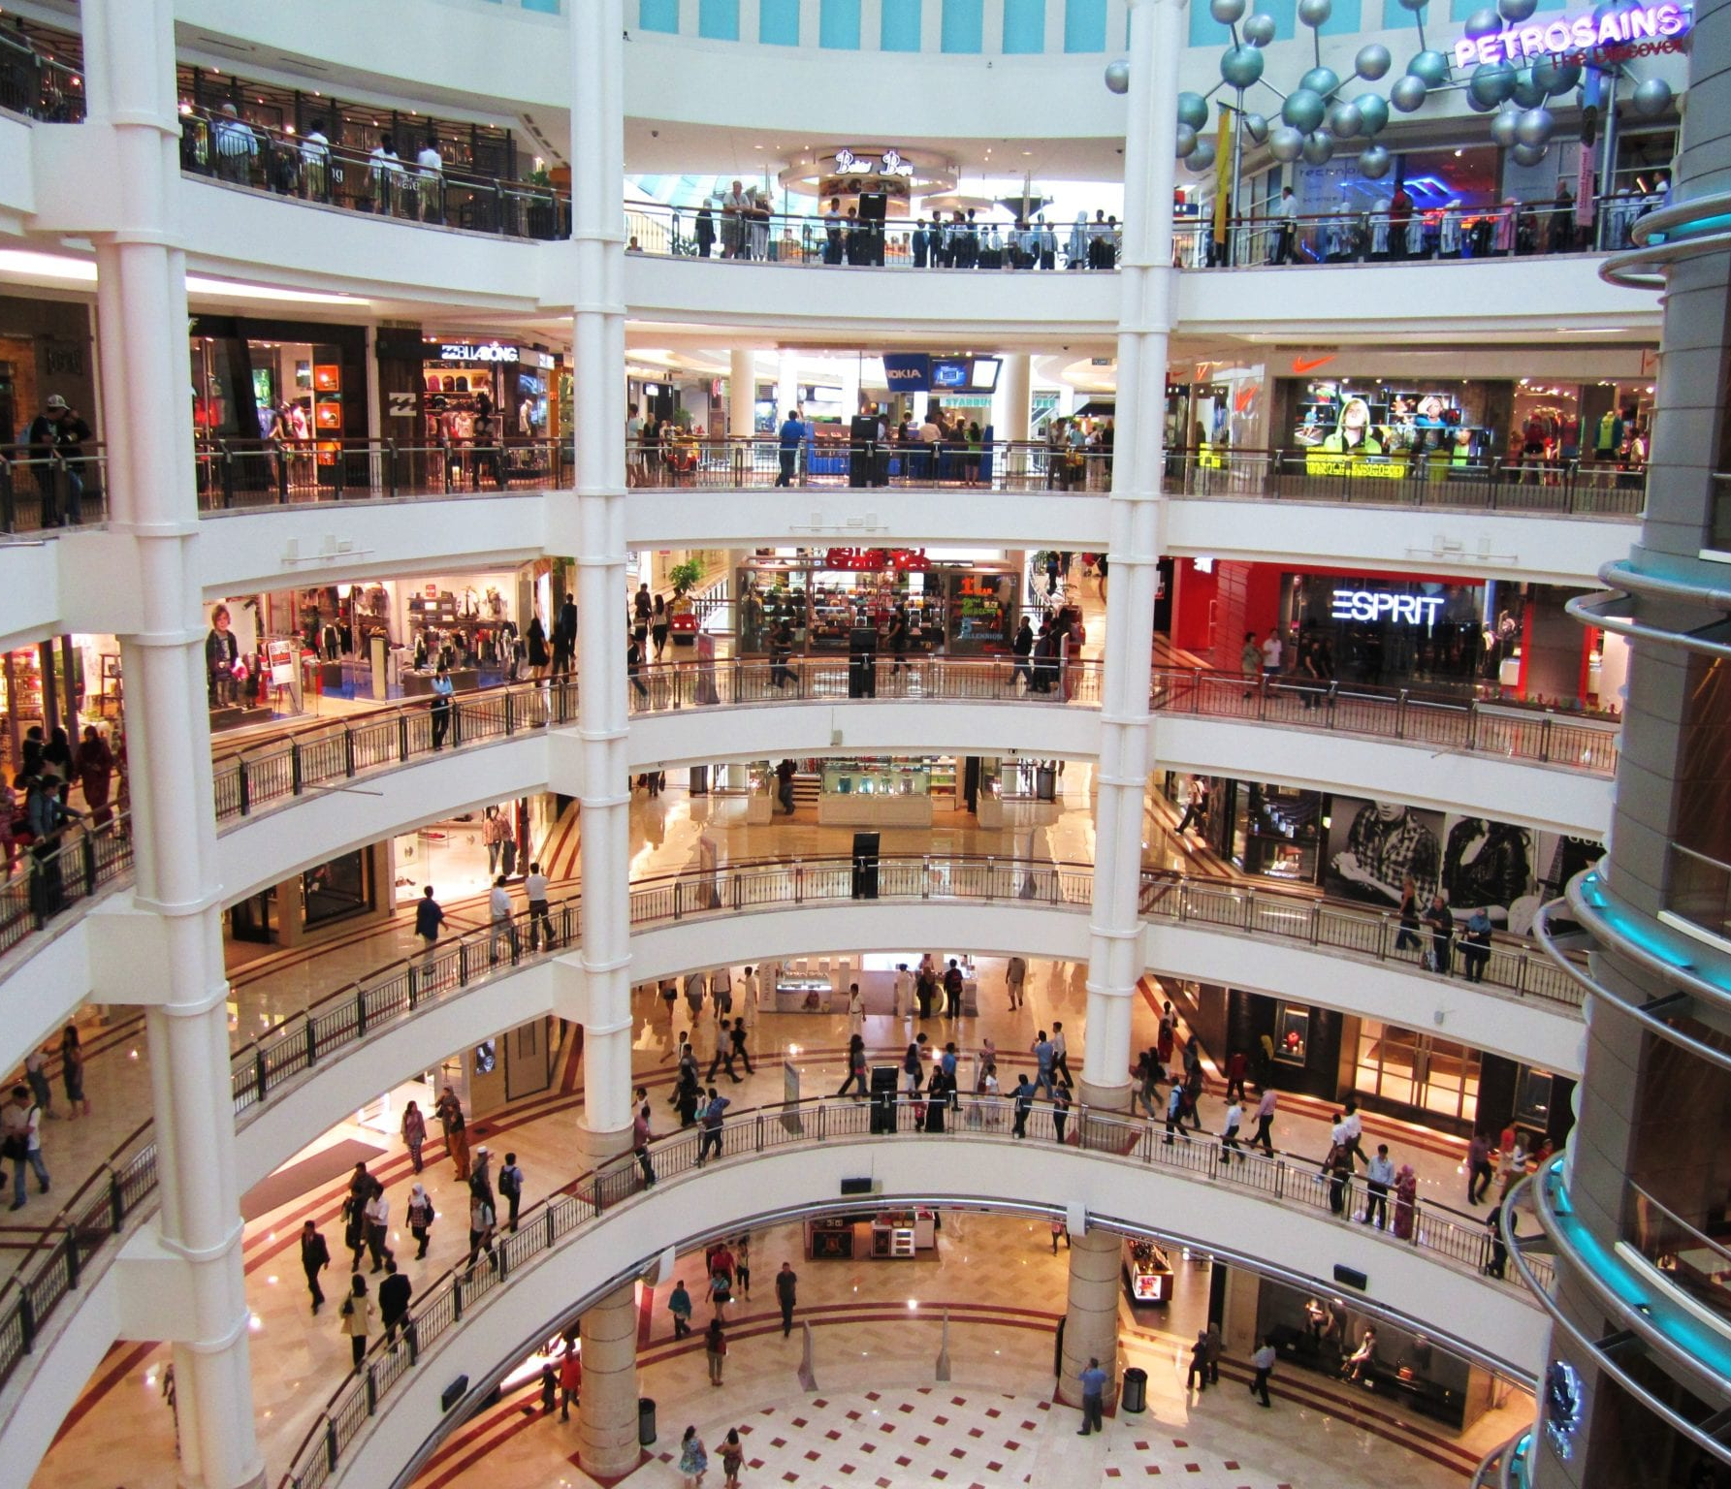
A mall
A mall or shopping centre is a huge building with shops selling a variety of things.
In a mall, shoppers can go from one building unit to another through the walkways.

Slide 19
A department store
A department store is a place where more residential (things which we generally buy often for our home) and personal things are sold. It is just a single retail business establishment.
A department store can be accommodated in a mall.

Slide 20
Pre-Teaching of Words:
escalator a moving stairway
a sob to cry noisily
extract a selection from a piece of writing
events social occasions

Slide 21
Step 1:
READ the story on the handout.
READ the exercises on your worksheet.
Then try to ANSWER the question:
WHAT IS THE STORY ABOUT?

Slide 22
Step 2: Let’s DISCUSS the question.
The story took place in a brand, new shopping mall. Anna went there with her Aunt Jemima and Uncle Bob. There, Anna met a little boy. While they were shopping, Aunt Jemima lost an earring while Uncle Bob forgot his new computer disc.

Slide 23
Step 3:
READ the story and questions again. Then try to ANSWER these questions:
Describe the shopping mall.
When did Aunt Jemima realise that she had lost her earring?
Why was the small boy crying?
Where did Uncle Bob leave his disc?
List all the shops mentioned in the story.

Slide 24
Step 4: Let’s DISCUSS the questions
1. Describe the shopping mall.
It was brand new and bigger than the old mall. It had four escalators and a lift.
2. When did Aunt Jemima realise that she had lost her earring?
She realised that she had lost her earring while she was trying on a scarf in a clothes
shop.
3. Why was the small boy crying?
He had dropped his toy car and lost a piece from it.
4. Where did Uncle Bob leave his disc?
He left it in the clothes shop.
5. List all the shops mentioned in the story. Computer shop, clothes shop and café.

Slide 25
Step 5:
LISTEN to me as I read the story and the questions aloud.
FOLLOW your text and READ it silently.

Slide 26
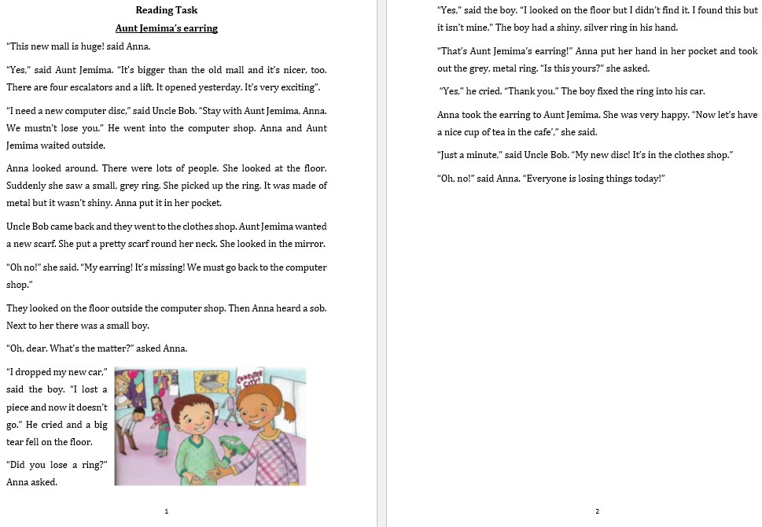

Slide 27
Step 6:
READ the text ALOUD.
PAUSE the recording.

Slide 28
Step 7:
WORK OUT the Questions Worksheet.

Slide 29
Step 8:

Slide 30
Step 9:
CHECK your work using the Answers Handout.

Slide 31
Post-Task :
Write a short email to a friend/relative, to invite him/her to join you on a trip the brand, new mall.

Slide 32
Keep in mind the G.A.P:
GENRE: an informal, short email (email address of receiver, subject, salutation, closing, …)
AUDIENCE: a friend/relative (friendly, chatty style)
PURPOSE: to invite a friend/relative on a shopping trip (set a date and time, try to convince him/her, give a valid reason why your friend/ relative should join you, ask friend/relative to reply to your email.)

Slide 33
receiver’s email (e.g.anna@hotmail.com)
email subject (e.g. Let’s meet!)
a salutation
a greeting
date and time
reason for your friend/relative to join you
a closing
signature
In your email,
make sure
to include:

Slide 34
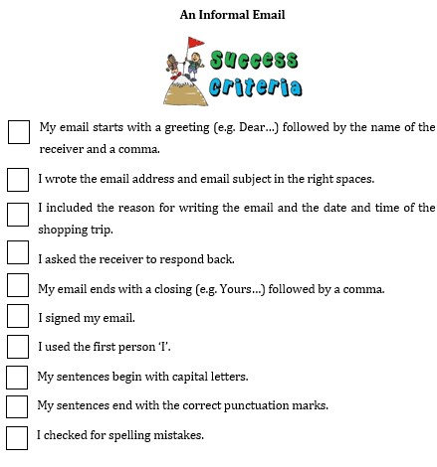
Success
Criteria

