Slide 1
Lesson 4 Writing
Year 5
English

Slide 2
Book Review

Slide 3
Lesson 4 Objectives
You will learn:
what a book review is.
how to write a book review.
the success criteria for writing a book review.

Slide 4
Lesson Resources
Book Review
Success Criteria

Slide 5
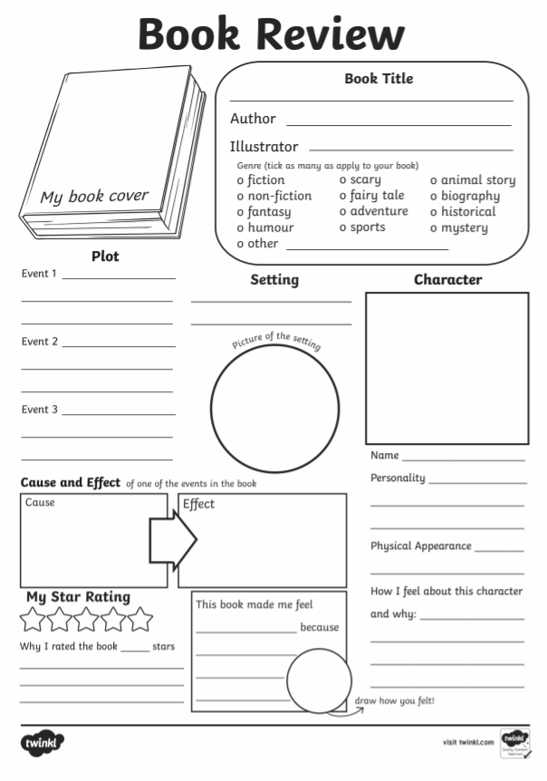
Book Review
A book review helps people decide whether or not the book would interest them enough to read it.
Reviews are a sneak peek at a book, not a summary.

Slide 6
What should a book review include?
Title and name of author
Information about the book – do not reveal too much!
Your opinion – whether you like it or not
What did you enjoy most? Why?
Why did you not enjoy it? How can it be improved?
Would you recommend the book or not?
Is it similar to any other books?

Slide 7
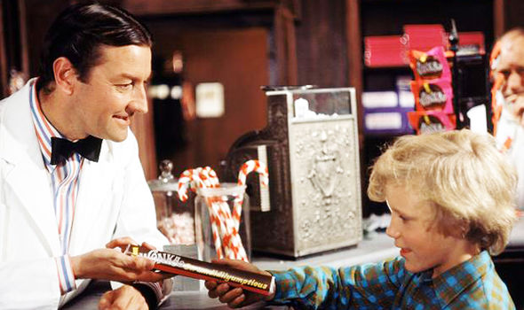
Literature Lesson
Charlie visits the candy shop
to buy a chocolate bar..

Slide 8
Read the book yourself!

Slide 9
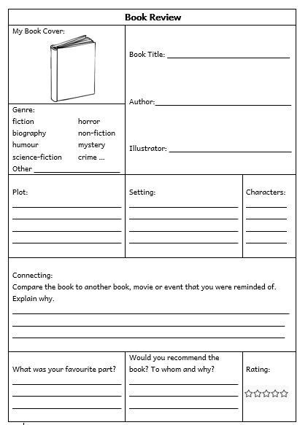
Book Review

Slide 10
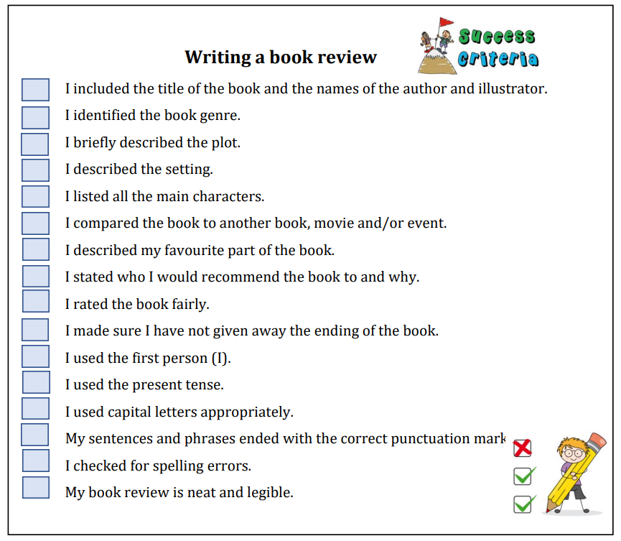
Success Criteria!
What are success criteria?
Success criteria are a list of steps you have to follow or a list of features you are to include in your task. They will make you aware of what is expected and help you self-assess your work.

Slide 11
Poster
to advertise/persuade

Slide 12
Lesson 5 Objectives
You will learn:
how to create a persuasive poster.
the success criteria for writing a persuasive poster.

Slide 13
Lesson Resources
Title of Poster
Writing Frame Handout
Success Criteria Handout

Slide 14
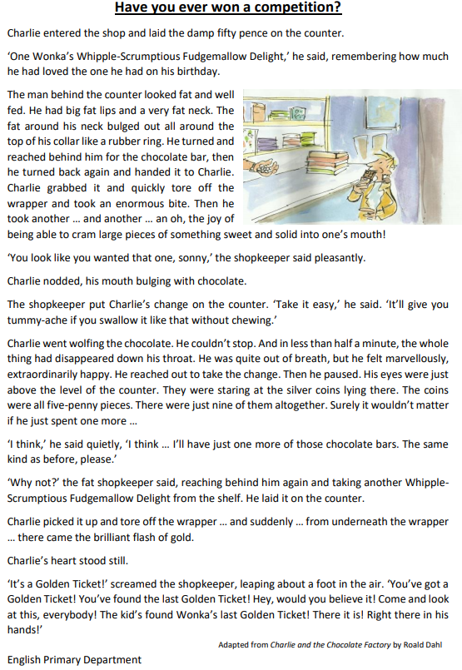
Check it out!
Listening Lesson: The Magician’s Shop
Literature Lesson:
Have you ever won a competition?

Slide 15
Title
A new candy shop has
opened in town.
Create a poster to
advertise this candy shop.

Slide 16
Pay attention!
Genre: POSTER
Audience:
YOUNG and ADULT READERS
Purpose:
TO PERSUADE READERS TO VISIT THE NEW CANDY SHOP
TO SHARE USEFUL INFORMATION ABOUT THE SHOP TO ITS CUSTOMERS
GAP
G: GENRE
A: AUDIENCE
P: PURPOSE

Slide 17
Writing to advertise/persuade
It sends a positive message about the product or service. (a new shop, there’s a lot of variety, cheap prices …)
It helps to aim the advert at a particular type of customer. (children and adults)
It makes it appeal to the reader’s personality. (use of bright colours, eye-catching pictures …)
Its purpose is to sell. (promote the product)

Slide 18
How do adverts catch your attention and stick in your memory?

Slide 19
Appealing/Positive Language
Unique
Most scrumptious
FREE
EXCLUSIVE
NumberONE!
Out of this world
Look no further!
Special Offer

Slide 20
Rhetorical Language
A rhetorical question is one that does not require an answer.
Will you let this opportunity pass you by?
How will you ever forgive yourself if you don’t
visit this shop?
Would you not like to taste all this goodness?

Slide 21
Exaggeration
A statement/information that is untrue or over the top.
The finest ingredients have been used to make this chocolate.
Everyone, young and old, have visited the new shop in town.
The shop has the lowest prices on the island.

Slide 22
Rule of three
It is believed that a person is more likely to remember things if they are grouped in three.
The shop is modern, large and welcoming.
The chocolate is smooth, velvety and
tastes divine.
The candy is sweet, delicious and scrumptious.

Slide 23
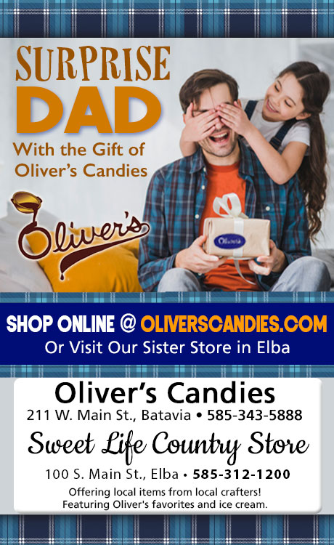

Slide 24
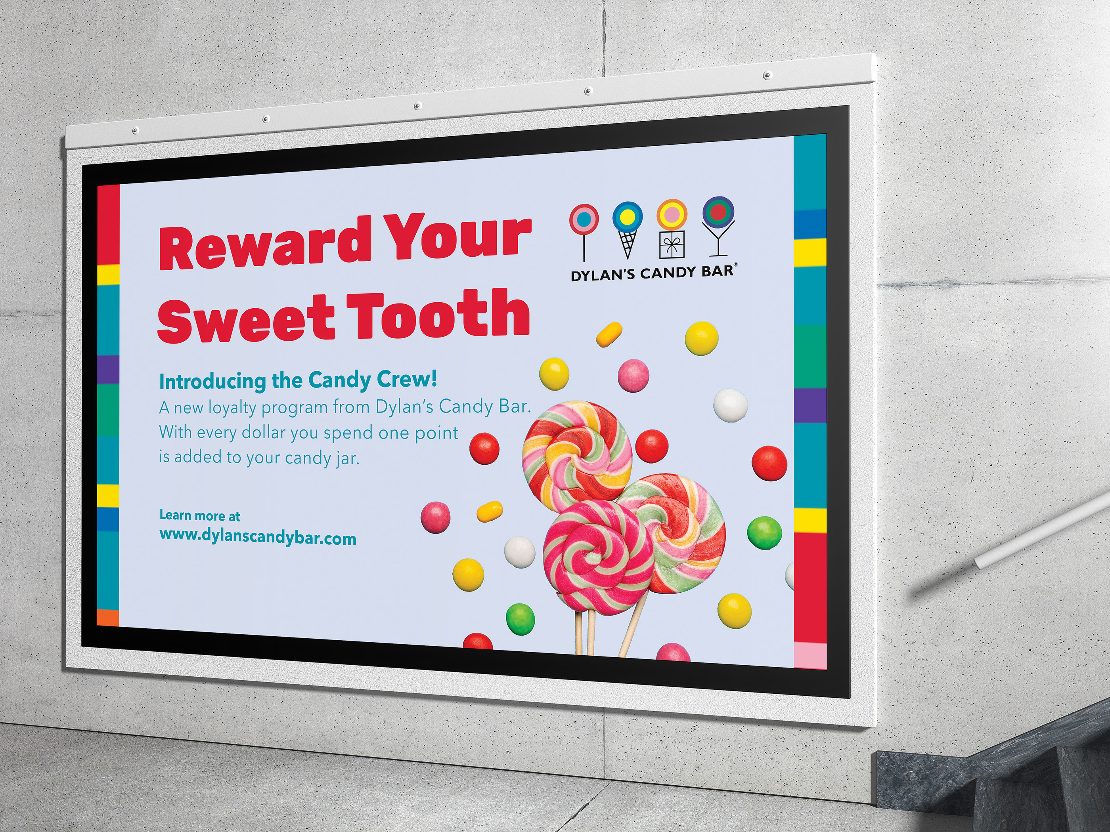

Slide 25
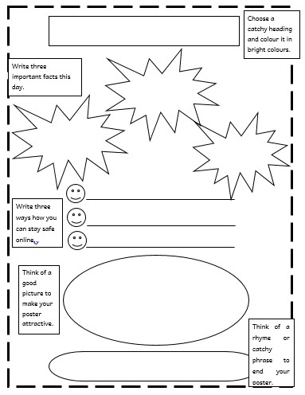
Writing Frame
Write the name of the shop or a rhetorical question or catchy phrase in bright colours.
Write three facts about the shop e.g. opening days, opening times, contact details.
Write three items you can buy from the shop. Use powerful adjectives.
Include a picture to make your poster attractive.
End your poster with a rhyme or catchy phrase e.g. a slogan. Include a special offer.

Slide 26
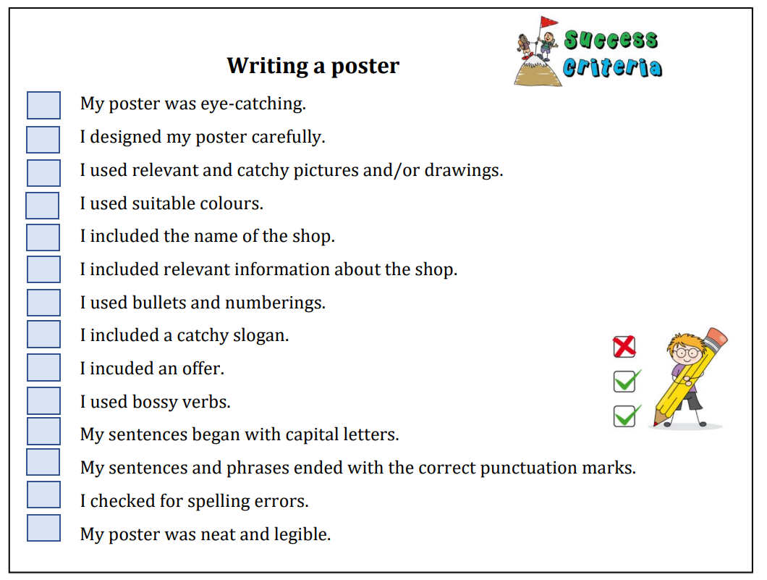
Success Criteria!
What are
success criteria?
Success criteria are a list of steps you have to follow or a list of features you are to include in your task. They will make you aware of what is expected and help you self-assess your work.

Slide 27
Thank You!

