Slide 1
Lesson 1 Listening
Year 5
English

Slide 2
Guess the theme!
School and Education

Slide 3
Lesson Objectives
You will:
listen attentively to a text.
answer questions about the text.
design your own uniform.
learn how to share your opinion.

Slide 4
Lesson Resources
Questions Worksheet
Answers Handout
School Uniform Word Mat

Slide 5
Picture 1
What can you see in each picture?
What do all these pictures have in common?

Slide 6
Picture 2
What does your school uniform include?
What are the colours?
Does it have a logo? Describe it.
What do you like about your uniform?
What don’t you like about it?
Is there anything you would change? If so, what would you change?

Slide 7
Words in the text!
I don’t like …
I think it looks …
I hate …
GIVE AN OPINION

Slide 8
Adjectives within the text
GREEN GREY WHITE GOLD
BORING STRICT ODD PURPLE
BLUE GREAT FASHIONABLE DESIGNER
EXPENSIVE BLUE OLD-FASHIONED
SMALL SHORT BETTER

Slide 9
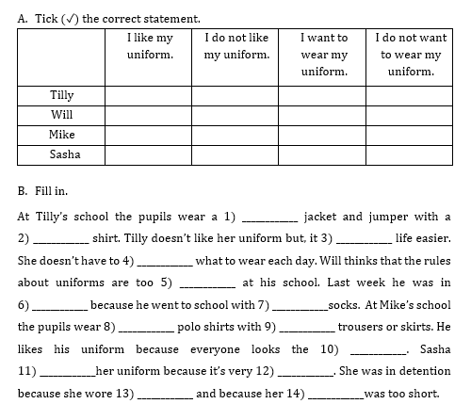
Step 1
READ the questions on the worksheet.

Slide 10
Step 2
LISTEN carefully to the text.
LISTEN carefully while I read the questions.
START ANSWERING the questions.

Slide 11
Step 3
LISTEN to the text for
the second time.
LISTEN while I read the questions again.
Try to ANSWER any unanswered questions.

Slide 12
Step 4

Slide 13
Step 5
CHECK your answers using the
Answers Handout.

Slide 14
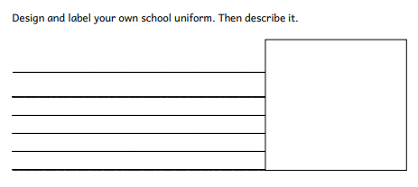
Activity Time!
Design your own uniform!
Think about:
colour
logo
clothing items
words/motto
how smart
how comfortable

Slide 15
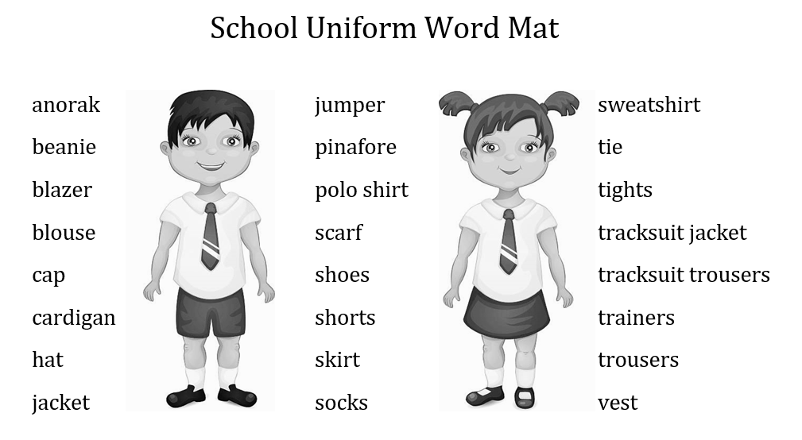
Word Mat

Slide 16
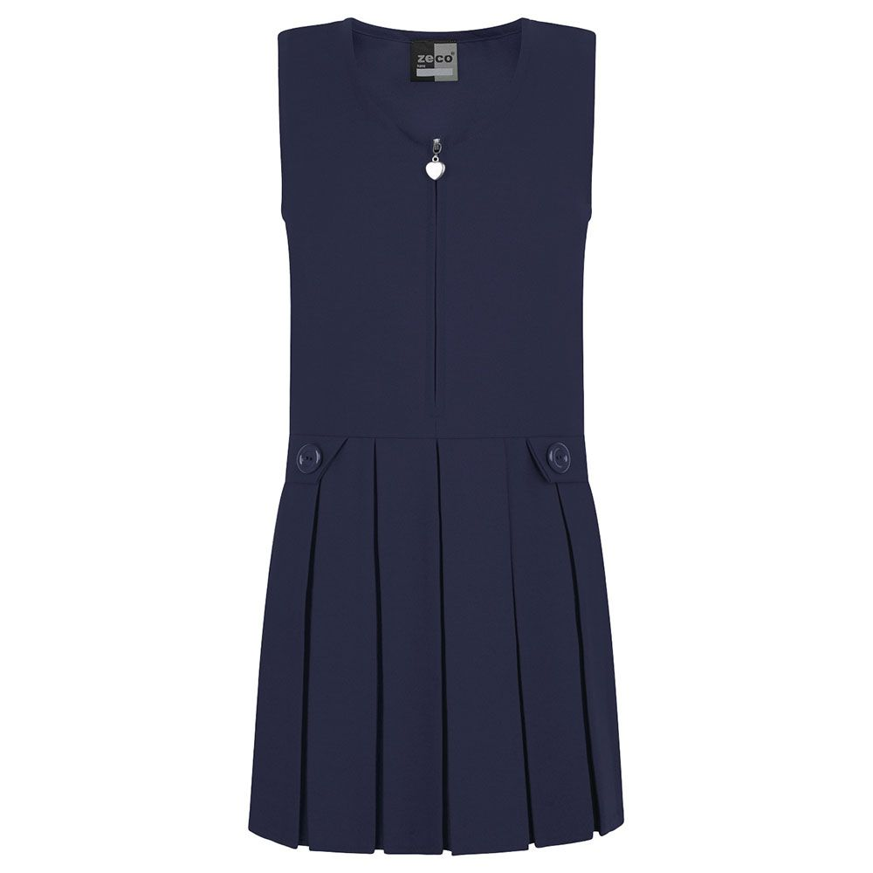
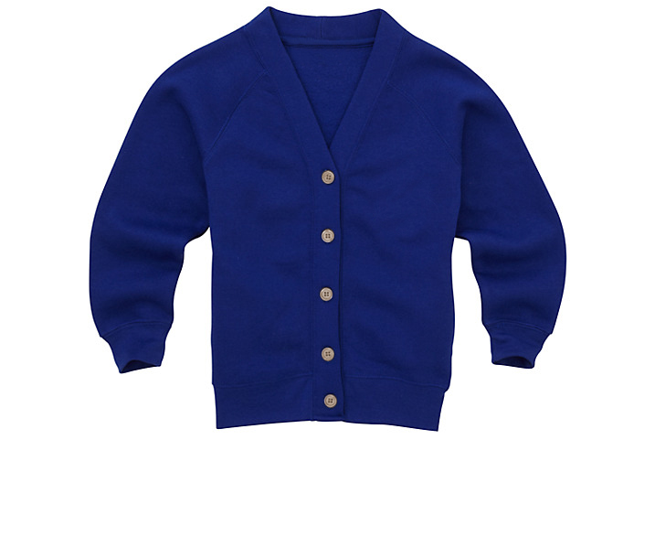
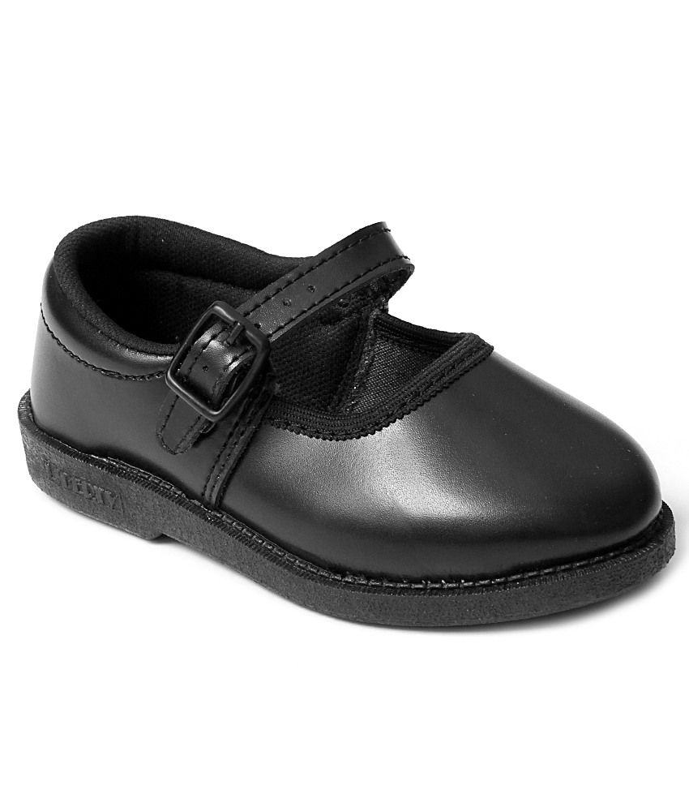
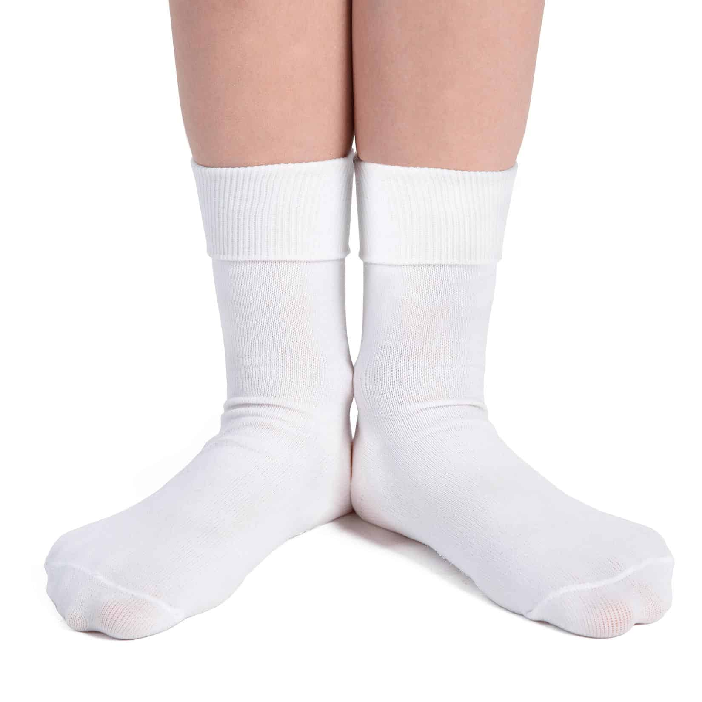
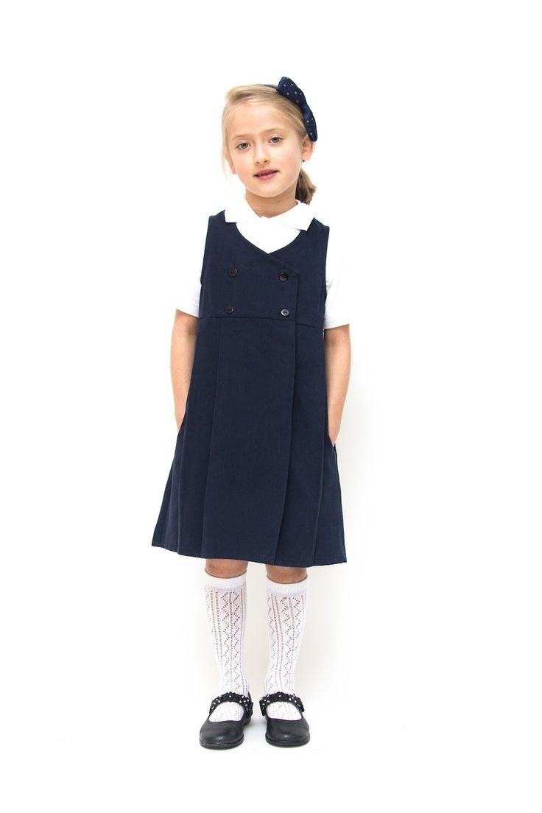
Activity
Ask an adult to describe his/her old school uniform.
How is it different from yours?

Slide 17
Thank You!

