Slide 1
Lesson 4 Speaking
Year 5
English

Slide 3
Lesson Objectives
You will learn:
how to plan a speech.
what are the success criteria for planning and giving a speech.

Slide 4
Lesson Resources
PowerPoint Presentation/
chart
Cue Card
Success Criteria

Slide 5
Speech
A speech is a talk you give in front of an audience.
Research the topic.
Plan your ideas.
Use PowerPoint Presentation/charts/notes.
Rehearse it.

Slide 6
Speech Title
Should pupils wear
school uniforms?

Slide 7
Other Lessons
Listening - Tilly, Will, Mike and Sasha described their uniform and expressed their opinion on it.
Reading - An article about school pupils who were punished because they wore the wrong trousers for school.
Writing - An opinion article to express your opinion on school uniforms.

Slide 8
Cue Card
What springs to mind when you hear the word uniform?
What do you think of school uniforms?
What are the advantages of wearing a school uniform?
What are the disadvantages of wearing a school uniform?
Should schools have a strict dress code?
Do uniforms prepare pupils for life at work?
Are uniforms important to give the school a good image?
Do uniforms take away a pupil's individuality?
Should pupils have a say about their uniform?
Would it be OK for pupils to have dress-down days?
Would it be OK for pupils to wear jewellery or clothing that is not part of the uniform?

Slide 9
Word Mat

Slide 10
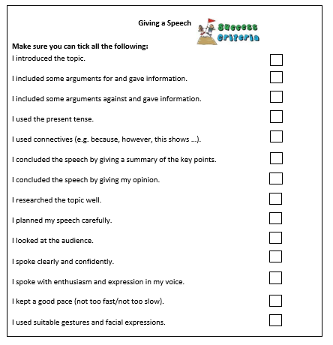
Success Criteria!
Success criteria are a list of steps you have to follow or a list of features you are to include in your task. They will make you aware of what is expected and help you self-assess your work.

Slide 11
Why not turn it into a debate?

Slide 13
Lesson Objectives
You will learn:
how to describe a picture.
how to compare and contrast two pictures.

Slide 14
Lesson Resources
Handout with Picture 1 and Picture 2

Slide 16
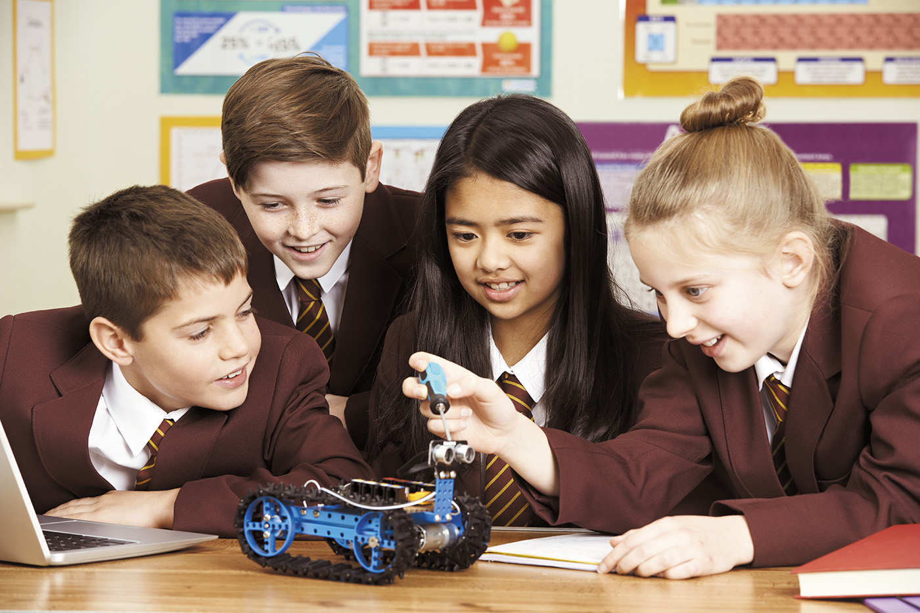

Slide 18
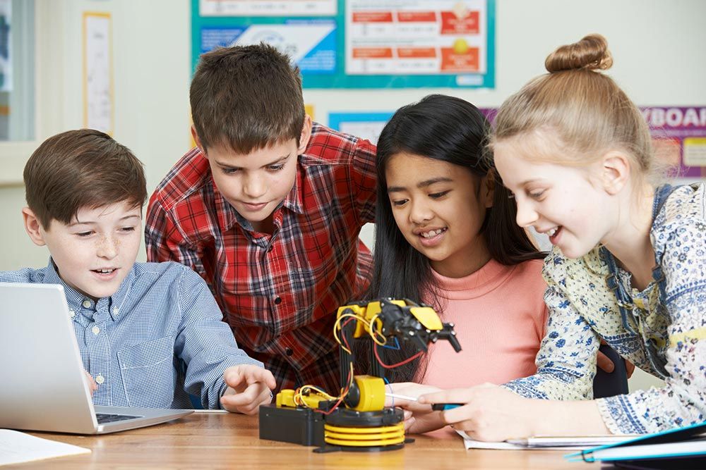

Slide 19
Compare and Contrast
Do you prefer Picture 1 or Picture 2? Why?
How are they different?
(number of children, place, age, physical description, posture, clothes, behaviour, feelings …)
How are these two pictures alike?
(number of children, place, age, physical description, posture, clothes, behaviour, feelings …)
Describe Picture 2.
(number of children, place, age, physical description, posture, clothes, behaviour, feelings …)
Describe Picture 1.
(number of children, place, age, physical description, posture, clothes, behaviour, feelings …)

Slide 20
Thank You!

