Slide 1
Describing Wild Animals
Year 5
Theme: Animals
Lesson Focus: Speaking

Slide 2
Success Criteria
When describing an animal I can:
Describe the animal’s appearance
Talk about where the animal lives and what it eats
Use the present simple (third person singular and plural)
Link ideas using connectives
Use adjectives to give more details about the animal.

Slide 3
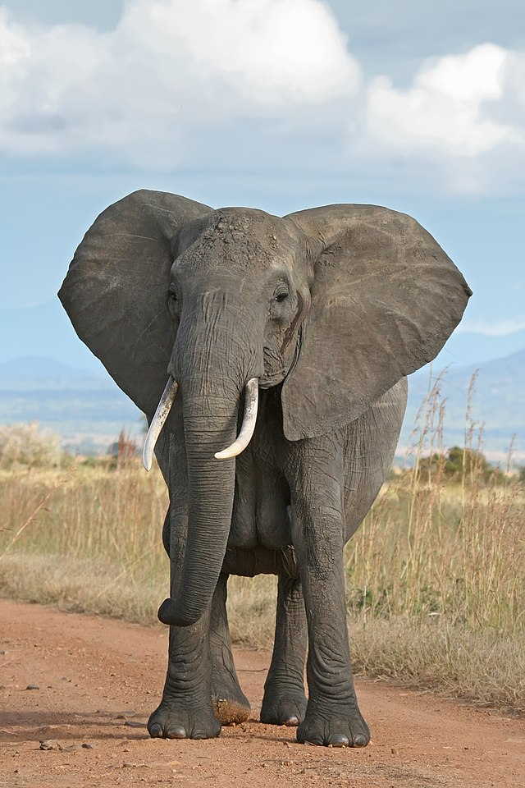
Describing an Elephant
Animal: elephant
Lives: Africa, India
Sleeps: at night
Eats: grass, leaves, root of trees, branches
It has: small eyes, big ears, long trunk, two tusks to dig and find food, four legs, long tail; trunk can grow up to 2 metres long
Height: above 3 meters
Length: 6 – 7.5 meters
Weight: up to 8,000kg
Distance: up to 500 km
Duration of life: 60-70 years.
Interesting fact: they show affection to each other by touching trunks or rubbing shoulders together

Slide 4
Describing an Elephant
Habitat
Elephants are found most often in savannas, grasslands, and forests of Africa and Asia.
Trunk
The elephant has a long trunk which it uses to feed or wash itself with. The trunk can grow up to 2 metres long. It also has two ivory tusks. It uses these to dig and find food.
Size
The African elephant weighs up to 8,000 kg and has a shoulder height of up to 3 metres.
Diet
Elephants are vegetarian and eat grass, leaves, branches and the roots of trees.
Interesting fact
Elephants show affection with each other by touching trunks or rubbing shoulders together.

Slide 5
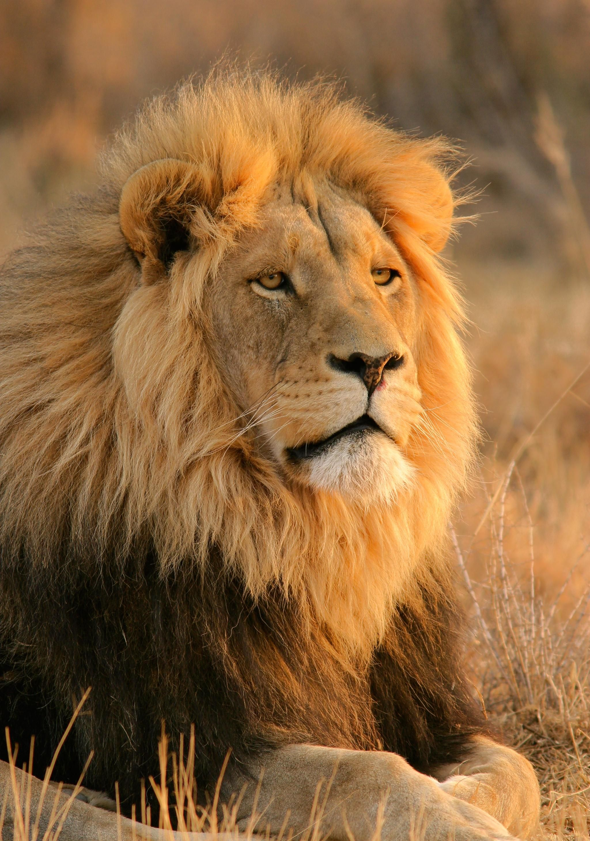
Describing a Lion
Animal: lion
Lives: Africa, Asia
Sleeps: long periods of time, around 20 hours in a day
Eats: zebra, wildebeest and antelope; lionesses hunt at night
It has: long body, large head, short legs; adult males have a distinctive golden mane
Body length: up to 2.9 metres from nose to tail
Threat: loss of habitat
Habitat: open plains to thick brush and dry thorn forest, in families called prides
Duration of life: up to 21 years in the wild
Interesting fact: a very loud roar

Slide 6
Describing A Lion
Habitat
Lions inhabit a wide range of habitats, from open plains to thick brush and dry thorn forest. They live in a group called a pride.
Life Cycle
Lions in the wild rarely live more than 8 to 10 years. Lions in zoos have a life span of about 25 years.
Diet
Lionesses usually do most of the pride’s hunting, mainly at night. They hunt animals such as zebra, wildebeest, and antelope.
Appearance
The lion is a well-muscled cat with a long body, large head, and short legs. Adult males are 2.7 to 3 meters long, from nose to tail. Adult males have a distinctive golden mane.
Interesting fact
A lion’s roar can be heard up to eight kilometres away.

Slide 7
Describing a Panda Bear
Animal: panda bear
Lives: China
Eats: bamboo, flowers, vines, grass and honey
Appearance: looks like a bear; legs, shoulders, ears and oval patches around the eyes are black; the rest of the coat is white.
Size: up to 1.6 metres long; weighs 75 to 100 kilograms
Threat: fewer than 180 pandas in captivity and fewer than 1,600 pandas in the wild; very rare
Habitat: cold bamboo forests
Diet: bamboo shoots
Life Span: in the wild – unknown; in captivity: +20 years
Status: endangered
Interesting fact: can swim; are good tree climbers; enlarged wrist bone that looks like a thumb to grasp objects

Slide 8
Describing A Panda Bear
Habitat
Pandas live in thick, cold bamboo forests.
Life Span
The panda’s lifespan in the wild is unknown but in captivity they can live for more than 20 years.
Appearance
Pandas are famous for their black and white markings. The legs, shoulders, ears and oval patches around the eyes are black while the rest of the coat is white.
Diet
A panda bear feeds mostly on bamboo, a tall woody plant full of fibre. They also eat flowers, vines, grasses, green corn and honey.
Size
Pandas weigh around 75 to 100 kilograms and reach 1.6 metres in length.
Interesting fact
They are good tree climbers and can also swim to escape predators. Pandas use an enlarged wrist bone that looks like a thumb to grasp objects like bamboo.

Slide 9
Thank You

