Slide 1
Lesson 3 Writing
Year 5
English

Slide 2
Lesson Objectives
You will:
learn how to write an opinion article.
learn how to express your opinion in writing.
learn what are the success criteria for writing an opinion article.

Slide 3
Lesson Resources
Title of Opinion Article
Writing Frame Handout
Sentence Starters Handout
Success Criteria Handout

Slide 4
What is an opinion article?
In an opinion article writers express their point-of-view and back it up by examples and explanations.

Slide 5
Title
Should pupils wear uniforms?
Write an article for your school website to express your opinion.

Slide 6
Pay attention!
Genre:
OPINION ARTICLE
Audience:
YOUNG READERS
Purpose:
TO EXPRESS YOUR OPINION
G.A.P
G: GENRE
A: AUDIENCE
P: PURPOSE

Slide 7
Opinion Article Structure
INTRODUCTION – Write what the article is about and share your opinion.
BODY 1 – Give some reasons (advantages) to support your opinion.
BODY 2 – Give some opposing reasons (disadvantages).
BODY 3 – Give more reasons to support your opinion.
CONCLUSION – Write a general sentence and one final, strong reason to support your point of view.

Slide 8
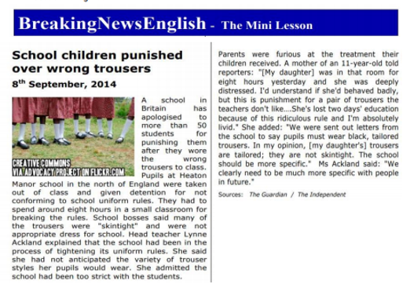
Reading Lesson

Slide 9
Let’s read some arguments which are for and some arguments which are against …

Slide 10
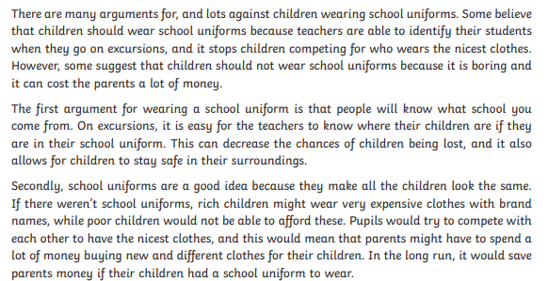
Arguments for …
Source: www.twinkl.com

Slide 11
Arguments against …
Source: www.twinkl.com

Slide 12
Listen to a debate!
A debate is a discussion involving two or more people around a topic. The people involved hold different opinions. They take turns sharing their opinions and give valid reasons that support them.

Slide 13
Let’s weigh the pros and cons!
Advantages (Pros)
teachers can identify pupils when they are on an outing
pupils cannot compete for those who wear the nicest outfits for school
all pupils, rich or poor, are equal
if you wear a uniform you can save money because parents do not need to buy several clothes for school
save time in the morning – you don’t need to think what you are going wear for school
it can eliminate bullying which can happen because of your clothes or appearance
Disadvantages (Cons)
wearing a uniform can be boring
uniforms are expensive
parents need to buy two or three sets
uniforms may be uncomfortable
uniforms may be ill-fitting
pupils are not allowed to express themselves and wear what they please
Advantages (Pros)
Disadvantages (Cons)

Slide 14
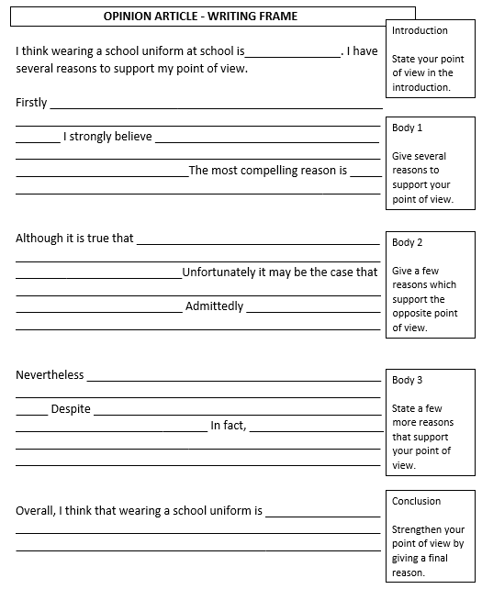
Writing Frame
This writing frame can be very useful!

Slide 15
Sentence Starters
I (really) apologise …
I am (really) sorry …
What can I say? ...
I shouldn’t have said ...
I shouldn’t have done it …
It’s my fault …
My bad!
I beg your pardon …
I am to blame for …
I hope you can forgive me ...

Slide 16
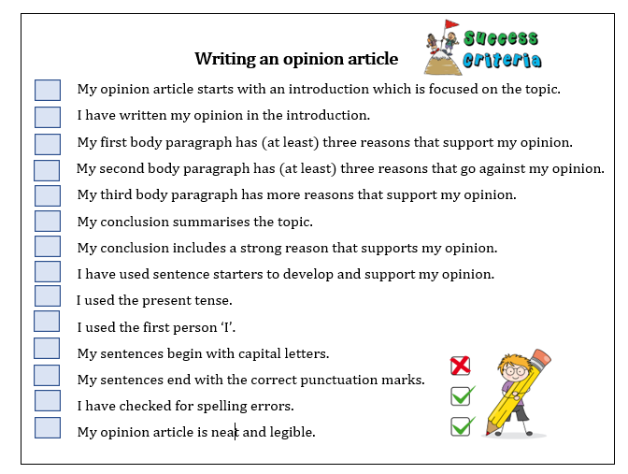
Success Criteria!
What are success criteria?
Success criteria are a list of steps you have to follow or a list of features you are to include in your task. They will make you aware of what is expected and help you self-assess your work.

Slide 17
Thank You!

