Slide 1
Lesson 2 Reading
Year 5
English

Slide 2
Lesson 2 Objectives
In Lesson 2 you will:
listen to a text being read aloud.
read a text silently and aloud.
answer questions about the text.
learn about the pros and cons of plastic.
understand how important it is to use paper bags or bags for life when you go shopping.

Slide 3
Lesson Resources
Dictionary
Reading Text
Questions Worksheet
Answers Handout

Slide 4
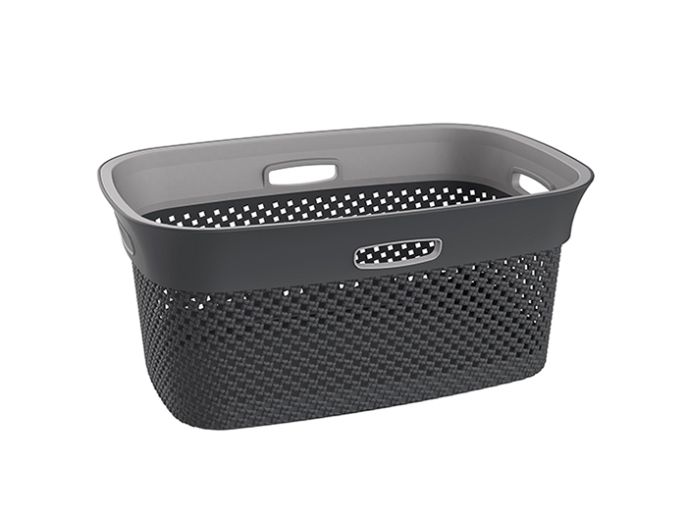
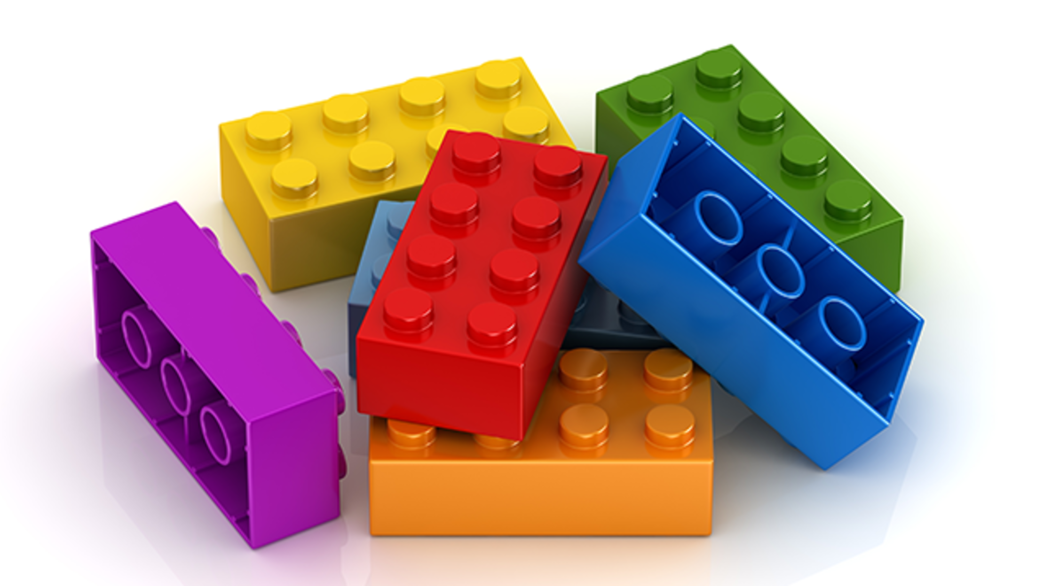
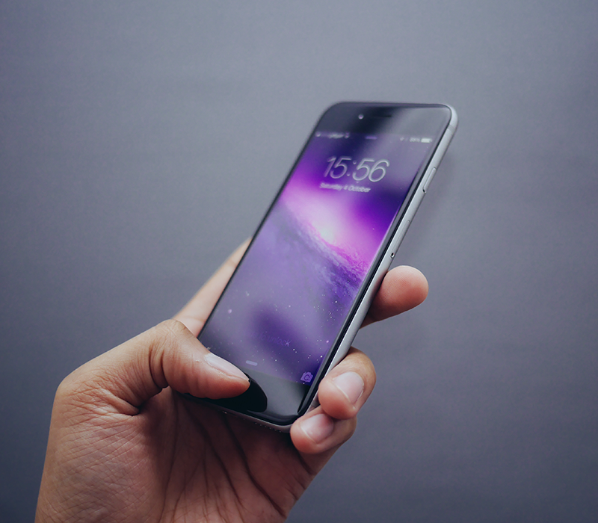
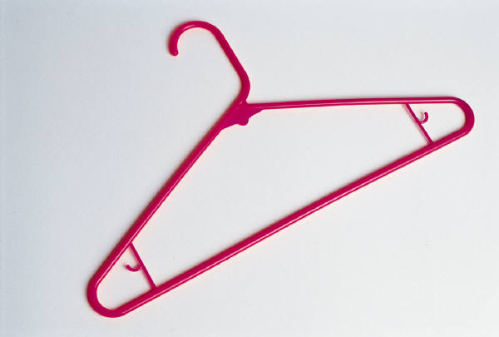
Plastic Everywhere
Have a look around
Have a look around.
What can you see that is made of plastic?
Now think about the things you use at home.

Slide 5
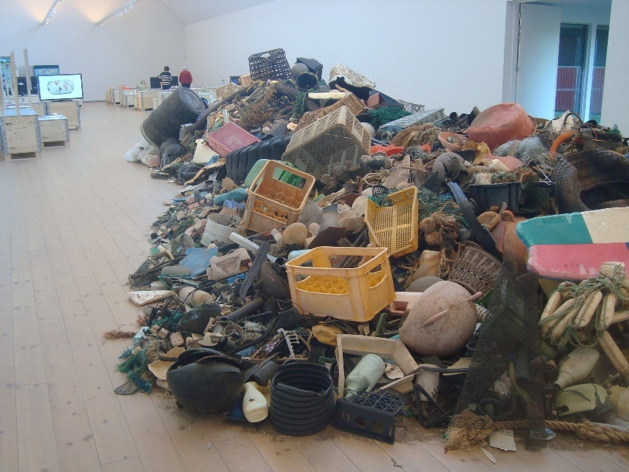
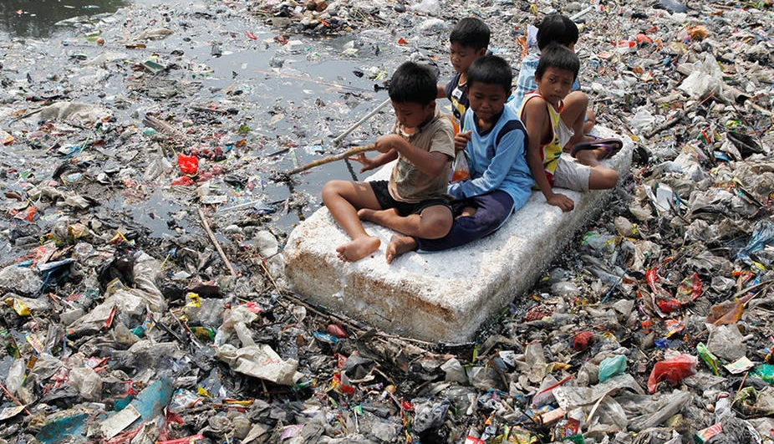
When plastic becomes a problem …
Photo courtesy of (@flickr.com) - granted under creative commons licence – attribution
Photo courtesy of (@theconversation.com) - granted under creative commons licence – attribution
Photo courtesy of (@pixabay.com) - granted under creative commons licence – attribution
What do you think when you see these pictures?

Slide 6
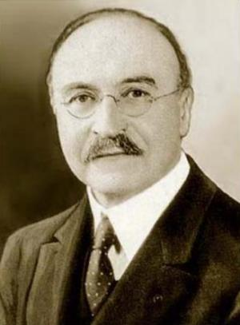
How it all began
Plastic was first created by a British inventor called Alexander Parkes, in 1885. He used some natural materials in his plastic.
In 1907, a Belgian man named Leo Baekeland invented Bakelite. This plastic was completely man-made and was used to make televisions, trays, jewellery, furniture and even toys.
Photo courtesy of (@wikimedia.org) - granted under creative commons licence – attribution
Leo Baekeland

Slide 7
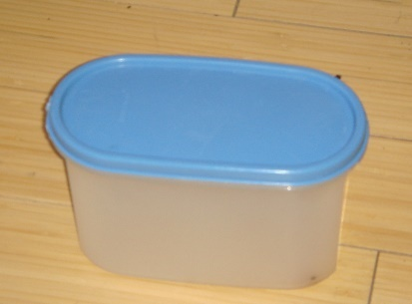
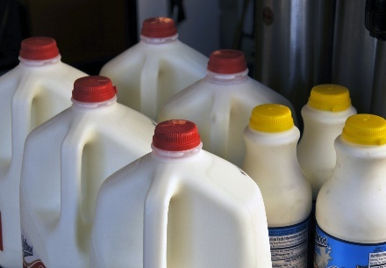
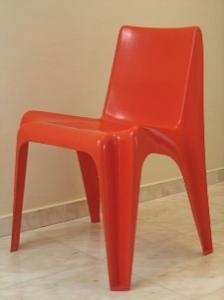
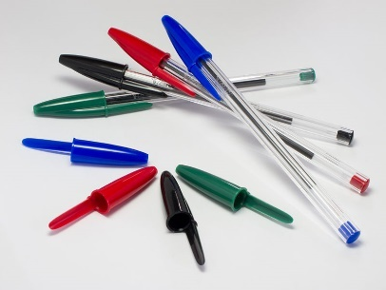
What is good about plastic?
It keeps things airtight, which is great for keeping food fresh.
It keeps things watertight, so nothing leaks out.
It can be shaped and moulded into lots of different things from chairs to cars and pens to carpet tiles.
Can you think of any other good things about plastic?

Slide 8
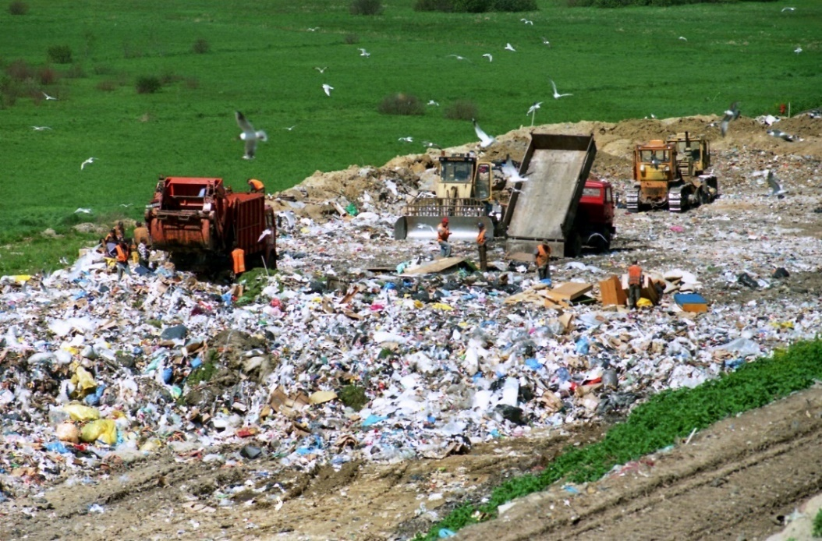
Problems caused by plastic
Plastic is harmful to all living things.
1. The way plastic is made releases harmful gases into the air.
2. Plastic lasts for a very long time. It cannot decompose like vegetables, fruit or meat.
3. If it is burnt, it releases harmful gases into the air and causes air pollution..
4. It is usually buried in huge landfill sites. This means we don’t see it, but it is still there and can last for many hundreds of years.
Photo courtesy of (@Wikimedia.org) - granted under creative commons licence – attribution

Slide 9
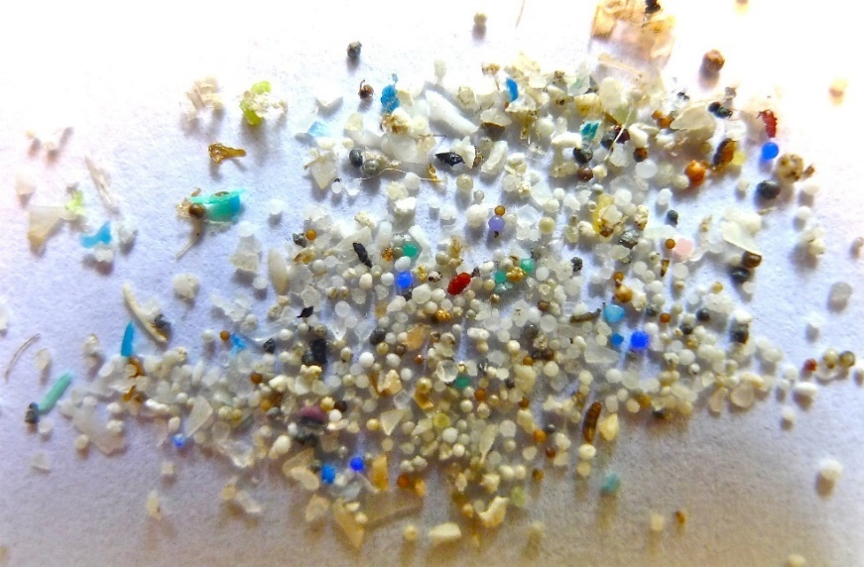
The Biggest Problem with Plastic
The biggest problem with unwanted plastic is the pollution and damage it does to the environment.
Plastic breaks into tiny pieces which then gets blown around by the wind and the rain.
Photo courtesy of (@flickr.com) - granted under creative commons licence – attribution
It ends up in our streams, rivers and the seas.
These microbeads are easily eaten by fish and other sea animals. It can make them very ill or even kill them. They can make us ill if we eat the fish.
Plastic is toxic for the world’s water and land, causing harm to the fish, animals and birds.

Slide 10
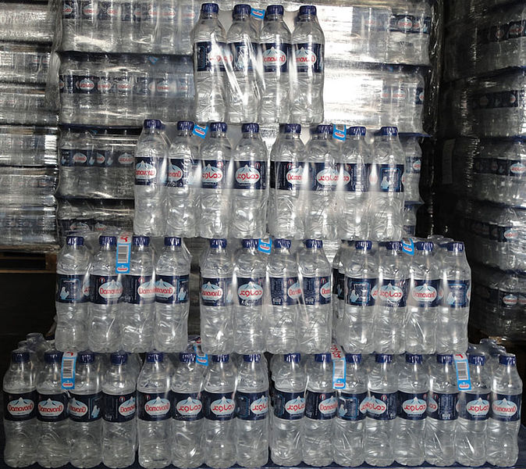
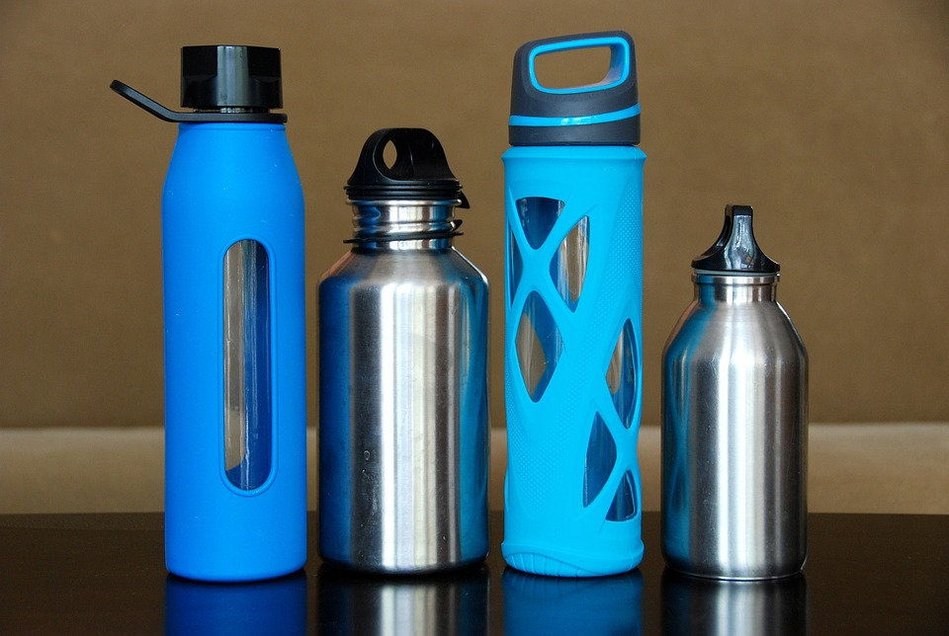
Make Your Choice
Look at these two pictures. Which do you think is the right thing to use, to help the environment?
Photo courtesy of (@Wikipedia.org) - granted under creative commons licence – attribution
Photo courtesy of (@pixabay.com) - granted under creative commons licence – attribution
Instead of using lots of water bottles and throwing them away, buy a reusable bottle.

Slide 11
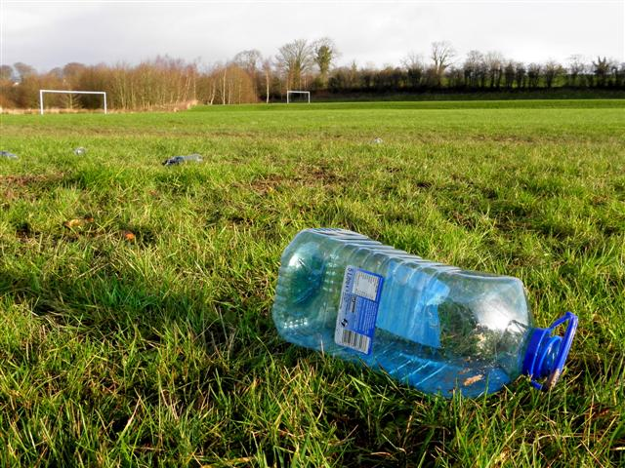
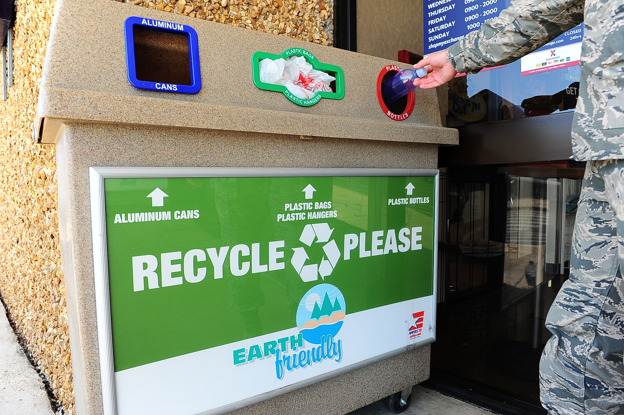
Make Your Choice
Look at these two pictures. Which do you think is the right to do, to help the environment?
Photo courtesy of (@geograph.ie) - granted under creative commons licence – attribution
Photo courtesy of (@Columbus.af.mil) - granted under creative commons licence – attribution
Instead of throwing plastic away, recycle it in the proper places.

Slide 12
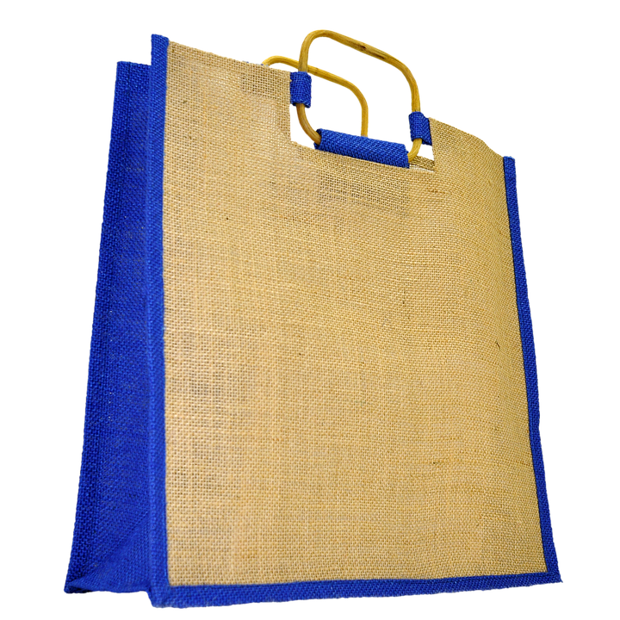
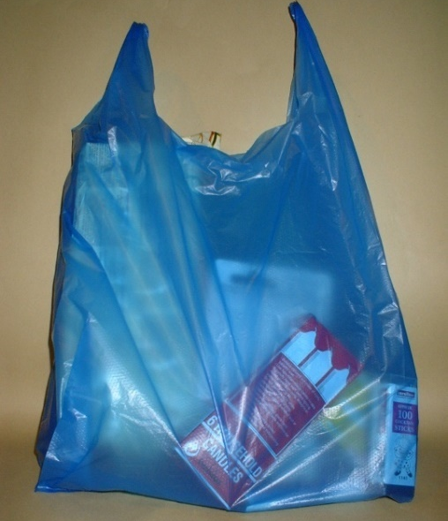
Make Your Choice
Look at these two pictures. Which do you think is the right bag to use, to help the environment?
Photo courtesy of (@pixabay.com) - granted under creative commons licence – attribution
Photo courtesy of (@flickr.com) - granted under creative commons licence – attribution
Instead of using thin plastic carrier bags and throwing them away, buy a bag for life and keep using it. It’s cheaper too!

Slide 13
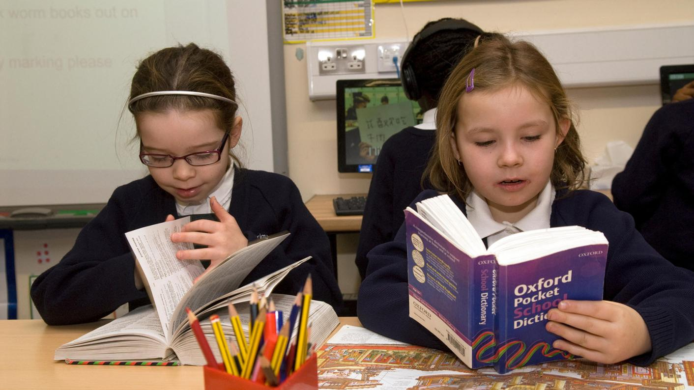
Using a dictionary!

Slide 14
New Words
despite
swapping
engineer
chief executive
scrap
biodegradable
rot
supermarket chain
trial
single-use
statistics
distributed

Slide 15
New Words
things that can decompose while blending in into the natural environment
decay/breakdown
scrap
biodegradable
rot
a supermarket found in different locations
trying or putting something to proof
to be used once and then disposed
single-use
throw away
supermarket chain
trial

Slide 16
New Words
divided among many
even though
statistics
distributed
despite
giving in exchange
a leading person
a person who uses and designs engines
engineer
information
swapping
chief executive

Slide 17
Step 1
READ the text
on the handout and the questions on the worksheet.

Slide 18
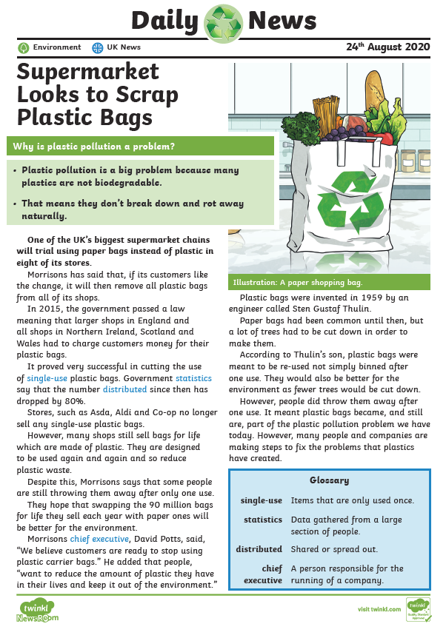

Slide 19
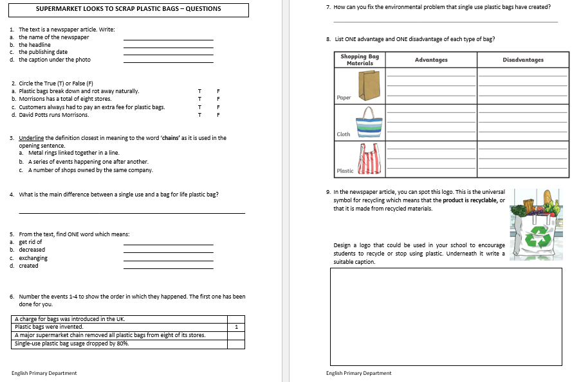

Slide 20
Step 1
After you read the text and questions
you should be able to
ANSWER the following question:
WHAT IS THE TEXT ABOUT?

Slide 21
Step 2: Discuss the question
What is the text about?
This text is a newspaper article because it has the name of the newspaper written on top, a headline, the date and a picture with a caption.
A big, British supermarket chain, Morrisons, is going to exchange plastic bags with paper bags. By doing so, this supermarket chain is trying to reduce plastic pollution and help the environment.
David Potts, the Chief Executive (leading person) is reported saying that people want to reduce the use of plastic in their lives.

Slide 22
Step 3
READ the text and questions again.
Then try to ANSWER the following questions:
How many Morrisons stores will be using paper bags and not plastic bags?
What are bags for life?
Why is Morrisons swapping the bags for life with paper bags?
Who was Sten Gustaf Thulin?
5. Why can paper bags be harmful to the
environment?
!

Slide 23
Step 4: Discuss the questions
How many Morrisons stores will be using paper bags and not plastic bags?
Eight of the stores
2. What are bags for life?
They are plastic bags designed to be used over and over again and so reduce the use of plastic.
3. Why is Morrisons swapping the bags for life with paper bags?
People were still throwing away bags for life. By swapping bags for life with paper bags, they will lessen plastic pollution.

Slide 24
Step 4: Discuss the questions
4. Who was Sten Gustaf Thulin?
He was the engineer who invented plastic bags.
5. Why can paper bags be harmful to the environment?
A lot of trees are cut down in order to make paper bags.

Slide 25
Step 5
LISTEN to me as I
READ the text ALOUD.

Slide 27
Step 6
READ the text ALOUD.

Slide 28
Step 7
Let’s DISCUSS
the questions.

Slide 29
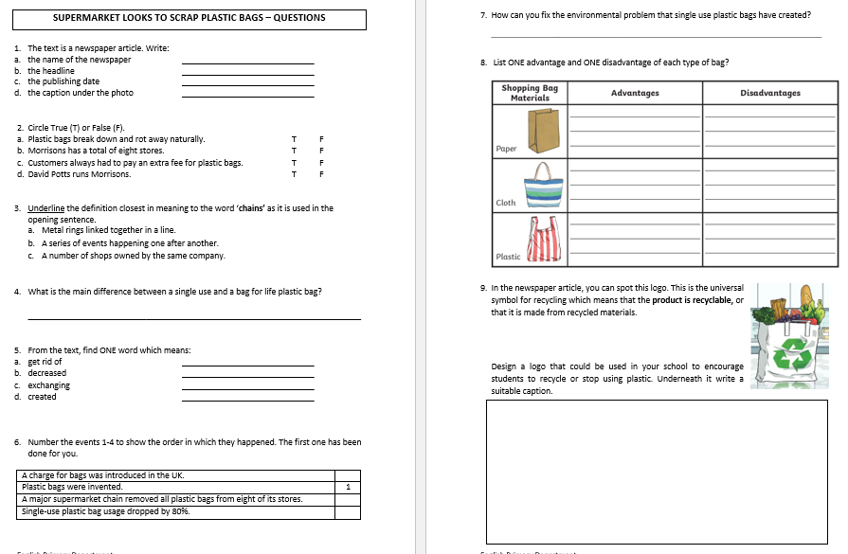

Slide 30
Step 8
WORK OUT the
Questions Worksheet.

Slide 31
Step 9

Slide 32
Step 10
CHECK your answers using the
Answers Handout.

Slide 33
Thank You!

