Slide 1
Lesson 5 Writing
Year 5
English

Slide 2
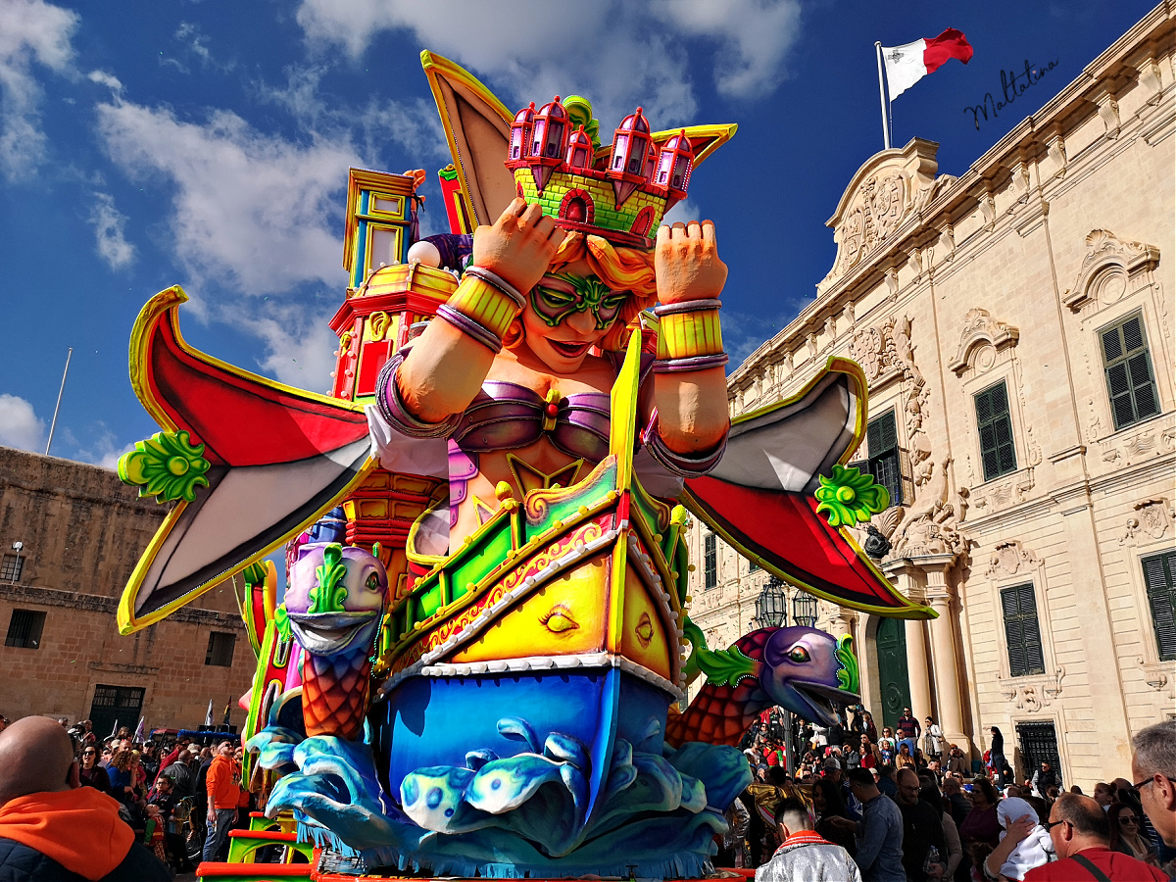
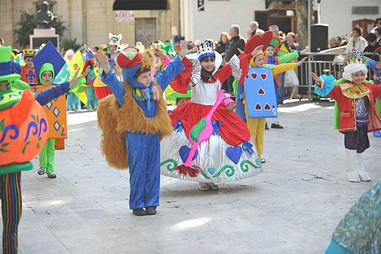
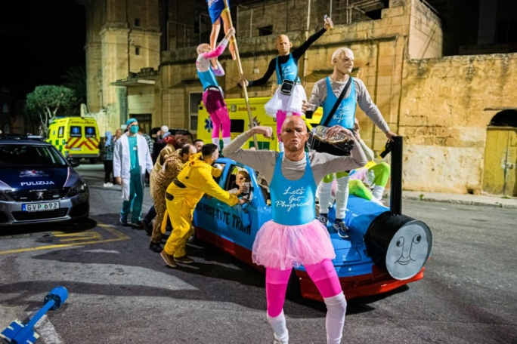
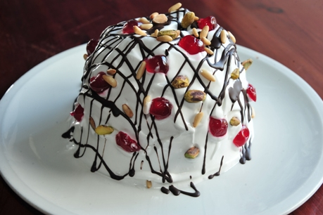
Guess today’s celebration

Slide 3
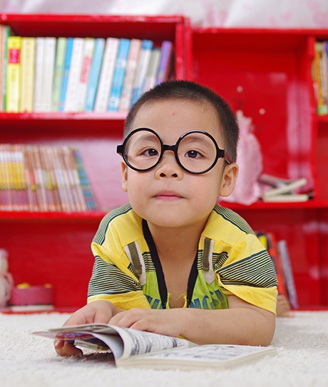
Lesson 5 Objectives
You will:
learn facts about a celebration.
learn what an informal letter is.
learn what are the success criteria for writing an informal letter.

Slide 4
Lesson Resources
Title of informal letter
Writing Frame Handout
Success Criteria Handout

Slide 5
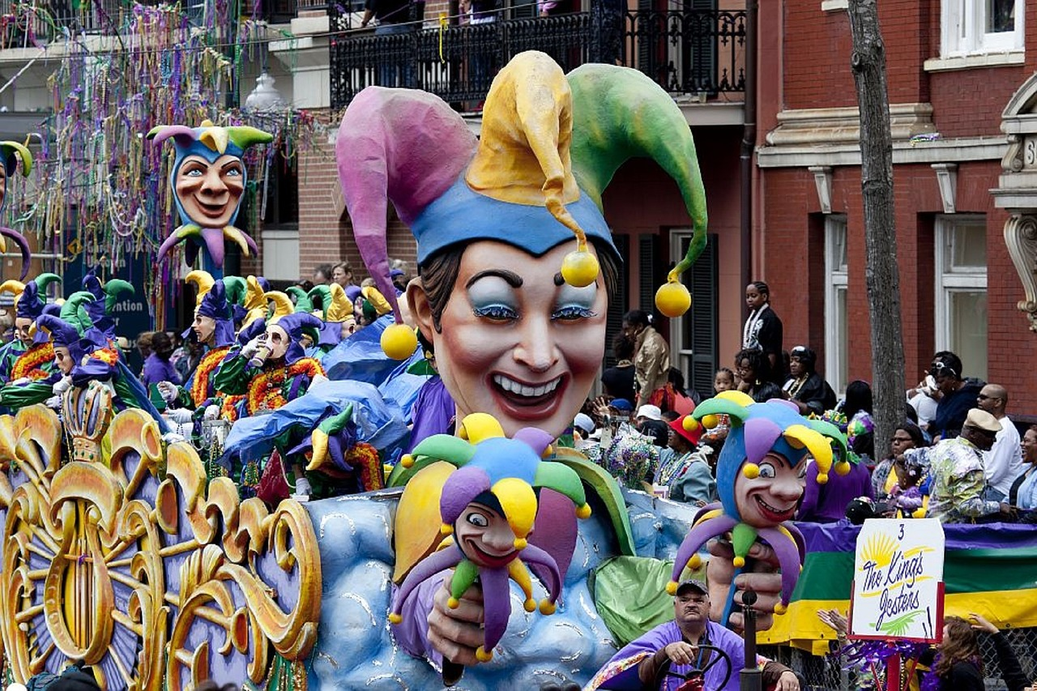
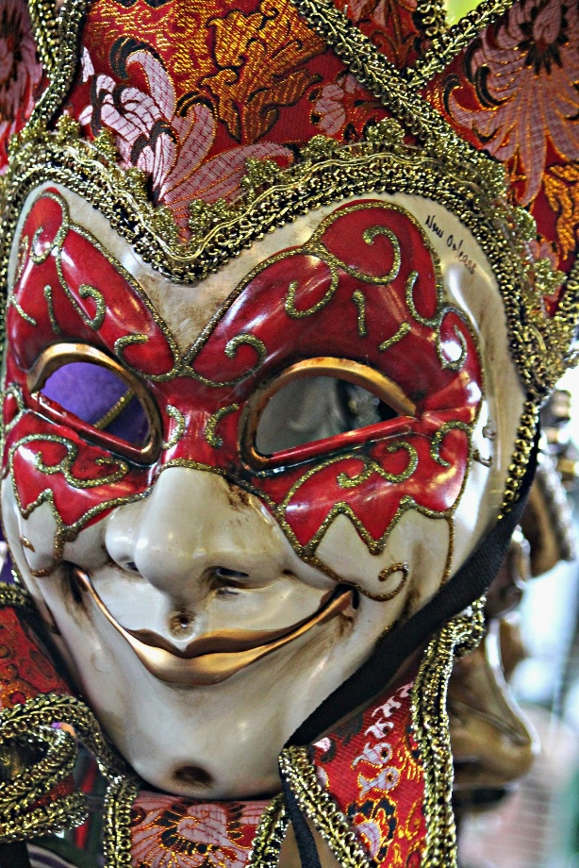
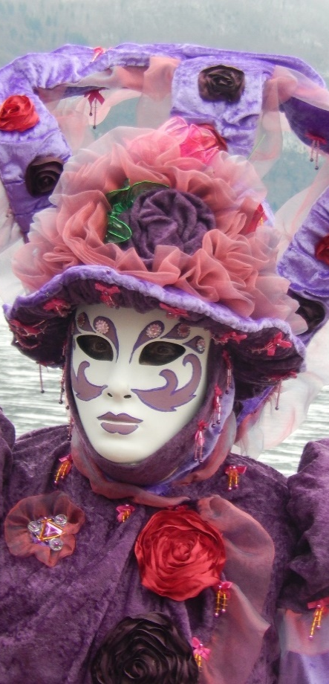
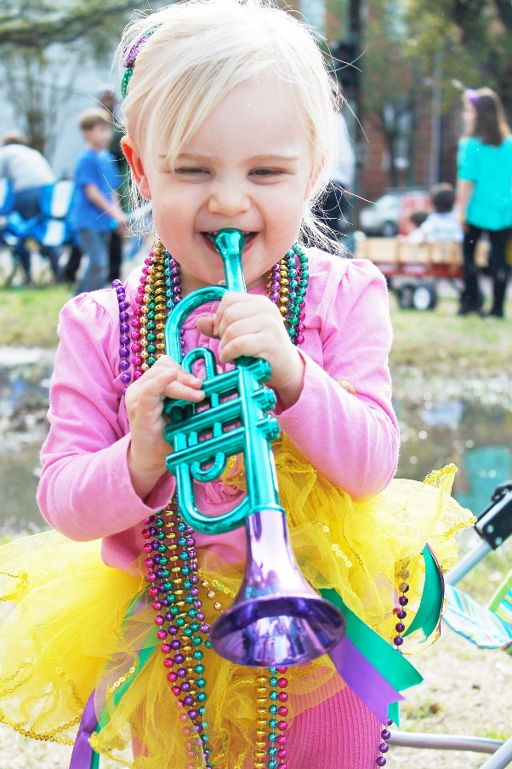
What is Carnival or Mardi Gras?
It is a celebration in February in many countries, such as America, Brazil, Italy and Germany. There is music, dance, colourful parades with gigantic floats and costumes. People wear different masks. Some are very elaborate.

Slide 6
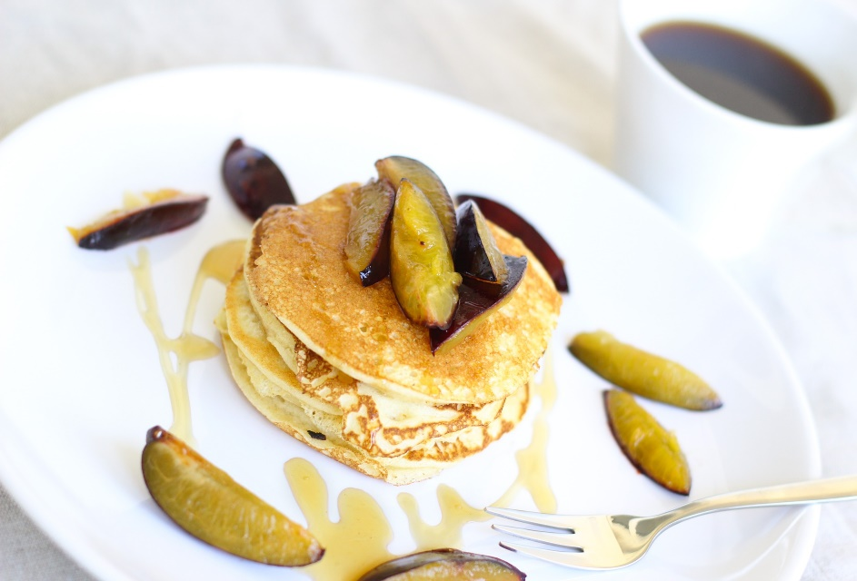
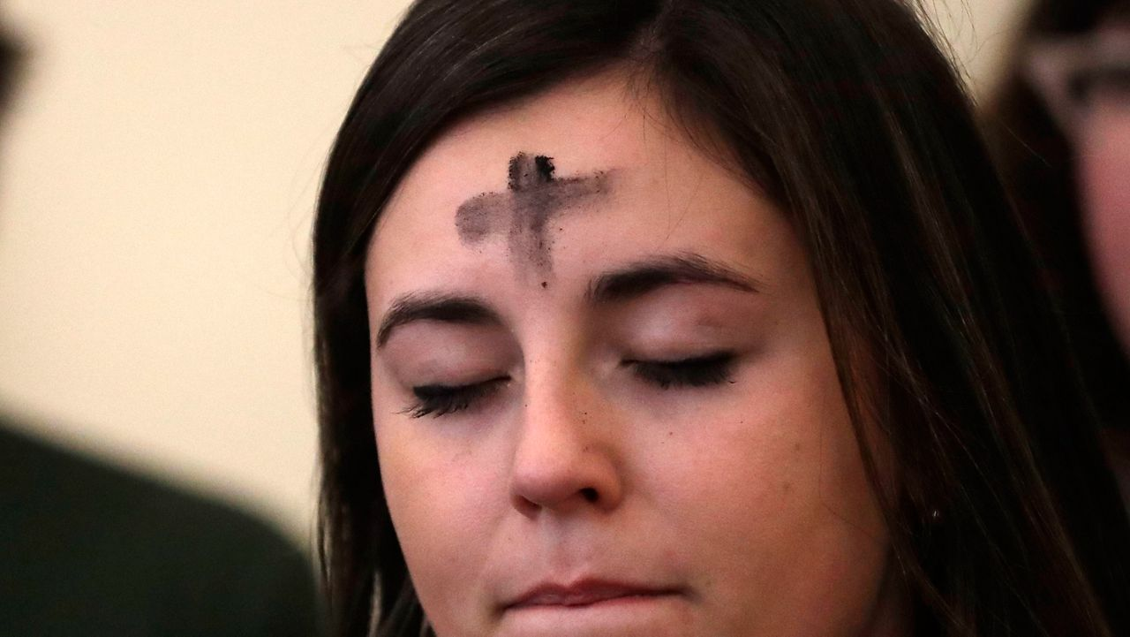
When does it happen?
It is celebrated on Shrove Tuesday, the day before Lent starts (Ash Wednesday).
However, the celebration is so popular in some countries that it can last for more than one day. In Germany, the carnival season starts in November!

Slide 7
What do the words mean?
Mardi Gras means ‘Fat Tuesday’ and Carnevale means ‘no meat’. Shrove Tuesday (Pancake Day in England) comes from the word ‘shrive’ which means to do without something to gain forgiveness from God.

Slide 8
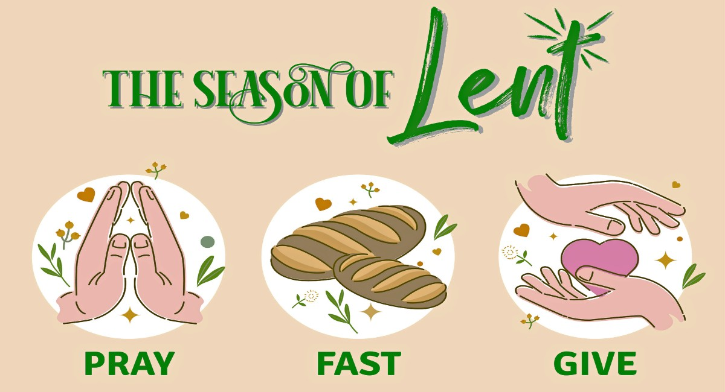
Why do people do this?
Lent was the time that Christians believe Jesus went into the wilderness and managed without things for “40 days and 40 nights”. Many people around the world do the same thing and do without something for Lent. So, this is a festival on the last day that you can eat the things you enjoy most (sweets, chocolate, meat etc). It’s like a big party before the fasting.

Slide 9
What is an informal letter?
An informal letter is a message to a person/s you know well such as a close relative or your friend. It is sent by mail.
An informal letter can have many functions such as to invite, to give instructions or to inform.

Slide 10
Title
Your aunty Grace, lives in Italy. Write her an informal letter, to tell her how you spent your last Carnival holidays and to invite her over for the next Carnival.

Slide 11
Pay attention!
Genre:
AN INFORMAL LETTER
Audience:
AUNTY GRACE WHO LIVES IN ITALY
Purpose:
TO INFORM AND TO INVITE
GAP
G: GENRE
A: AUDIENCE
P: PURPOSE

Slide 12
Features of an INFORMAL LETTER
Your personal address, written in the top right-hand corner.
The date when you are writing the letter, written under the address,
A salutation followed by a comma (e.g. Dear Aunty Grace,), in the left-hand corner.
An introduction where you thank the receiver for the last letter, ask how he/she is and state the purpose.
Three body paragraphs.
A conclusion where you send your regards and ask the receiver to write back.
A closure followed by a comma (e.g. Yours, Love, …), in the middle of the page.
Your signature under the closure.
INDENT ALL PARAGRAPHS.
SKIP A LINE BETWEEN EACH OF THE ABOVE.
SKIP TWO LINES BETWEEN THE CLOSURE AND THE SIGNATURE.

Slide 13
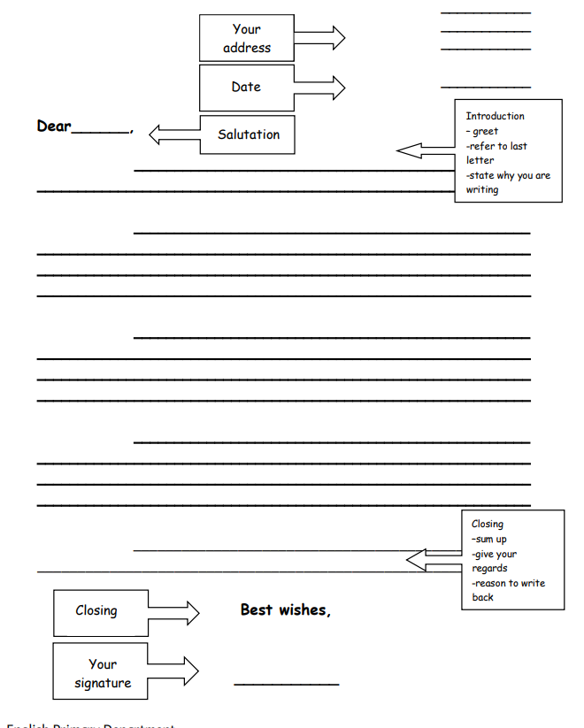

Slide 14
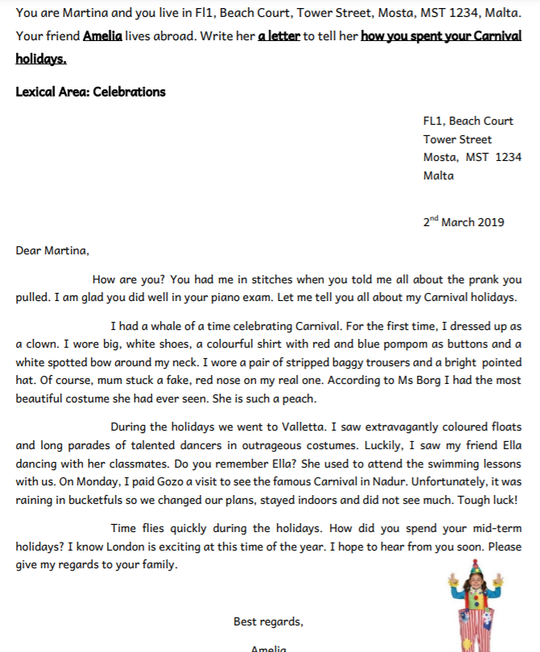
Writing Model
INTRODUCTION
- Ask your aunty how she is
- Reference to the content of the last letter
- Reason why you are writing
Amelia,
BODIES
-Your costume
-Places you have been (school, Valletta, Victoria, Nadur … )
-What did you see (floats, dancers, parades, costumes, streets and shop decorations … )
-What did you do (school party, ate Mum’s prinjolata, you visited …, you watched the Italian/Venice Carnival on television …)
CONCLUSION
- Ask if she did anything to celebrate Carnival in Italy
- Invite her over
- Ask her to write back
- Ask her to give your regards to your uncle and cousins
Martina

Slide 15
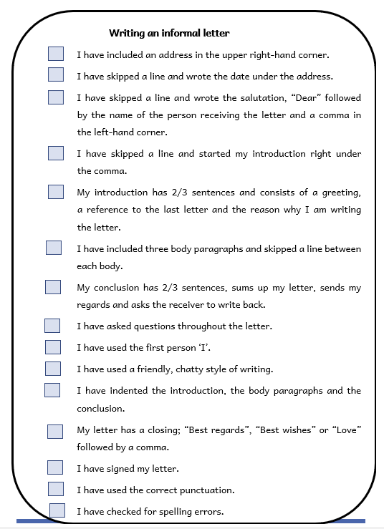
Success Criteria!
What are success criteria?
Success criteria are a list of steps you have to follow or a list of features you are to include in your task. They will make you aware of what is expected and help you self-assess your work.

Slide 16
Thank You!

