Slide 1
Lesson 4 Literature
Year 5
English

Slide 2
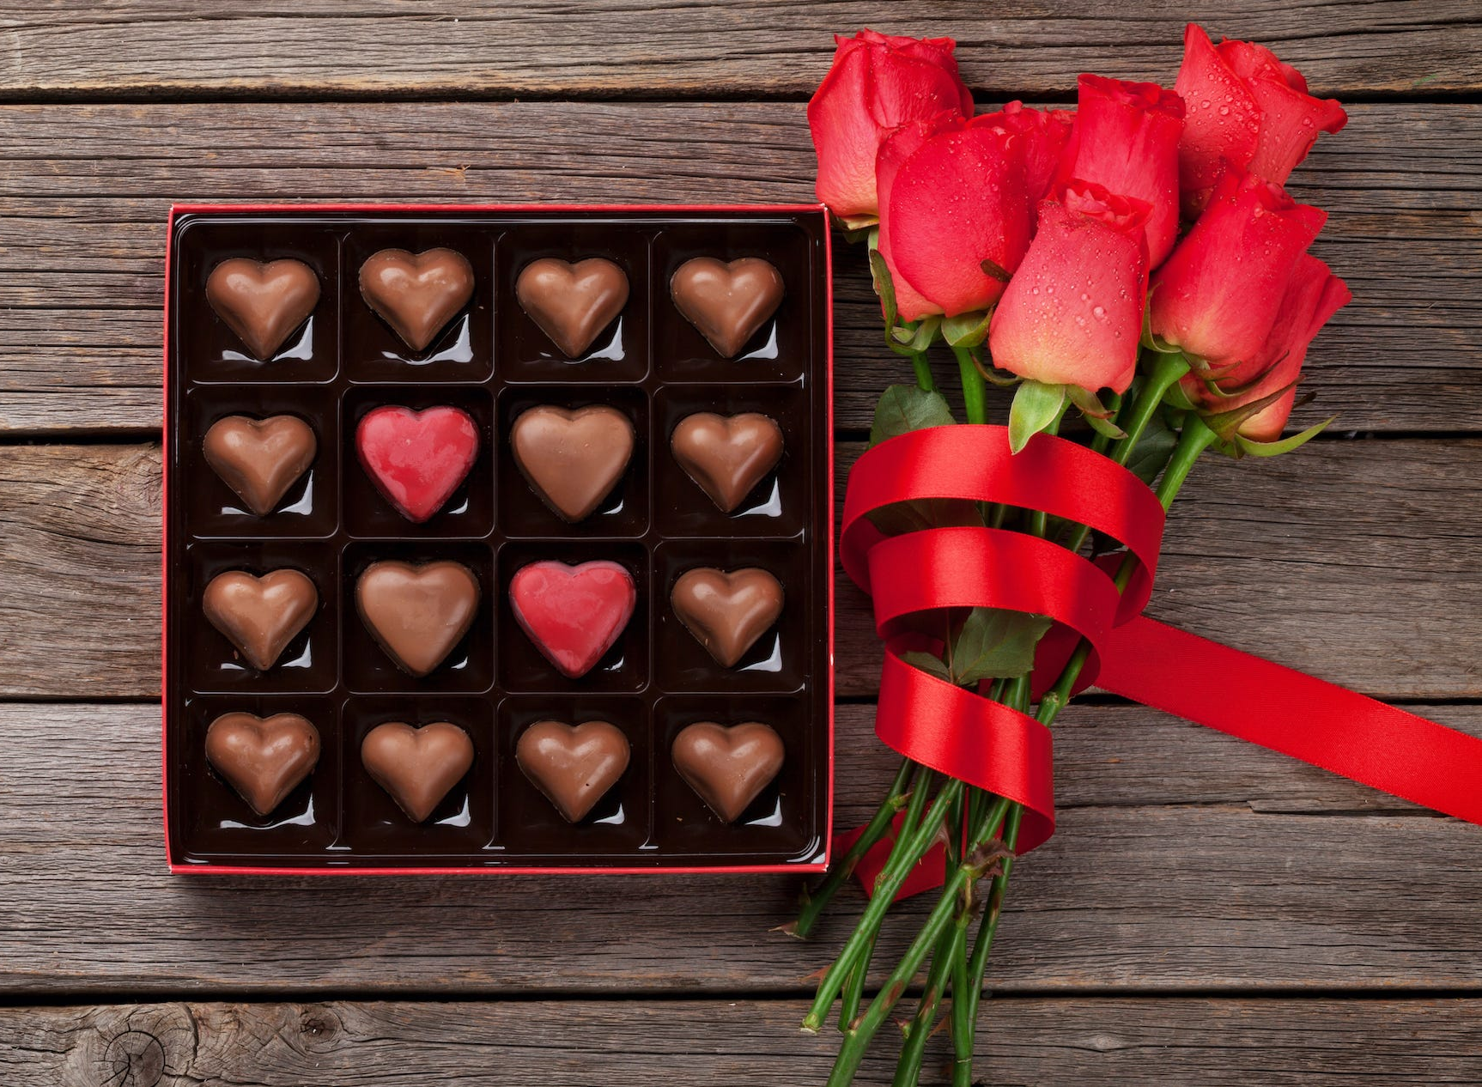
Guess today’s celebration

Slide 3
Lesson 3 Objectives
You will:
learn facts about a celebration.
read two poems silently and aloud.
listen to the two poems being read aloud.
answer questions about the two poems.

Slide 4
Lesson Resources
Poems Handout
Questions Worksheet
Answers Handout

Slide 5
Valentine’s Day is celebrated on the 14th of February. It’s a day when people show their love to each other by sending presents and messages of love.

Slide 6
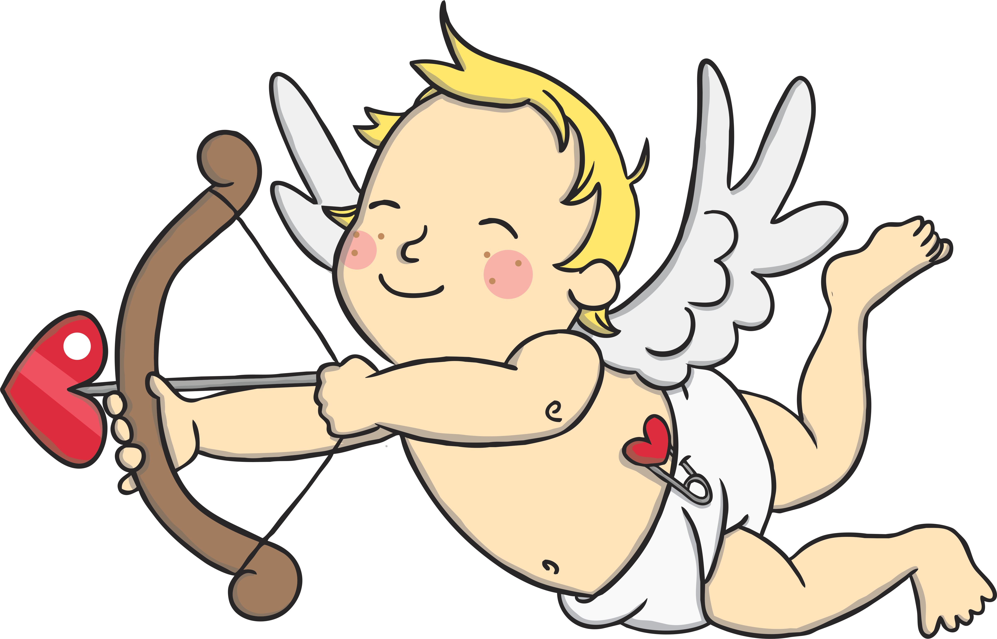
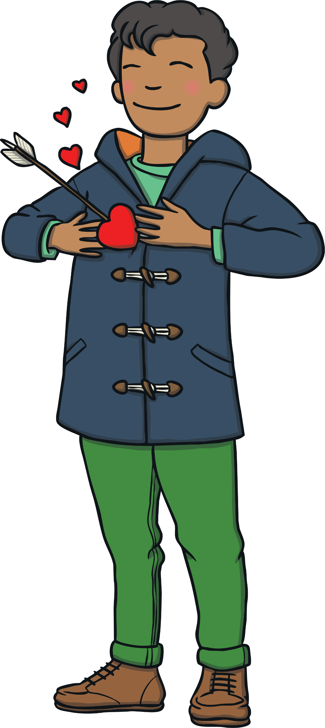
Cupid is the Roman God of Love and helps people to find love on Valentine’s Day. He is a winged cherub with a bow and an arrow.

Slide 7
People give each other flowers and chocolates on Valentine’s Day. They usually send red roses.
People also send Valentine’s Day cards to each other with a special message inside.

Slide 8
Step 1
READ the poems silently.
After you read the poems
ANSWER the following questions:
WHAT ARE THE POEMS ABOUT?
HOW DID THEY MAKE YOU FEEL?

Slide 9
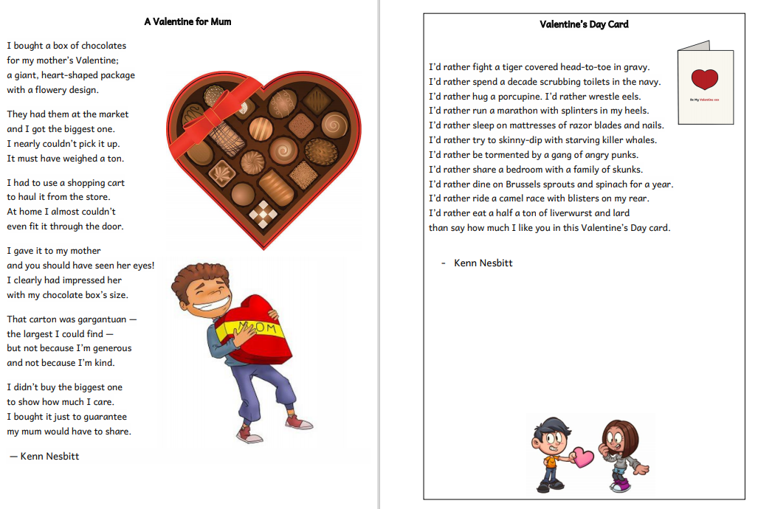

Slide 10
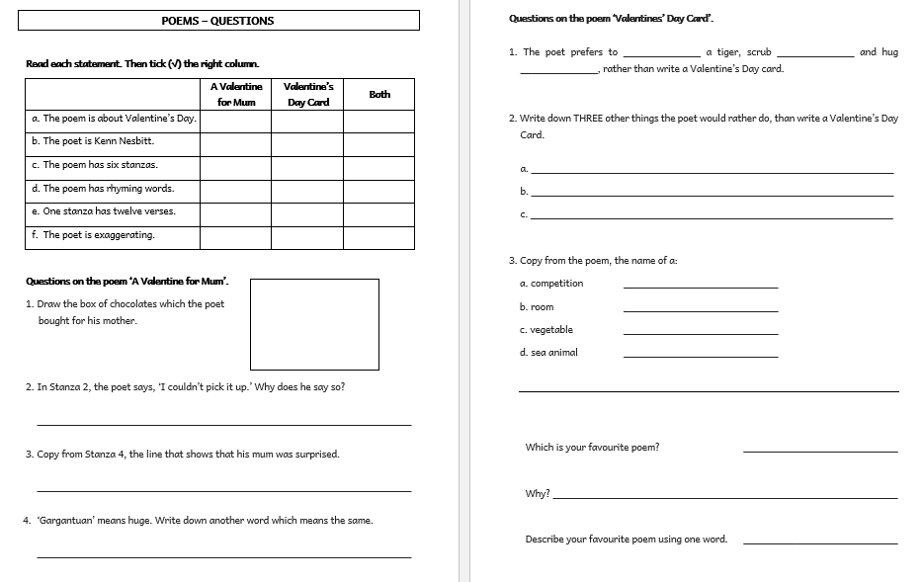

Slide 11
Step 2 - Discuss the question
What are the poems about?
The poem ‘A Valentine for Mum’ is about a big, heavy chocolate box which the poet buys for his mum. Since it’s quite big, the poet finds it hard to lift, carry or fit it through his house door.
In the poem ‘Valentine’s Day Card’, the poet would rather do dangerous, painful and disgusting things rather than write a Valentine’s card.

Slide 12
Step 3
READ the poems again.
Then try to ANSWER the following questions.

Slide 13
Step 3: Answer these questions!
Poem 1
What is the shape of the chocolate box?
How did the poet carry the chocolate box?
Why did the poet buy the biggest chocolate box?
Poem 2
What would the poet prefer to hug?
How long would the poet eat Brussel sprouts and spinach?
How would a camel race with blisters in your rear feel?

Slide 14
Step 4 - Discuss the questions
Poem 1
1. What is the shape of the chocolate box?
It is in the shape of a heart.
2. How did the poet carry the chocolate box?
He used a shopping cart.
3. Why did the poet buy the biggest chocolate box?
The poet wants his mum to share the chocolate with him.
Poem 2
4. What would the poet prefer to hug?
He’d prefer to hug a porcupine.
5. How long would the poet eat Brussels sprouts and spinach?
A year
6. How would a camel race with blisters in your rear feel?
Painful

Slide 15
Step 5
LISTEN and READ SILENTLY.
Then LISTEN to me while I EXPLAIN the worksheet.

Slide 18
Step 6
READ the poems yourself.

Slide 19
Step 7
WORK OUT
the worksheet.

Slide 20
Step 8

Slide 21
Step 9
CHECK your answers using the
Answers Handout.

Slide 22
Thank You!

