Slide 1
Lesson 2 Reading
Year 5
English

Slide 2
Lesson 2 Objectives
In Lesson 2 you will:
listen to a text being read aloud.
read a text silently and aloud.
answer questions about the text.
learn useful information about the Internet.
learn how to stay safe online.

Slide 3
Lesson Resources
Dictionary
Reading Text
Questions Worksheet
Answers Handout

Slide 4
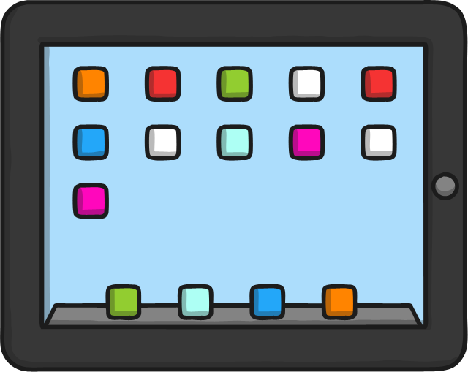
What is the Internet?
The Internet is made up of billions of computers that are able to connect with each other.
These computers are all around the world.
They are connected by cables and Wi-Fi.
They share information.

Slide 5
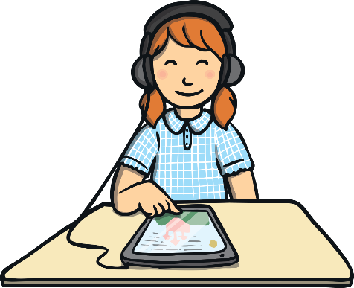
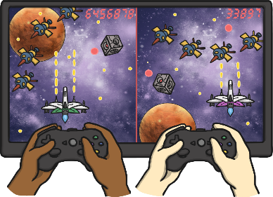
What can we use the Internet for?
You and your family might use the Internet to do things like:
play music;
video call your friends and family;
find out information;
watch TV programmes or films;
play games;
buy things;
tell your friends what you have been doing;
share photos;
send emails and messages.

Slide 6
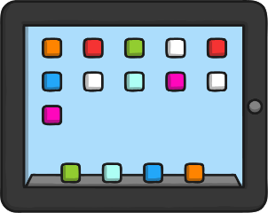
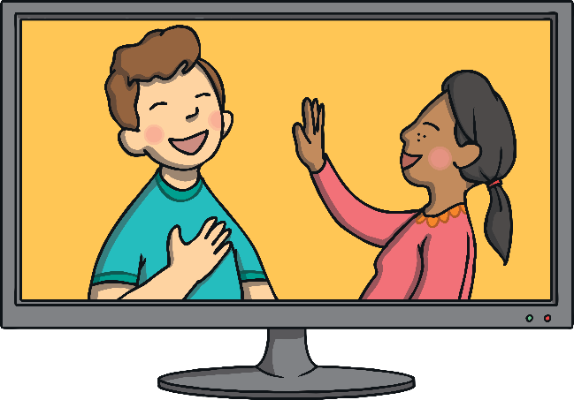
How do we access the Internet?
We can use different devices when we want to go onto the Internet, like:
a computer or laptop
a tablet
a mobile phone
a smart tv
a games console

Slide 7
How does my device connect to the Internet?
When the Internet was first created we needed wires to connect our computer to it.
Now we can use Wi-Fi.
You can’t see Wi-Fi signals because they use and send radio waves.
These waves are all around us but we can’t see them with our eyes or hear them with our ears.
Computers, laptops, tablets and other
devices can find the radio waves.
They use the information in the radio waves to make the pictures we see on the screen and the sounds we hear coming from the speakers.

Slide 8
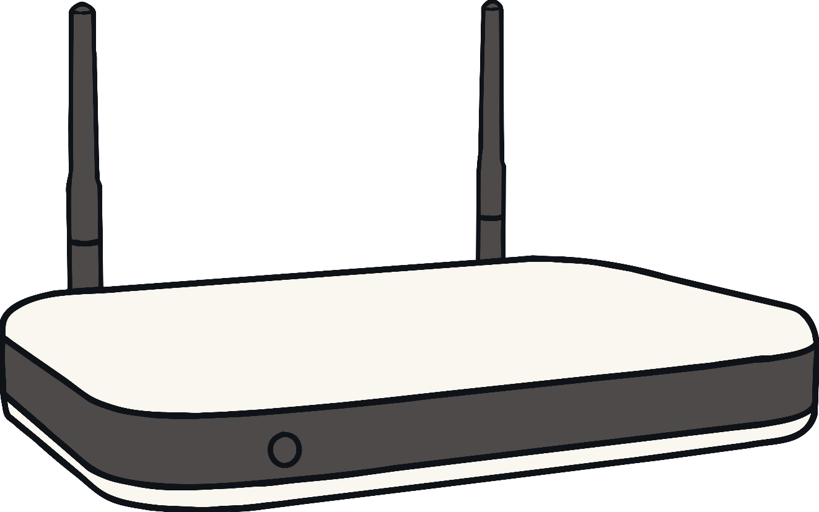
How does the Wi-Fi get to our homes?
The Wi-Fi router sends out the radio signals.
Have you got one of these in your home?

Slide 9
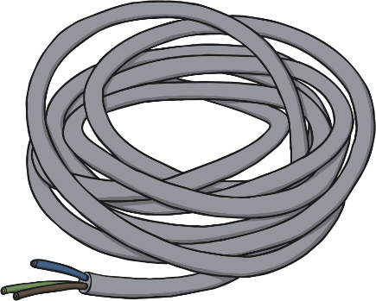
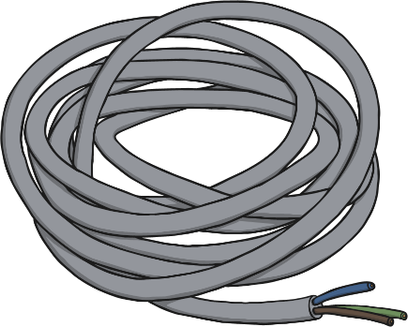
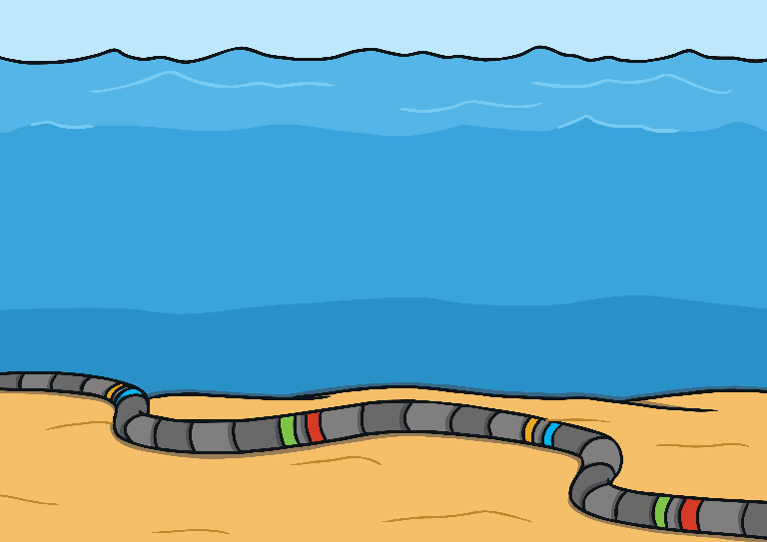
How does the Internet get to the router?
The router has a phone cable and the information travels along this and into the router.
The Internet runs through the phone lines. It is just like making a complicated phone call!
The cables travel all around the world, even across oceans.

Slide 10
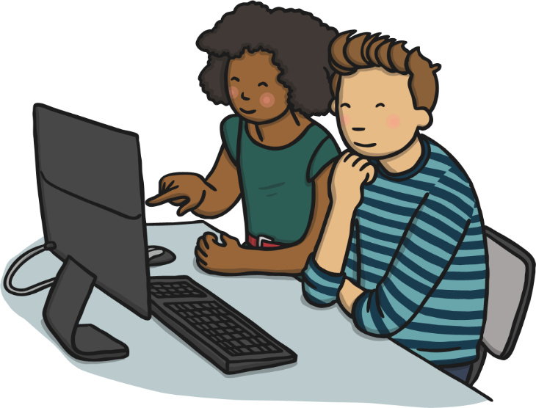
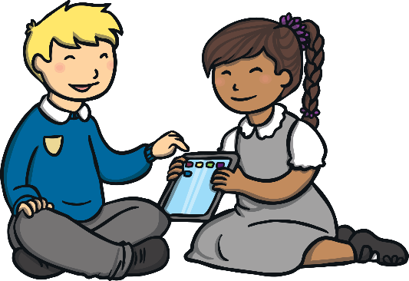
Why does the Internet seem to go slow sometimes?
If lots of people in your home use the Internet all at once, it can cause problems. It can:
stop the TV programme from loading;
stop the music from playing;
stop the website from loading.

Slide 11
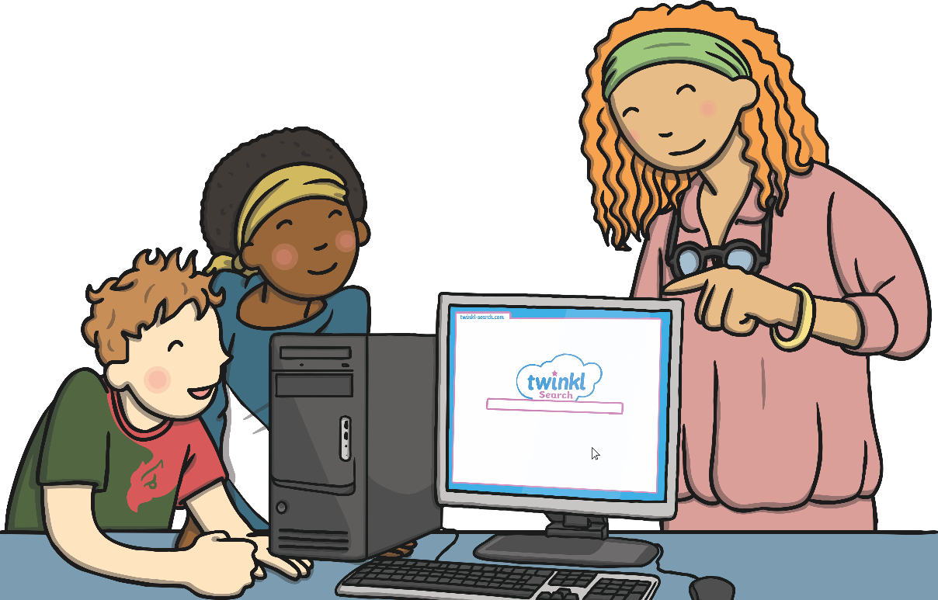
Staying Safe
Lots of people use the Internet.
You need to make sure an adult helps you when you use the Internet.
How can you stay safe on the Internet?

Slide 12
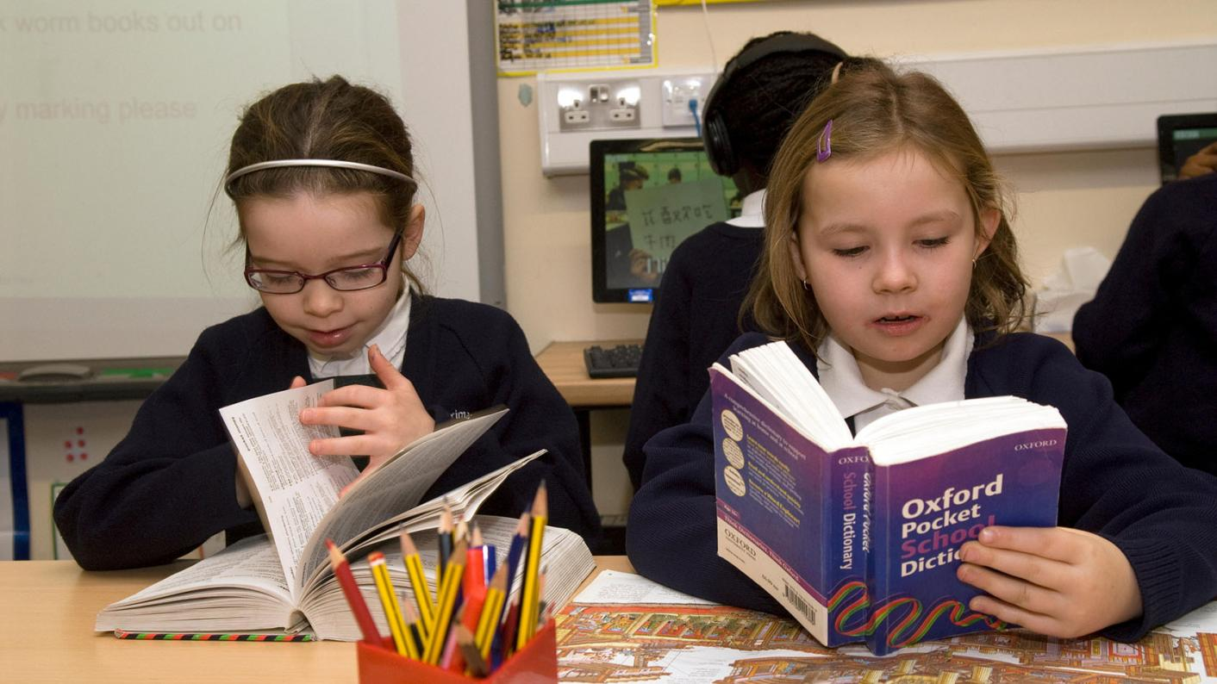
Using a dictionary!

Slide 13
New Words
personal
attachment
damage
cyberbullying
awareness
coordinated
charities
promote
responsibly
devices
unimaginable
illegal

Slide 14
New Words
organised things so that they work well together
organisations set up to provide help to those in need
awareness
coordinated
charities
encourage/support
when you do the things you are supposed to do well
machines
devices
when you are conscious about something
promote
responsibly

Slide 15
New Words
not allowed by the law
private/intimate
unimaginable
illegal
personal
a computer file sent with an email
to cause harm
bullying using electronic devices
cyberbullying
unbelievable
attachment
damage

Slide 16
Step 1
READ the text
on the handout and the questions on the worksheet.

Slide 17
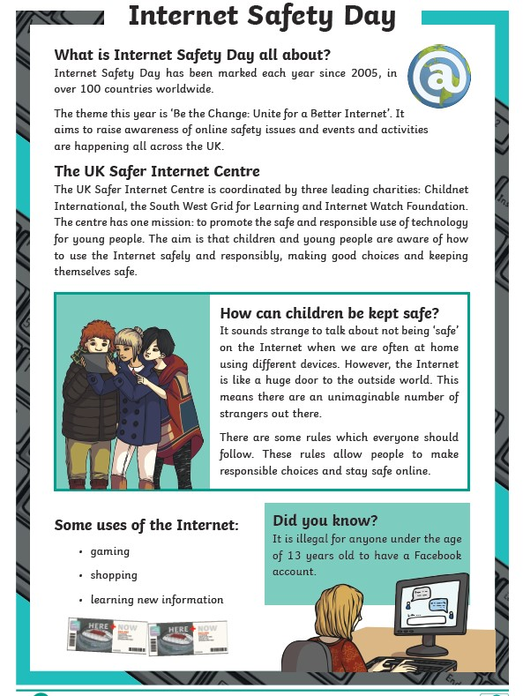
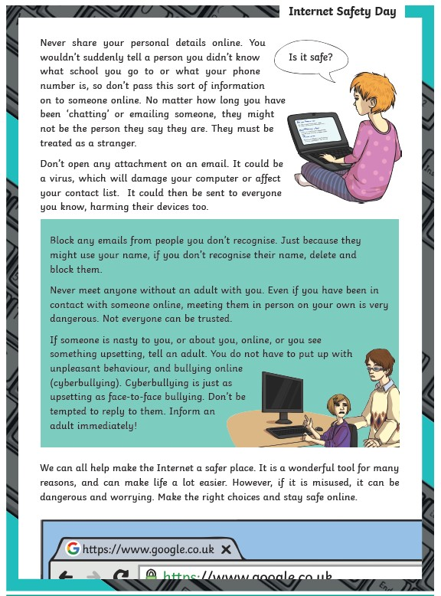

Slide 18
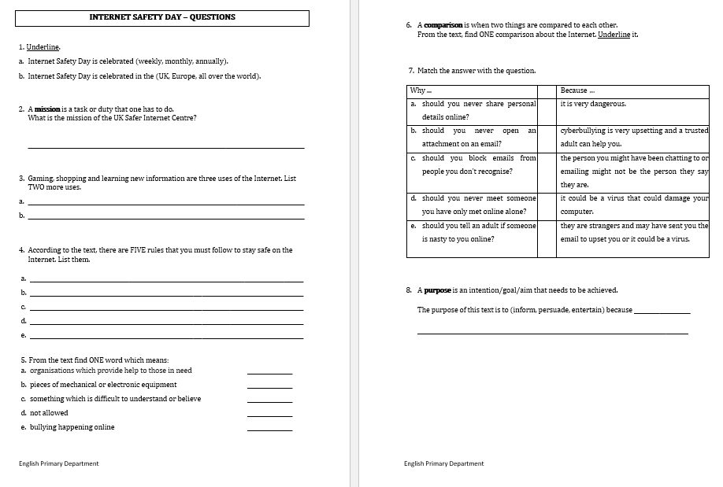

Slide 19
Step 1
After you read the text and questions you should be able to ANSWER the following question:
WHAT IS THE TEXT ABOUT?

Slide 20
Step 2: Discuss the question
What is the text about?
The text explains what Internet Safety Day is. The text gives details about the UK Safer Internet Centre. Finally, the text informs its young readers how they can stay safe on the Internet.
Information in this text is organised under different subtitles.

Slide 21
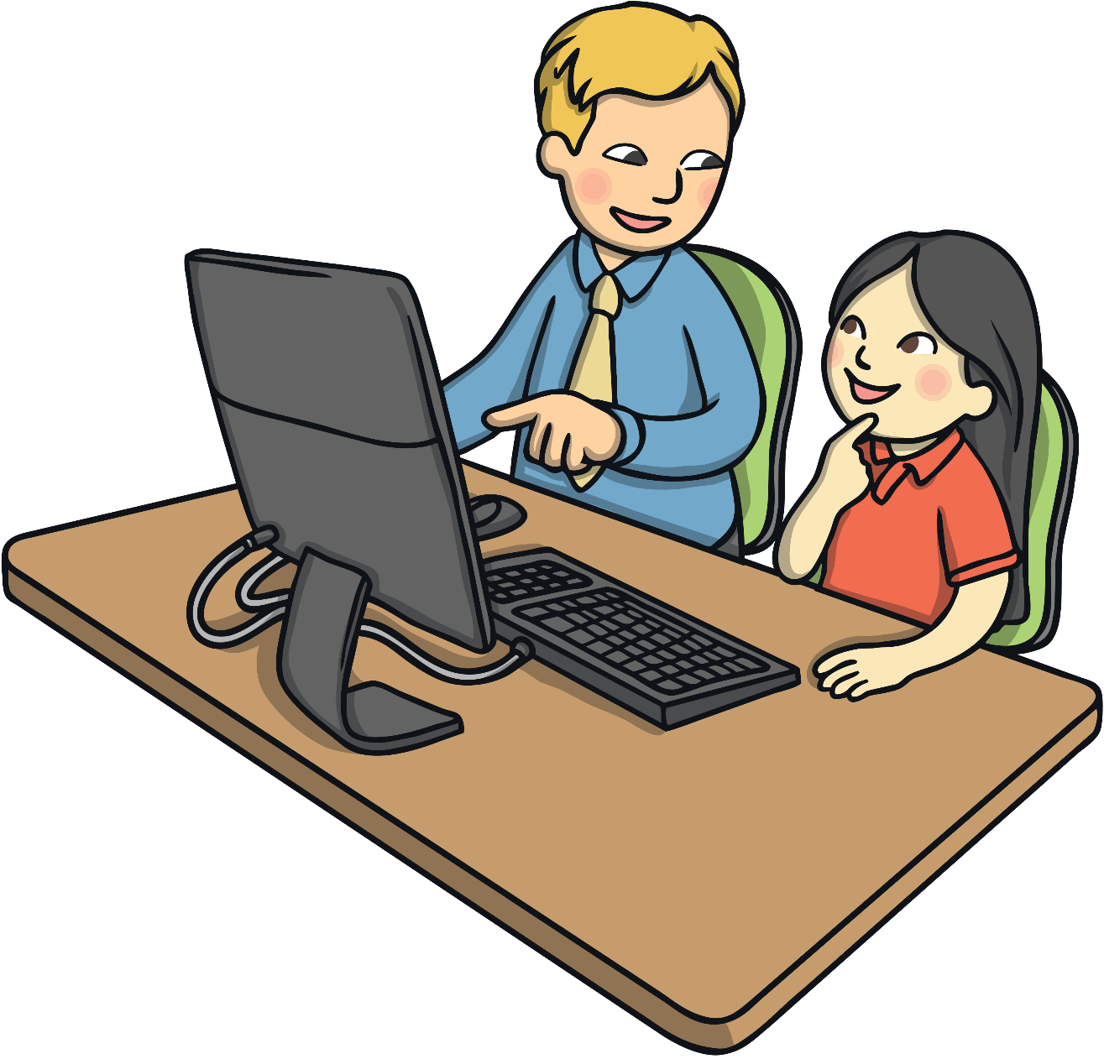
Safer Internet Day – Tuesday, 9th February, 2021
The theme for Safer Internet Day 2021 is
'An internet we trust: exploring reliability in the online world’.

Slide 22
Step 3
READ the text and questions again.
Then try to ANSWER the following questions:
How many countries celebrate ‘Internet Safety Day’?
What is the mission of the UK Safer Internet Centre?
List three Internet uses found in the text.
What are the five online safety tips shared in the text?

Slide 23
Step 4: Discuss the questions
How many countries celebrate ‘Internet Safety Day’?
Over 100 countries
2. What is the mission of the UK Safer Internet Centre?
The Centre’s mission is to promote the safe and responsible use of technology for young people.
3. List three Internet uses found in the text.
Gaming, shopping and learning new information.

Slide 24
Step 4: Discuss the questions
4. What are the five online safety tips shared in the text?
The five online safety tips are:
never share your personal details online;
don’t open any email attachments;
block emails from people you don’t recognise;
never meet anyone without an adult with you;
tell an adult if someone is nasty to you or you see
something upsetting.

Slide 25
Step 5
LISTEN to me as I
READ the text ALOUD.

Slide 27
Step 6
READ the text ALOUD.

Slide 28
Step 7
Let’s DISCUSS
the questions.

Slide 30
Step 8
WORK OUT the
Questions Worksheet.

Slide 31
Step 9

Slide 32
Step 10
CHECK your answers using the
Answers Handout.

Slide 33
Thank You!

