Slide 1
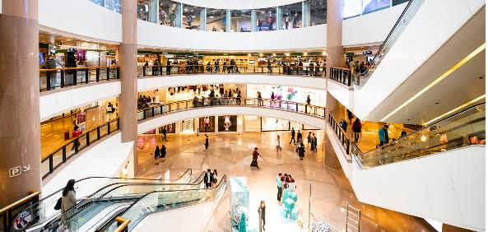
Lesson 3: Speaking Topic: Shopping and Services Year: 4

Slide 2
Lesson Objectives:
During this lesson I will:
learn how to plan and act a role-play.
answer questions about a thematic picture.

Slide 3
Download these resources:
Sentence Starters and Prompts
Handout
Thematic Picture Handout

Slide 4
Step 1: Watch this video clip. Then answer this question: What is the video clip about?

Slide 5
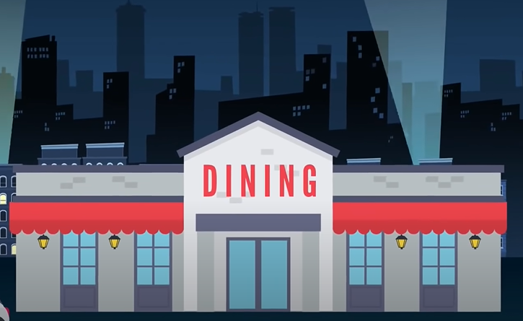
https://www.youtube.com/watch?v=bgfdqVmVjfk&t=75s
From 00:00 – 2:57

Slide 6
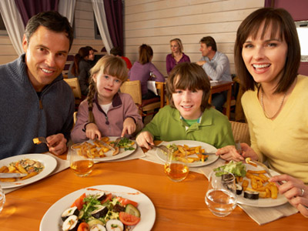
What is the video clip about? The video clip is about a family who goes out for dinner in a restaurant. They speak to a waiter and order a three-course meal (starter, main course and dessert). Let’s look at other examples to help you out.

Slide 7
PART 1
Role play:
Ordering food in a café.

Slide 8
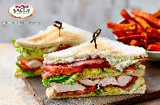
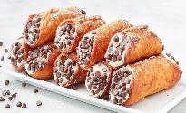
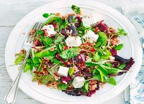
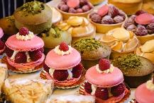
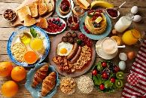
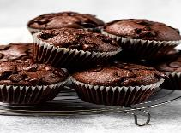
Prepare a role-play at a café .
Then act out the role-play with a friend/relative.
sandwiches
omelette
hot cross buns
salads
coffee
tea
orange juice
muffins
cakes

Slide 9
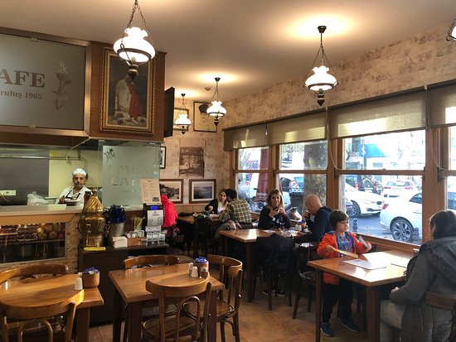
Sentence Starters and Prompts Handout
Taking Orders
What can I get you?
How can I help you?
Can I get you anything else?
Is there anything else you’d like?
Ordering food and drinks
I’d like … please.
Can I have … please?
I’ll have …
Just …

Slide 10
PART 2
Role-Play:
Buying goods

Slide 11
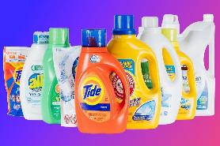
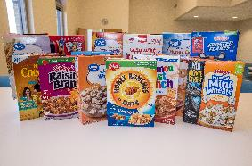
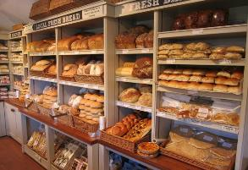
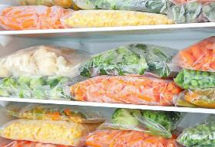
Prepare a dialogue at the supermarket.
Then act out the role-play with a friend/relative.
cheese
ham
fruit and vegetables
detergents
canned food
cereal
frozen food
pasta and rice
oil
salad dressing
bread

Slide 12
AT THE BUTCHER’S
Shopkeeper: Oh, hello again! Do you want the ham and sausages as usual?
Customer: Yes, but apart from the ham and sausages I also need some burgers.
Shopkeeper: I haven’t got too many burgers left. How many do you need?
Customer: Four burgers only.
Shopkeeper: Ok, here you are. Is this everything you want?
Customer: Yes, that's everything. How much is it?
Shopkeeper: €6, please.
Customer: Here you are. See you next week!
Shopkeeper: Thank you. See you!
A Dialogue Model

Slide 13
Prepare a dialogue at the stationery.
Then act out the role-play with a friend/relative.
cards
stickers
books
workbooks
charts
tape
pencil cases
envelopes
pens/pencils
glue
colours and markers
writing paper
paper clips
paintbrushes

Slide 14
Sentence Starters and Prompts Handout
Can I help you?
What would you like to buy?
How much/many would you like?
Do you have any … ?
May I please have …?
Can you put this in a bag, please?
Would you like something else?
How much would that be, please?
Here is your change.
Thank you. See you soon.
Thank you for your service. I appreciate it.

Slide 15
PART 3
Thematic Picture

Slide 16
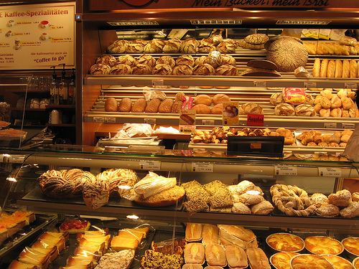
Look at this picture carefully.
What kind of shop is this?
What does it sell?
Have you ever been to such a shop?

Slide 17
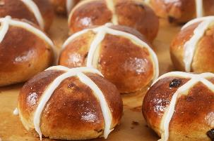
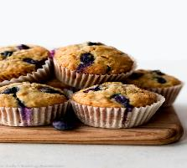
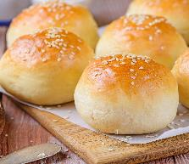
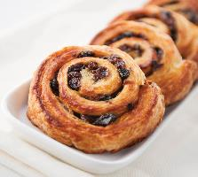
Answer the questions about these pictures.
Which food is your favourite?
Which food is your least favourite?
Do you eat this type of food often?
List some ingredients needed to bake this food.

Slide 18
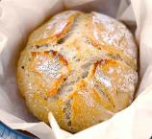
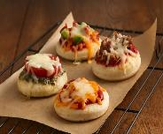
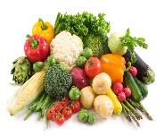
Look at the large picture. It shows a bakery. Look at the smaller pictures below.
Which of these can you find in a bakery?
Which of these are not usually found in a bakery?

Slide 19
Choose one of the small pictures.
Then practise out loud saying whether you would find the object or not at the bakery. Give reasons why.
Repeat for all the small pictures.

Slide 20
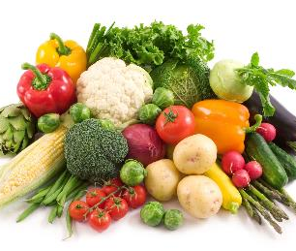

Slide 21
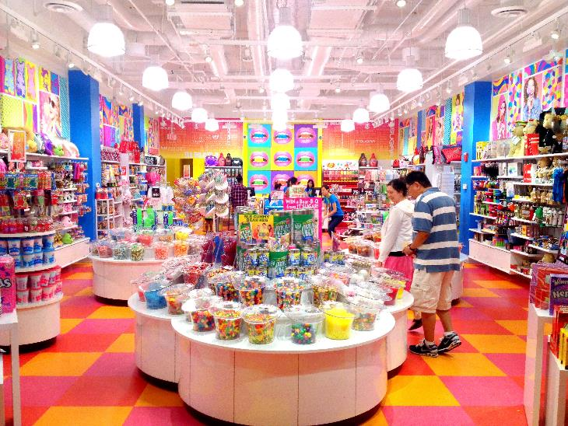
Post- Task Activity:
Have you ever been in a candy/sweets shop?
Imagine you are at a candy shop.
List down ten things you would buy in this shop.

