Slide 1
Lesson 2 Listening
Year 5
English

Slide 2
Lesson 2 Objectives
You will:
listen to and view attentively a text.
answer questions about the text.
learn facts about a historical event.
carry out research on one planet.

Slide 3
Lesson Resources
Questions Worksheet
Answers Handout

Slide 4
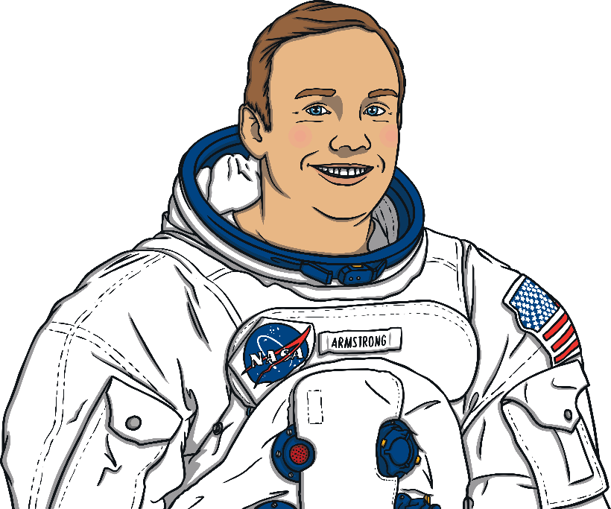
1961
Yuri Gagarin became the first man in space.
1963
Valentina Tereshkova was the first woman in space and a crater on the far side of the moon was named after her!
1960
1965
1970
1969
Neil Armstrong and Buzz Aldrin set foot on the moon!

Slide 5
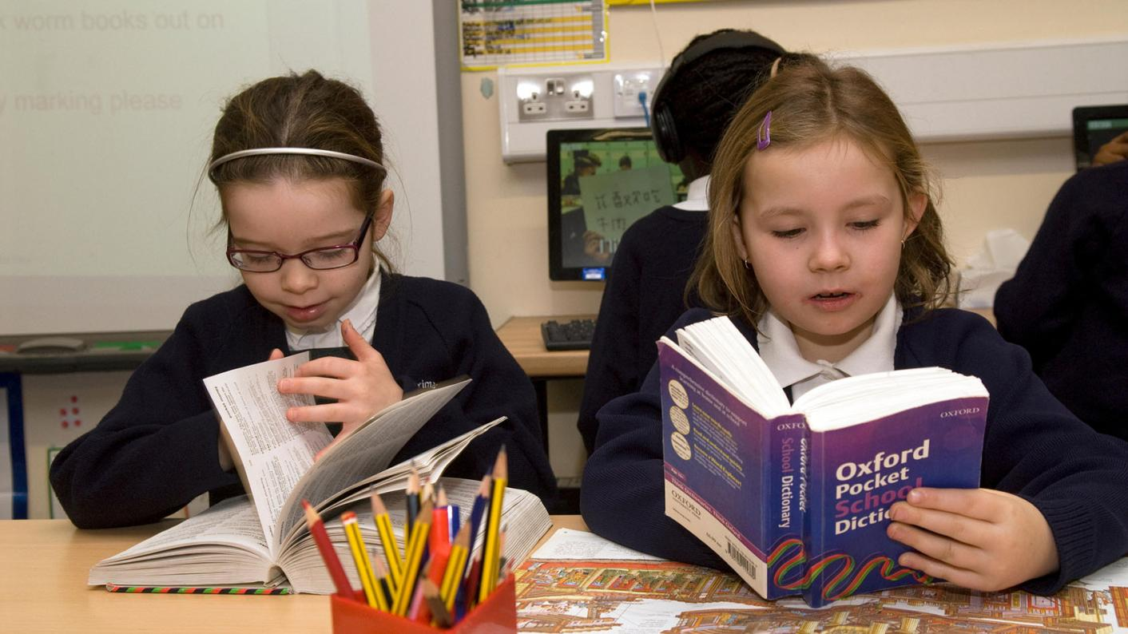
Using a dictionary!

Slide 6
Words and phrases in the text!
orbit
expedition
command module
circuit breaker accomplished
bulky
oxygen
mementos
mission
atmosphere

Slide 7
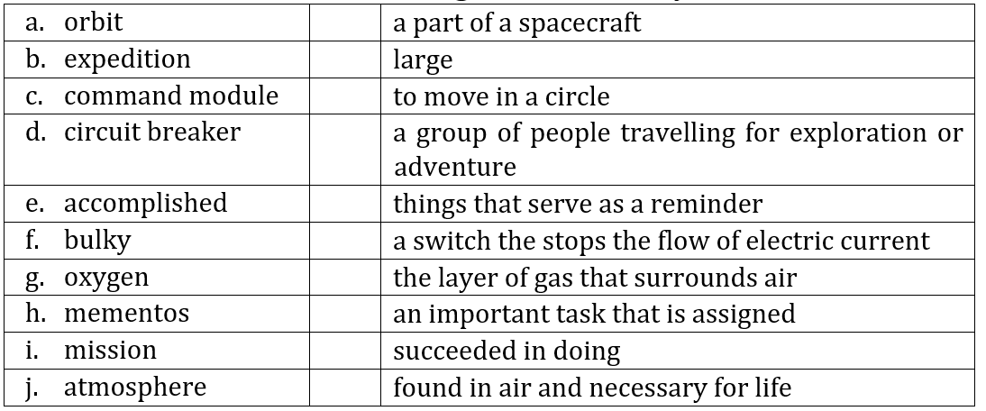
Now match!
QUESTIONS WORKSHEET

Slide 8
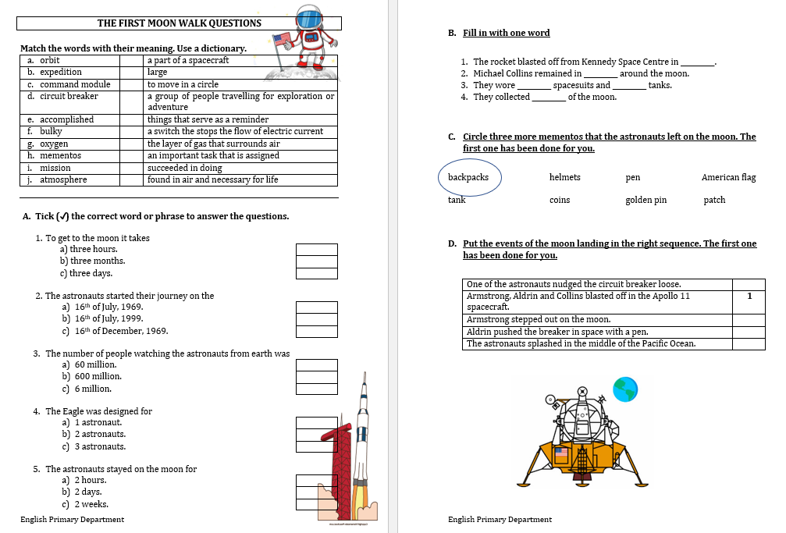
Step 1
READ the questions on the worksheet.

Slide 9
Step 2
LISTEN TO and VIEW the videoclip.

Slide 10
… Step 2
LISTEN carefully while I read the questions.
START ANSWERING the questions.

Slide 11
Step 3
LISTEN TO and VIEW the videoclip for the second time.

Slide 12
… Step 3
LISTEN while I read the questions again.
Try to ANSWER any unanswered questions.

Slide 13
Step 4

Slide 14
Step 5
CHECK your answers using the
Answers Handout.

Slide 15
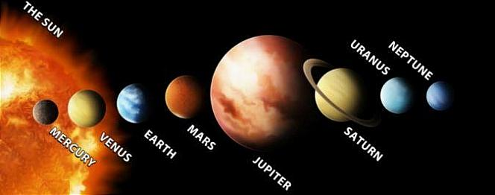
Research Time!
The Solar System
Which of these planets would you like to visit? Collect information on this planet.
The information will come handy later on this week.

Slide 16
Thank You!

