Slide 1
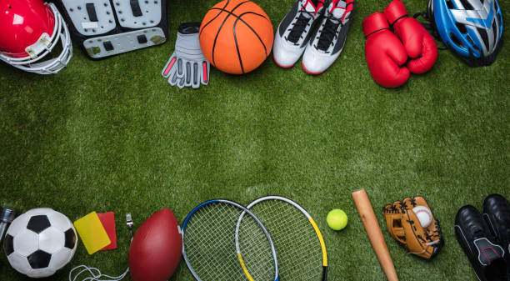
Sports and Games
Lesson 5 - Writing
Notes:
Hello children. This is our 5th lesson on the topic Sports and Games. In this lesson we are going to write a description of our favourite sport or game.

Slide 2
Notes for the Educator
This lesson is pegged directly to Learning Outcomes W 5.9 I can write a paragraph appropriately for an audience and with a purpose; W5.12 I can make a text more interesting or more relevant to me by changing the vocabulary and W5.14 I can use resources to help me plan my written work and present it accurately.
Teachers are to refer to the Scheme of Work where each lesson is explained in more detail.
Effects are included to make the presentation more interactive. Please present the PowerPoint in Slideshow mode.
Wherever possible we have included the use of online apps to enhance the teaching and learning experience.
The Notes section underneath the slides may contain some further points which can be developed during the lesson.
Teachers are encouraged to adapt this PowerPoint presentation to meet the learners’ language needs.
Tasks included in the PowerPoint presentation are also being shared as handouts.
For any comments, feedback or suggestions please email us at: marie-claire.camilleri@ilearn.edu.mt; urieth.attard@ilearn.edu.mt; mary.jude.camilleri@ilearn.edu.mt. You may also call the office on: 25983683.

Slide 3
I am learning how to write a short message.
I can plan what I want to include in the message.
I can write a short paragraph to describe my favourite sport.
I can improve my writing by revising and editing it.

Slide 4
Your friend would like to take up a new sport. She sends you a message to ask you about your favourite sport. Reply to her message and give her some information about it.
Notes:
Learners may also refer to the drawing of their favourite sport.

Slide 5
G
Genre – a message
Audience – your friend
Purpose – to describe your favourite sport
A
P
Notes:
IMP: Although the writing of a report is not recommended among the genres listed for Year 3 in the Supporting Document, it can still be used to assess descriptive writing.

Slide 6
Think about…
What would you write in the message? Make a list of 5 points to write about.
Say which is my favourite sport
…..

Slide 7
Nicole
Nicole, how are you? My favourite sport is swimming. I have swimming class once a week in an indoor swimming pool. I wear a swimsuit and goggles. My swimming coach is Mr David. I can swim by myself but sometimes I use a noodle. I really enjoy this sport because it keeps me healthy. You should try it, too!
14:30
Notes:
I liked reading about Maya’s favourite sport – what about you?
Now let’s take a closer look at what Maya wrote.

Slide 8
She answered her friend’s question by telling her what her favourite sport is.
Nicole, how are you? My favourite sport is swimming. I have swimming class once a week in an indoor swimming pool. It is heated so I never feel cold. I wear a swimsuit and goggles. I can swim by myself but sometimes I use a noodle. I really enjoy this sport because it keeps me healthy. You should try it, too!
She started by greeting her friend. She used her friend’s name and asks her how she is.
details about how often she practises swimming and where
Adds more detail to make it sound more interesting.
some equipment she uses
Explains what she wears.
Gives a reason why she enjoys this sport.
Concludes the message by encouraging her friend to try it.

Slide 9
What did the writer include in her message?
greeted her friend
told Nicole what her favourite sport is
wrote about how often she practises this sport
mentioned a piece of equipment that she uses
explained where she practises the sport
described what she wears
gave reasons why she likes this sport
encouraged her friend to try this sport
Notes:
Have learners jot down ideas individually then come back as a whole group and discuss.

Slide 10
To write a good message, I need to
greet my friend
tell the reader what my favourite sport is
say something about how often I practise this sport
mention some equipment that I use
explain where I practise it
describe what I wear
conclude by giving reasons why I like this sport.
1
2
3
4
5
6
7

Slide 11
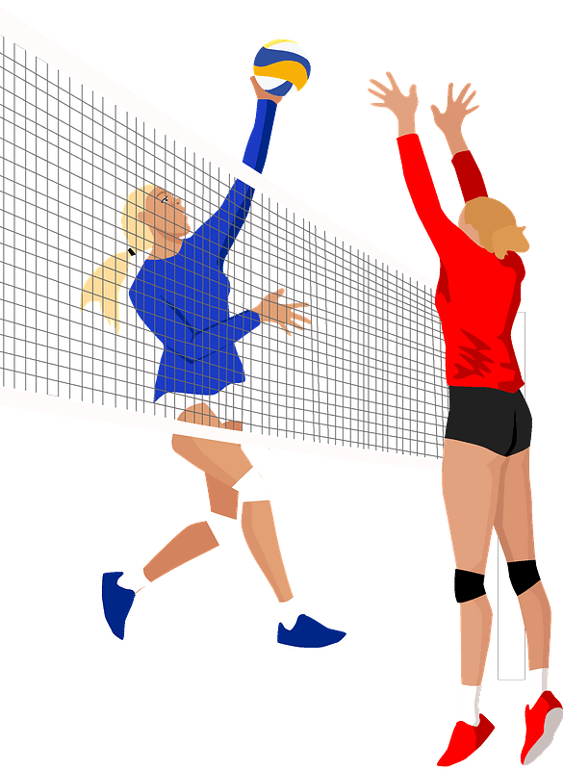
once a week
ball and a high net
hit the ball with hand or arm and throw it over the net
team sport
2 teams of six players
volleyball
T-shirt and shorts/tracksuit and gym shoes
indoor court
Makes me fast, strong and healthy.
Notes:
Now that I know how I need to organise my writing, I can start planning it.
My favourite sport is volleyball. I’m going to jot down some ideas that I can include in my writing.
Since this is not a story, the ideas do not need to be one after the other. There is no particular order.

