Slide 1
Lesson 5 Literature
Year 5
English

Slide 2
Lesson 5 Objectives
You will:
use the dictionary to find the meaning of new words.
read a literary text silently and aloud.
listen to a literary text being read aloud.
learn what setting, narrator and protagonist mean.

Slide 3
Lesson Resources
Dictionary
Reading Text Handout
Questions Worksheet
Answers Handout

Slide 4
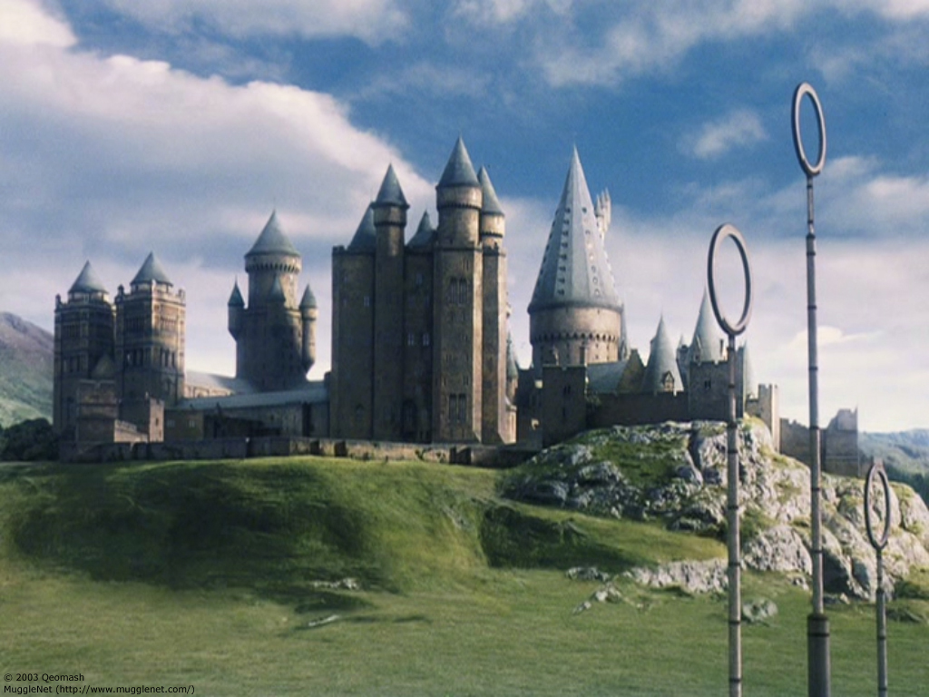
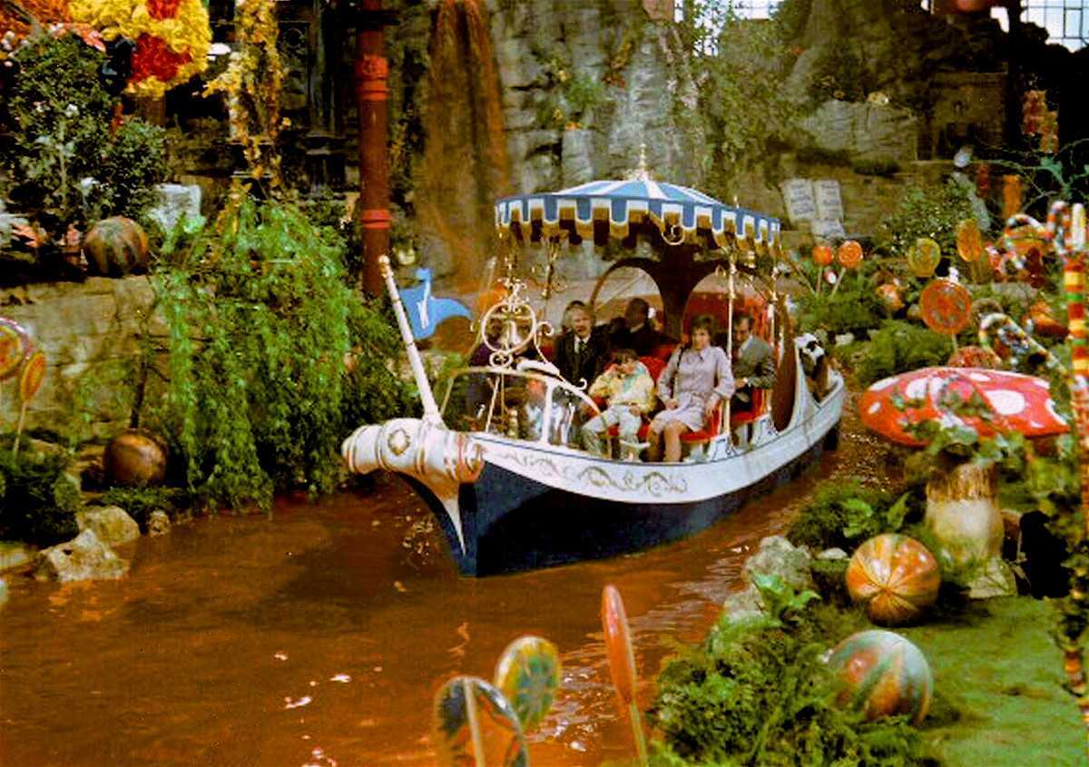
Setting
The setting is the time and place in which the story takes place. Settings can be real or fictional, or a combination of both.

Slide 5
Narrator
The narrator is a person who narrates something, especially a character who recounts the events of a novel or narrative poem.

Slide 6
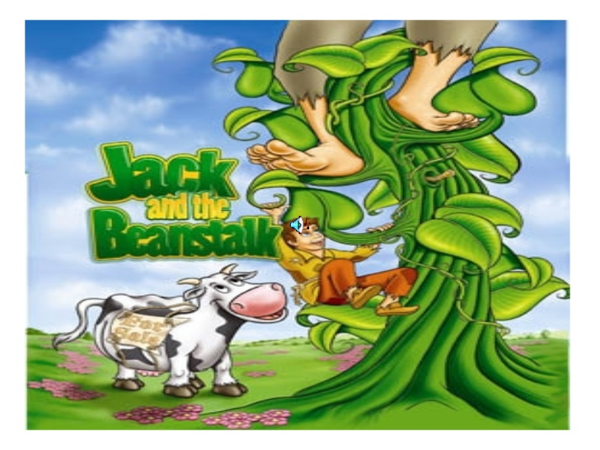
Protagonist
The protagonist is the leading character or one of the major characters in a play, film, novel, etc…

Slide 7
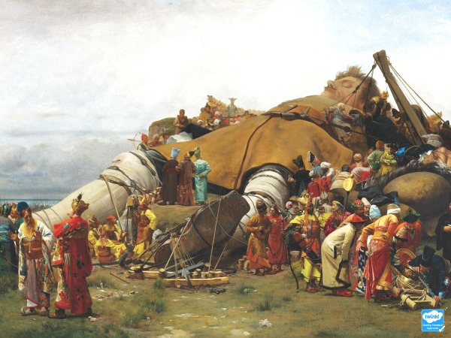

Slide 8
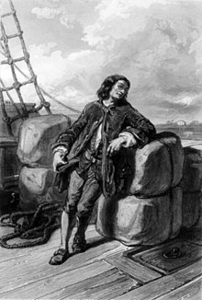
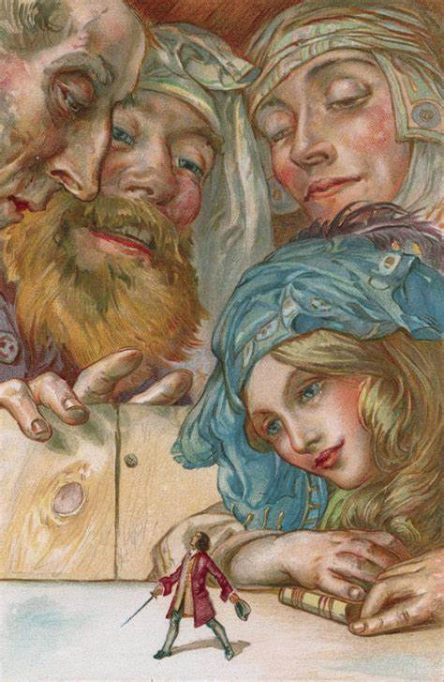
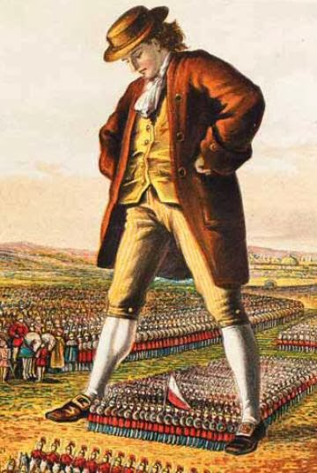
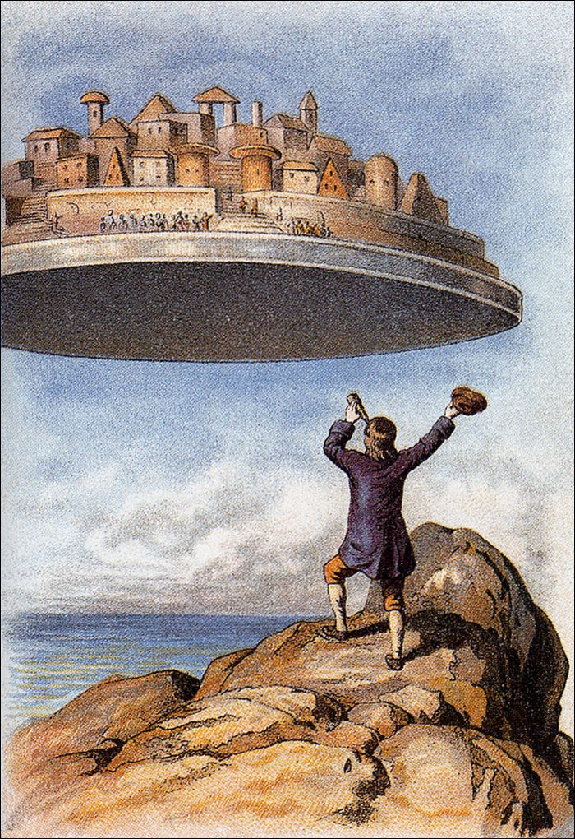
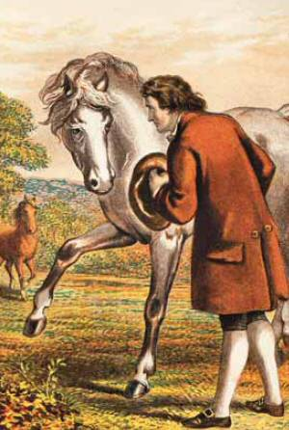
Lemuel Gulliver,
on his ship
Brobdingnag, a land of big people
Lilliput, a land of little people
Laputa, a land of intelligent but useless people
Houyhnhnm, a land of horses

Slide 9
Who is Lemuel Gulliver?
Lemuel Gulliver, is the fictional protagonist and narrator of
Gulliver’s Travels, a novel written by Jonathan Swift.
Gulliver was born in England in 1661.
Gulliver studied medicine and educated himself in navigation and mathematics.
He left a comfortable life in England for an adventurous life of exploration.
In 1699, Gulliver set sail on a voyage.
Bad food weakened the crew.
His ship encountered violent storms, hit a rock and split.
Six of the crew members, including Gulliver, got into a small boat.
The boat overturned.
Gulliver swam until he reached an island.

Slide 11
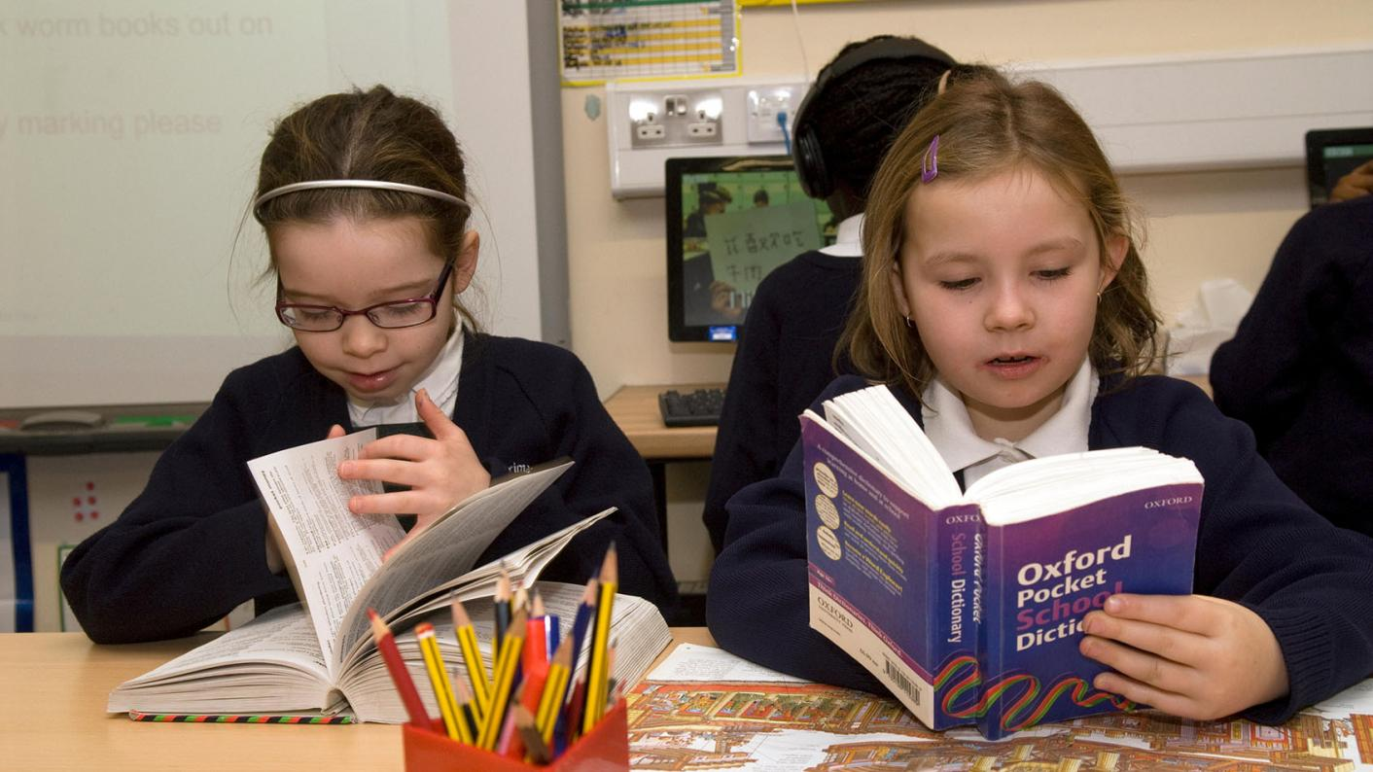
NEW WORDS - Using a dictionary!

Slide 12
New words
potion …
a drink that has a special or magical effect on someone

Slide 13
survivor
fastened
instance
inhabitant
horizon
straining
pierced
miniature
astonishment
peered
captor
scarcely

Slide 14
survivor
horizon
astonishment
fastened
the line where the earth or sea seems to meet the sky
tied securely
great surprise or wonder
a person who outlives an accident, illness, war, etc.

Slide 15
straining
peered
instance
pierced
looked narrowly or curiously
a certain point or situation
made a hole in or through
stretching beyond

Slide 16
captor
inhabitant
miniature
scarcely
a small copy of something bigger
someone who has captured a person or thing
only just
a person or animal that lives
in a place

Slide 17
Step 1
READ silently the text.
After you read the text ANSWER the following questions:
WHAT IS THE TEXT ABOUT?
HOW DID IT MAKE YOU FEEL?

Slide 18
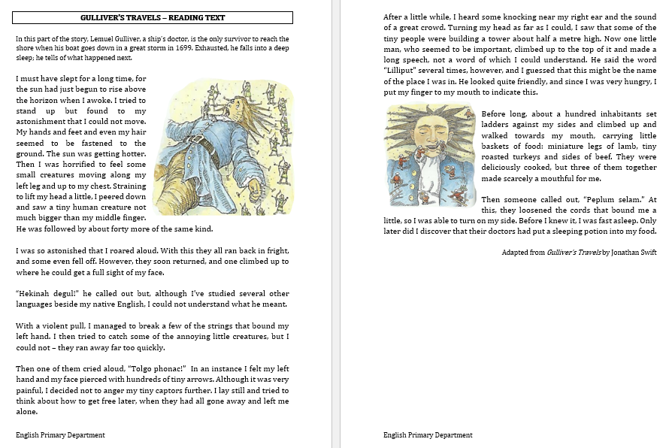

Slide 19
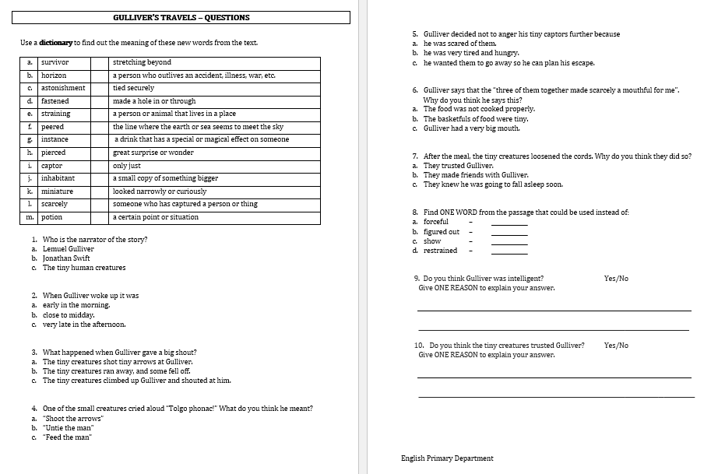

Slide 20
Step 2 - Discuss the question
What is the text about?
In this extract, Gulliver, finds himself tied to the ground. He is surrounded by tiny people. When he first tries to escape, his captors throw arrows at him. Gulliver asks them for food because he is hungry. They give him delicious food with a special potion in it. Gulliver falls fast asleep.

Slide 21
Step 3
READ the text again.
Then try to ANSWER the following questions.

Slide 22
Step 3: Answer these questions!
Who is the main protagonist of the story?
What is the setting of the story?
What happened to Gulliver’s ship?
How did Gulliver feel when he felt the little people moving along his leg and chest?
What happened when Gulliver tried to catch the creatures?
How did Gulliver discover the name of the place?
How do we know that the little people were good cooks?
What do you think the phrase, ‘Peplum selam’ means?

Slide 23
Step 4 - Discuss the questions
Who is the main protagonist of the story?
Lemuel Gulliver
2. What is the setting of the story?
The setting of the story is Lilliput, a land of tiny people.
3. What happened to Gulliver’s ship?
The ship went down in a big storm.
4. How did Gulliver feel when he felt the little people moving along his leg and chest?
Horrified

Slide 24
Step 4 - Discuss the questions
5. What happened when Gulliver tried to catch the creatures?
They pierced his left hand and face with hundreds of tiny arrows.
6. How did Gulliver discover the name of the place?
The little man who climbed on top of the tower, said the word ‘Lilliput’ several times.
7. How do we know that the little people were good cooks?
The food they gave him was ‘deliciously cooked’.
8. What do you think the phrase, ‘Peplum selam’ means?
I think it means ‘loosen the cords’ because when the
man shouted ‘Peplum selam’, the creatures loosened the cords.

Slide 25
Step 5
LISTEN and
READ SILENTLY
with me.

Slide 28
Step 6
READ the text yourself.

Slide 29
Step 7
WORK OUT
the worksheet.

Slide 30
Step 8

Slide 31
Step 9
CHECK your answers using the
Answers Handout.

Slide 32
Compare the extract with the video clip. Find some differences.

Slide 33
What are the differences?
The little creatures could speak Gulliver’s language.
The inhabitants of Lilliput had already built towers and a bridge by the time Gulliver woke up.
Gulliver managed to stand up.
Gulliver thought he had been dreaming so he closed his eyes.
One of the inhabitants threw a spear at him.
The rest of the inhabitants tried to tie him down by
throwing ropes with fitted hooks at the ends.

Slide 34
Thank You!

