Slide 1
Lesson 1 Listening
Year 5
English

Slide 3
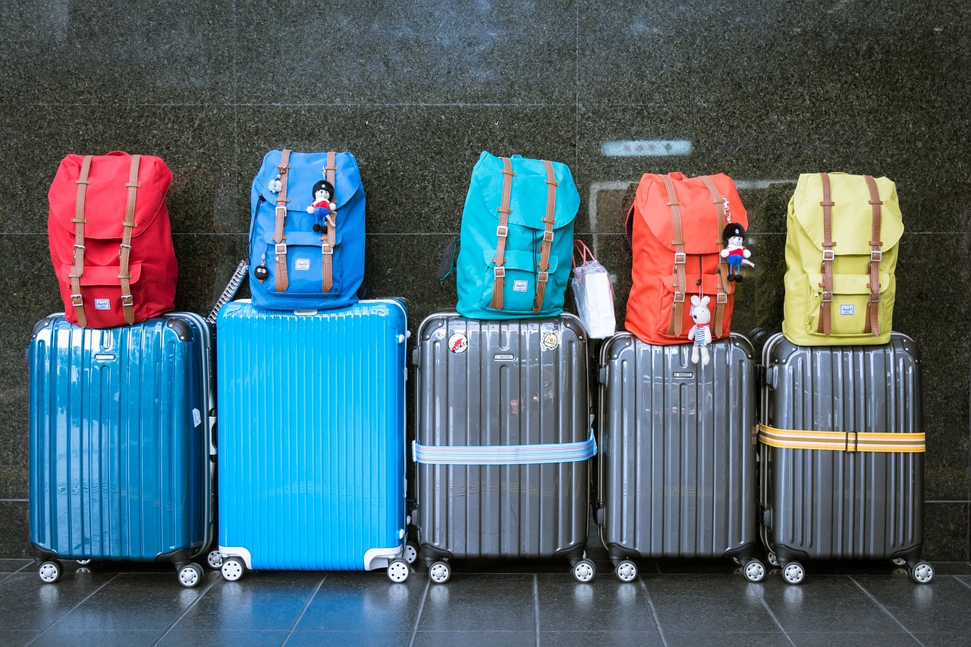
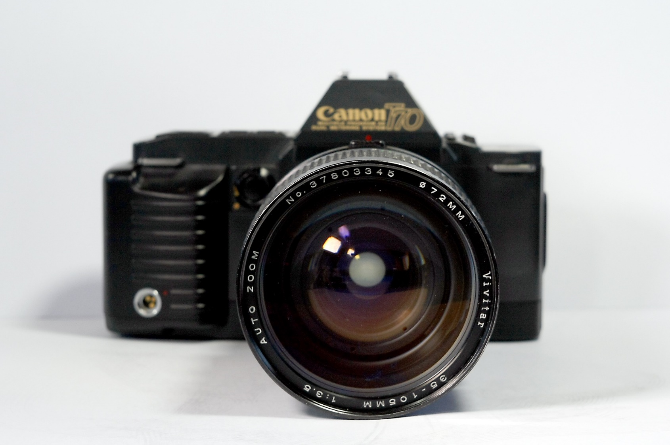
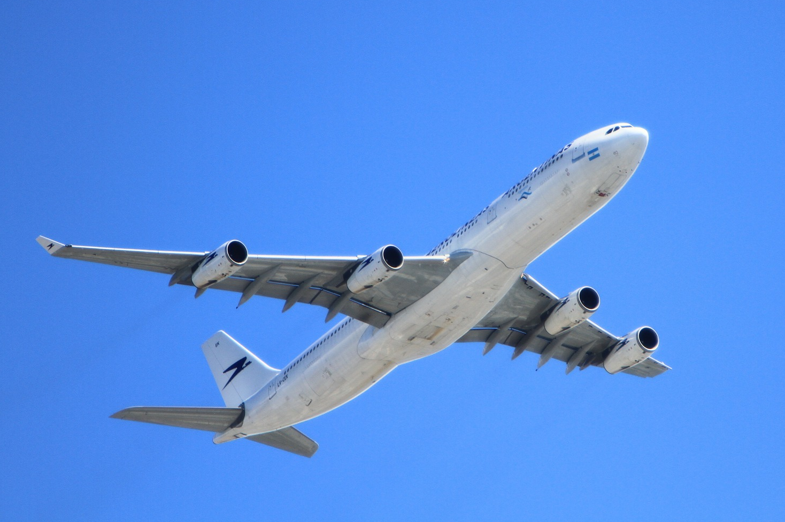
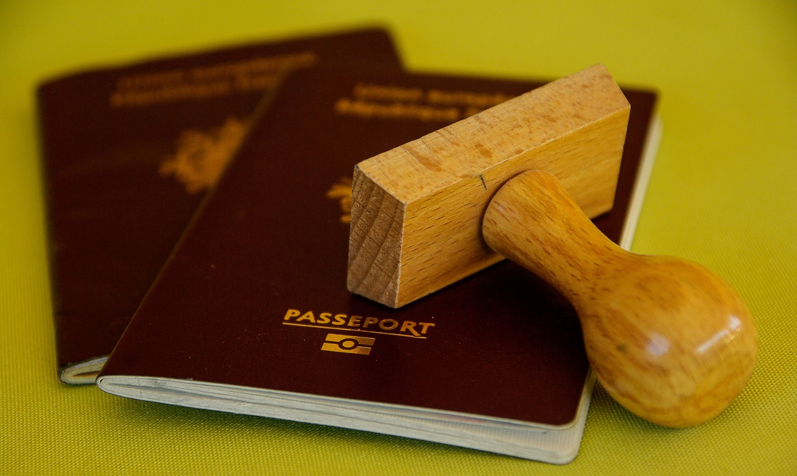
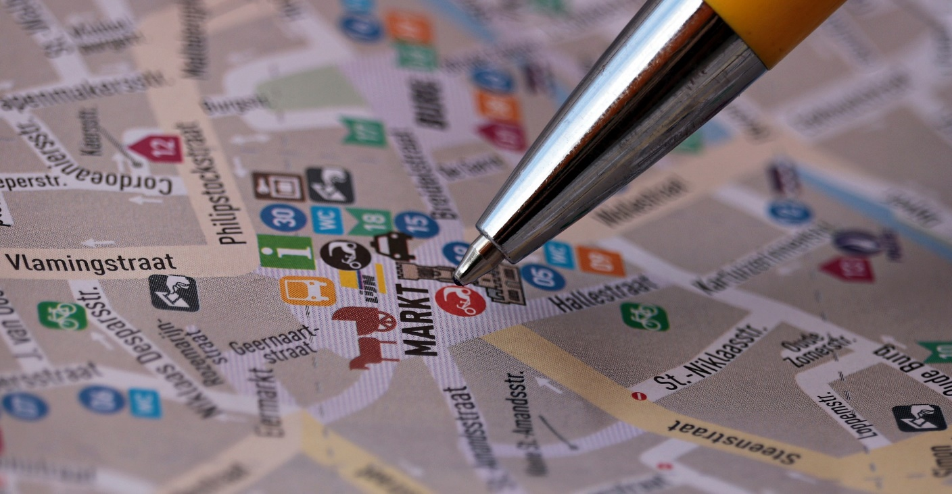
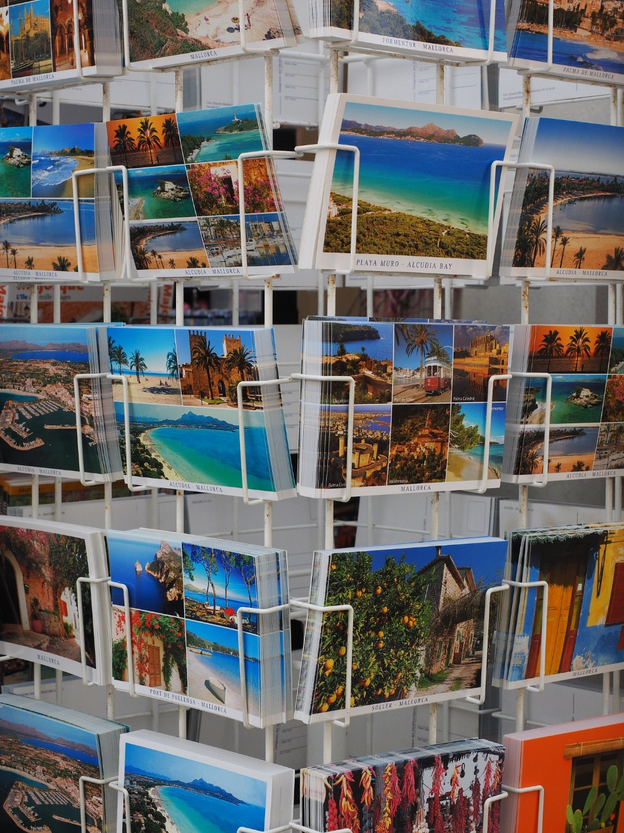
luggage
camera
aeroplane
passport
map
postcards

Slide 4
PLACES

Slide 5
Lesson 1 Objectives
You will:
listen to a text.
answer questions about the text.
discuss where to go, where to stay and what to do when you go on holiday.

Slide 6
Lesson Resources
Questions Worksheet
Answers Handout
Bucket List Worksheet

Slide 7
Where do you go on holiday?
by the beach
on a mountain
in a city
by the lake
in a forest
go skiing
on an island
go camping
go to the desert
go abroad
go on a cruise
on a safari

Slide 8
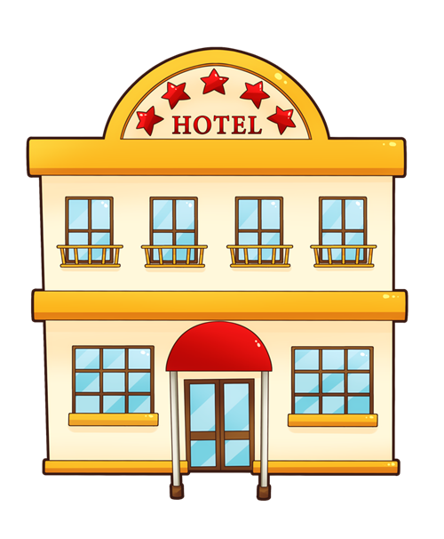
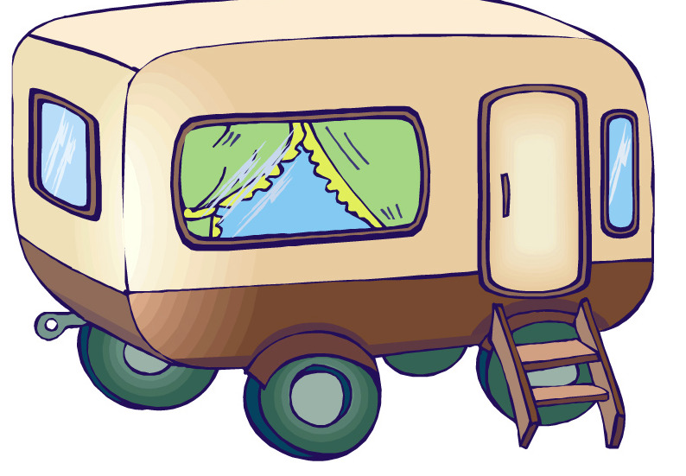
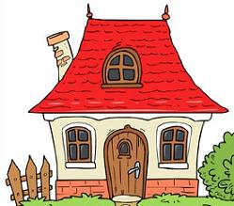
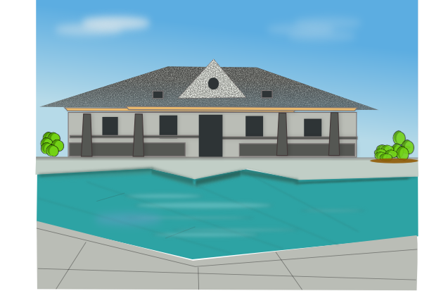
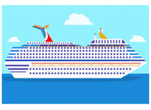
Where do you stay?
hotel
tent
caravan
cottage
flat
farmhouse/villa
cruise ship

Slide 9
What do you do?
go hiking
swimming
sunbathing
take photos
buy souvenirs
go shopping
taste the local food
watch a football game
visit museums
visit places of interest
read a book
practise a new sport
go sightseeing
go to the zoo/aquarium
go to a concert/festival
visit an amusement park

Slide 10
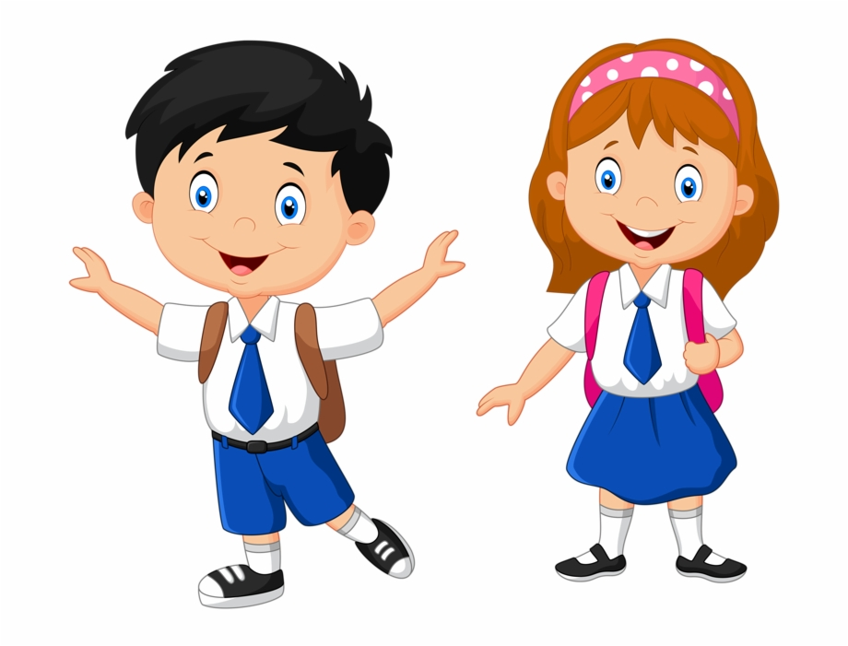
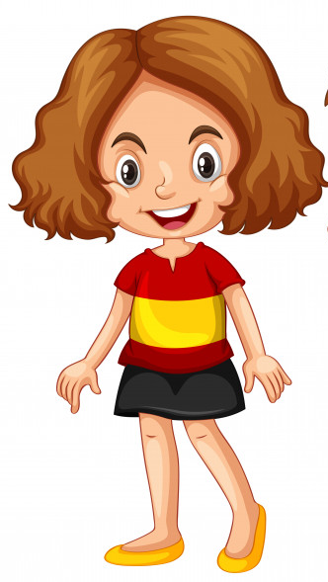
Karen
Chris
Tara

Slide 11
Present Tense
I go to France with my family.
We stay in a tent.
It is used to talk about an action that happens on a regular basis.

Slide 12
Future Tense
We are going to America.
We will go to America.
It is used to talk about an action that is going to happen in the future.
going to + verb
I am going to learn new words.
will + verb
I will learn new words

Slide 13
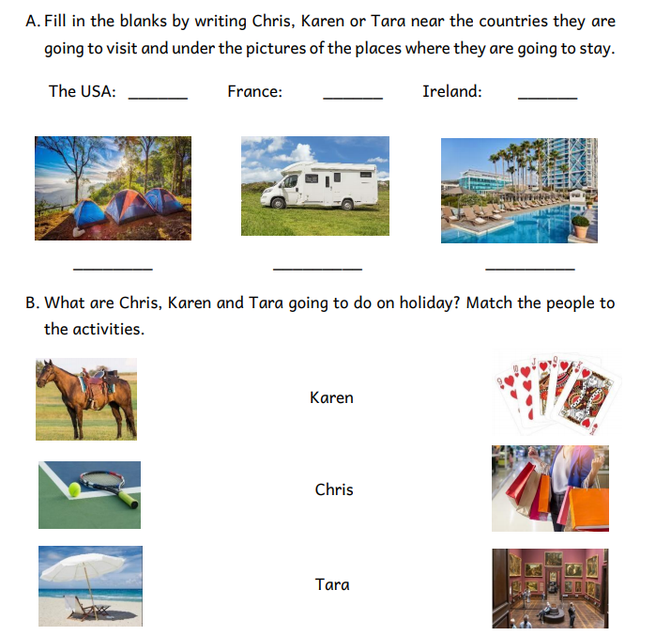
Step 1
READ the questions
on the worksheet.

Slide 14
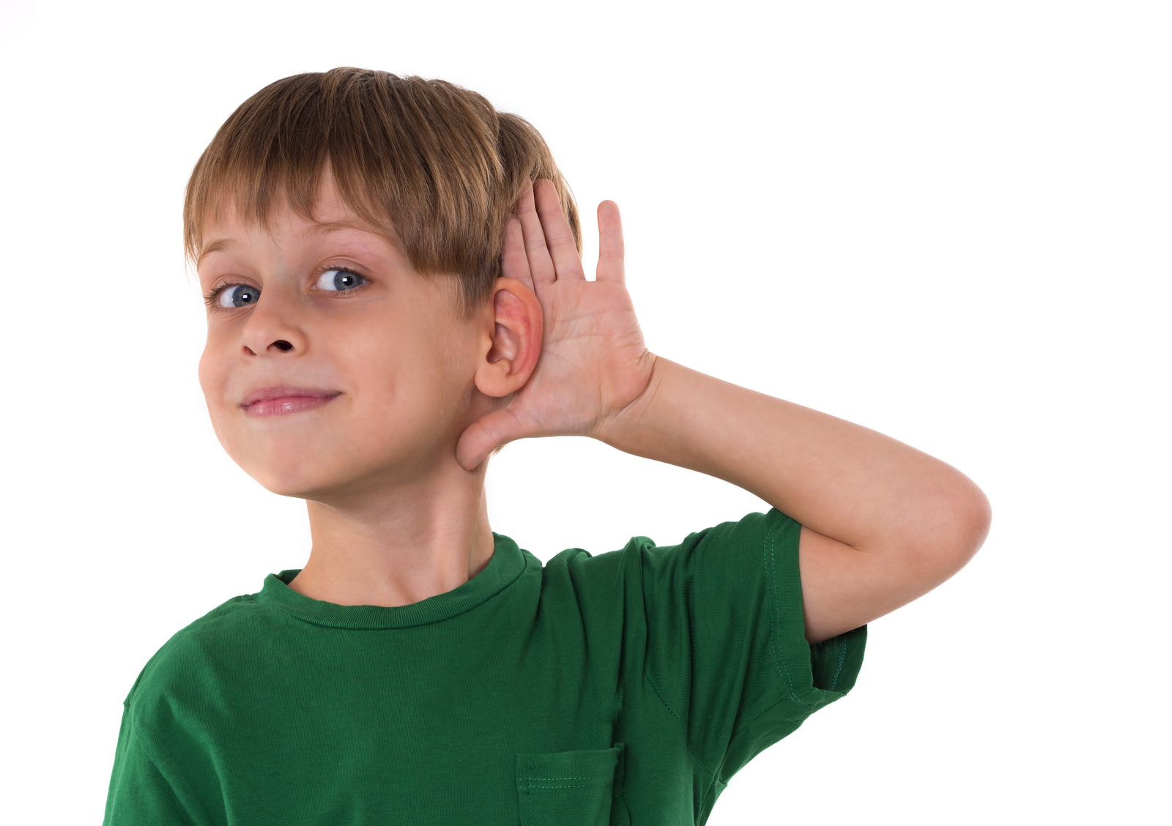
Step 2
LISTEN carefully to the text.
LISTEN carefully while I read the questions.
START ANSWERING the questions.

Slide 15
Step 3
LISTEN to the text for
the second time.
LISTEN while I read the questions again.
Try to ANSWER any unanswered questions.

Slide 16
Step 4

Slide 17
Step 5
CHECK your answers using the
Answers Handout.

Slide 18
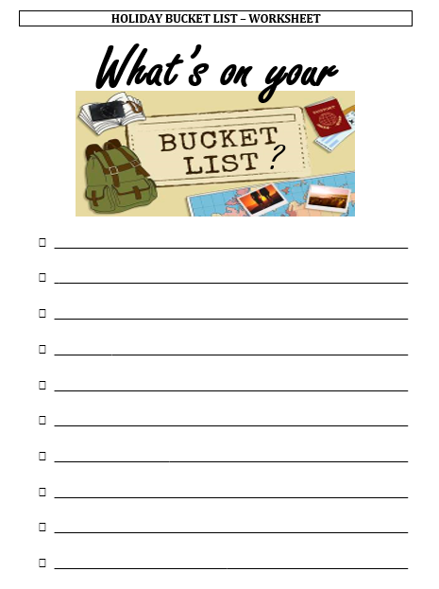
My Holiday Bucket List
What is a BUCKET LIST?
A bucket list consists of a number of experiences or achievements that a person hopes to get done during their lifetime.
e.g. visiting Paris and climbing to the top of the Eiffel Tower

Slide 19
Thank You!

