Slide 1
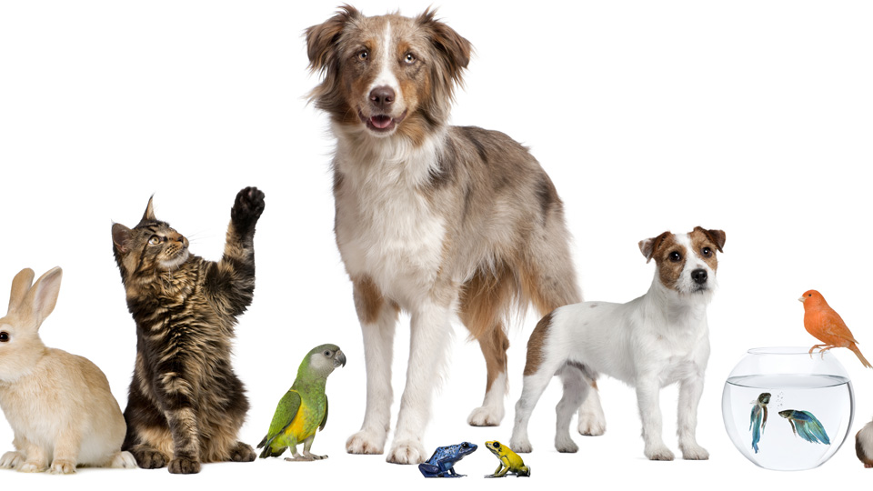
Pets
Lesson 5 - Speaking
Notes:
In this lesson we’re going to practise talking about our pets. Do you know which are the world’s most popular pets? Write down a list of animals which you think are the most popular pets across the world.

Slide 2
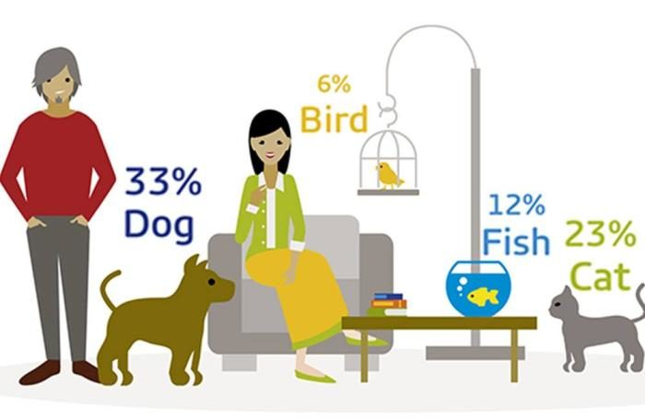
An Infographic
Notes:
According to this infographic the most popular pets are: dogs, cats, birds and fish. Did you make a correct guess? Why do you think most people prefer dogs? I think because dogs are very loyal animals, and they’re friendly too.

Slide 3
I am learning how to describe my pet.
I can talk about my pet’s appearance and what it eats.
I can add more details to describe my pet.
I can self correct some mistakes I make while speaking.

Slide 4
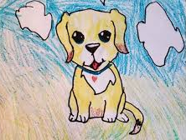
Describe your pet
Speaking Activity
Notes:
In this activity we are going to talk about our pets. We can also think back to how the teenagers we listened to in the Listening Lesson described their pets. Let’s see if we can refresh our memories.

Slide 5
name
appearance
where you keep it, e.g. cage
food
what it enjoys doing
interesting information

Slide 6
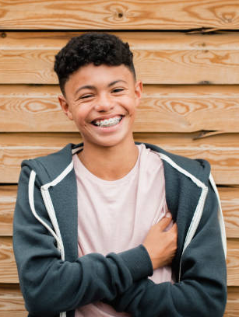
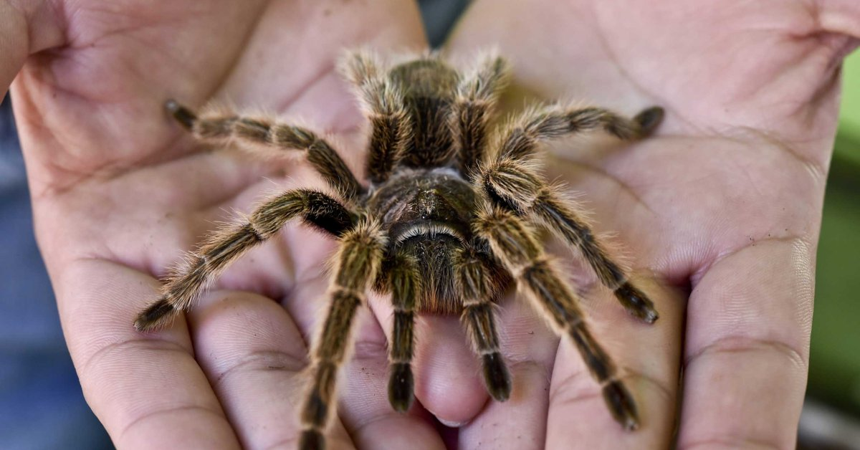
tarantula
Description | unusual, large
Where it comes from | South America
Name | Fang
Feeding habits | 8 times a day live insects bought from the pet shop
Interesting information | poisonous hairs on Fang’s legs, Ben has to be careful when he takes Fang out of his box
Ben

Slide 7
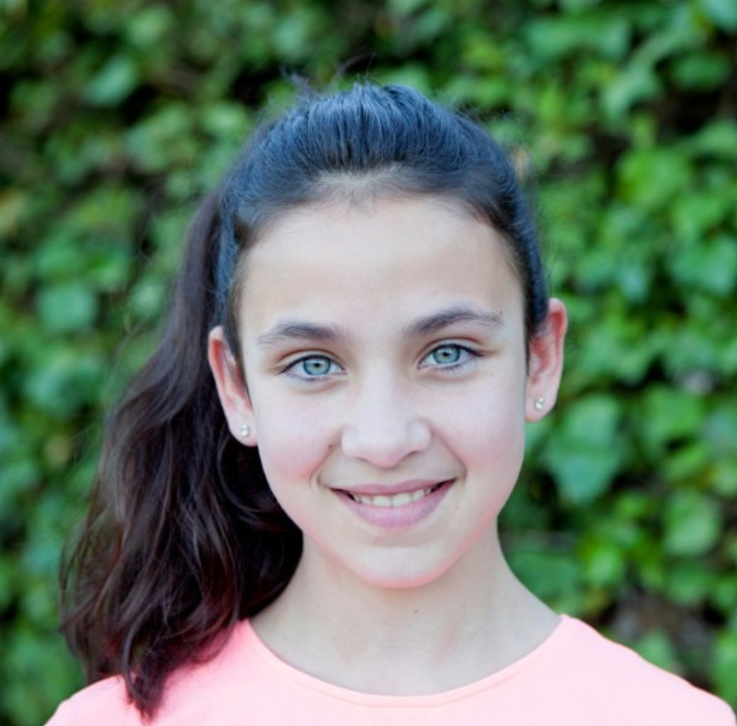
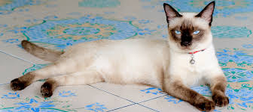
Siamese cat
Description | cream and chocolate brown, blue eyes
Name | Choco
Feeding habits | twice a day loves to eat chicken, fish and tins of cat food
Interesting information | clever, she can open the kitchen door by jumping up and pushing down the handle.
Mandy

Slide 8
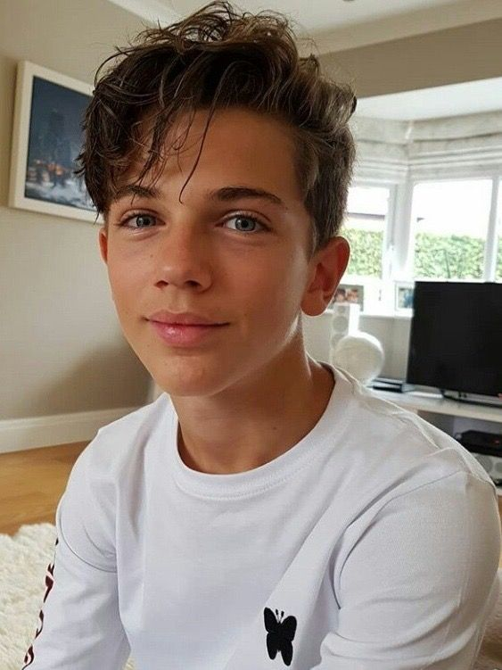
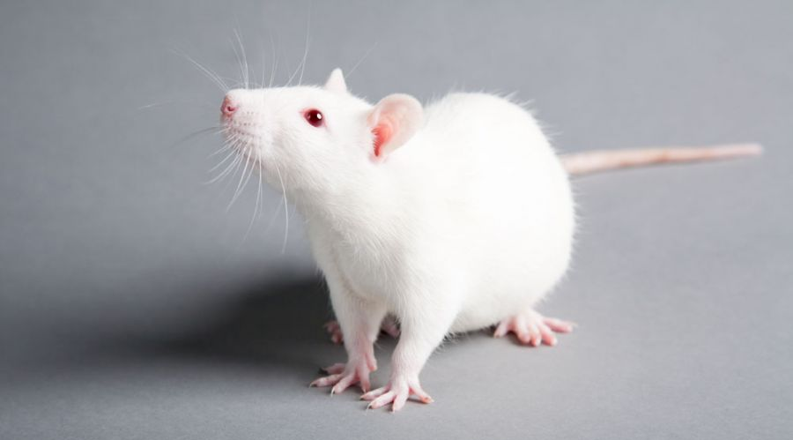
rat
Appearance | white, pink eyes, long pink tail
Name | Rupert
Feeding habits | twice a day seeds and cereal, cheese
Interesting information | lives in a cage loves running around julian’s room
Julian

Slide 9
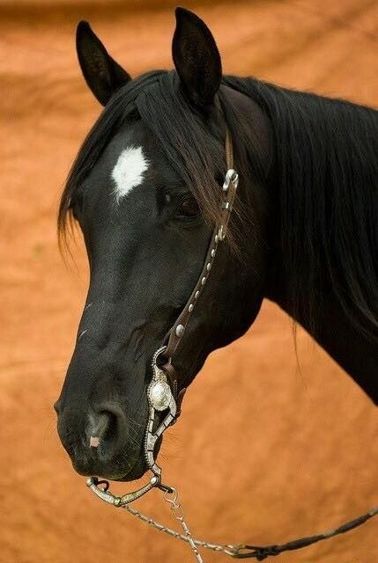
horse
Description | black with white star on her head
Name | Starlight
Feeding habits | once a day oats and grass
Interesting information | brushes her everyday before school rides her for an hour everyday after school
Sylvia

Slide 10
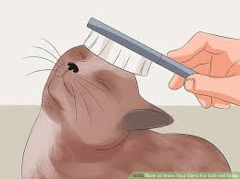
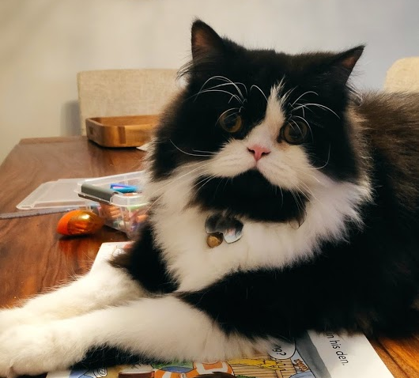
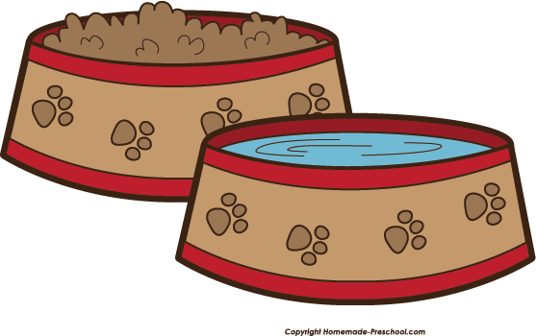
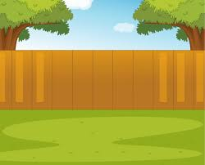
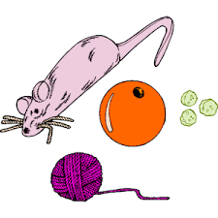
cuddles
brush
Black with white markings around face, white socks; green eyes
litter
dry food and water
cleans himself
toys
backyard
Notes:
So first we need to brainstorm ideas of what our pet needs. This is the way I will be organising my ideas – these will remind me of the important points I need to tell my friend.

Slide 11
Ozzy
black with white markings around face, white socks,
green eyes
long soft fur - Persian
Name
Appearance
Feeding habits
Interesting information
dried cat food twice a day and fresh water
playful, loving, loves being around people; loves playing with toys, brush his long hair
Notes:
Now, I am going to use these ideas to talk about my pet cat. I have a pet cat called Ozzy. He is black with white markings around his face and white socks on his legs. His eyes are green. He is a Persian cat so he his fur is long and soft. He eats dried cat food twice a day and drinks fresh water. Ozzy is playful and he loves being around people. I brush his long fur everyday.

Slide 12
Brainstorm ideas
Notes:
Now it’s your turn to write your email. Learners might use the Graphic Organiser used in Lesson 5 Speaking.

Slide 13
Thank you for using this resource. Check out our latest resources below.

