Slide 1
Lesson 3 Speaking
Year 5
English

Slide 2
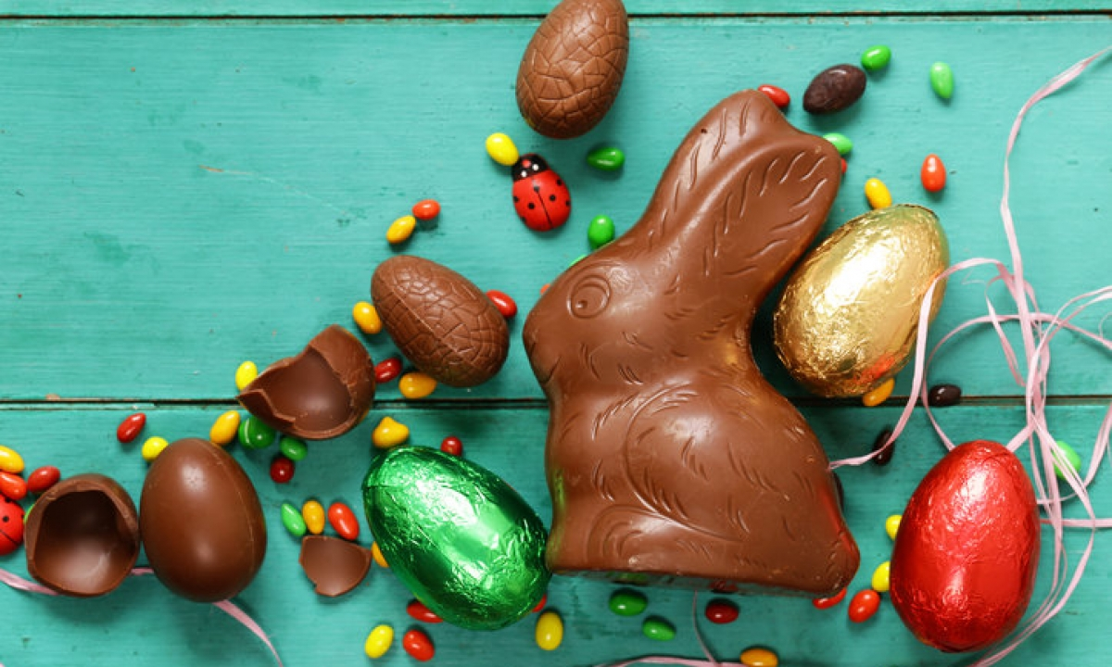
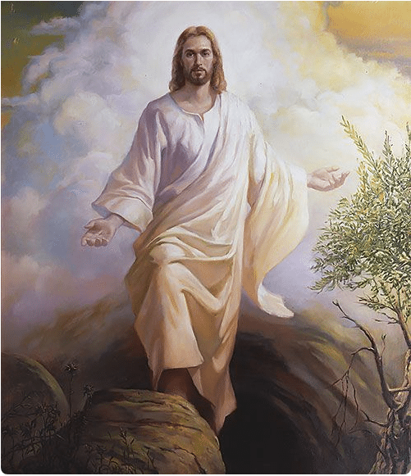
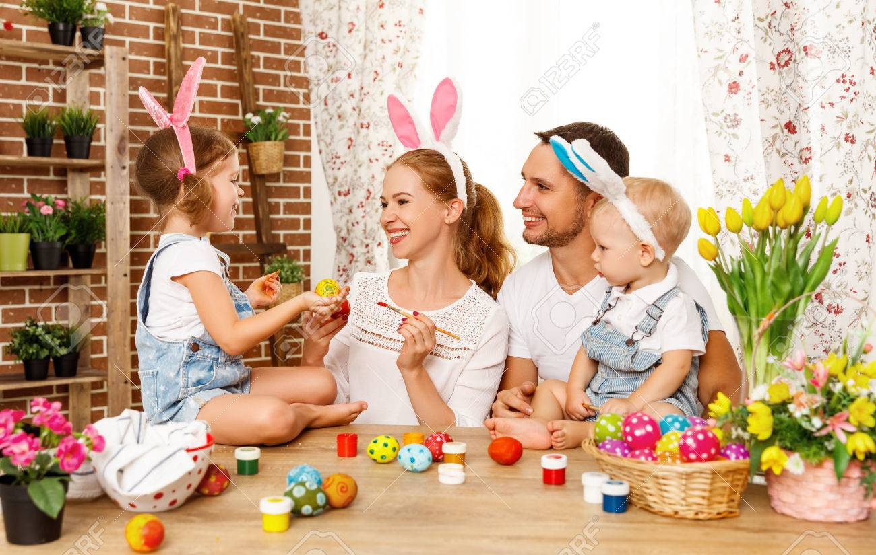
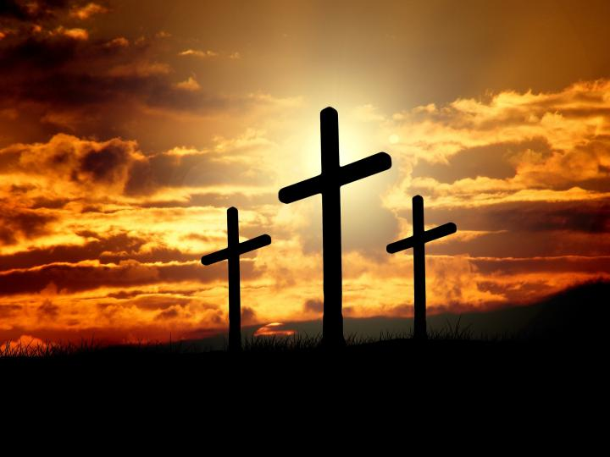
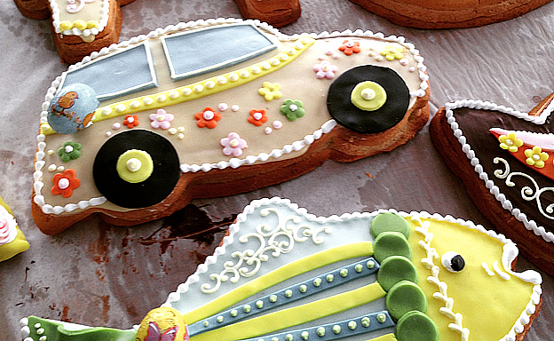
Guess today’s celebration!

Slide 3
Lesson 3 Objectives
You will:
learn information about a celebration.
ask questions to fill in missing information.

Slide 4
Lesson Resources
Worksheet A
Worksheet B
Answers Handout

Slide 5
Australia
In Australia, the Easter bilby is an alternative to the Easter bunny.
Chocolate bilbies are eaten instead of chocolate rabbits.
Rabbits are considered pests in Australia.

Slide 6
Poland
On Easter Monday, boys roam around the streets and sprinkle girls with water or perfume.
Baskets of food are taken to church to be blessed.
On Easter Sunday, people eat eggs and cakes in the shape of a lamb. The lamb symbolises Christ.
They also have painted Easter eggs called pisanki that are handcrafted and painted with traditional symbols of spring.

Slide 7
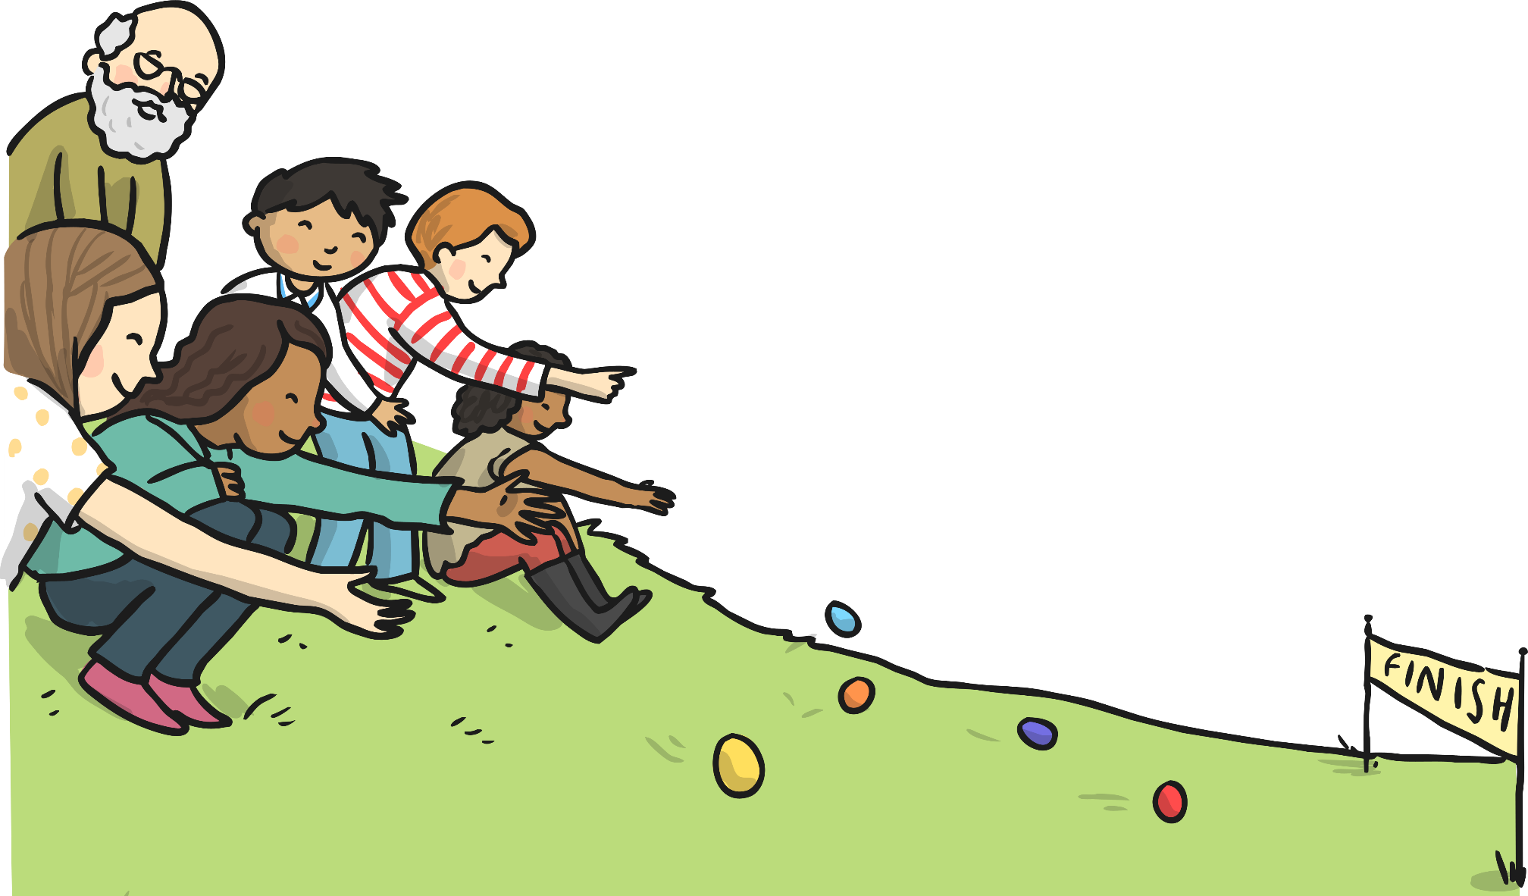
Scotland
In Scotland, they have egg rolling competitions. Eggs are boiled and then painted.
Children then roll eggs down grassy hills.
Whoever’s egg rolls the farthest wins.
The rolling of the egg symbolises the rolling away of the stone from Jesus’ tomb.

Slide 8
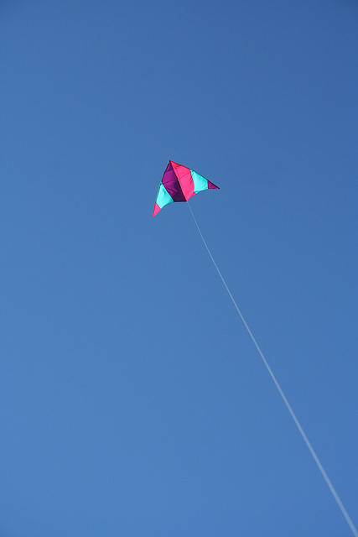
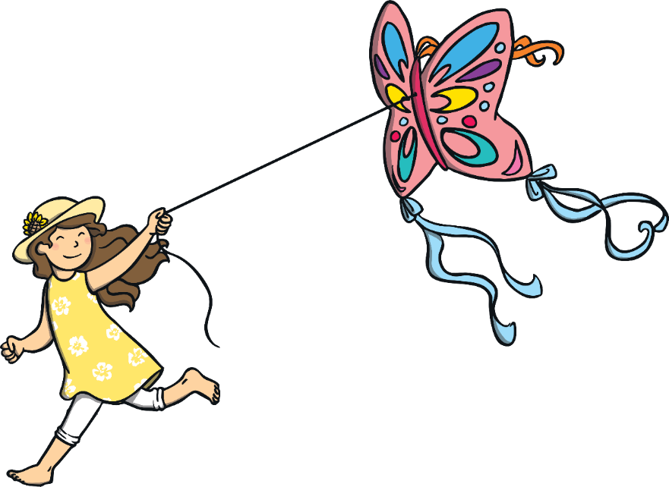
Bermuda
People fly kites to symbolise the rising of Christ.

Slide 9
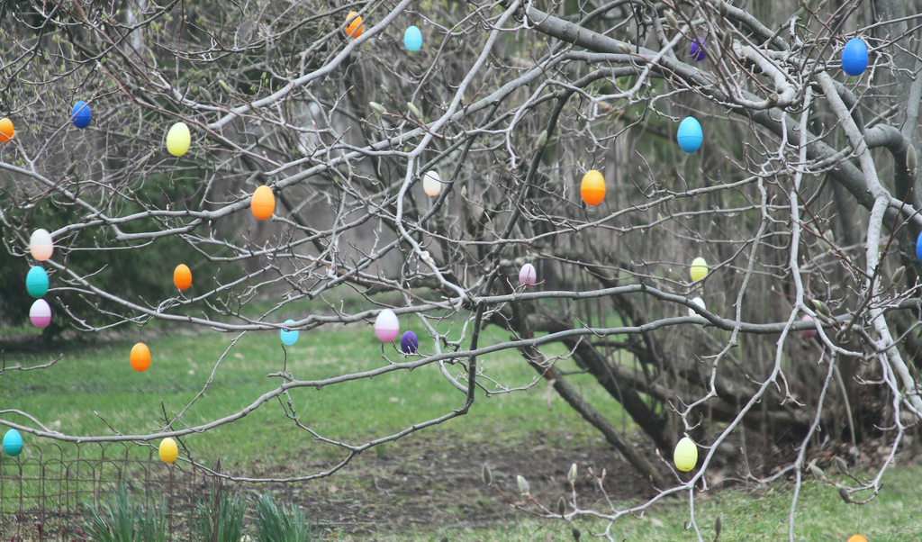
Germany
In Germany, they have Easter egg trees called ostereierbaum. Decorated eggs are hung from the branches of the tree.

Slide 10
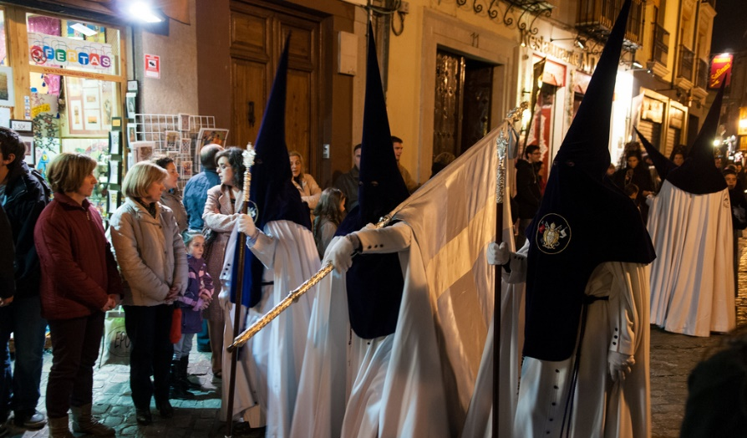
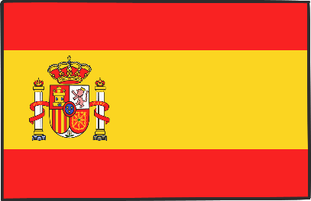
Spain
Children bring palm leaves to church on Palm Sunday. Girls decorate their branches with tinsel and sweets.
On Ash Wednesday, a cross of ash is put onto people’s foreheads to say sorry to God for the bad things they have done.
Spain also has processions with floats illustrating the Easter story and marching bands. The parades are followed by cloaked people seeking forgiveness from God.

Slide 11
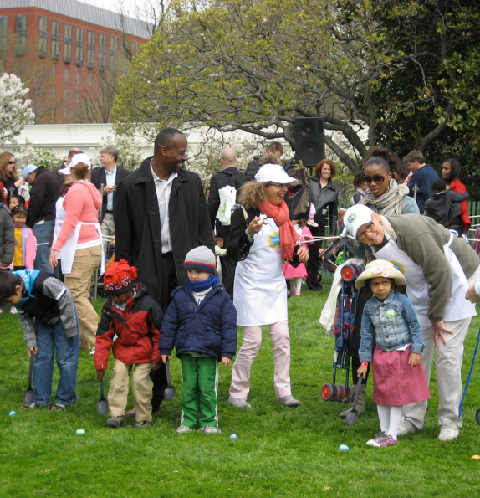
USA
At the White House in Washington DC, there is an Easter egg rolling event held every year.
Children push decorated eggs through the grass with long handled spoons.
In recent years celebrities have turned up to entertain the rollers!

Slide 12
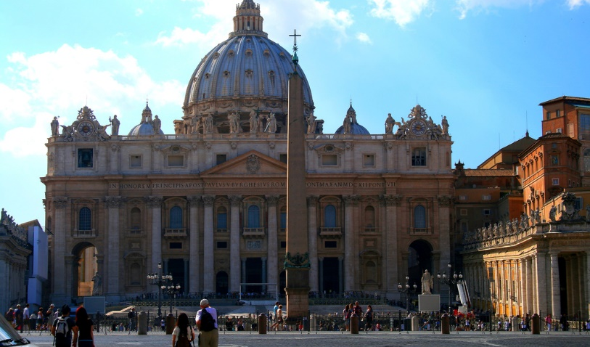
Italy
In Rome, the Pope washes the feet of a dozen men at a re-enactment of the Last Supper on Maundy Thursday.
On Good Friday, many people gather at Saint Peter’s Basilica to listen to the Pope’s mass at 3pm.
The Pope has a candle-lit walk to remember Christ. Italian people normally eat roasted lamb and a traditional cake shaped like a dove called “colomba”.

Slide 13
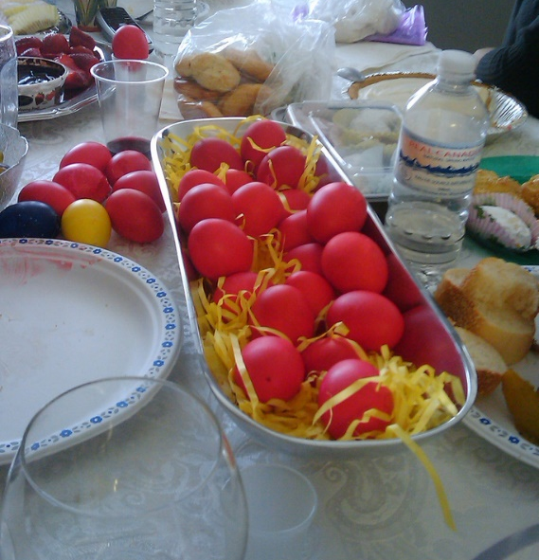
Greece
Easter festival begins before Easter.
On Maundy Thursday, Easter bread is baked and eggs are dyed red symbolising the blood of Christ.
On Holy Saturday, people attend midnight mass where they all bring a candle to light from the churches' Holy Flame.
Easter Sunday is spent with friends and family for a meal of roast lamb.

Slide 14
Speaking Task
Give Worksheet A to your friend/relative.
Individually, read the text.
Individually, identify what kind of information is missing.
Write down questions to find out the missing information.
5. Then ask each other questions in order to complete your text.

Slide 15
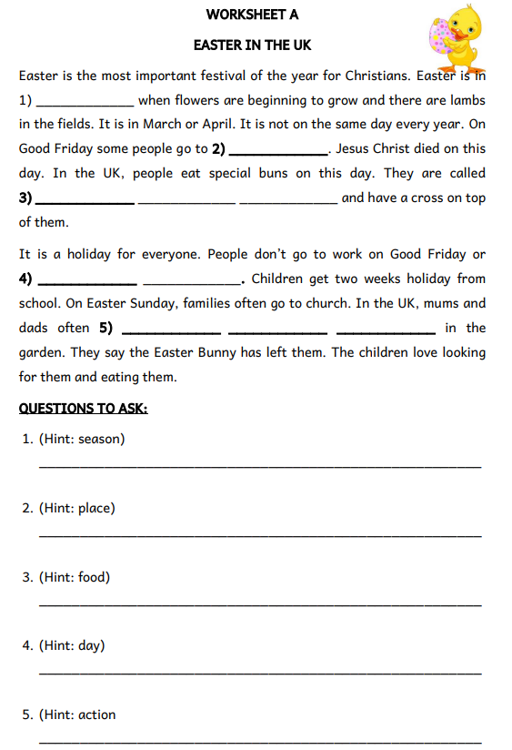
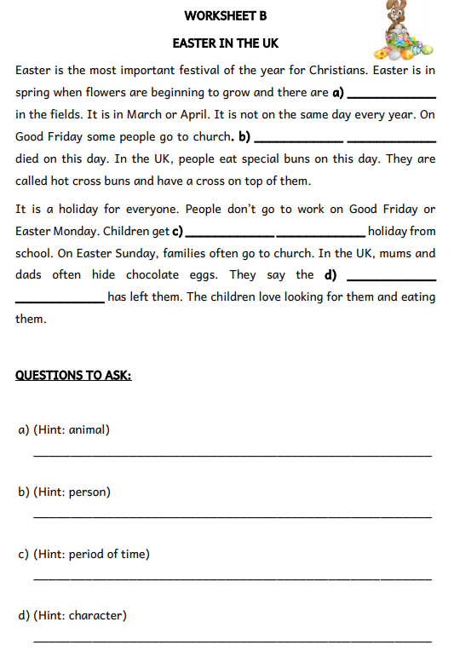

Slide 16
Final steps:
1. COMPARE your worksheets.
2. CHECK your answers using
the Answers Handout.

Slide 17
Thank You!

