Slide 1
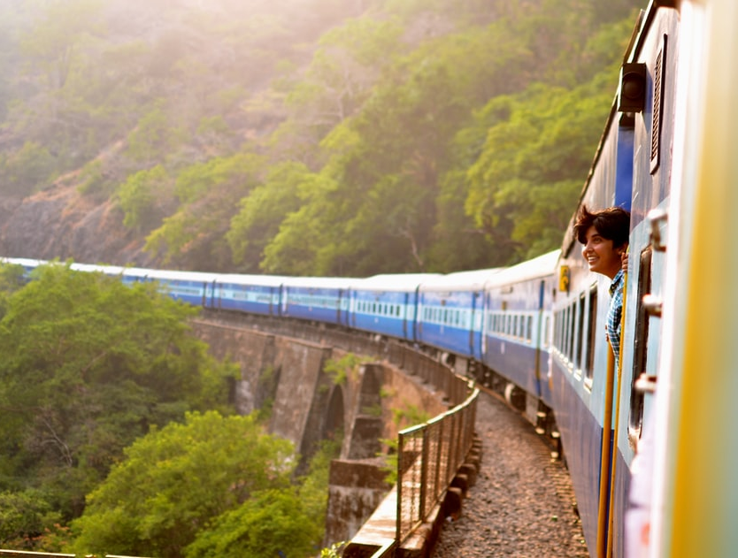
Lesson 1: Listening Topic: Travel Year: 4

Slide 2
Lesson Objectives:
In this lesson I will:
listen attentively to a text.
answer questions about a text.
learn about trains.

Slide 3
Download these resources:
Questions Worksheet
Answers Handout

Slide 4
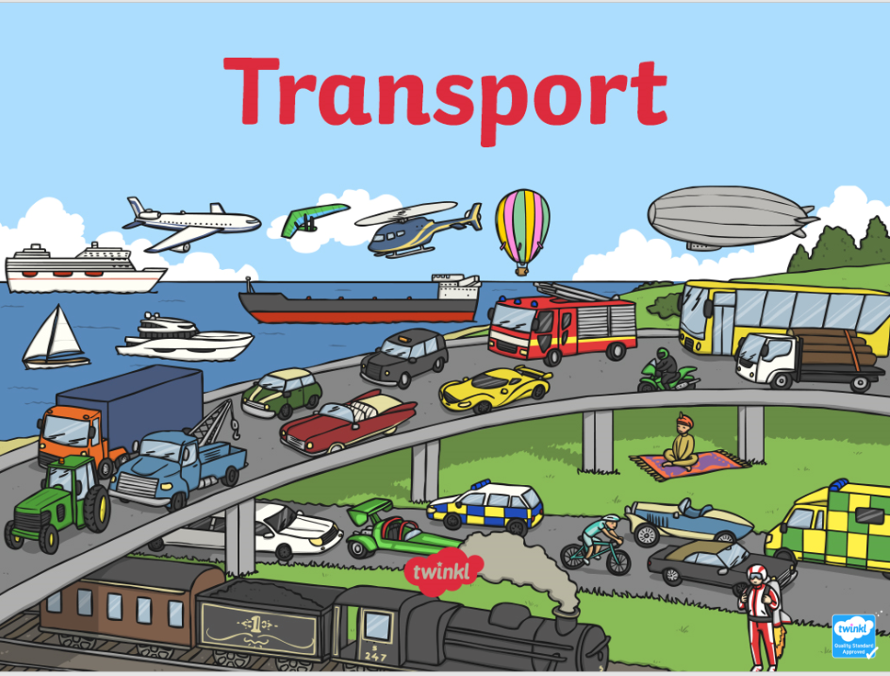
Pre-Listening Task:
How do we travel?

Slide 5
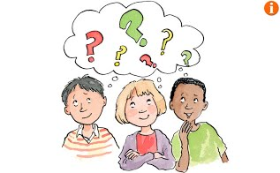
Listen to the song.. Then answer this question: What is the song about?

Slide 7
What is the song about?
The song is about different types of transport which we use to travel from one place to another.
List ten means of transport mentioned in the song.

Slide 8
These are the means of transport mentioned in the song.
car
truck
train
bus
motor scooter
bike
unicycle
plane
submarine
helicopter
taxi
rocket ship

Slide 9
What do you know about trains?

Slide 10
Train facts:
A train is a series of connected vehicles that travel along railroad tracks.
Trains are powered by a locomotive, also known as an engine.
A locomotive engine can be powered by steam, diesel or electricity.
Before diesel and electric trains, steam powered trains were popular.

Slide 11
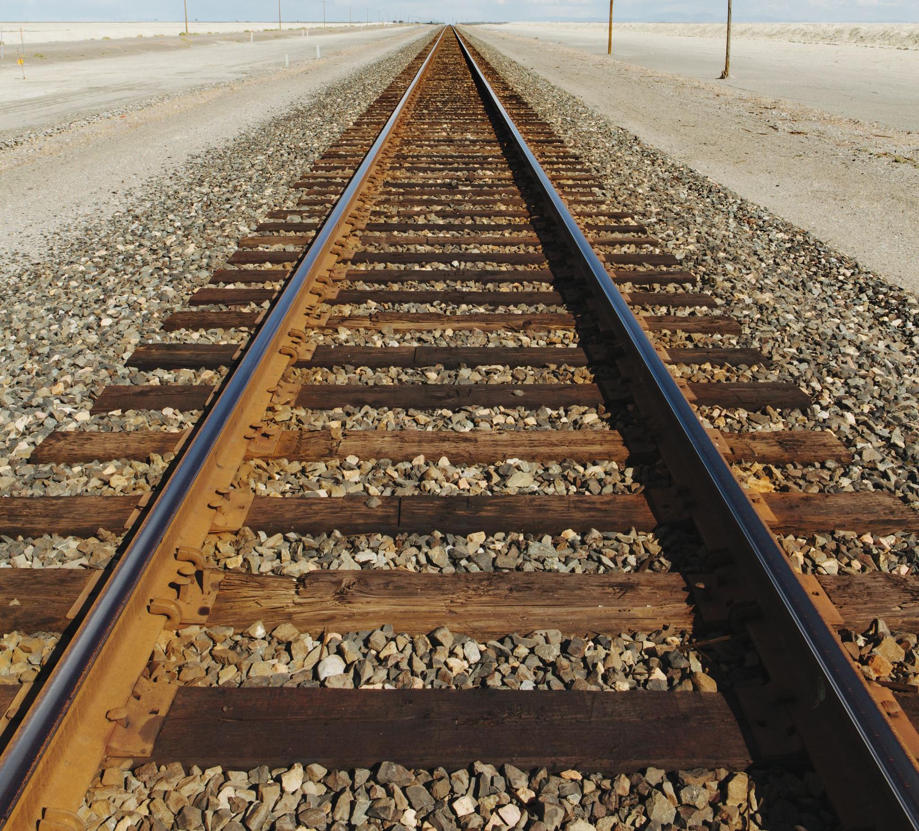
Before diesel and electric trains, steam powered trains were popular.
Modern trains either use diesel or electricity, but steam powered trains still exist for recreational purposes.
A train can be used to transport people and cargo over a short or long distance.
There are two common types of trains, a passenger train and a freight train.
A passenger train is used to transport people to and from different locations.
A freight train is used to transport cargo to and from different locations.

Slide 12
Listening Text 1

Slide 13
Pre-Teaching of Words: travellers - people who travel a trip - a journey Welsh - a person from Wales

Slide 14
Step 1: READ silently the questions on the worksheet.

Slide 15
Step 2:
LISTEN carefully to the text.
LISTEN carefully, while I read the questions.
START ANSWERING the questions.

Slide 16
Step 3:
LISTEN to the text for the second time.
LISTEN while I read the questions again.
Try to ANSWER any unanswered questions.

Slide 17
LISTENING TEXT 2

Slide 18
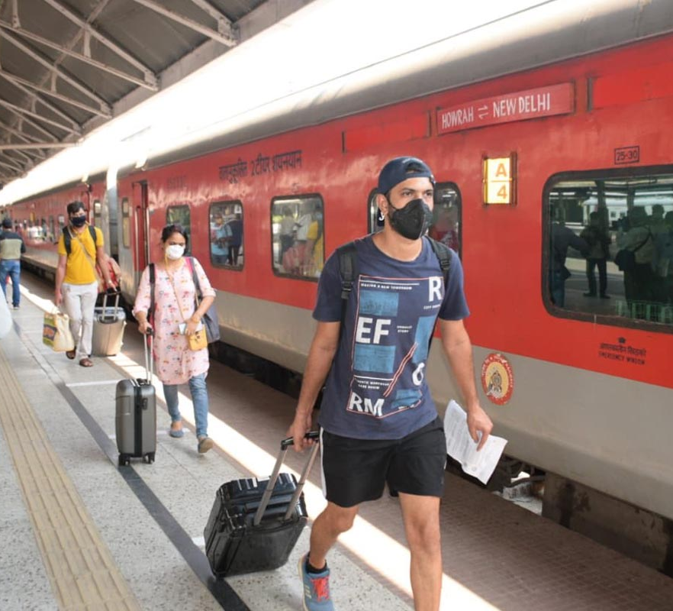
Pre-Teaching of Words: platform an area alongside a railway track delayed postponed passenger someone riding on or in a vehicle

Slide 19
Step 1: READ silently the questions on the worksheet.

Slide 20
Step 2:
LISTEN carefully to the text.
LISTEN carefully, while I read the questions.
START ANSWERING the questions.

Slide 21
Step 3:
LISTEN to the text for the second time.
LISTEN while I read the questions again.
Try to ANSWER any unanswered questions.

Slide 22
Step 4:
Revise the answers.

Slide 23
Step 5:
CHECK your answers using the answers handout.

Slide 24
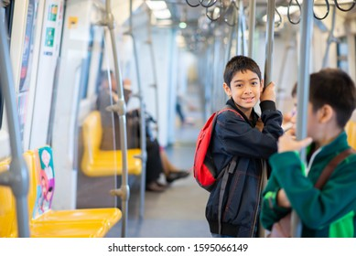
Post-Listening Task:
Role play: Imagine your relative/friend is at the train station waiting for his/her train. Interview him/her. Use these questions from the recording:
Where are you going?
Why are you going there?
What time is your train leaving?

Slide 25
Sentence Starters
You: Hello ... How are you?
Relative/Friend: Hello … I’m … What about you?
You: I’m … What are you doing here?
Relative/Friend: I’m waiting for the train.
You: Where are you going?
Relative/Friend: I am going to …
You: Why are you going there?
Relative/Friend: I am going there to …
You: What time is your train leaving?
Relative/Friend: It will depart in … minutes./ at ... .
You: How long is your journey?
Relative/Friend: It is … long.
You: That’s a long/short trip. Have a safe trip!
Relative/Friend: Thank you.

