Slide 1
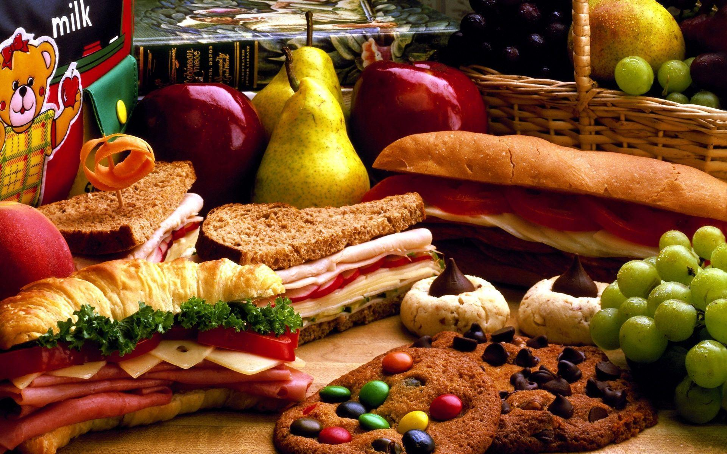
Let’s eat!

Slide 2
Notes for the Educator
This lesson is pegged directly to Learning Outcome LS 5.2 I can understand audio-visual texts across a range of genres, identifying the main idea and specific information.
It also targets other language outcomes such as: LS 5.8 I can communicate my own experiences, likes and dislikes fluently and accurately with some allowance to self-correct in the process.
The audio-visual can be accessed via: https://www.youtube.com/watch?v=PN_4IpCgVIQ&t=13s. For the purpose of this lesson, the clip should be stopped at 1:43.
Teachers are to refer to the Scheme of Work where each lesson is explained in more detail.
Effects are included to make the presentation more interactive. Please present the PowerPoint in Slideshow mode.
Wherever possible we have included the use of online apps to enhance the teaching and learning experience.
The Notes section underneath the slides may contain some further points which can be developed during the lesson.
Teachers are encouraged to adapt this PowerPoint presentation to meet the learners’ language needs.
Tasks included in the PowerPoint presentation are also being shared as worksheets.
For any comments, feedback or suggestions please email us at: marie-claire.camilleri@ilearn.edu.mt; urieth.attard@ilearn.edu.mt; mary.jude.camilleri@ilearn.edu.mt. You may also call the office on: 25983683.

Slide 3
Listen to Kim sharing a recipe for cookies.
Read and respond to a recipe.
Read a playscript about a boy who climbed a magic beanstalk.
Describe different foods and explain how to prepare our own favourite recipe.
Write a recipe for a dish we really enjoy.

Slide 4
You have 15 seconds to look at a picture showing different foods. When the time is up, write down as many foods as you can remember.

Slide 5
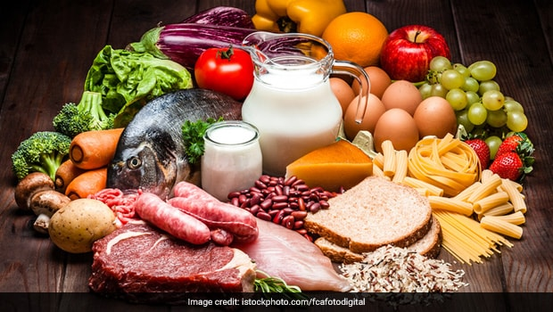
Notes:
Which of these foods do you like to eat?
Are all these foods healthy?
Which is your favourite recipe?
Have you ever cooked anything? What?
Do you often help in the kitchen? How?

Slide 6
grapes

Slide 7
bread

Slide 8
beans

Slide 9
sausages

Slide 10
chicken

Slide 11
potato

Slide 12
milk

Slide 13
meat

Slide 14
broccoli

Slide 15
carrots

Slide 16
mushrooms

Slide 17
tomato

Slide 18
cream

Slide 19
cheese

Slide 20
eggs

Slide 21
rice

Slide 22
fish

Slide 23
lettuce

Slide 24
pasta

Slide 25
apple

Slide 26
orange

Slide 27
strawberries

Slide 28
yellow pepper

Slide 29
tomato

Slide 30
aubergine

Slide 31
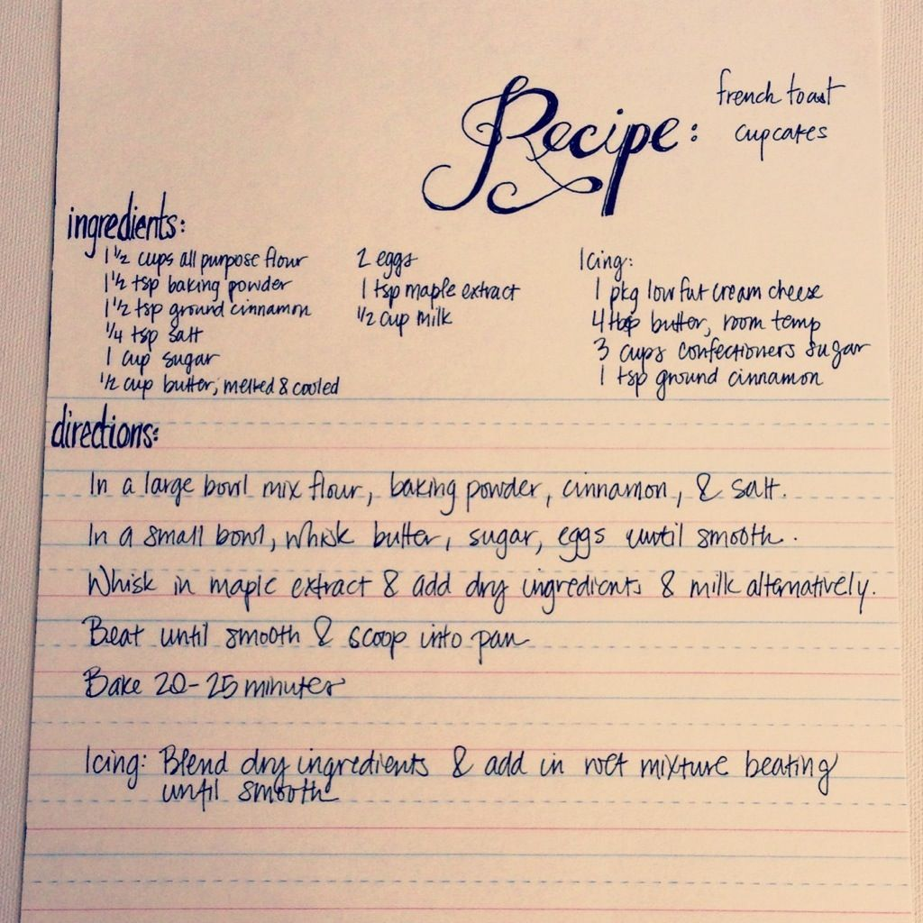
recipe
Notes:
Ask: Where do we find recipes? When do we use a recipe? Who writes recipes? This is what a recipe usually looks like. There’s the name of the dish, the ingredients and the directions or the method, which is a step by step guide for how to prepare the dish.

Slide 32
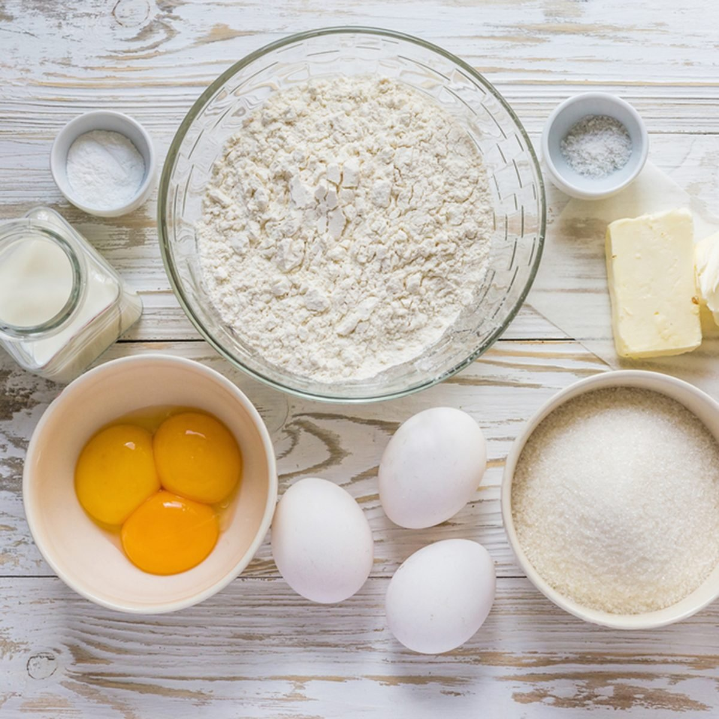
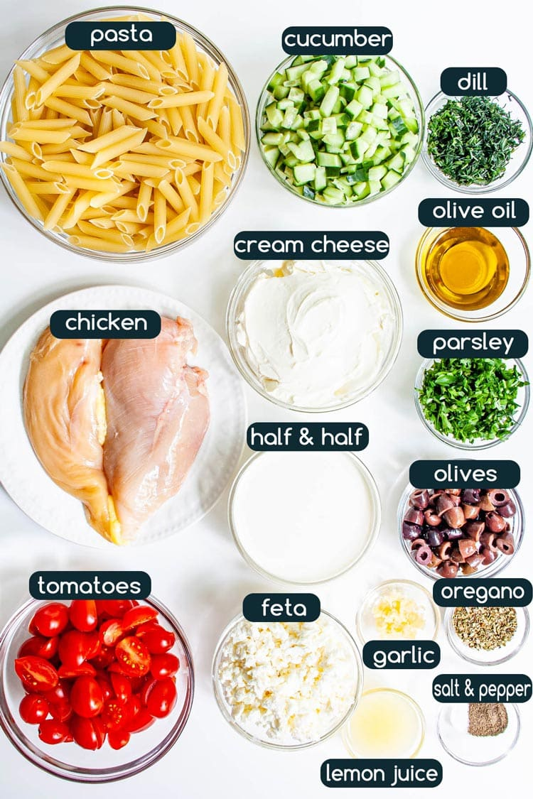
ingredients
Notes:
This is a long word. We can break it apart into smaller chunks. Do you know what this word means?

Slide 33
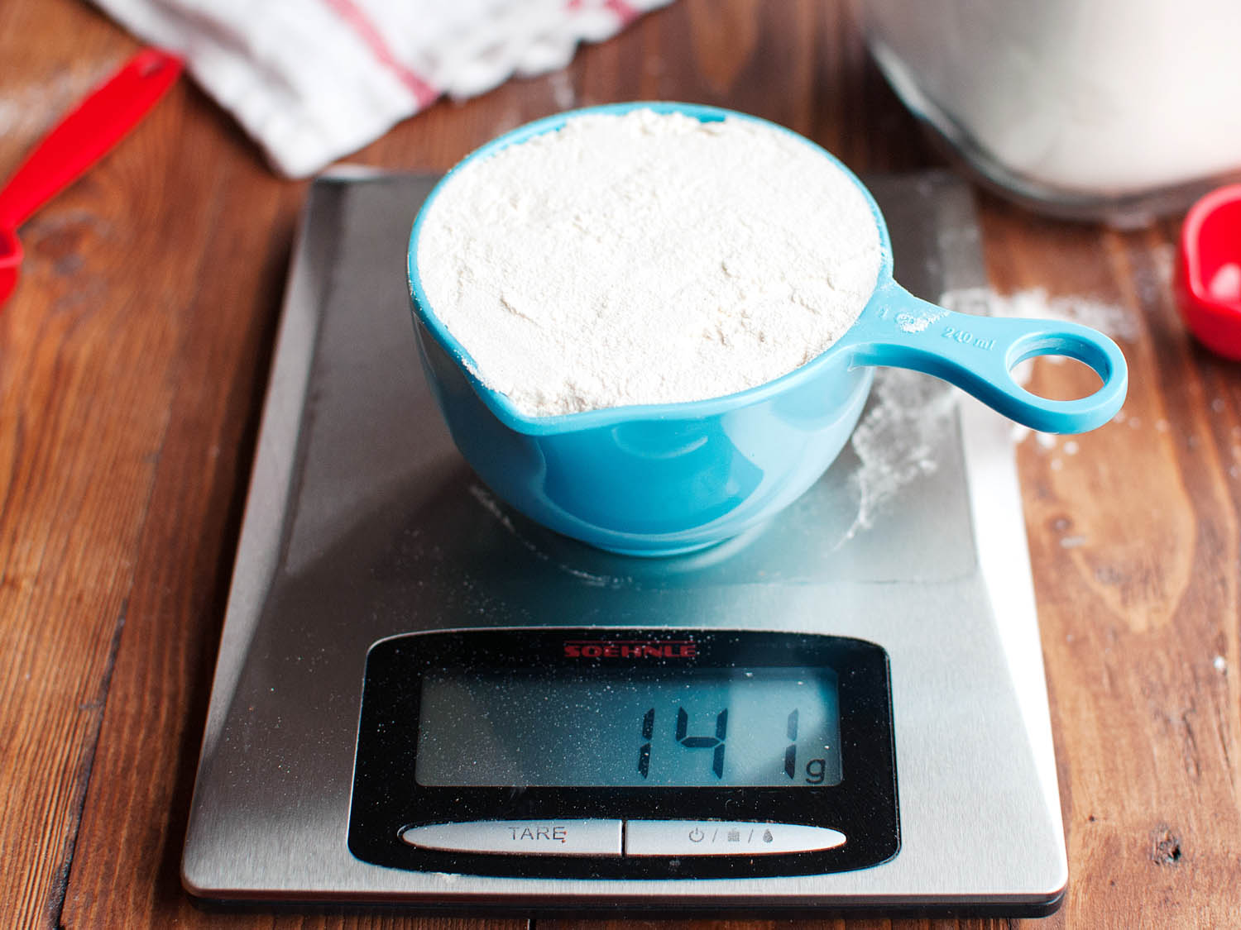
ounces
Notes:
Ounces are a unit of measurement. Nowadays we use grams or millilitres more than ounces.

Slide 34
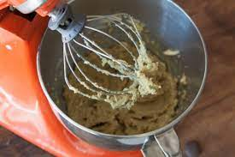
blend

Slide 35
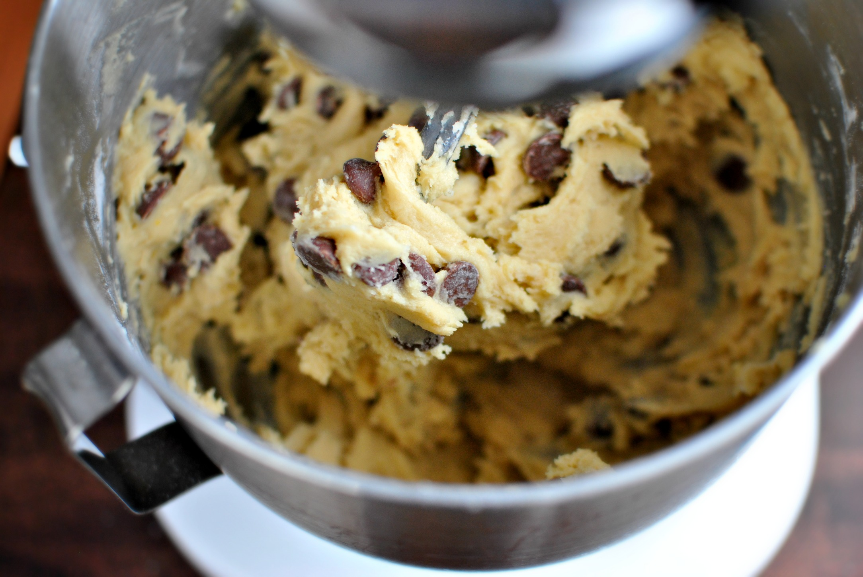
mixture
Notes:
Can you spot the small word in this big word?

Slide 36
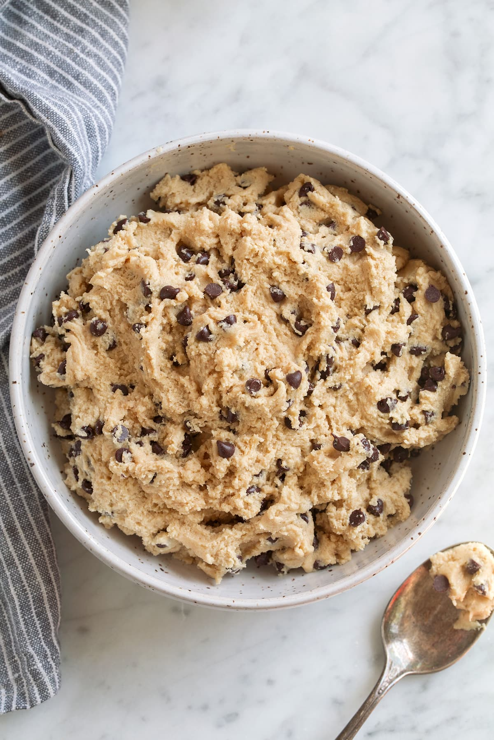
cookie dough

Slide 37
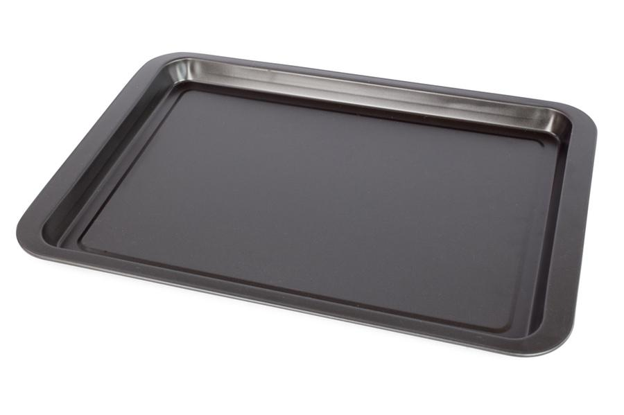
baking tray

Slide 38
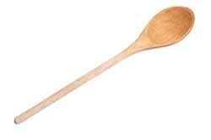
wooden spoon

Slide 39
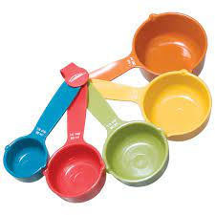
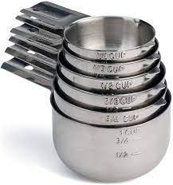
cups
Notes:
These are measuring cups that are used for cooking purposes to measure amounts.

Slide 40
I am learning how to listen and respond to an audio-visual text.
I can understand what the main idea is.
I can listen to specific details and keywords.
I am able to complete the tasks.

Slide 41
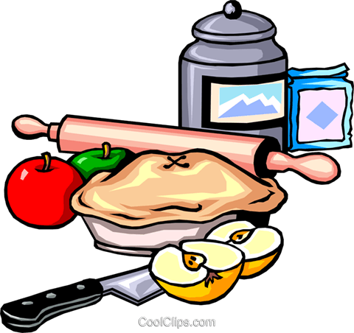
1st Listening Task:
Listen carefully to the ingredients.

Slide 42
Task 1
Task 2
Task 3

Slide 43
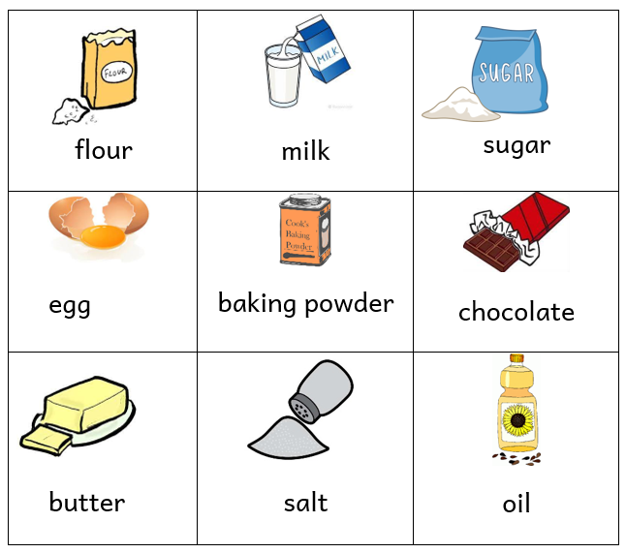
Task 1. Which of these ingredients do you need ?
Notes:
Right! Now, let’s answer some questions about the listening text. If you have the worksheet in front of you, you can do Task 1 on the handout. We need to circle 5 ingredients mentioned in the recipe..

Slide 44
2nd Listening Task:
Listen carefully to the amounts needed for each ingredient .
Notes:
Click the play button.

Slide 45
Task 2. How much of each ingredient do you need?
3
____ cups flour
1 ½ teaspoon baking powder
_____ ounces butter
1 ½ _________ sugar
_______ egg
8
cups
1
Notes:
Right. Let’s see how much of each ingredient we need.

Slide 46
3rd Listening Task:
Listen carefully to the order of the recipe.

Slide 47
Task 3. Put the recipe in order.
3
Next, add the egg and blend in the mixture from the first bowl.
5
Allow the cookies to cool for a few minutes but don’t eat them all at once.
4
Finally, use a wooden spoon to put balls of cookie dough onto the baking tray and bake in the oven for 10 minutes.
1
First, mix the flour and the baking powder in a bowl.
2
Then, in another bowl mix the sugar and butter.
Notes:
Right, let’s see which instruction comes first. What do I do after? What happens next? And then.

Slide 48
Task 3. Put the recipe in order.
1
First, mix the flour and the baking powder in a bowl.
2
Then, in another bowl mix the sugar and butter.
3
Next, add the egg and blend in the mixture from the first bowl.
4
Finally, use a wooden spoon to put balls of cookie dough onto the baking tray and bake in the oven for 10 minutes.
5
Allow the cookies to cool for a few minutes but don’t eat them all at once.
Notes:
Let’s read the whole recipe in order to see if it makes sense.

Slide 49
Task 4: Are these sentences True or False?
 |  | True | False
1. | This is a recipe for a chocolate cake.
2. | For this recipe you need five ingredients.
3. | In this recipe you can mix everything in the same bowl.
4. | You use the wooden spoon to put balls of cookie dough onto the baking sheet.
5. | You can eat the cookies immediately after you take them out of the oven.
Notes:
In the final activity, we are going to see whether each sentence is True or False, we can do this together.

Slide 50
Thank you for using this resource. Check out our latest resources below.

