Slide 1
Lesson 5 Speaking
Year 5
English

Slide 2
Compare and Contrast

Slide 3
Lesson 5 Objectives
You will:
learn the difference between a shopping mall and a market.
answer questions to compare and contrast the shopping mall and the market.

Slide 4
Lesson Resources
Picture Prompts

Slide 5
What is a market?
A market is organised outside. It is held on a specific day of the week.
A market does not have permanent shops and the products are non-branded.
Usually, a market is located along streets and close to town centers.

Slide 6
What is a shopping mall?
A shopping mall is a huge shopping complex, which houses a number of shops and restaurants.

Slide 7
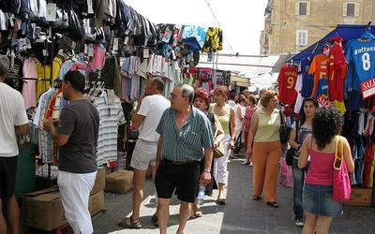

Slide 8
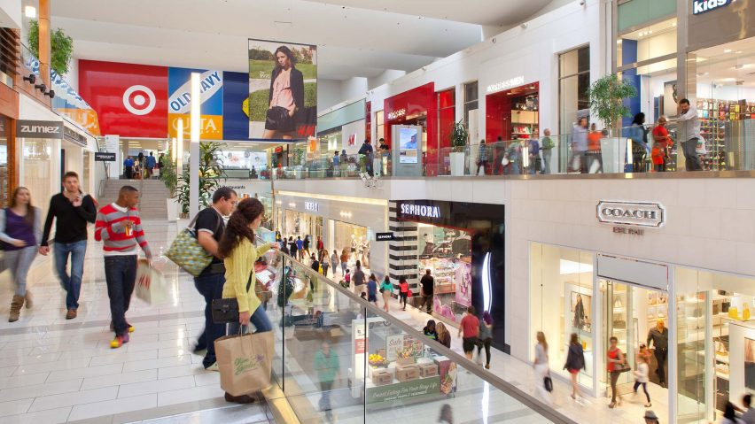

Slide 9
Which of these two places do you like most?
Have you ever been to a market?
What did you buy?
Have you ever been to a shopping mall?
What can you buy from a shopping mall?
How are they different?
How are these two pictures alike?

Slide 10
Role-Play

Slide 11
Lesson 5 Objectives
You will:
plan and participate in a role-play.

Slide 12
Lesson Resources
Role-Play Handout

Slide 13
Watch the video clip!

Slide 14
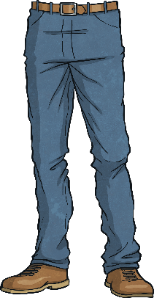
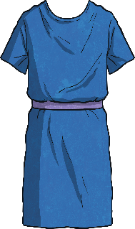
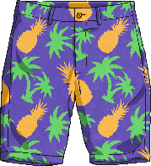
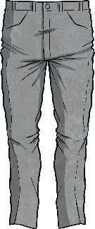
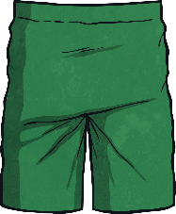
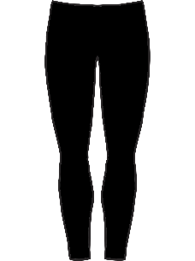
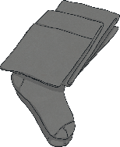
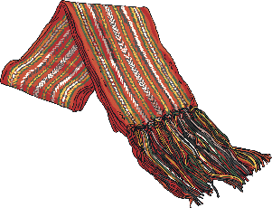
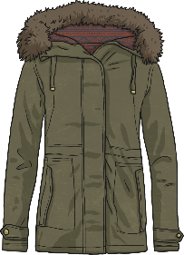
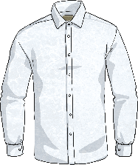
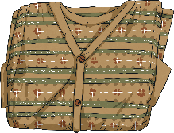
cap
T-shirt
swimming trunks
jeans
swimming costume
skirt
dress
shorts
jumper
trousers
socks
tights
scarf
leggings
shoes
hoodie
boots
coat
shirt
cardigan
hat

Slide 15
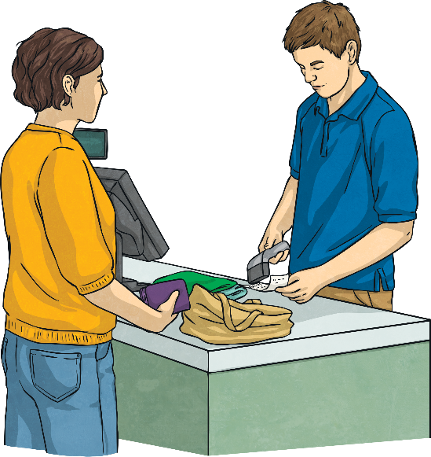
Key Phrases Role Play
Sales Assistant = SA SA: Hello, how can I help you? C: I’m looking for a T-shirt. SA: How about this one? C: Do you have it in yellow? SA: What size would you like? C: Medium. SA: Let me have a look… here it is! C: Great. How much is it? SA: It’s €15.99. C: And can I try it on? SA: Of course. The dressing rooms are over there. C: Thanks.
C: Can I pay by card? SA: Yes, you can. That’s €15.99 in total. C: Thanks! SA: Come again soon!

Slide 16
Greeting
SA: Hello/Good morning/Good afternoon/, how can I help you/how may I assist you?
C: Excuse me! Can you help me?
C: I’m looking for a T-shirt/a pair of jeans/a casual dress/a smart shirt …
SA: How about this one?
C: This is perfect./Do you have it in yellow/with long sleeves/plain …?
SA: What size would you like? C: Medium/Size 8 …
C: I really like this jacket. Do you have it in medium/Do you have it in black? SA: Let me have a look./Just a minute./Let me go and check… Here it is./Unfortunately we don’t have any left! I sold the last one, this morning.
Explain what you are looking for.

Slide 17
C: Great. How much is it? SA: It’s €15.99. (But with the Sales it comes at €7 …) C: And can I try it on?/Where can I try it on? SA: Of course. The dressing rooms are over there. C: Thanks.
SA: How does it fit?
C: It fits too tight./It’s perfect./It feels perfect./It’s a bit loose/They are too short./They fit fine.
SA: Would you prefer a larger/smaller size?
C: Yes, please.
SA: Let me go and check. … I’m sorry that’s the last one./Here you are.
C: Oh, no! What a pity!/That’s great! Thanks.
Ask for price and for dressing rooms.
Discuss fit.

Slide 18
C: Can I pay by card/use cash? SA: Yes, you can/of course. That’s €15.99 in total. C: Thanks! SA: Come again soon!
Ask about payment.

Slide 19
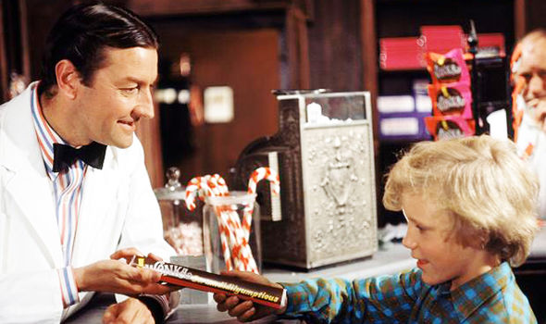
Literature Lesson
Charlie went inside the Candy Shop
to buy a chocolate bar..

Slide 20
At the candy shop
Pretend you are in a candy shop.
You are going to buy your favourite candy
e.g. a bag of marshmallows.
What would you say to the sales assistant?
How would the sales assistant reply?
Plan, rehearse and act out this role-play.

Slide 21
Thank You!

