Slide 1
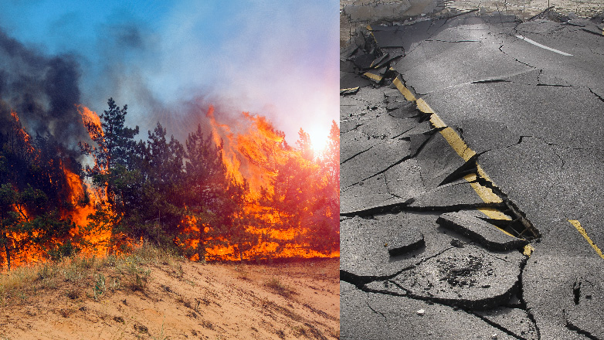
Lesson 3: Speaking Topic: Weather and Natural Disasters Year: 4

Slide 2
Lesson Objectives:
I will:
play the game Guess the Disaster.
carry conversations with a friend/relative based on the questions found on the conversation cards.

Slide 3
Download these resources:
Conversation cards

Slide 4
Guess the natural disaster!

Slide 5
1st Natural Disaster
I am like a train of gigantic waves that occurs during an earthquake or a volcanic eruption. Most of these happen in the Pacific Ocean.

Slide 6
.
Who am I?

Slide 7
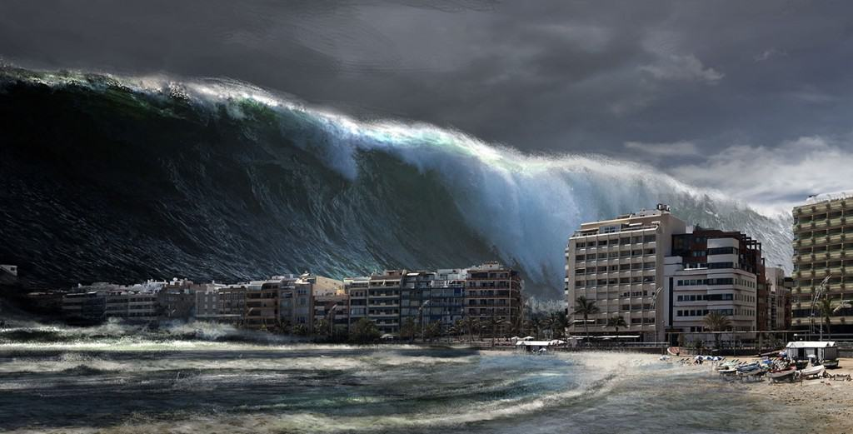

Slide 8
.
Tsunami

Slide 9
2nd Natural Disaster:
I am caused by the movement of the Earth’s plates.

Slide 10
.
Who am I?

Slide 11
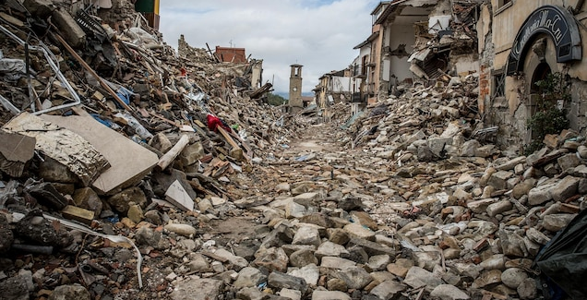

Slide 12
.
Earthquake

Slide 13
3rd Natural Disaster:
I am one of the worst natural disasters. I occur when a storm causes rivers to overflow or by high tides.

Slide 14
.
Who am I?

Slide 15
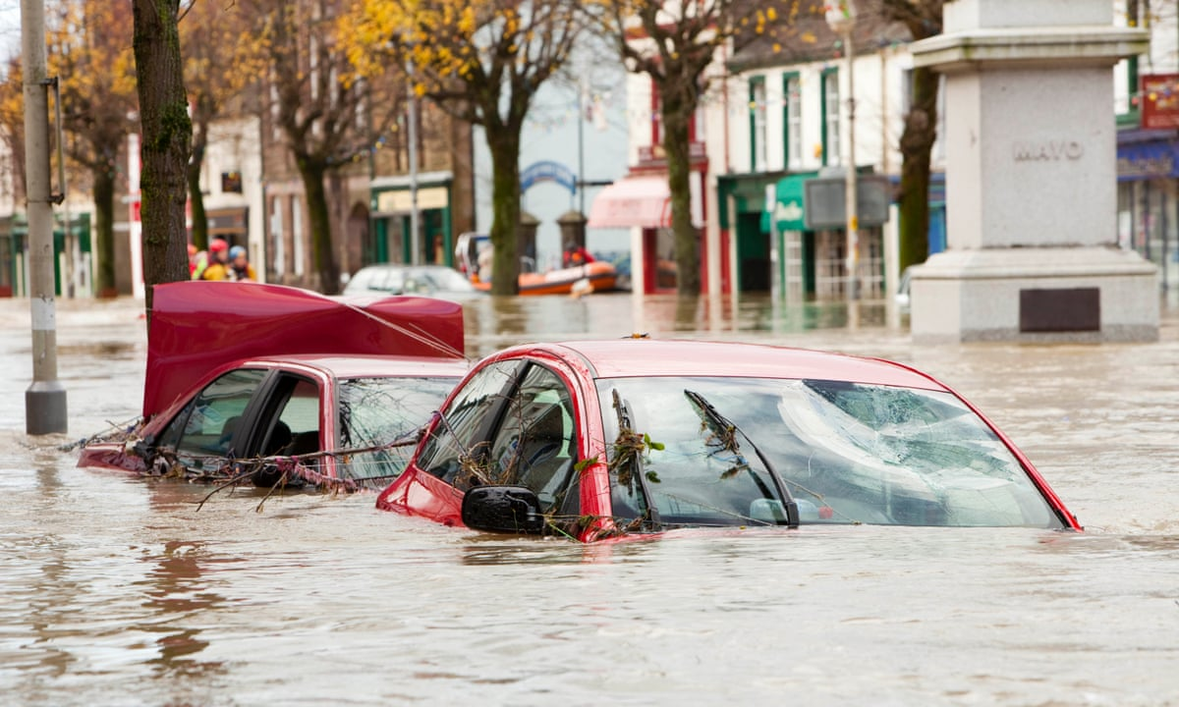

Slide 16
.
Flood

Slide 17
4th Natural Disaster:
I am a strong tropical storm with high winds and heavy rain. I cause tremendous damage when I hit land.

Slide 18
.
Who am I?

Slide 19
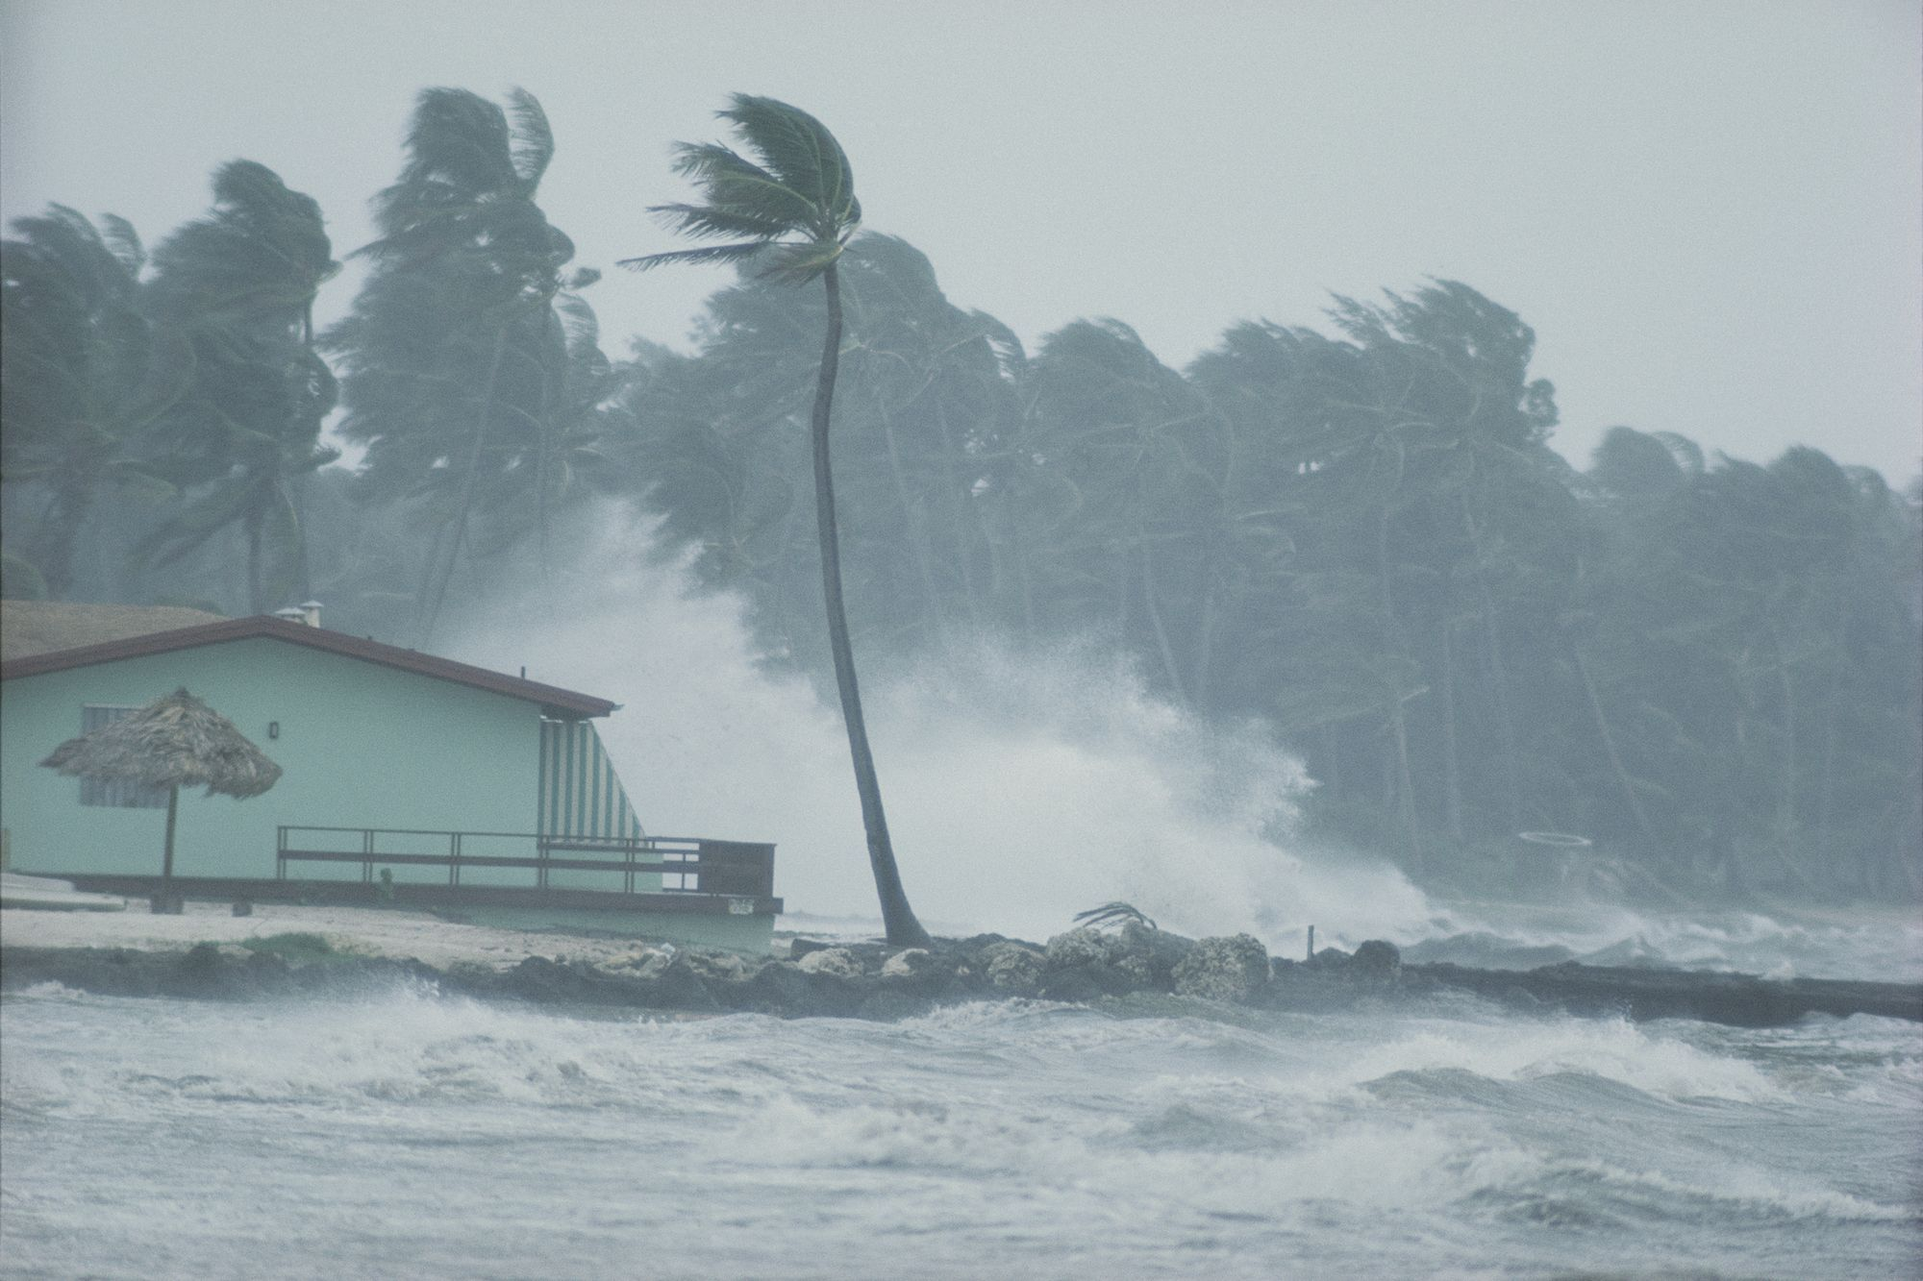

Slide 20
.
Hurricane

Slide 21
5th Natural Disaster:
I occur when there has not been enough rain for crops and plants to grow. Farm animals die and people do not have enough to eat.

Slide 22
.
Who am I?

Slide 23
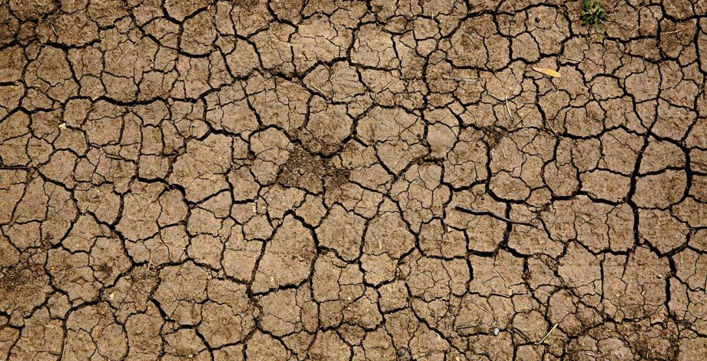

Slide 24
.
Drought

Slide 25
6th Natural Disaster:
I am an explosion that happens from openings in the earth’s surface. When I erupt I spew magma, lava and ash.

Slide 26
.
Who am I?

Slide 27
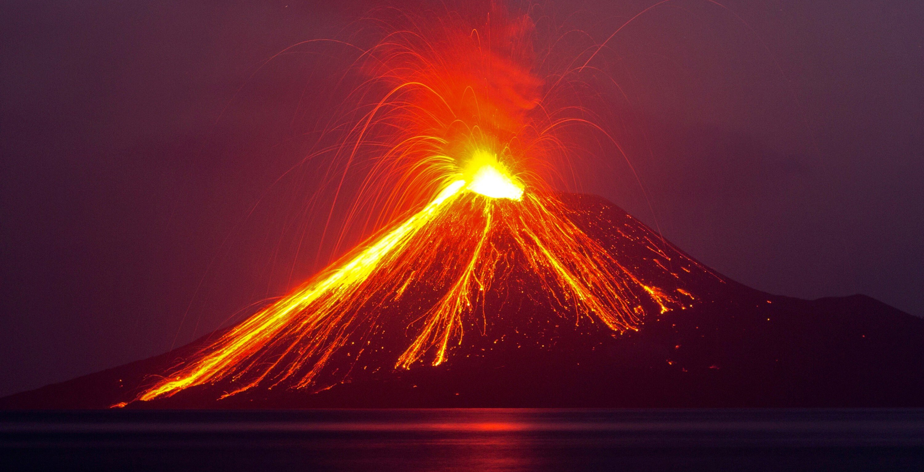

Slide 28
.
Volcano

Slide 29
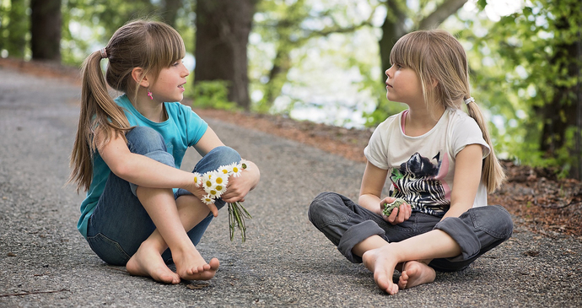
Conversation Time!
Two or more pupils can take part in this game. Pupils take it in turn to pick up a conversation card and try to answer the question/s on it.

Slide 30
Conversation Cards
30

Slide 33
Answer the following questions.
Which natural disaster strikes you the most?
Mention some damages caused by natural disasters.
How can you help a country, struck with a natural disaster?

