Slide 1
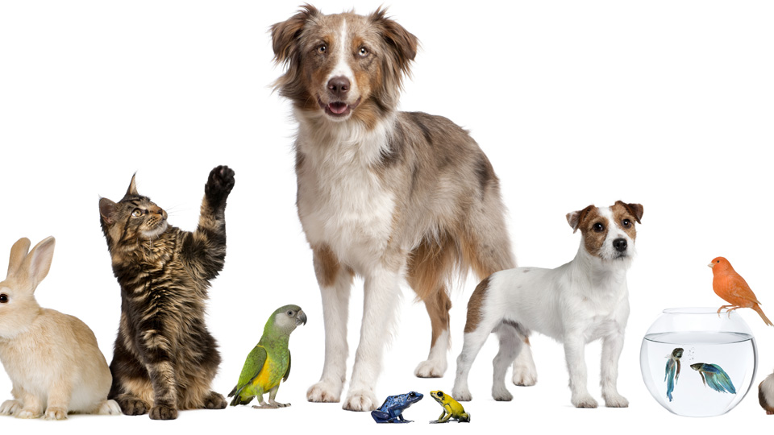
Pets
Lesson 6 - Writing

Slide 2
Notes for the Educator
This lesson is pegged directly to Learning Outcome W 5.9 I can write a paragraph appropriately for an audience and with a purpose, W5.12 I can make a text more interesting or more relevant to me by changing the vocabulary and W5.14 I can use resources to help me plan my written work and present it accurately.
Teachers are to refer to the Scheme of Work where each lesson is explained in more detail.
Effects are included to make the presentation more interactive. Please present the PowerPoint in Slideshow mode.
Wherever possible we have included the use of online apps to enhance the teaching and learning experience.
The Notes section underneath the slides may contain some further points which can be developed during the lesson.
Teachers are encouraged to adapt this PowerPoint presentation to meet the learners’ language needs.
Audio files or links to websites may be included.
Tasks included in the PowerPoint presentation are also being shared as handouts.
For any comments, feedback or suggestions please email us at: marie-claire.camilleri@ilearn.edu.mt; urieth.attard@ilearn.edu.mt; mary.jude.camilleri@ilearn.edu.mt. You may also call the office on: 25983683.

Slide 3
You are Oliver. Kai sent you an email to attend the National Pet Show and to tell you that he can take care of your pet while you are away. Reply to his email to accept the invitation and give him some information about how to take care of your pet.

Slide 4
G
email
To your friend Kai
to accept invitation and to tell him how to take care of your pet.
A
P

Slide 5
I am learning how to write an email.
I can use resources to help me plan my email.
I can write an email to inform my friend how to take care of my pet.
I can check my work, improve my writing and correct mistakes.

Slide 6
1. In the ‘To’ box write the email address of the person you are writing to.
2. In the ‘Subject’ write the title of your email. It could be something like ‘Sleepover’ or ‘Weekend Plans’.
3. In the ‘From’ write your own email address.
4. Click on ‘Attach’ if you need to add on a document or picture to your email.
Once you have checked what you have written a couple of times, then the final thing you need to do is press ‘Send’. The email will be sent! Remember…you cannot unsend an email once you press ‘Send’.
5. Write your message in the large area. Be chatty, funny, informal to your friends and family and more formal to others. This bit is just like writing a letter.

Slide 7
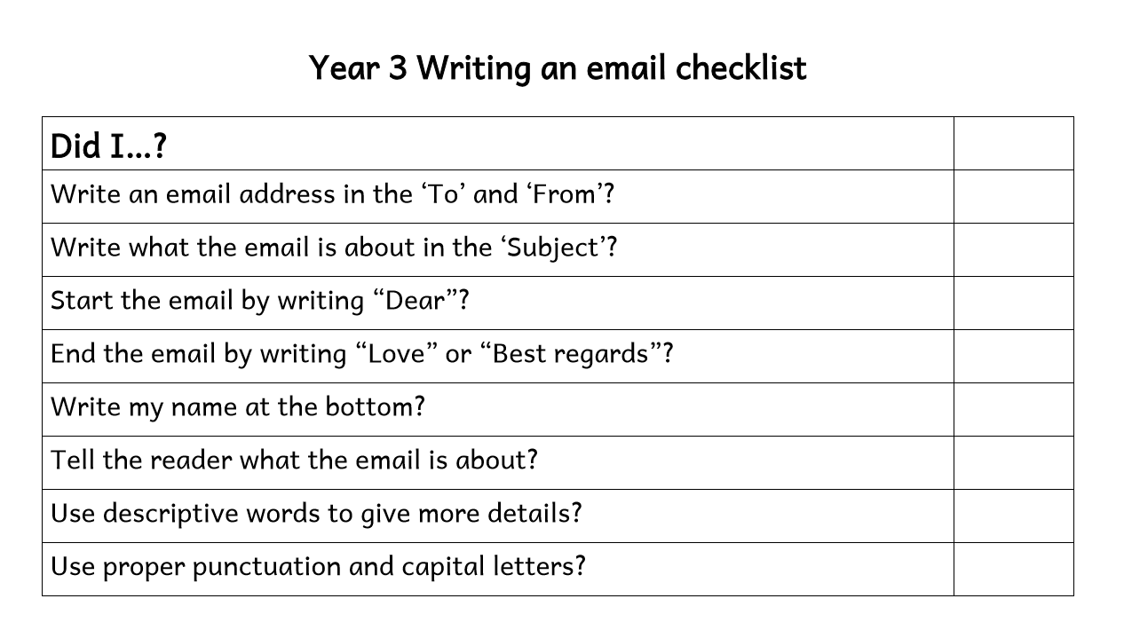

Slide 8
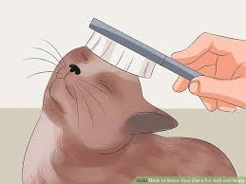
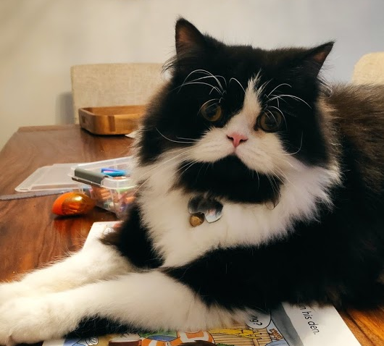
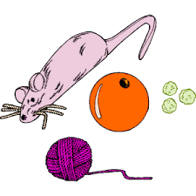
cuddles
brush
Black with white markings around face, white socks; green eyes
litter
dry food and water
cleans himself
toys
backyard
Notes:
We can use the same plan that we prepared during the Speaking lesson. However for the purpose of the email we can do away with the they physical description of the pet. You can have the learners reflect on whether we need to write this information in the email.

Slide 9
How to take care of _________.
Detail 1:
Detail 2:
Detail 3:
Main idea
Details
Notes:
Organise your ideas – what will the main idea be, what supporting details will you write?

Slide 10
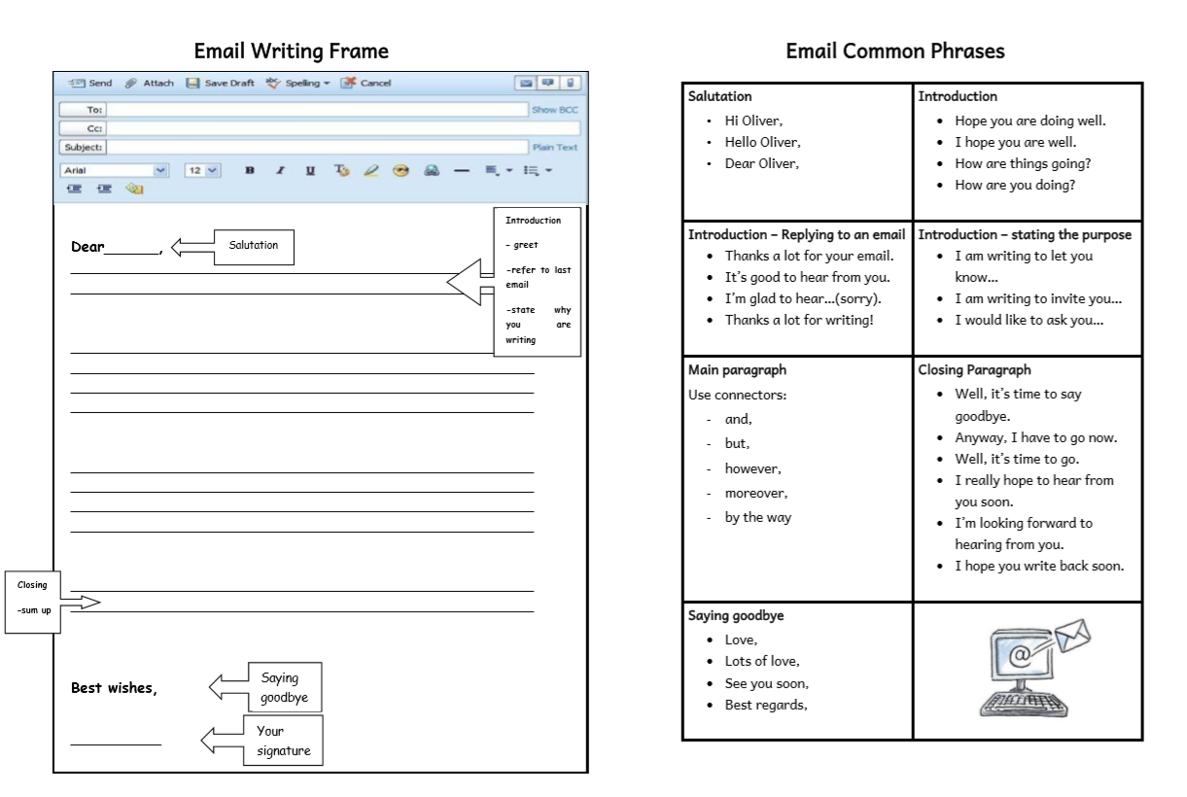
Notes:
How can I start my email? We can keep the handout with the template of the email in front of us because it will help to remember which phrases I can use. I can also refer to the model email to borrow some ideas for my writing. For now, I am just going to write down my ideas. Don’t worry too much about spelling mistakes for now. Watch me as I write mine on the board.

Slide 11
Step 1: Brainstorm ideas
Notes:
Now it’s your turn to write your email. Learners might use the Graphic Organiser used in Lesson 5 Speaking.

Slide 12
Step 2: Think of the main idea and the details.
How to take care of _________.
Detail 1:
Detail 2:
Detail 3:
Main idea
Details
Notes:
Organise your ideas – what will the main idea be, what supporting details will you write?

Slide 13
Step 3: Write the draft.
Step 4: Revise your email.
Step 5: Edit and proofread.
Step 6: Publish!

Slide 15
Thank you for using this resource. Check out our latest resources below.

