Slide 1
Sports and Games
Lesson 4: Speaking

Slide 2
Notes for the Educator
This lesson is pegged directly to Learning Outcome 6.1.7 Use appropriate and grammatically correct language to communicate meaningfully with a purpose and 6.1.11 Develop and participate in dialogues using appropriate language.
Teachers are to refer to the Scheme of Work where each lesson is explained in more detail.
Effects are included to make the presentation more interactive. Please present the PowerPoint in Slideshow mode.
Wherever possible we have included the use of online apps to enhance the teaching and learning experience.
The Notes section underneath the slides may contain some further points which can be developed during the lesson.
Teachers are encouraged to adapt this PowerPoint presentation to meet the learners’ language needs.
Audio files or links to websites may be included.
Tasks included in the PowerPoint presentation are also being shared as handouts.
For any comments, feedback or suggestions please email us at: marie-claire.camilleri@ilearn.edu.mt; urieth.attard@ilearn.edu.mt; mary.jude.camilleri@ilearn.edu.mt. You may also call the office on: 25983683.
Notes:
.

Slide 3
I am learning how to use functional language in two conversations
I can carry out an interview to get more information.
I can use appropriate vocabulary and phrases in a conversation.
I can self correct some mistakes I make while speaking.

Slide 4
Interviewing a famous tennis player
Notes:
Right, for our first speaking activity we will pretend to interview a famous tennis player. If you remember correctly we have already carried out an interview in our first Unit, so you should be familiar with how it should be done.

Slide 5
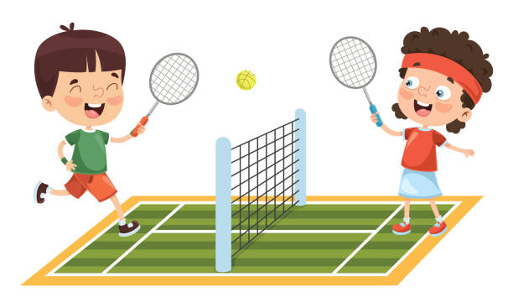
1. Work in pairs. Choose a role card.
Student A
Student B
You are a fan of a famous tennis player.
You’d like to ask the following questions:
When is he / she playing next?
Where is he / she playing next?
What was his / her most difficult match?
Is he / she sometimes nervous before a match?
Has he / she got a lucky charm?
How many hours does he / she practise every week?
When did he / she start playing tennis?
You are a famous tennis player.
A fan is going to interview you. Tell your fan:
When you are playing next
Where the match is going to be
About your most difficult match
That you are sometimes nervous before a match
That your lucky charm is a…
That you practise…hours every week.
That you started playing when you were…
Notes:
Ask someone who is at home to be your partner. Then choose a role card either Student A or Student B. Read the cues on the card carefully. Let’s read them together.
You can practice asking the questions on your cue card first or if you are the tennis player you can practise answering the questions before you actually carry out the interview.

Slide 6
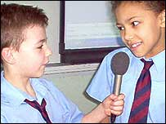
Act out your dialogue.
Student A
Excuse me, may I ask you some questions?
Another question that I wanted to ask you is…
Thank you so much for talking to me.
Oh, just one more thing. Could I have your autograph, please?
Student B
Go right ahead.
No problem. Was there anything else that you wanted to ask?
I’m afraid I’ve got to go now. Very nice talking to you.
Notes:
When you have practiced your questions or answers, it’s time to act out your dialogue. Here are some sentence starters to help you along the way… So if you’re student A, the interviewer you can start off the interview by saying…
If you are Student B, that is the famous tennis player, you can say…
I suggest that you have a go at trying out both roles, both the interview and the famous tennis player.

Slide 7
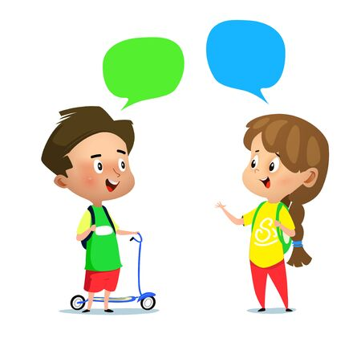
Carrying out a conversation

Slide 8
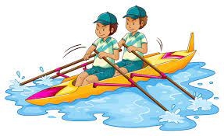
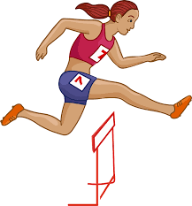
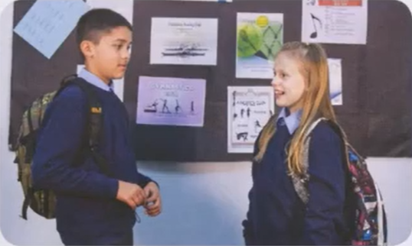
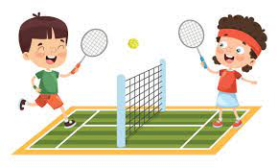
Notes:
The photo shows a boy called Charlie and a girl called Olivia. Where are Olivia and Charlie and what are they talking about? They are at school, standing in front of a notice board showing posters of different sports. So probably they are talking about joining a sports club.

Slide 9
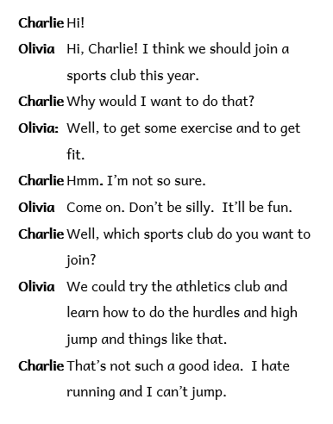
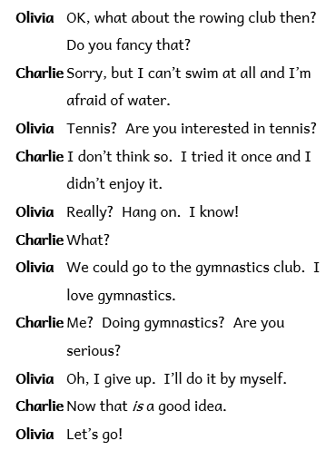
\
Notes:
Read to the dialogue and check your predictions.

Slide 10
Task 1
Work in pairs. Practise the dialogue.
Notes:
The first part of this activity is easy – all you need to do is reread the dialogue in pairs. So, one of you can be Olivia and the other person at home can be Charlie. Now take it in turns to say your part.

Slide 11
Task 2
Work in pairs. You are thinking of joining an after school sports club. Think about
reasons for joining
which clubs you could join
reasons not to join
Make up your own dialogue and act it out.
Notes:
Now for this part of the task you need to work with your partner and pretend that you are considering joining a sports club. Which sports club would you choose? Is it a club where only one sport is played or a club where different sports are practised? You also need to think about the reasons for joining and possible reasons why you shouldn’t join. Follow the example of the dialogue between Charlie and Olivia and create a similar dialogue.

Slide 12
Notes:
Here you can see some posters advertising different sport clubs.

Slide 13
What to say: Saying that you’re not interested
Why would I want to do that?
That’s not such a good idea.
Sorry, but I can’t / I hate…
I don’t think so.
I’d rather not.
Notes:
Before you actually start, let’s go over some common phrases that you might include in your dialogue. If you want to say that you are not interested in joining the sports club that your friend is suggesting you can say…

Slide 14
What to say: Saying that you’re not interested
I’m afraid I disagree.
I don’t agree with you / that.
I’d be inclined to disagree.
That’s not the way I see it.
I don’t feel the same.

Slide 15
What to say: Showing uncertainty
I’m not so sure…
I’m not sure about it.
I don’t know for sure.
Notes:
If you’re not certain that the sprot club that your friend is suggesting is the right club for you, you might say…

Slide 16
What to say: Agreeing
I totally agree with you/ that.
I couldn’t agree more.
I’d go along with that.
I feel the same.
You’re absolutely right.
Absolutely. / Definitely. / Exactly.
Notes:
On the other hand, if you agree with the choice of your friend, you can say…

Slide 17
What to say: Agreeing
No doubt about it.
That’s a good point. / I see your point.
I see where you’re coming from.

Slide 18
What to say: Partly Agreeing
I see your point but...
I kind of agree with you / that…
I agree with you to an extent, however,…
You make a good point, but…
Notes:
If you are partly agreeing, you can say…

Slide 19
What to say: Asking opinions
What do you think / reckon?
Do you see what I’m getting at?
Do you see / know what I mean?
Do you agree with me?
Would you go along with that?
Notes:
If you want to ask your friend’s opinion, you can do so by asking…

Slide 20
What to say: Asking opinions
Would you agree with me that…?
What are your thoughts on…?
Don’t you think (that)…?
Notes:
Great. Now it’s over to you. Take some time to prepare the dialogue first – perhaps you might wish to take down some notes to help you as you are carrying out the dialogue. Remember to include some of the common phrases to show that you agree, disagree, partly agree or if you want to ask for your friend’s opinion.
And that’s a wrap. I hope you have enjoyed the activities in this lesson. Thank you for joining me and I hope to see you again for our 5th and last lesson of this unit.

Slide 21
Thank you for using this resource. Check out our latest resources below.

