Slide 1
Lesson 5 Literature
Year 5
English

Slide 2
Lesson Objectives
You will:
use the dictionary to find the meaning of new words.
read a piece of prose silently and aloud.
listen to a piece of prose being read aloud.
answer questions about the text.

Slide 3
Lesson Resources
Dictionary
Reading Text
Questions Worksheet
Answers Handout

Slide 4
Picture 1
What can you see in the picture?

Slide 5
Picture 2
The Brilliant World
of Tom Gates
by
Liz Pichon

Slide 7
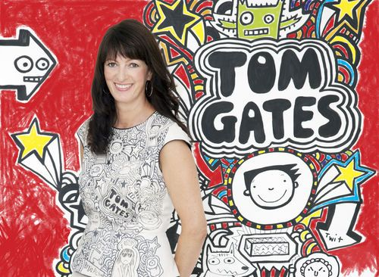
Picture 3
Liz Pichon

Slide 8
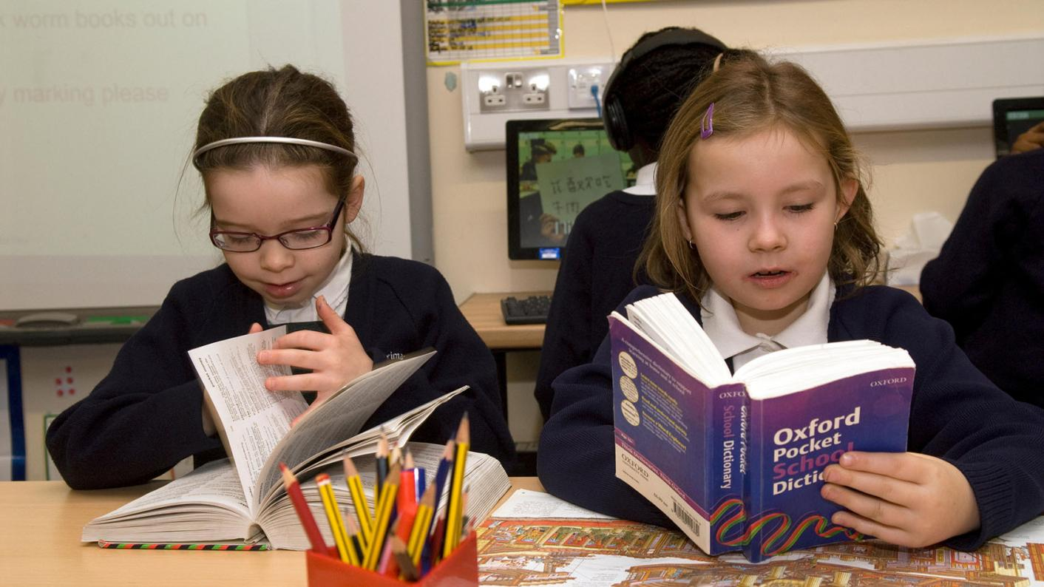
Using a dictionary!

Slide 9
New words
chunk …
a large piece of something

Slide 10
New words
rearranged
distracted
occasionally

Slide 11
Step 1
READ THE TWO TEXTS AND THESE QUESTIONS:
What were the texts about?
Did you like reading them?
How did they make you feel?

Slide 12
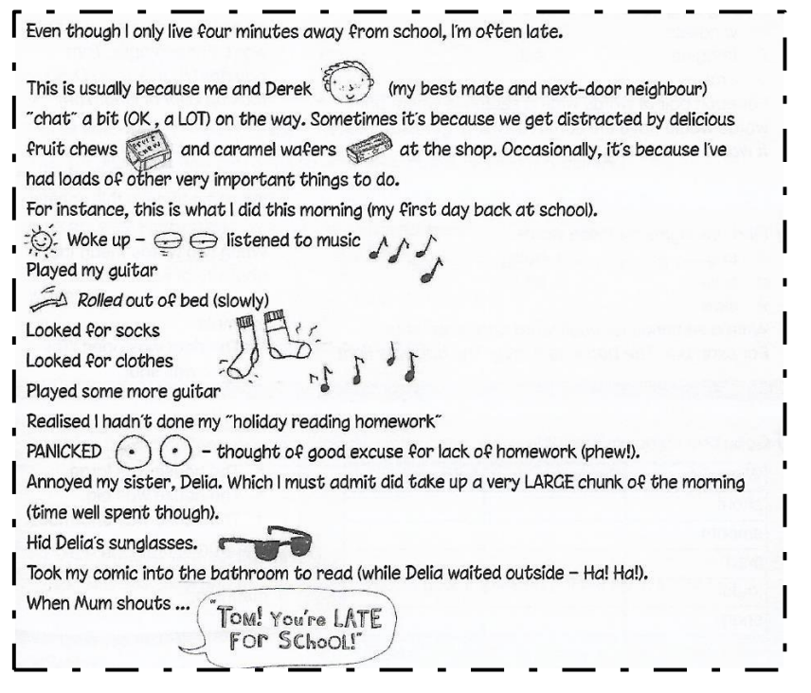
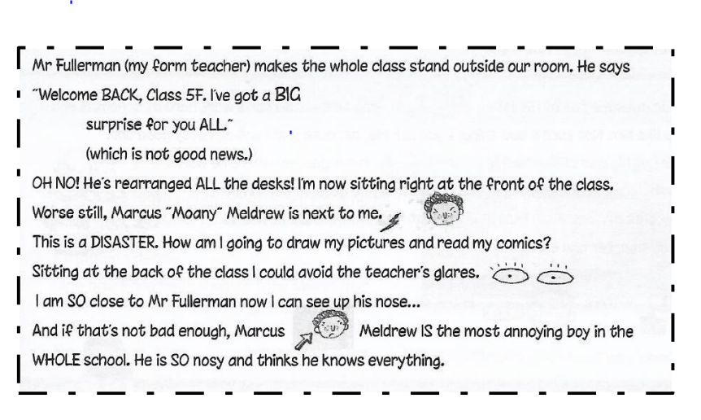

Slide 13
Step 2
DISCUSS THE QUESTIONS:
What were the texts about?
Did you like reading them?
How did they make you feel?

Slide 14
Step 3
Does Tom live far away from school?
Tom is often late for school for many reasons. Can you think of a few?
What are Tom’s hobbies?
Do you think Tom is a diligent pupil?
Do you think Tom gets along with his sister Delia?
What is Mr. Fullerman’s surprise? Is Tom pleased with it?
READ THE TEXTS AND THESE QUESTIONS:
Tom is often late for school. List a few reasons.
Do you think Tom is a diligent pupil?
Do you think Tom gets along with his sister Delia?
Is Tom pleased with Mr Fullerman’s surprise? Why?

Slide 15
Discuss the questions
Tom is often late for school. List a few reasons.
He chats a lot with his friend Derek. They stop at the shop to buy candy. He wastes time listening to music, playing the guitar, looking for his clothes, annoying his sister Delia and reading a comic.
Do you think Tom is a diligent pupil?
No. He does not do his homework or have his clothes ready before school.
Do you think Tom gets along with his sister Delia?
No. He annoyed his sister, hid her glasses and kept her waiting outside the bathroom.
Is Tom pleased with Mr Fullerman’s surprise? Why?
No. He is going to sit at the front of the class so he cannot draw or read comics. He is going to sit next to Marcus who is annoying.

Slide 16
Step 5
LISTEN AND READ
SILENTLY
WITH ME.

Slide 18
Step 3
Work out the
Questions Worksheet.

Slide 19
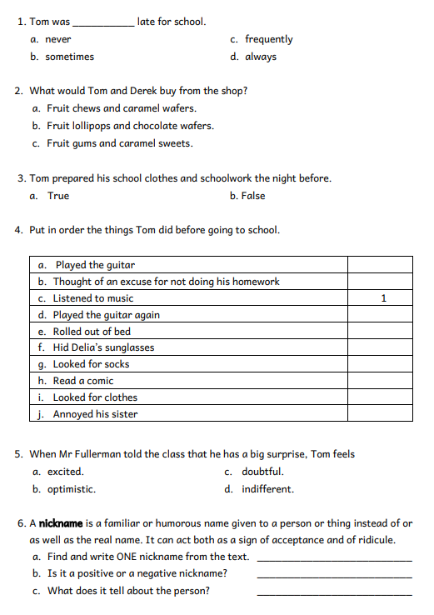
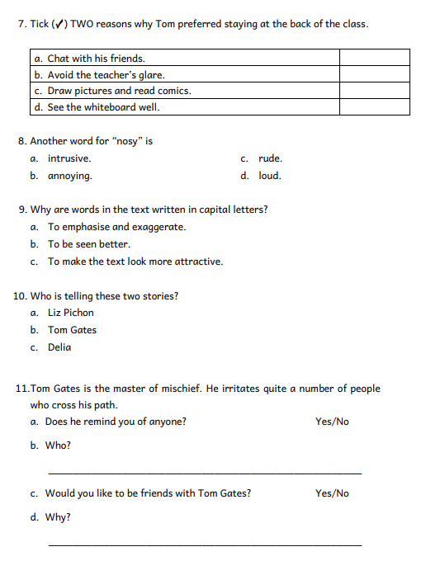

Slide 20
Step 4
Revise your answers.

Slide 21
Step 5
Check your answers
using the
Answers Handout.

Slide 22
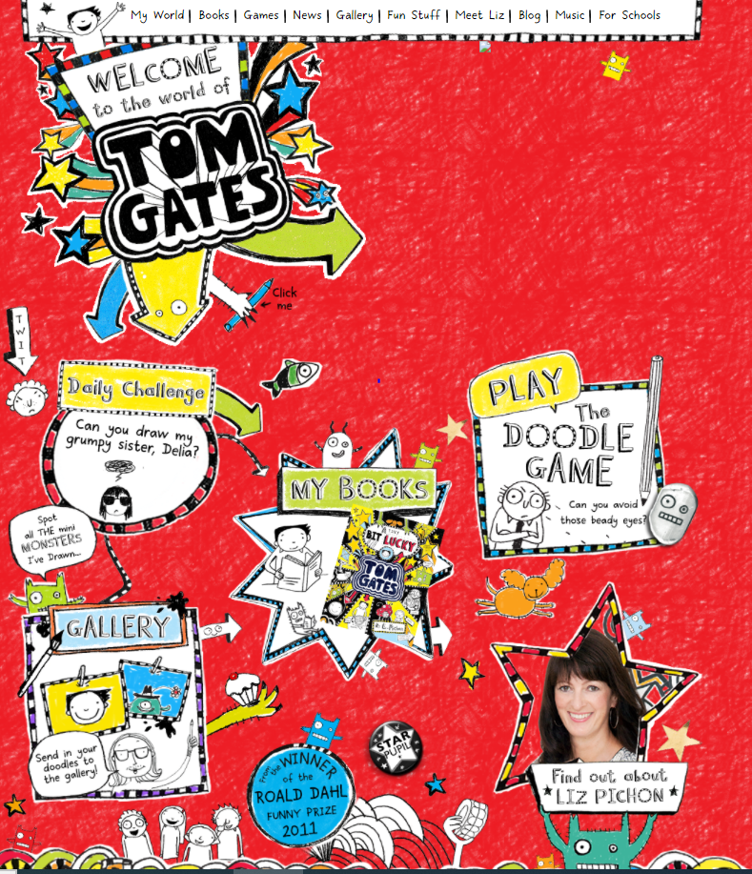
My World - Tom Gates (theworldoftomgates.com)
Website

Slide 23
Thank You!

