Slide 1
Lesson 4: Writing Topic: Travel Year: 4

Slide 2
Part 1

Slide 3
Lesson Objectives:
Today I will learn:
what happens to lost objects found in trains.
how to fill in a lost property
form.

Slide 4
Download these resources:
Online Lost Property Form
Success Criteria Worksheet

Slide 6
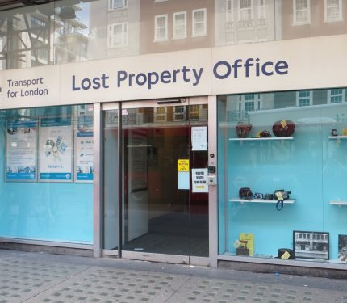
What type of building can you see in the picture? What is the purpose of this building? Where can it be found?

Slide 7
Lost property online form
Imagine you have left something behind you on a train and you want to file in a report. Fill in the online Lost Property Form to try to get back your personal belonging.

Slide 8
Let’s understand the title well.
Keep in mind the GAP:
GENRE:
a lost property form
AUDIENCE:
officers who work at the lost property office PURPOSE:
to report lost items

Slide 9
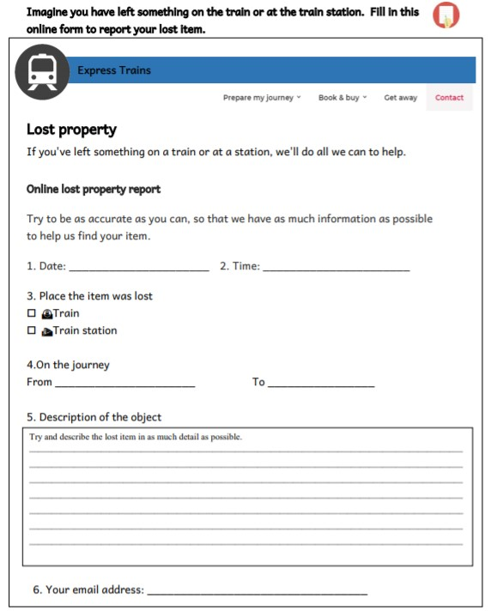

Slide 10
Success Criteria

Slide 11
Part 2

Slide 12
Lesson Objectives:
Today I will learn:
how to write a postcard.
the success criteria for writing a postcard.

Slide 13
Download these resources:
Postcard Writing Frame
Success Criteria Worksheet

Slide 14
Writing Title
Write a postcard to a relative or friend to tell him/her about your first train journey ever.

Slide 15
Let’s understand the title well.
Keep in mind the GAP:
GENRE - writing a postcard
AUDIENCE - relative / friend
PURPOSE - to tell him/her about your first train journey

Slide 17
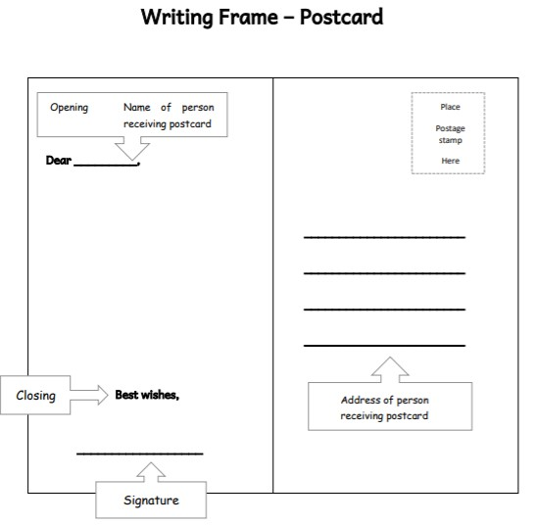

Slide 18
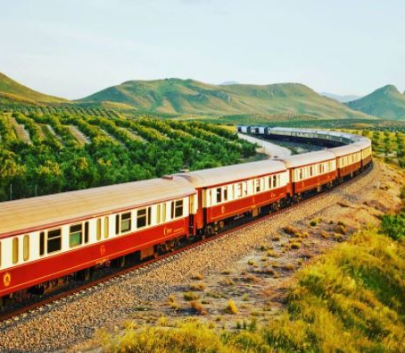
When was your train journey?
Where did you depart from?
Where were you travelling to?
With whom did you travel?
Was it a short or long distance?

Slide 19
How did you spend your time on your journey?
Did you opt for a window seat?
Did you enjoy the scenario enroute?
Did you eat anything during your journey?
Did you feel safe?
How was the experience?

Slide 20
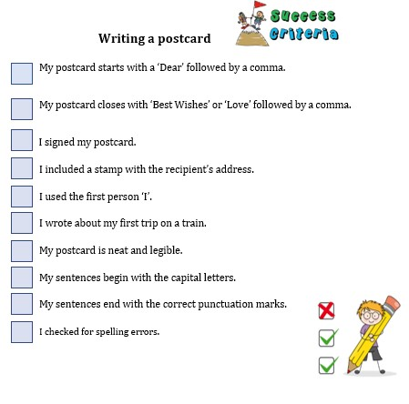

Slide 21
Post-Task: At the Train Station

Slide 22
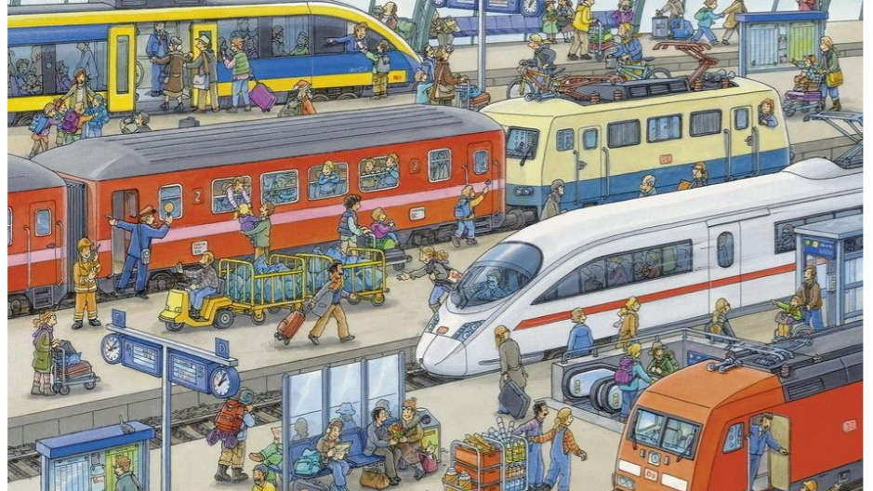

Slide 23
Write down all the words that come to your mind when you look at this picture.
What can you hear at a train station?
What can you see at a train station?
What can you do at a train station?
Who can you meet at a train station?

