Slide 1
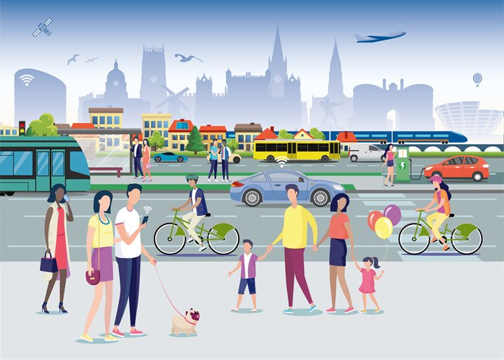
Getting around
Lesson 1 - Listening

Slide 2
Notes for the Educator
This lesson is pegged directly to Learning Outcome LS 5.2 I can understand audio-visual texts across a range of genres, identifying the main idea and specific information.
It also targets other language outcomes such as: LS 5.8 I can communicate my own experiences, likes and dislikes fluently and accurately with some allowance to self-correct in the process.
The material for this lesson was adapted from: https://learnenglishkids.britishcouncil.org/poems/going-school
Teachers are to refer to the Scheme of Work where each lesson is explained in more detail.
Effects are included to make the presentation more interactive. Please present the PowerPoint in Slideshow mode.
Wherever possible we have included the use of online apps to enhance the teaching and learning experience.
The Notes section underneath the slides may contain some further points which can be developed during the lesson.
Teachers are encouraged to adapt this PowerPoint presentation to meet the learners’ language needs.
Tasks included in the PowerPoint presentation are also being shared as worksheets.
For any comments, feedback or suggestions please email us at: marie-claire.camilleri@ilearn.edu.mt; urieth.attard@ilearn.edu.mt; mary.jude.camilleri@ilearn.edu.mt. You may also call the office on: 25983683.

Slide 3
Listen to a poem about different means of transport .
Read and respond to an advert.
Read and respond to a story about magical ways to travel.
Describe different vehicles.
Write an advert for a bicycle we no longer need.

Slide 4
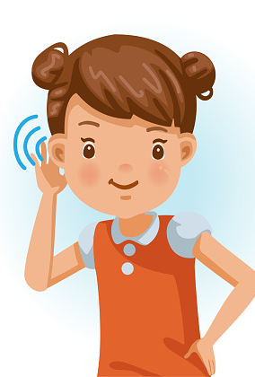
I am learning how to listen and respond to audio-text.
I can understand what the main idea is.
I can listen to specific details and keywords.
I am able to complete the tasks.
Notes:
In this lesson, we are learning how to listen and respond to poem. We will know that we are learning by showing that we understand what the main idea is, by listening to specific details and keywords, and by completing the tasks.

Slide 5
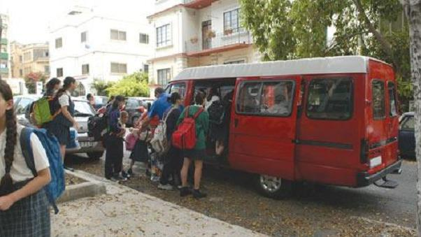
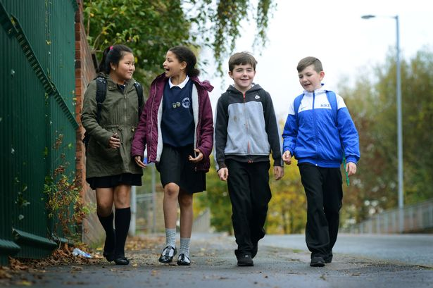
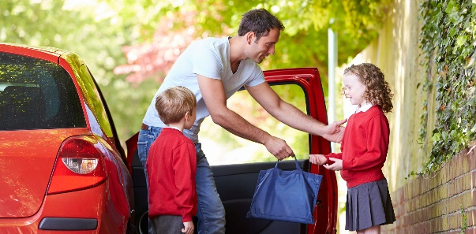
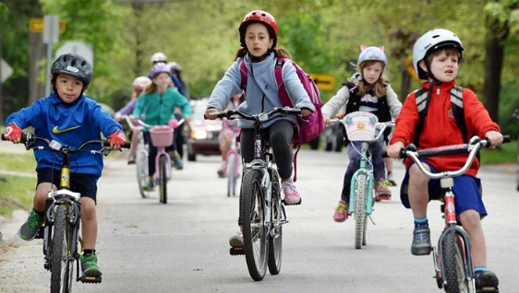
Notes:
Let’s start off by looking at some photos. Look carefully at each photo and discuss these questions with an adult sitting next to you:
Where do you think these children are going? What means of transport are they using? How do you go to school or get around? Can you mention one good thing and one bad thing about each form of transport?

Slide 6
laughed
laugh
ed
Notes:
Now let’s go through some vocabulary that we are going to hear in the poem. Ask: What is this word? How can we chunk it?
Do you know what to laugh means? It means to find something funny or amusing and you chuckle or produce a sound with your mouth

Slide 7
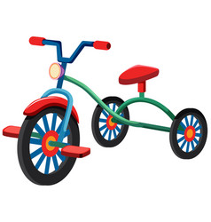
tricycle

Slide 8
whizzed
whiz
Notes:
To go quickly past something. onomatopeic.

Slide 9
weather
Notes:
Refers to how the day is, if it’s hot or cold or rainy or windy.

Slide 10
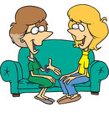
chatted
chat

Slide 11
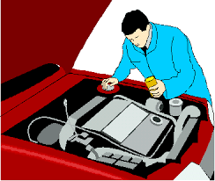
engine
Notes:
The machine inside the car – that makes the car move.

Slide 12
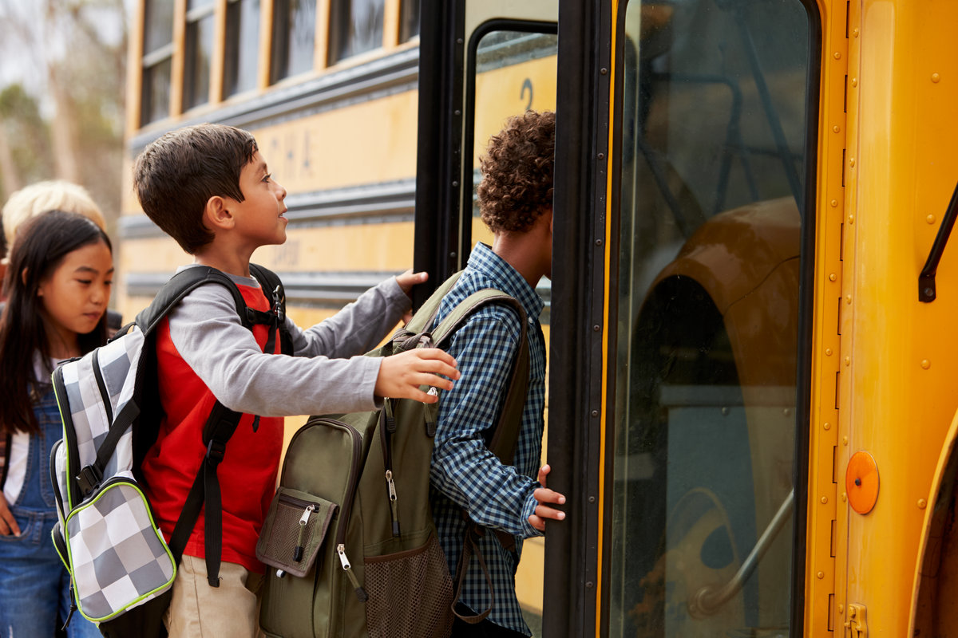
Make a Prediction:
What do you think this text is about?
Notes:
Now, I wonder if you can make a prediction about what the poem is about? Look at the picture to help you make a prediction.

Slide 13
1st Listening Task:
Listen carefully to the means of transport mentioned.
Notes:
Now, let’s turn on our listening ears and listen carefully. We shall listen to the audio-visual three times. In the first listening, I would like you to listen carefully to the means of transport mentioned.

Slide 14
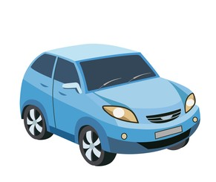
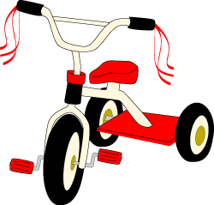
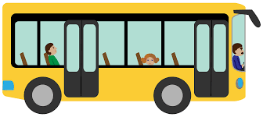
Task 1. Draw a picture of how the children in the poem get to school. You need to draw 5 pictures.
❶ | ❷ | ❸ | ❹ | ❺

Slide 15
2nd Listening Task:
Listen carefully to what the poet says about each means of transport.
Notes:
Great. Next, we are going to listen to the poem for the 2nd time. This time, I would like you to listen very carefully to what the poet says about each means of transport.

Slide 16
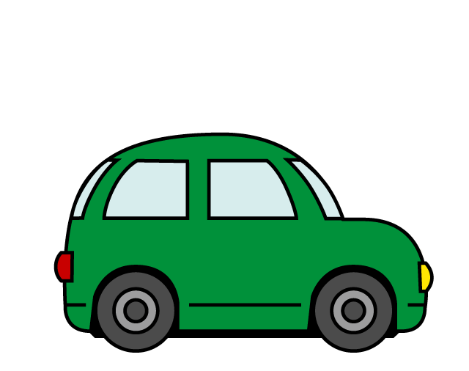
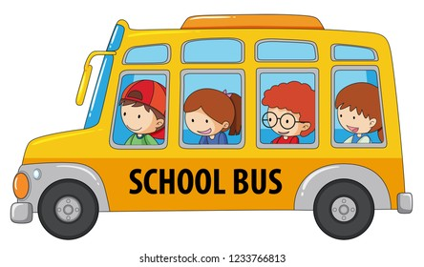
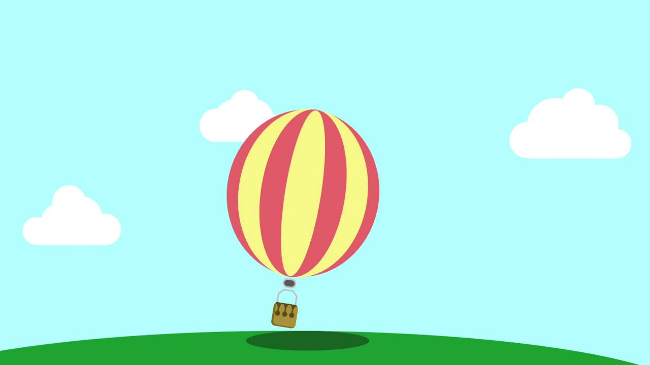
Task 2. What does the poet say about each of these means of transport?
A
B
C
D
D
16 | It was a free ride.
 | Makes your legs strong.
 | Can float over the traffic.
 | Arrives on time every day.
 | You have to wait a long time in the queue.
E
E
C
B
A

Slide 17
3rd Listening Task:
Listen carefully to the rhyming words.
Notes:
Now, for the third listening task, we need to listen out for any rhyming words.

Slide 18
Task 3. Match the rhyming words.
me
gate
late
way
arrive
weather
together
free
day
drive
Notes:
Let’s match the rhyming words.

Slide 19
Choose two means of transport from those mentioned in the poem. Say something good and something bad about each of them.
very easy to get stuck in a traffic jam
you can go almost anywhere
avoids traffic on the roads
not very safe in bad weather
Notes:
As a follow up task, choose two means of transport mentioned in the poem. Think of something good and something bad each of them.

Slide 20
Thank you for using this resource. Check out our latest resources below.

