Slide 1
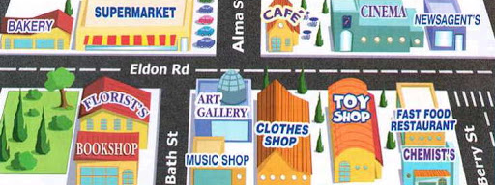
Places and Directions
Lesson 5: Writing

Slide 2
Notes for the Educator
This lesson is pegged directly to Learning Outcomes W 5.9 I can write a paragraph appropriately for and audience and with a purpose and W5.14 I can use resources to help me plan my written work and present it accurately.
Teachers are to refer to the Scheme of Work where each lesson is explained in more detail.
Effects are included to make the presentation more interactive. Please present the PowerPoint in Slideshow mode.
Wherever possible we have included the use of online apps to enhance the teaching and learning experience.
The Notes section underneath the slides may contain some further points which can be developed during the lesson.
Teachers are encouraged to adapt this PowerPoint presentation to meet the learners’ language needs.
Audio files or links to websites may be included.
Tasks included in the PowerPoint presentation are also being shared as handouts.
For any comments, feedback or suggestions please email us at: marie-claire.camilleri@ilearn.edu.mt; urieth.attard@ilearn.edu.mt; mary.jude.camilleri@ilearn.edu.mt. You may also call the office on: 25983683.

Slide 3
I am learning how to write directions.
I can use vocabulary for direction.
I can explain how to get to a place.
I can check my work, improve my writing and correct mistakes.
Notes:
In this lesson we will be working on writing directions. To do so, we will need to use vocabulary for direction correctly. We will need to explain how to get to a place clearly and we need to check our work to improve our writing and correct mistakes.

Slide 4
You work as a receptionist at The Bridge Hotel in London. A tourist staying at the hotel has asked you to write down the directions for some popular London sights he would like to visit. Write short messages with directions.
Notes:
So let’s take a look at the reading task and try to identify the genre, the audience and the purpose.

Slide 5
G
message
A
A tourist
P
To inform
Notes:
With regards to genre, we are going to write a message. A message is a short piece of writing, to communicate an idea. With regards to audience – this means the persons for whom we are writing the messages – in this case, we are writing the messages for a tourist who wants to visit some attractions in London. Finally, we need to consider the purpose, that is why we are writing the messages – in this case to inform him or to let him know the correct way to these attraactions.

Slide 6
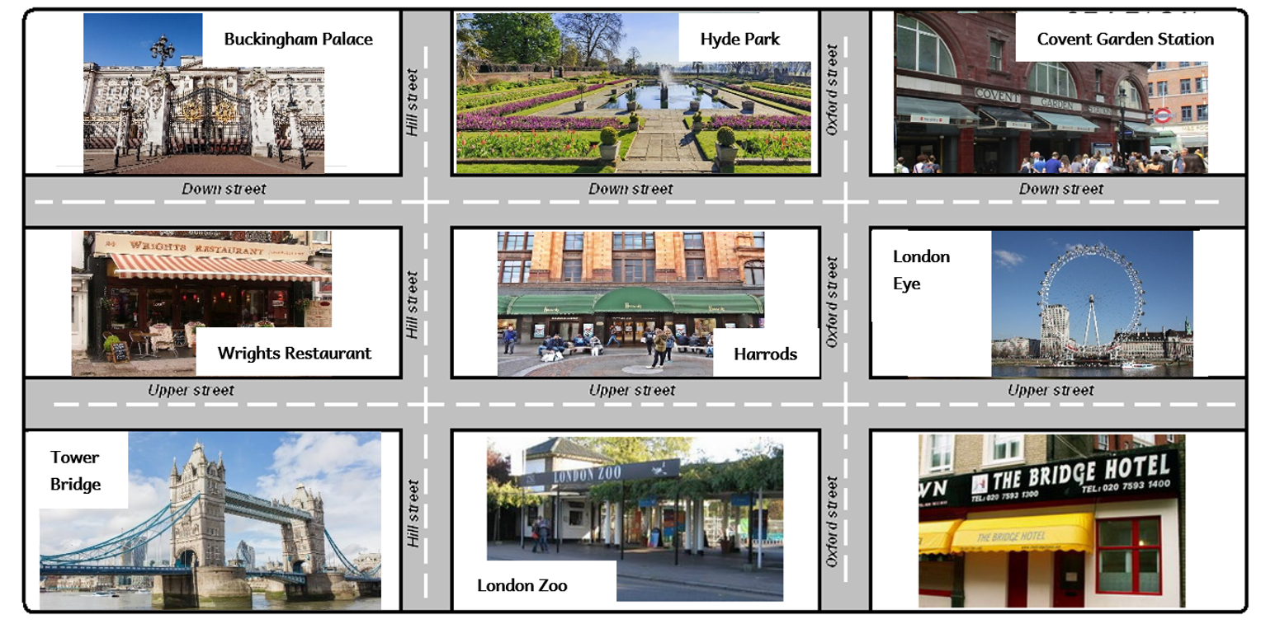
Notes:
Now, in order to do this task, we need to refer to a map of London. Now, this is not the real map! It is a simple one that we will be using only for this lesson. So, if you ever plan to go to London, don’t even think of using this map, because will certainly get lost in the middle of London! Anyway, let’s have a look at this map!
So, let’s start with the name of the streets…here we have Hill Street and Oxford Street. Then we have Upper Street and Down Street going across. Right so bottom right we have The Bridge Hotel and it is marked by a red dot, that means we are starting from here,because this is where the tourist is staying and it is where we work as a receptionist too! Then there is London Eye and Covent Garden Station above it. In the middle row at the bottom, we have the London Zoo, then Harrods which is a well-known department store in London and on top of it there is Hyde Park, another famous tourist attraction. On the left, in the bottom corner, we have Tower Bridge, then Wrights Restaurant and the famous Buckingham Palace where the Queen lives. Right, so now we are familiar with the map and we can start writing our messages.

Slide 7
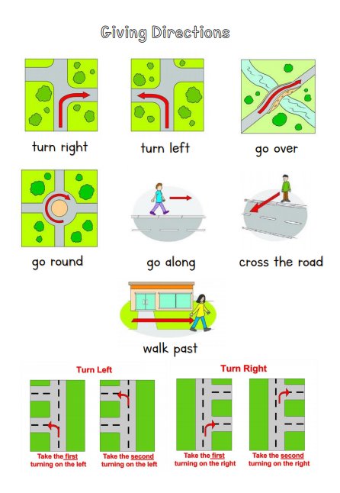
Notes:
The tourist left a note for the receptionist. The first place he would like to go to is Harrods.

Slide 8
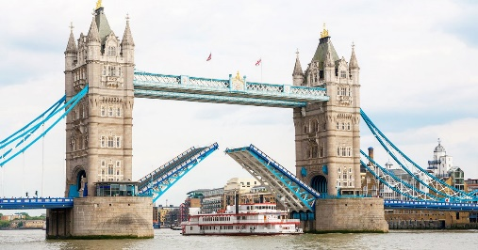
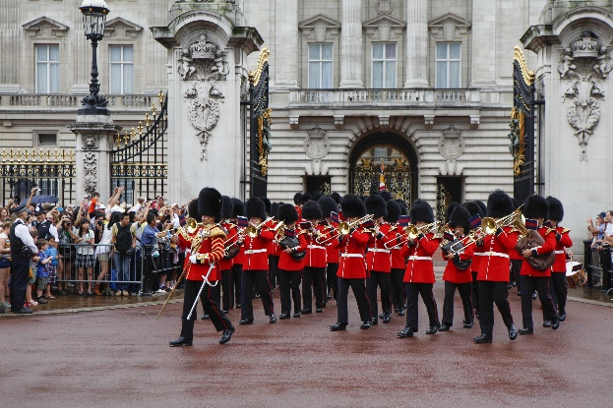
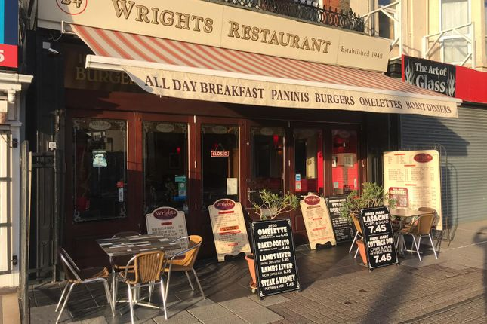
Buy gifts from Harrods.
See Tower Bridge.
See the Changing of the Guards at Buckingham Palace
Have lunch at Wrights Restaurant
Notes:
The tourist left a note for the receptionist. The first place he would like to go to is Harrods.

Slide 9
Get a gift from Harrods.
walk along
turn left
on the right
opposite
Notes:
Keep the map in front of you so that together we can trace our way from the hotel to Harrods. The red spot shows where we are going to start from. Next we need to find Harrods. I’m going to mark mine with a circle. Now we need to draw arrows to show the way to Harrods. Now let’s think of the vocabulary that we can use.

Slide 10
Go to Harrods to buy a gift.
To get to Harrods, walk along Oxford Street. Turn left into Upper Street. Harrods is on your right, opposite the zoo.
walk along
turn left
on the right
opposite
Notes:
Now, try to write

Slide 11
See the Tower Bridge
walk along
turn left
cross the road
Notes:
Right, now you need to be careful. The tourist is at Harrods so he will start walking from here. That means that I need to write the directions from Harrods to the Tower Bridge. Let’s try this out.

Slide 12
See the Tower Bridge
To get to the Tower Bridge…
walk along
turn left
cross the road
Notes:
Now, try to write

Slide 13
See the Changing of the Guards at Buckingham Palace.
walk along
Take the second turning left
cross Down Street
Notes:
Now, the tourist wants to see The Changing of the Guard at Buckingham Palace. He was at the Tower Bridge, last. So we need to give him directions from the Tower Bridge to Buckingham Palace. Let’s try it out.

Slide 14
See the Changing of the Guards at Buckingham Palace.
To get to Buckingham Palace…
walk along
Take the second turning left
cross Down Street
Notes:
Now, try to write

Slide 15
Have lunch at Wrights Restaurant.
Walk along
Take the first turning right onto Hill Street
At the corner, turn right onto Upper Street
On the right
Notes:
Last of all, the tourist wants to grab something to eat at Wrights Restaurant. That means that we need to give him directions from Buckingham Palace to Wrights Restaurant.

Slide 16
Eat at Wrights Restaurant.
Walk along
Take the first turning right onto Hill Street
At the corner, turn right onto Upper Street
On the right
To get to Wrights Restaurant…
Notes:
Now, try to write

Slide 17
Notes:
Now you can check your work by using this checklist for writing directions. We need to check our directions against these criteria. Let’s go through them.
Right. That brings us to the end of this lesson and this unit on Places and Directions. Thank you for joinig me once again, and I look forward to see you soon.

Slide 18
Thank you for using this resource. Check out our latest resources below.

