Slide 1
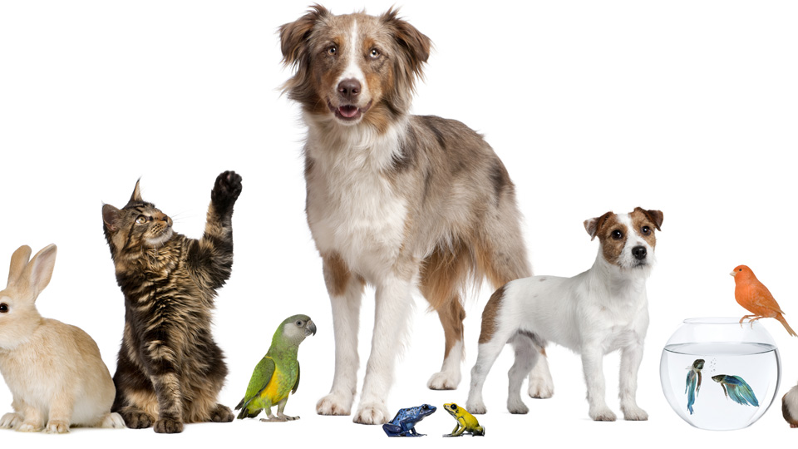
Pets
Lesson 4 Literature
Notes:
Hello again children. Welcome to our third lesson. In this lesson we are going to listen and respond to a story by my favourite author Julia Donaldson. Let me show you the cover of this book.

Slide 2
Notes for the Educator
This lesson is pegged directly to Learning Outcome LIT 5.3 I can respond to simple poems, stories, and plays by speaking and writing briefly about how I feel about the literary texts and about the events and characters in these texts.
Teachers are to refer to the Scheme of Work where each lesson is explained in more detail.
The story in this lesson can be found on: https://www.youtube.com/watch?v=LIWXpiy8wwo&t=154s. For the purpose of this lesson, we stopped the videoclip at 3:18.
Effects are included to make the presentation more interactive. Please present the PowerPoint in Slideshow mode.
Wherever possible we have included the use of online apps to enhance the teaching and learning experience.
The Notes section underneath the slides may contain some further points which can be developed during the lesson.
Teachers are encouraged to adapt this PowerPoint presentation to meet the learners’ language needs.
Tasks included in the PowerPoint presentation are also being shared as handouts.
For any comments, feedback or suggestions please email us at: marie-claire.camilleri@ilearn.edu.mt; urieth.attard@ilearn.edu.mt; mary.jude.camilleri@ilearn.edu.mt. You may also call the office on: 25983683.

Slide 3
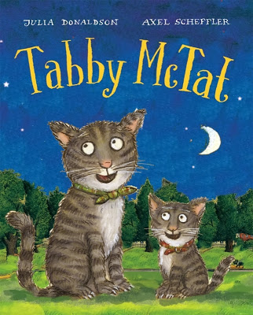
I see…
I think…
I wonder…
Notes:
The name of the story is Tabby McTat. It is also the name of the main character in the story, the tabby cat. Do you know what a Tabby cat is? a grey or brownish cat streaked with dark stripes.
Tabby McTat is a happy cat, singing along all day with Fred the busker. But when Fred gives chase to a thief, the two are separated.

Slide 4
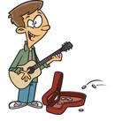
busker
Notes:
Busker – by looking at the picture, what do you think is a busker? a person who performs music or other entertainment in the street or another public place for monetary donations.

Slide 5
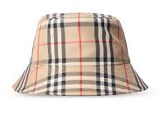
checked

Slide 6
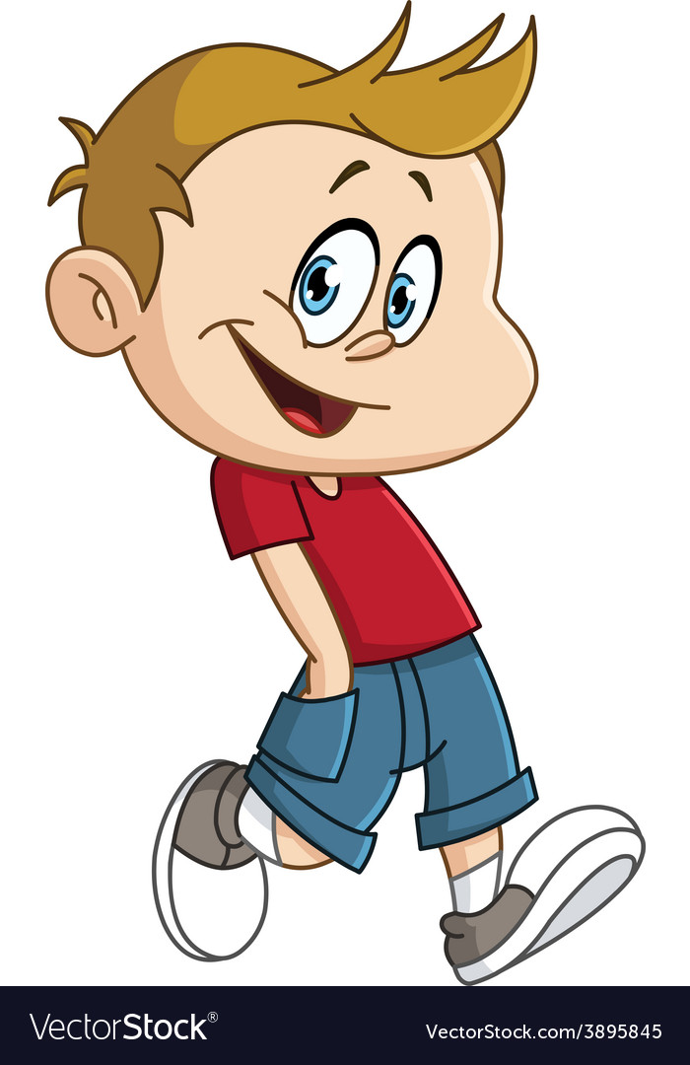
stroll

Slide 7
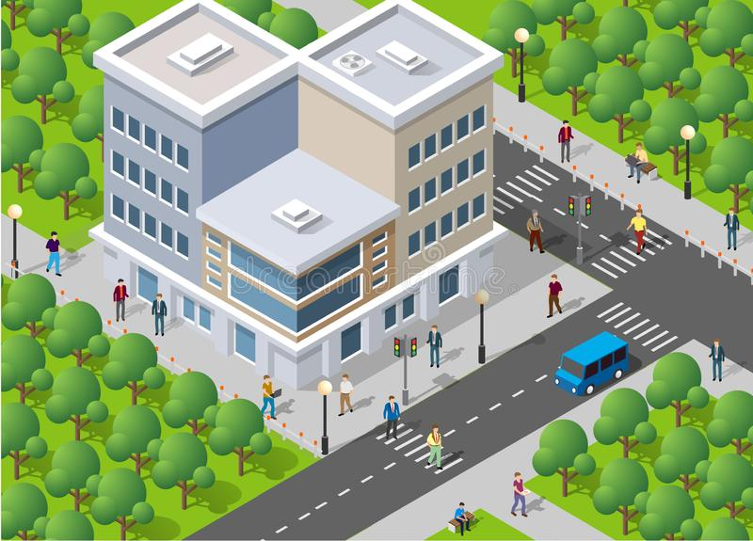
block

Slide 8
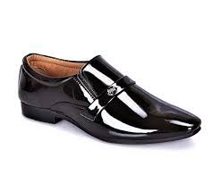
glossy

Slide 9
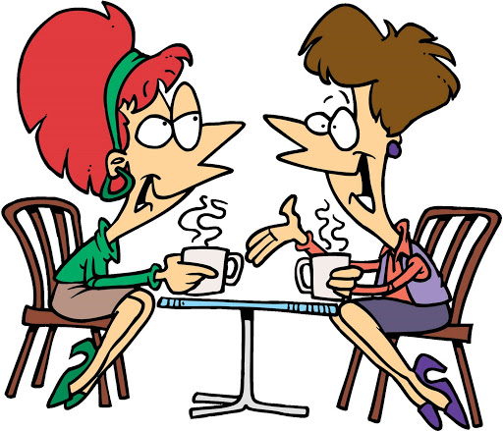
chatting
Notes:
Chunking: We do this whenever we break up the word into smaller parts. For example the word: chatting can be broken up into smaller words. The word block for example can be broken down into bl + ock. The ending part rhymes with rock and sock and frock and clock. So then I just add the bl sound

Slide 10
I am learning how to respond to a story.
I can talk about the main events of the story.
I can talk about the main character.
I can answer questions about the story.

Slide 11
What is the story about?
Where does the story take place (the setting)?
Why did the author write this story? What is the purpose?
Notes:
First we are going to listen to part of the story of Tabby McTat and afterwards we will look at the main character in more depth. Let’s listen to the story first, to get the general idea.

Slide 12
Notes:
Stop at 3:18

Slide 13
Think about this story…
What is this story about?
A cat who gets separated from his owner.
Notes:
Now that we have listened to the story, let’s discuss the three main questions I asked you to think about.

Slide 14
Think about this text…
Where does the story take place?
Busy streets – perhaps in London?
Prunella and Pat’s house

Slide 15
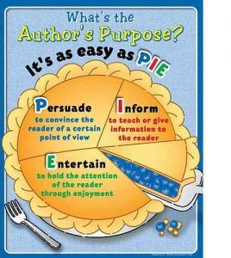
What was the author’s purpose in writing this text?
To entertain the reader with an interesting story.
✓
To inform the reader or give more information.
To persuade the reader to do or believe something.

Slide 16
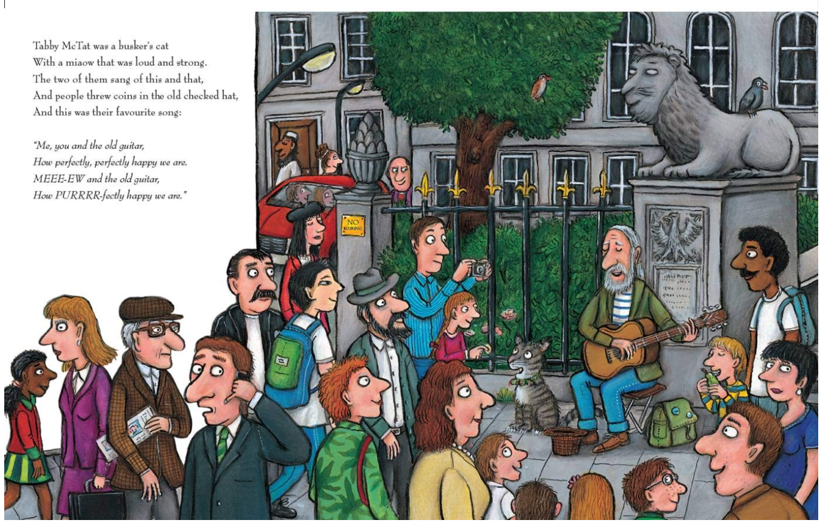
Tabby McTat was a busker’s cat.
What is a busker?
Lots of people are watching Tabby McTat and the busker sing. What different things are they holding in their hands?
If you could play to learn any musical instrument what would it be?
Notes:
Now, let’ talk a bit more about some of the pictures in more detail. One of the reasons why I enjoy reading Julia Donaldson’s books so much is that the illustrations are very detailed and they help me or the reader understand the story. Let’s look at this picture in more detail and try to answer the questions. This is the first page from the story and here the reader is introduced to the main characters – the busker and Tabby McTat

Slide 17
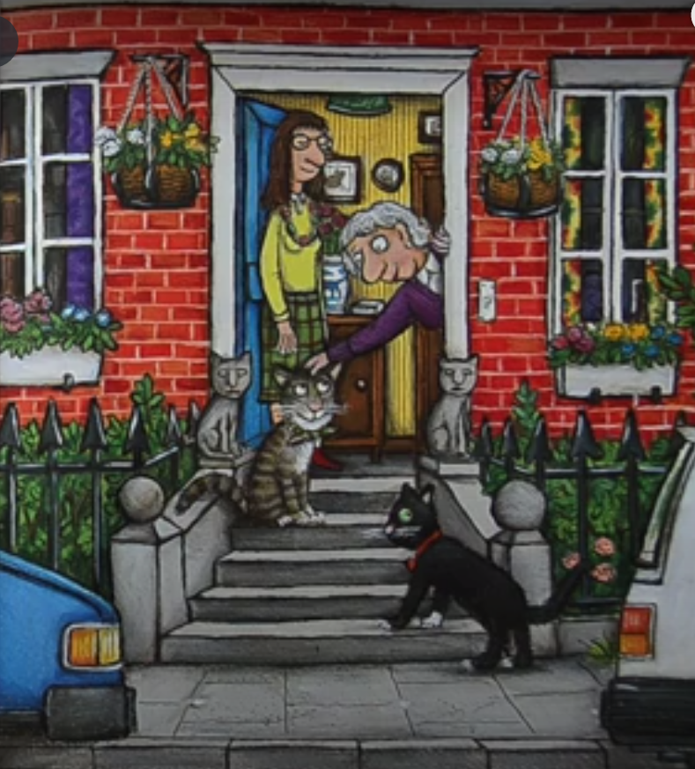
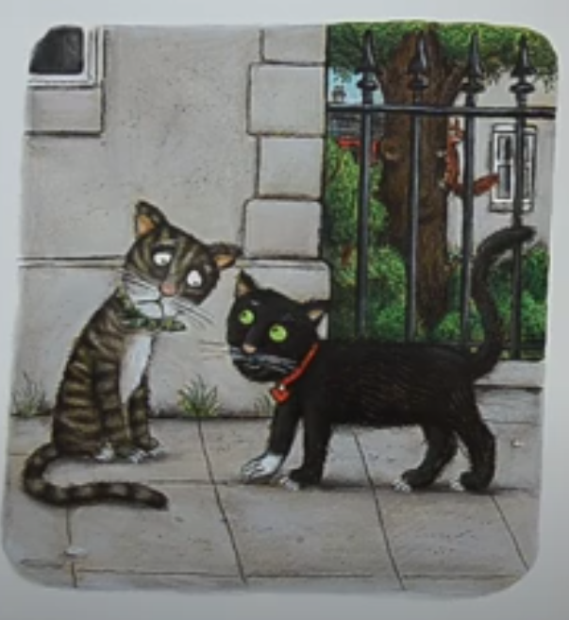
Tabby McTat can’t find Fred.
Why can’t Tabby McTat find Fred?
What does Tabby McTat think happened to Fred?
How can you tell that Prunella and Pat like cats?

Slide 18
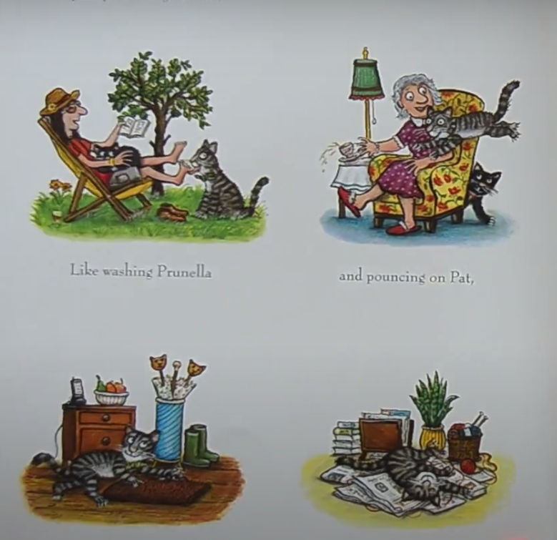
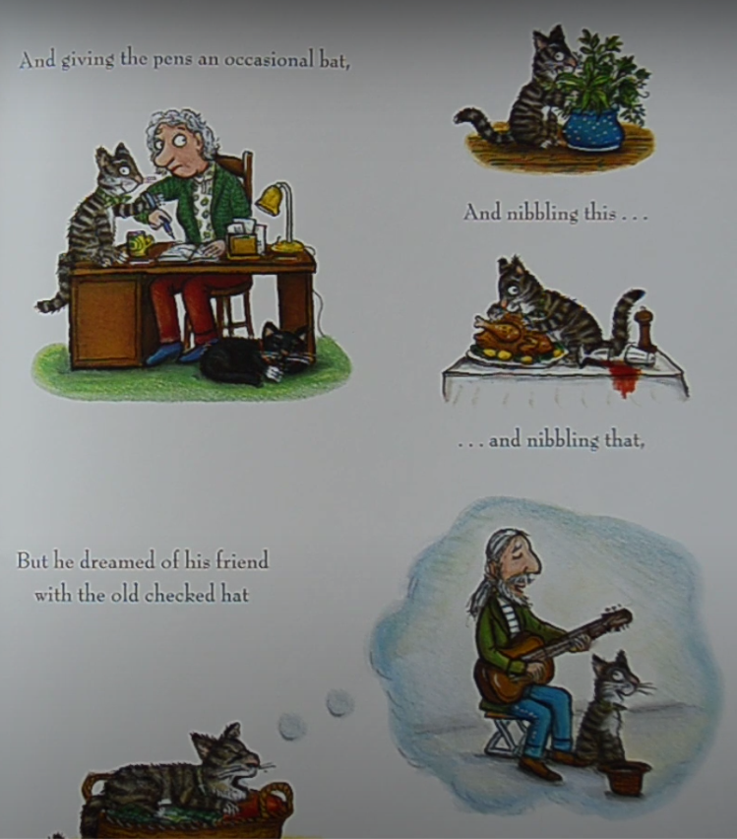
Tabby McTat has a very full life.
Tabby McTat has plenty of things to do.
Can you see what they are?
Does he do anything naughty?
Why do you think he dreams of his friend Fred?

Slide 19
scruffy
glossy
white eyes
green eyed
green neck tie
red collar with heart shaped tag
grey stripy fur
white chin and bib
black with one white sock
Notes:
First, let’s look at how Tabby McTat looks. Let’s compare the way Tabby McTat looks to how Sock looks.

Slide 20
says
thinks
does
feels
Notes:
Right, now let’s go deeper into Tabby McTat’s character up to the point where we stopped the story. When we think about character we generally think in terms of what a character feels, says, thinks and does. We need to support our answers by finding evidence from the text. If we had the book in front of us, we would be able to flip through the pages to find the information we need, but instead we need to listen to the story one more time.

Slide 21
Notes:
Stop at 3:18

Slide 22
says
thinks
His meow is loud and strong.
When he sings he says that he’s perfectly happy.
He says nice words to Sock.
He thinks that Fred went off without him.
He wonders what happened to Fred.
does
feels
Sings, takes a stroll, chats with Sock.
Waits for Fred to come back
Washes Prunella, pounces on Pat, hides the car keys, flattens the newspaper
Happy to be with the busker
Lonely, abandoned, afraid when he can’t find the busker
Confused
In love/relieved

Slide 23
Thank you for using this resource. Check out our latest resources below.

