Slide 1
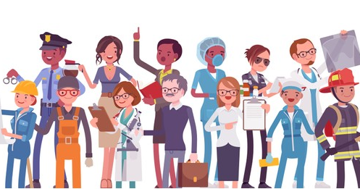
Jobs and Occupations
Lesson 3 - Literature

Slide 2
Notes for the Educator
This lesson is pegged directly to Learning Outcome 6.2.3. Demonstrate ability to integrate and adapt their reading strategies when reading difficult or unfamiliar text; 6.2.6 Participate in shared reading experiences and 6.2.8 Read and understand unfamiliar text.
Teachers are to refer to the Scheme of Work where each lesson is explained in more detail.
Effects are included to make the presentation more interactive. Please present the PowerPoint in Slideshow mode.
Wherever possible we have included the use of online apps to enhance the teaching and learning experience.
The Notes section underneath the slides may contain some further points which can be developed during the lesson.
Teachers are encouraged to adapt this PowerPoint presentation to meet the learners’ language needs.
Audio files or links to websites may be included.
Tasks included in the PowerPoint presentation are also being shared as handouts.
For any comments, feedback or suggestions please email us at: marie-claire.camilleri@ilearn.edu.mt; urieth.attard@ilearn.edu.mt; mary.jude.camilleri@ilearn.edu.mt. You may also call the office on: 25983683.

Slide 3
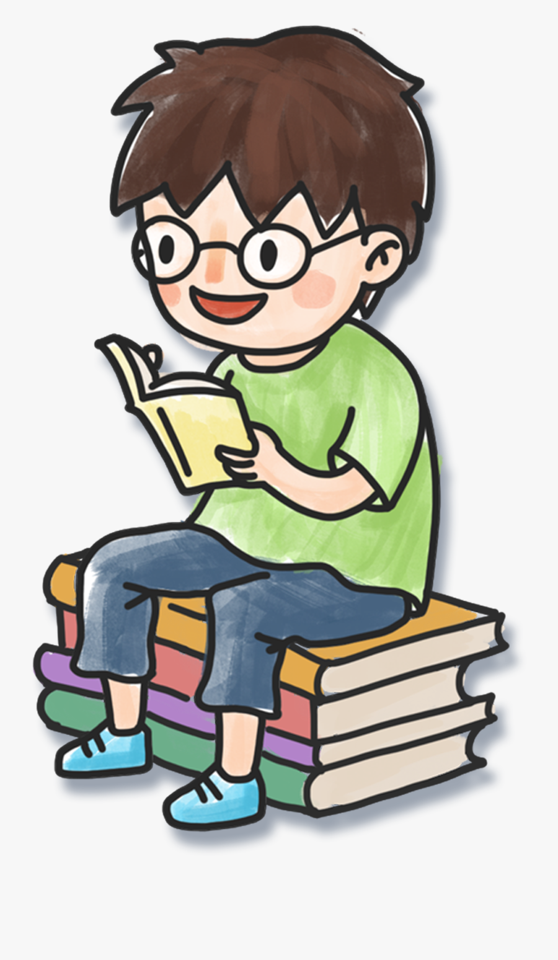
I am learning to read and respond to a poem.
I can read and respond to a poem.
I can understand the poet’s message.
I can make inferences based on the information in the poem.

Slide 4
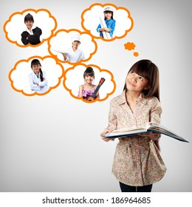
Notes:
When you are older, what kind of job would you like to have? An artistic job? Or a practical job? What are the differences? A job helping other people? How many different jobs can you think of for these categories.

Slide 5
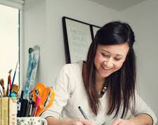
Notes:
Artistic jobs: artist, fashion designer, illustrator, art teacher, make-up artist

Slide 6
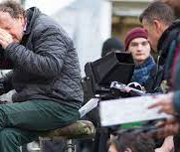
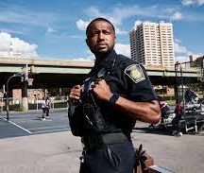
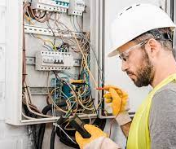
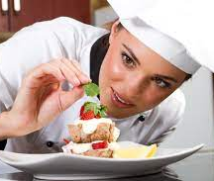
Notes:
Practical jobs: camera person, electrician, mechanic, police officer, chef

Slide 7
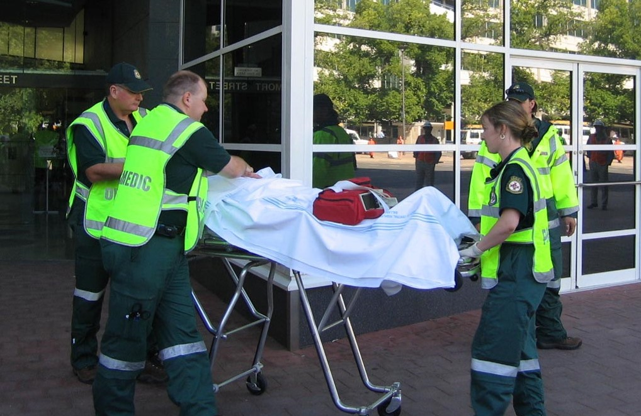
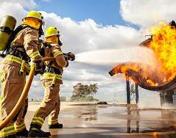
Notes:
Helping jobs: surgeon, paramedic, teacher, nurse, firefighter

Slide 8
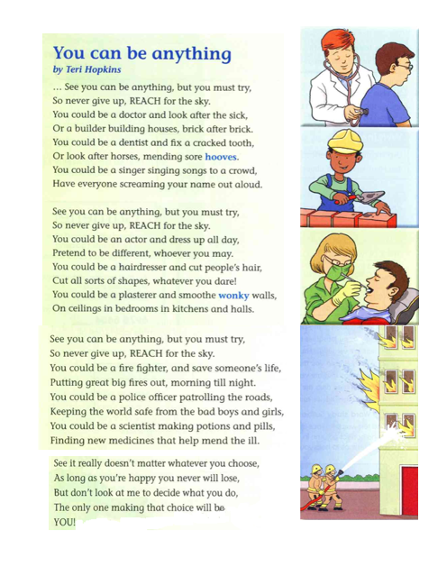
Notes:
Now, read the poem silently to yourselves. Underline any words that you don’t understand.
Does the poem mention any jobs that you thought of in the beginning of the lesson?
Right, now I’m going to read it aloud. Please follow along while I read.

Slide 9
Understanding the poem
How many jobs does the poet mention?
Are any of the jobs similar?
Which jobs are very different from each other?
What point is the poet making by writing about jobs that are very different?
What is the main theme of the poem?

Slide 10
hostler
How many jobs does the poet mention?
Notes:
So, let’s go over this question carefully. Let’s underline all the jobs that are mentioned in the poem.
Looking after horses – here the poet doesn’t mention the name of the job, but it is still a job, so we should count it. A person who looks after horses is called a hostler
Right, there are 11.

Slide 11
Are any of the jobs similar?
Notes:
Here, so the question is asking us to find similar jobs. I think that a doctor and a dentist are very similar because they are both jobs that help people to live or feel better. The person needs to study a lot in order to become a doctor or a dentist, so they are similar in that way as well. Similarly, I think that a fire fighter and a police officer are also similar because they are both dangerous jobs which help people live safely.

Slide 12
Which jobs are very different from each other?
Notes:
I think an actor and a dentist are two very different jobs. They require different skills and qualities such as an actor needs to have a good memory and be knowledgeable about different plays and books. A dentist needs to be knowledgeable about dental hygiene and can fix teeth or cavities. Besides an actor needs to be confident in front of an audience of people whereas a dentist only sees one client at a time.

Slide 13
What is the main idea of the poem?
poet’s message
Notes:
So, when we think about the main idea of the poem, we think about the message that the poet is trying to express. It becomes very clear, when reading this poem that the poet wants the reader to believe that he or she can be anything as long as they try and word hard to become what they wish. There’s plenty of repetition to support this – in fact, almost each stanza starts with the same words ‘ See you can be anything’ followed by ‘ but you must try’. The poet also wants the reader to never give up – no matter how hard it might be – we need to aim high – have high standards – aspire to be the best and to always do your best.
At the end of the poem, the poet also tells the reader that they are only the persons who can truly decide what they want to become when they grow up – so don’t rely on anybody else to make this decision for you. And why might that be a good idea? Because you will be the one doing that job everyday – so it’s best if you choose your job yourself.

Slide 14
What point is the poet making by writing about jobs that are very different?
crooked
Notes:
Yes, the poet mentions jobs that are very different, that require different skills compleltly such as a plasterer and a doctor. As a doctor you would need to be very knowledgeable about different medical conditions, the way the body works. A plasterer needs to know a lot about paint and also know how to paint walls professionally. You would also need to know how to smooth crooked walls – that’s the meaning of wonky. Yet, they are both important jobs and the poet wants to stress that ultimately, it doesn’t matter what career path you choose as long as that job makes you happy.

Slide 15
Find ten words for jobs in the poem and look at the endings. Then write them in the correct column. Can you add five more jobs?
-er | -or | -ist
builder
singer
doctor
dentist
hairdresser
actor
scientist
plasterer
firefighter
police officer

Slide 16
Can you find three pairs of rhyming words?
day
may
sick
brick
try
sky

Slide 17
Find and quote an example of repetition in this poem.
See you can be anything, but you must try
So never give up, REACH for the sky
Notes:
We’ve already mentioned repetition. Let’s go back to the poem to quote an example.
Why do you think the author writes ‘REACH’ in capital letters. The poet uses capital letters for the word Reach for emphasis. To give it importance – even when we are reading it.

Slide 18
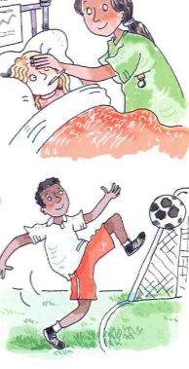
Use the pictures to make two more sentences using the same structure in the poem. Make the sentences rhyme!
You could be a ________ and ______.
________________________________.
You could be a ________ and ______.
_______________________________.

Slide 19
what we can do…
Read and enjoy a poem.
Respond to the poem by answering questions.
Identify the main idea of the poem and the poet’s message.
Notes:
Let’s see what we accomplished in this lesson.

Slide 20
Thank you for using this resource. Check out our latest resources below.

