Slide 1
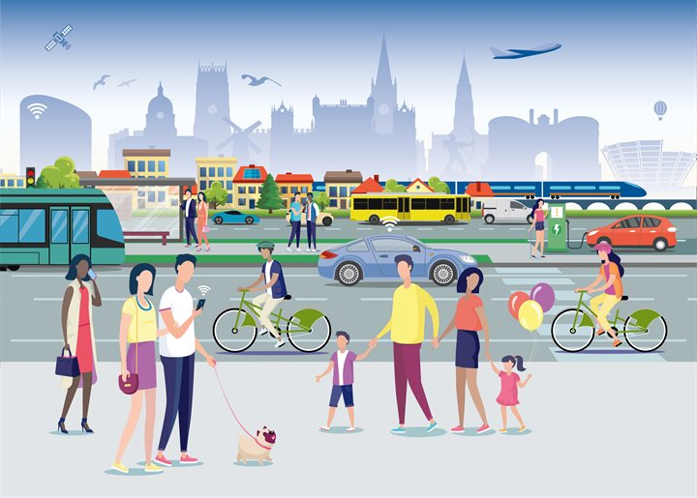
Getting around
Lesson 4 - Speaking

Slide 2
Notes for the Educator
This lesson is pegged directly to Learning Outcome LS 5.8 I can communicate my own experiences, likes and dislikes fluently and accurately with some allowance to self-correct in the process.
Teachers are to refer to the Scheme of Work where each lesson is explained in more detail.
Effects are included to make the presentation more interactive. Please present the PowerPoint in Slideshow mode.
Wherever possible we have included the use of online apps to enhance the teaching and learning experience.
The Notes section underneath the slides may contain some further points which can be developed during the lesson.
Teachers are encouraged to adapt this PowerPoint presentation to meet the learners’ language needs.
Audio files or links to websites may be included.
Tasks included in the PowerPoint presentation are also being shared as handouts.
For any comments, feedback or suggestions please email us at: marie-claire.camilleri@ilearn.edu.mt; urieth.attard@ilearn.edu.mt; mary.jude.camilleri@ilearn.edu.mt. You may also call the office on: 25983683.
Notes:
.

Slide 3
I am learning how to describe vehicles.
I can use adjectives to describe a vehicle’s appearance and features.
I can use simple sentence patterns to talk about means of transport.
I can self correct some mistakes I make while speaking.
Notes:
Learning intention for this lesson is to learn how to talk about different foods. We will know that we are doing so by being able to describe vehicle’s appearance and features, by using sentence patterns to talk about means of transport and by self-correcting mistakes while we are speaking.

Slide 4
Describe the vehicle
Speaking Activity 1
Notes:
Let’s start off with the first activity.

Slide 5
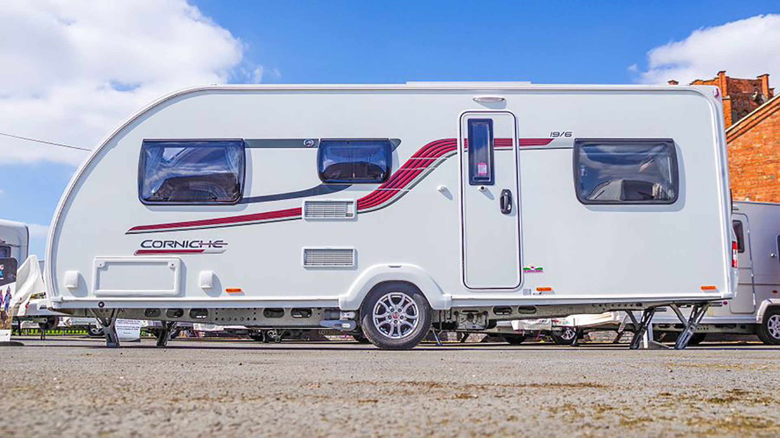
Colour
Shape
Speed
Size
Notes:
What is this vehicle? It is a caravan. How can we describe it? So, we can describe it in terms of size – how big or small it is, its colours, its shape and features and its speed.

Slide 6
This is a caravan.
It is quite large. It is white with a red stripe along its side. It is spacious and bright. It has windows on each side and a small door.
size | colour | shape | speed
large
white a red stripe along its side
spacious, bright, windows and a door
Notes:
Let’s try to fill this table together with adjectives that describe the caravan. For size, I can say that it is quite large, in terms of colour I can say that it is white with a red stripe along its side. To describe its shape and features, I can say that it seems to be spacious, and it has windows and door. With regards to speed, I can’t really say anything because this particular caravan needs to be pulled by a car.
Right, now let’s try to use these adjectives into sentences. So about the caravan I can say that It is….Notice how I usually start my sentences with This is, It is or It has…

Slide 7
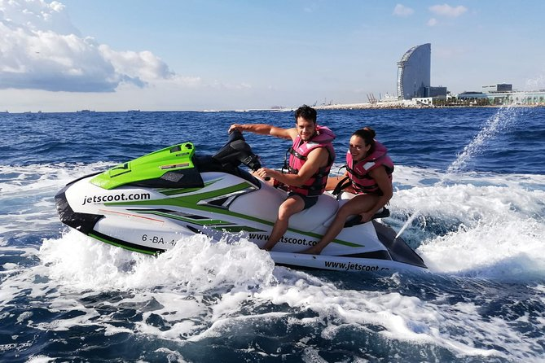
Colour
Shape
Speed
Size
jet-ski
white
fast
modern
roomy
Notes:
Now, let’s try to do the same thing about a jet-ski. How can I describe it in terms of size, colour, shape and features and speed? The words at the bottom may help you.

Slide 8
This is a jet ski.
It is white with green. It can sit two people comfortably. It has a steering wheel and it can go very fast in the water.
size | colour | shape | speed
roomy – can sit two people
white with green
modern – with steering wheel
fast
Notes:
Have you come up with the following adjectives to describe the jet-ski? Now let’s try to make sentences to give a good description.

Slide 9
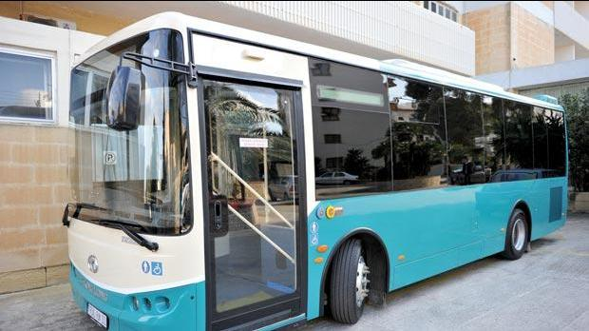
Colour
Shape
Speed
Size
bus
crowded
slow
noisy
comfortable
Notes:
Now, we are going to do the same thing again, but this time with the Arriva bus. Take some time to come up with words to describe the bus.

Slide 10
This is a ______.
It is ___________. It is ________ and it has ___________. Sometimes, it can __________ because _____________. It can go _________ but ______________.
size | colour | shape | speed
modern, large tinted windows, crowded
Fast – depending on traffic, frequent stops
big
Top part white, green bottom
Notes:
Let me show you the words I thought of. Now, can you form sentences using these adjectives. Make sure there is an adult next to you to hear your description.

Slide 11
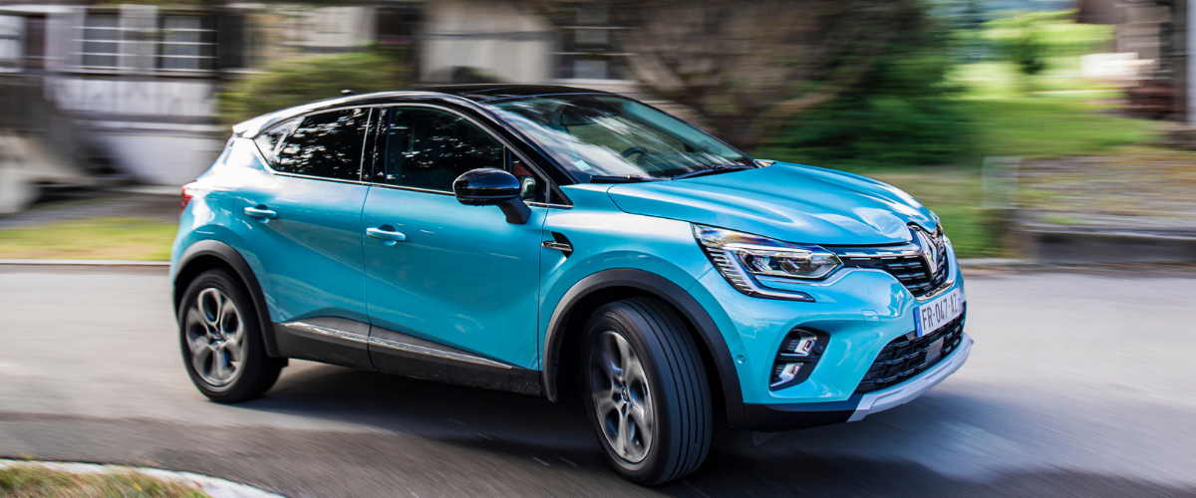
car
Colour
Shape
Speed
Size
private
fast
safe
comfortable
Notes:
Next, we have a car. Think of different ways how to describe the car.

Slide 12
Black roof, blue body
This is a ______.
It is ___________. It can _________________. It has a __________ . It has _________ and ___________. It can go ______ but it is quite _________.
size | colour | shape | speed
Spacious – sits five people
Black roof, blue body
modern, tinted windows, side mirrors, safe
Fast – depending on traffic
Notes:
Let’s use these words and form sentences.

Slide 13
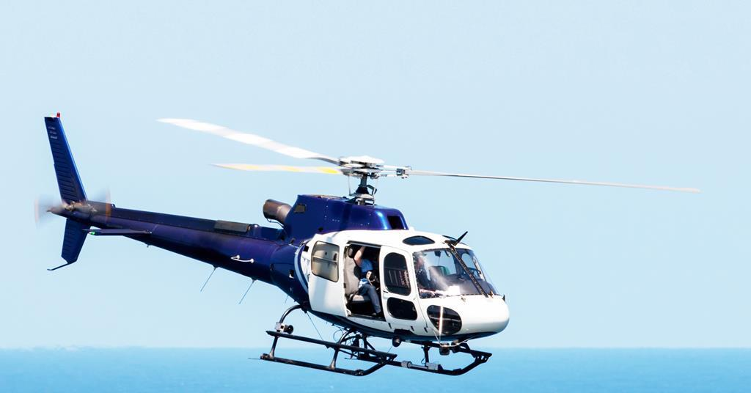
Colour
Shape
Speed
Size
helicopter
sleek
blue
white
fast
Notes:
Finally, let’s try to describe a helicopter.

Slide 14
This is a ______.
It is ___________. It can _________________. It is _____ and __________ . It has ____________________. It can go ______ and it is used _________.
size | colour | shape and features | speed
blue tail, white cockpit
rotating blades, sliding door, noisy, land anywhere
fast, emergencies
big, long narrow

Slide 15
Transport riddles
Speaking Activity 2
Notes:
In this activity you need to guess which vehicle I am describing by listening carefully or reading the clues that I am about to share with you. Proceed with slides 17 through 20.

Slide 16
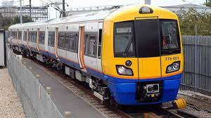
I have a bell and a loud whistle.
I can carry lots of people and things.
I may be long. I may be short.
My wheels roll only on rails.
?
train

Slide 17
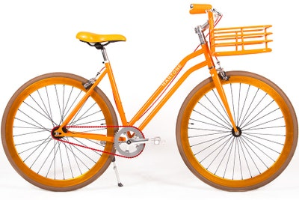
?
I have two wheels.
I have pedals for you to cycle.
Sometimes I have a bell or a horn.
You can ride on me.
What am I?
bicycle

Slide 18
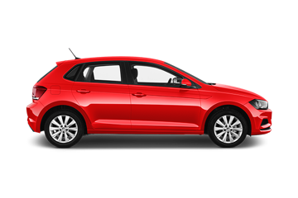
I have four wheels.
I am very useful.
I take people to work and on vacations.
I take people shopping, too.
What am I?
?
car

Slide 19
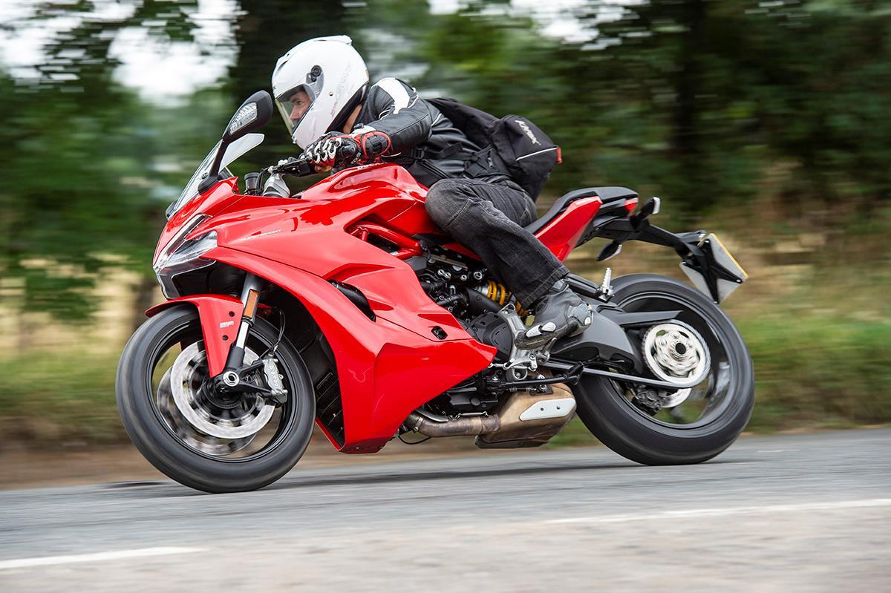
?
I am tricky to ride, but lots of fun.
I can carry two people at a time.
Do not forget your helmet.
Who am I?
motorbike

Slide 20
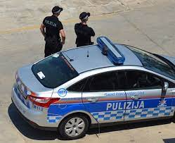
?
I have a siren and flashing lights.
My driver keeps you safe.
I drive criminals to jail.
Who am I?
police car

Slide 21
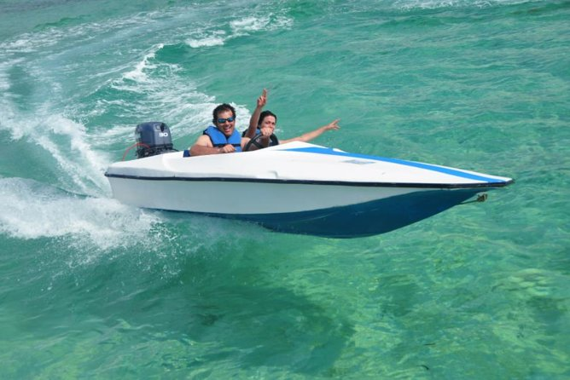
Clue 1 | Say something about how the vehicle looks.
Clue 2 | Say something about why the vehicle is used.
Clue 3 | Say something about where you can find it.
 | Who am I?
speedboat
Notes:
Now, it is your turn to make up clues. Let’s make up clues about a speedboat first. You need to think of three clues, kind of like I did. In the first clue, say something about how the vehicle looks. In your second clue say something about why the vehicle is used and in the third clue, say something about where you can see this vehicle. Can someone at home guess the vehicle?

Slide 22
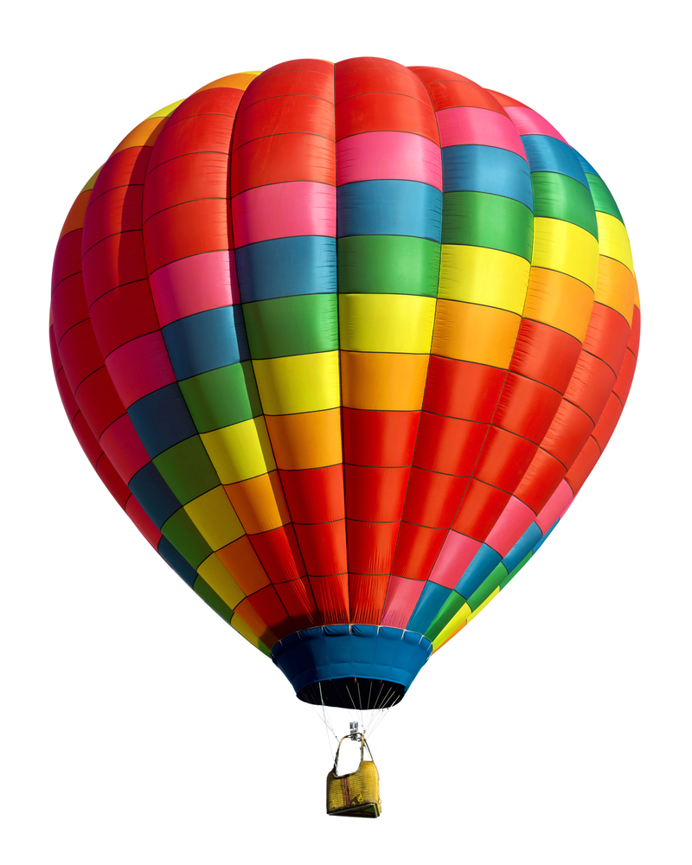
Clue 1 | Say something about how the vehicle looks.
Clue 2 | Say something about why the vehicle is used.
Clue 3 | Say something about where you can find it.
 | Who am I?
hot air balloon
Notes:
Let’s do the same about these vehicles: a hot air balloon, a plane and a space ship.

Slide 23
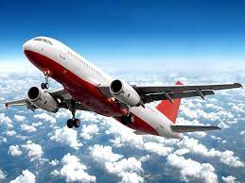
Clue 1 | Say something about how the vehicle looks.
Clue 2 | Say something about why the vehicle is used and by who.
Clue 3 | Say something about where you can find it.
 | Who am I?
plane

Slide 24
Clue 1 | Say something about how the vehicle looks.
Clue 2 | Say something about why the vehicle is used and by who.
Clue 3 | Say something about where you can find it.
 | Who am I?
space ship

Slide 25
Clue 1 | Say something about how the vehicle looks.
Clue 2 | Say something about why the vehicle is used and by who.
Clue 3 | Say something about where you can find it.
 | Who am I?
?
Notes:
Learners think of another means of transport. They use the same patterns to come up with clues about this vehicle.

Slide 26
Thank you for using this resource. Check out our latest resources below.

