Slide 1
Jobs and Occupations
Lesson 3 - Reading

Slide 2
Notes for the Educator
This lesson is pegged directly to Learning Outcomes R 5.5 I can use a range of strategies to aid comprehension and find the required information in the text and R 5.7 I can make informed assumptions about a text or long work from its title and introductory material.
Teachers are to refer to the Scheme of Work where each lesson is explained in more detail.
Effects are included to make the presentation more interactive. Please present the PowerPoint in Slideshow mode.
Wherever possible we have included the use of online apps to enhance the teaching and learning experience.
The Notes section underneath the slides may contain some further points to help you during the lesson.
Teachers are encouraged to adapt and make the necessary changes to this document as required to meet the learners’ language needs.
Audio files or links to websites may be included.
The tasks included in the PowerPoint presentation are also being shared as handouts.
For any comments, feedback or suggestions please email us at: marie-claire.camilleri@ilearn.edu.mt; urieth.attard@ilearn.edu.mt; mary.jude.camilleri@ilearn.edu.mt. You may also call the office on: 25983683.

Slide 3
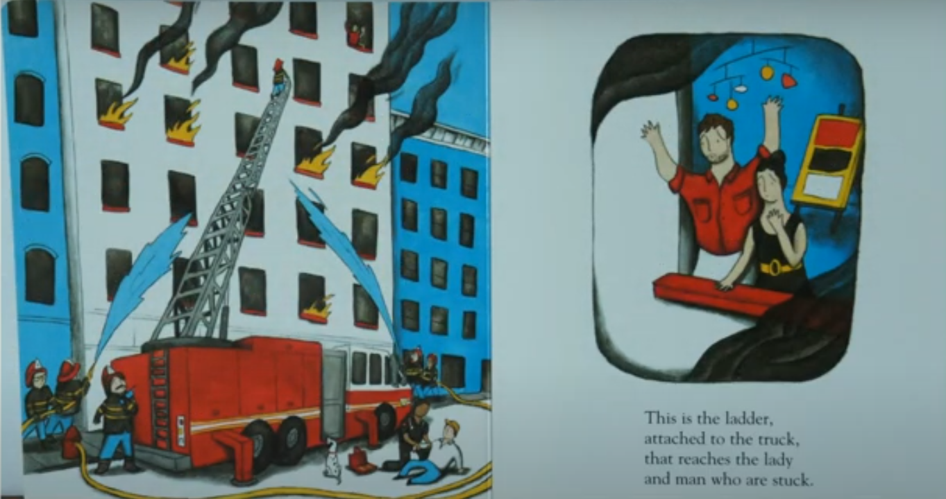
Notes:
Do you remember our book from our last lesson? What was it about?

Slide 4
I am learning how to read an information text and respond to it.
I can scan the text to look for specific answers.
I can say what the text is about by looking at the pictures and captions.
I am able to complete the tasks.

Slide 5
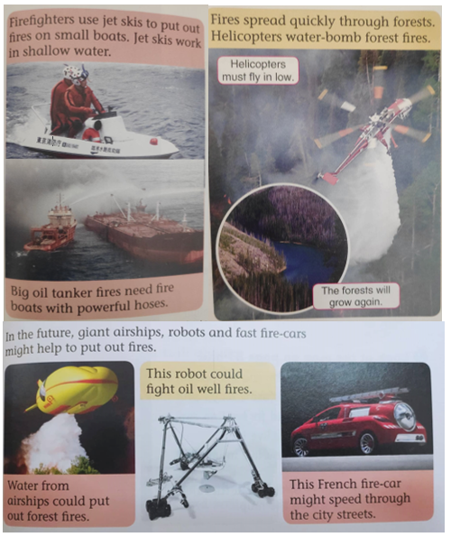
Notes:
What do you notice about this text?
What can you say about the pictures? Are the pictures drawn by an illustrator or are they real pictures?

Slide 6
real events
photos

Slide 7
map with arrows and labels
Notes:
It also has a diagram with arrows and labels.

Slide 8
captions that explain the photos
Notes:
Under or above each picture there is a caption – which explains the picture
Do you think this is similar or different to the text we read before?
Let’s have a look at the two texts.

Slide 9
FICTION
NON-FICTION
not a real story
story talk
illustrations
read in order
beginning, middle and end
problem and solution
real
fact talk
photos, graphs or charts
read in any order
table of contents
information

Slide 10
Author’s Purpose
to persuade
to inform
to entertain

Slide 11
P
I
E
P
I
E
FICTION
NON-FICTION
Read to enjoy ourselves
Read to learn
Purpose:
To Entertain
Purpose:
To Inform

Slide 12
Notes:
Let’s have a closer look at the text. You may now refer to the handout with the text that you downloaded.
Looking at the pictures can help us understand the text better. You can also pick out key words from the text that help you locate information.

Slide 14
Task 1. Complete the sentences by using words from the text.
giant
The sun is a _________ fire out in space.
We light a fire to keep ourselves __________.
A person who is trained to fight fires is called a _______________.
Jet skis are used to put out fires in ___________ water.
In the future ____________ could be used to put our forest fires.
warm
fire fighter
shallow
airships

Slide 15
Notes:
Can you find Malta on the map? Is it labelled? Do you know where it is?
Can you name some other countries from the map? Do you know anyone who lives in another country?

Slide 16
Task 2. Join the picture to its caption.
A fire boat putting out a fire on a big oil tanker.
A modern fire-car which drives at highspeed.
Fire is used to keep us warm and cook our meals.

