Slide 1
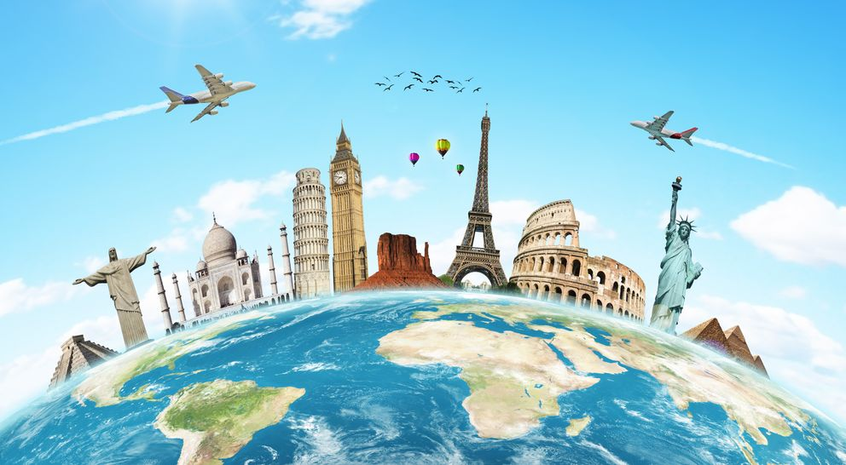
The World Around Us
Lesson 3: Literature

Slide 2
Notes for the Educator
This lesson is pegged directly to Learning Outcome LIT 5.3 I can respond to simple poems, stories, and plays by speaking and writing briefly about how I feel about the literary texts and about the events and characters in these texts.
Teachers are to refer to the Scheme of Work where each lesson is explained in more detail.
The book Earth Dance featured in this lesson may be accessed using this link: https://www.youtube.com/watch?v=tppaMitQj_0
Effects are included to make the presentation more interactive. Please present the PowerPoint in Slideshow mode.
Wherever possible we have included the use of online apps to enhance the teaching and learning experience.
The Notes section underneath the slides may contain some further points which can be developed during the lesson.
Teachers are encouraged to adapt this PowerPoint presentation to meet the learners’ language needs.
Tasks included in the PowerPoint presentation are also being shared as handouts.
For any comments, feedback or suggestions please email us at: marie-claire.camilleri@ilearn.edu.mt; urieth.attard@ilearn.edu.mt; mary.jude.camilleri@ilearn.edu.mt. You may also call the office on: 25983683.

Slide 3
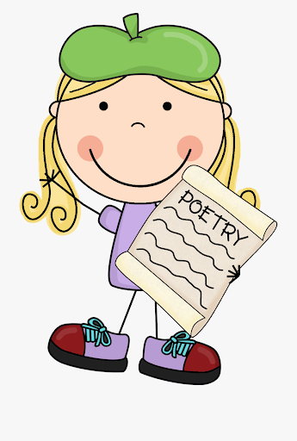
I am learning how to understand a poem.
I can make a mental picture of what I am reading.
I can talk about elements of poetry.
I can answer questions about it.

Slide 4
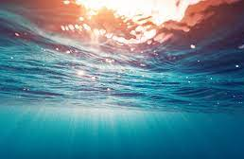
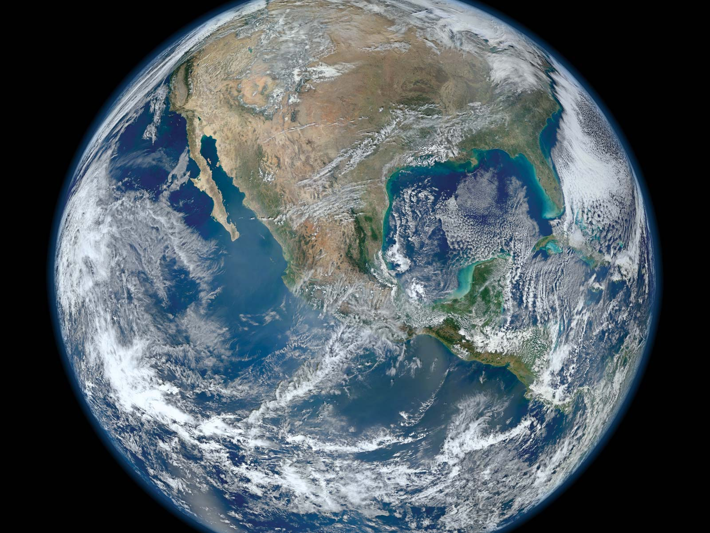
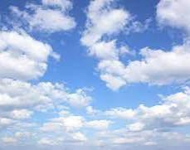
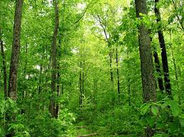
Notes:
Look carefully at these pictures and think how these pictures are related. What do these pictures show?

Slide 5
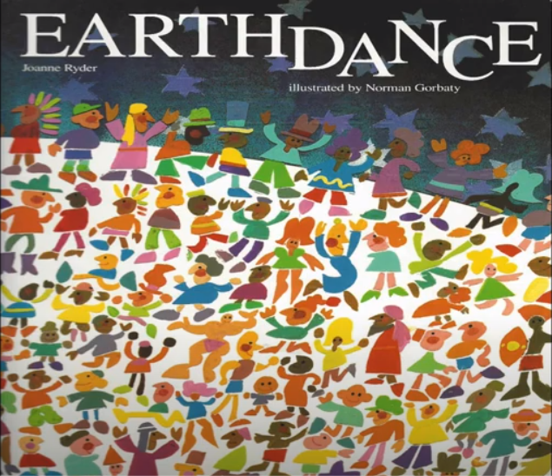
Notes:
Today we will read a book called Earth Dance. It is written by Joanne Ryder. Do you know that the earth dances? Can you think of ways that the earth dances and moves? We have been reading lots and lots of poems, and many of those poems are very quick to read. Today we are going to look at a longer poem that crosses all the pages of a book.

Slide 6
Notes:
Even though you don’t feel it, the earth is moving under your feet all the time. Every day, the earth makes one complete turn on itself and that is how we have day and night. While it’s spinning very slowly on itself, it’s also slowly going around the sun. It takes the earth one whole year to go around the sun – and that is why we have seasons.

Slide 7
Notes:
I chose this poem because the way the poem is written and the colourful illustrations take us on a descriptive journey of the world's environments from oceans and mountains to grasslands and glaciers. Also, what I really like about this poem, is that the poet Joanne Ryder uses a lot of figurative language such as similes to bring the earth to life.

Slide 8
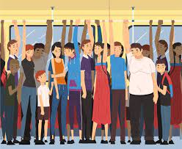
crowded
Notes:
In the word crowded there’s the word crowd, a crowd means a lot of people together in a place, crowded is used to describe a place for example – The bus was crowded with people and we had to stand up.

Slide 9
quilt
Notes:
a warm bed covering made of padding. We use it mostly in winter, then we put it away during the warm summer months.

Slide 10
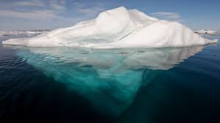
iceberg
Notes:
a large floating mass of ice detached from a glacier or ice sheet and carried out to sea.

Slide 11
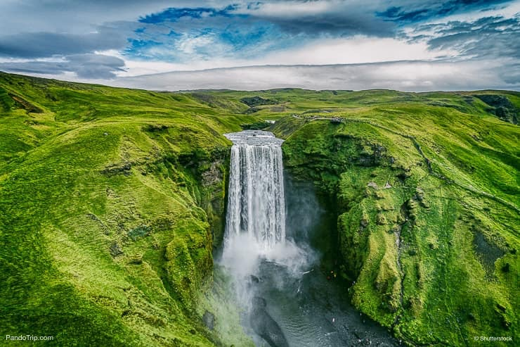
waterfall
Notes:
a cascade of water falling from a height,

Slide 12
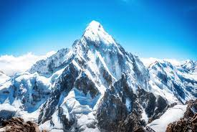
mountains
Notes:
a large steep hill rising above the surface of the ground.

Slide 13
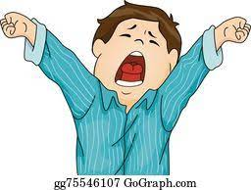
yawning

Slide 14
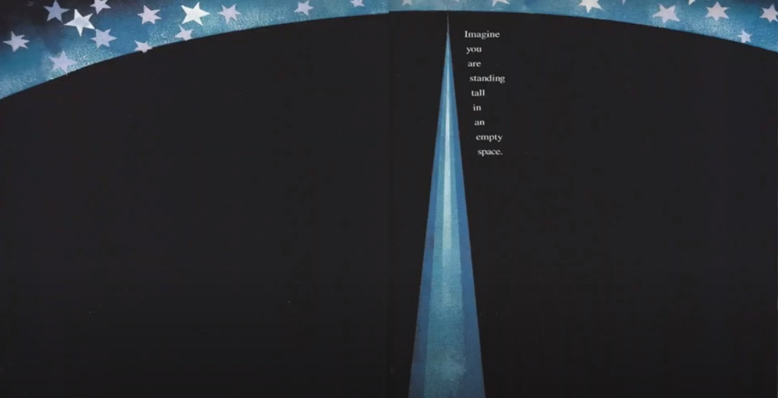

Slide 15
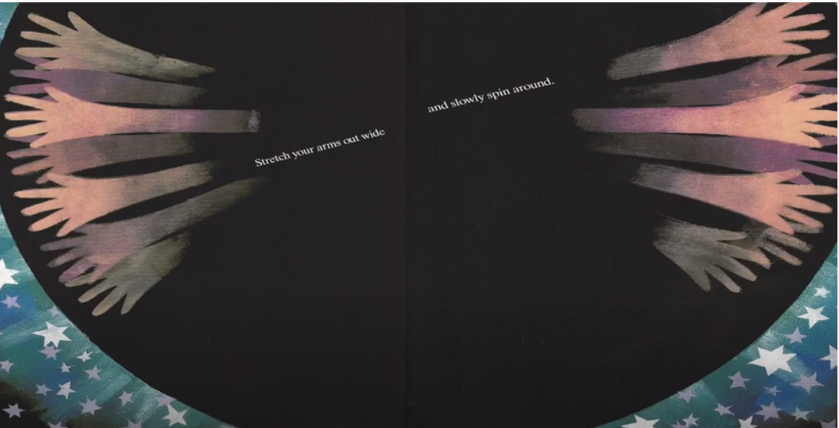

Slide 16
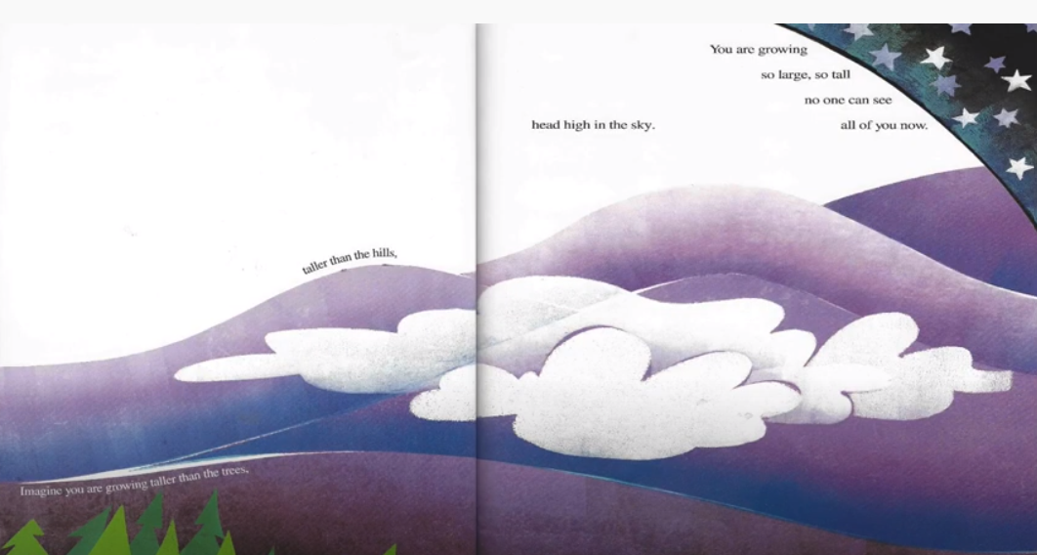

Slide 17
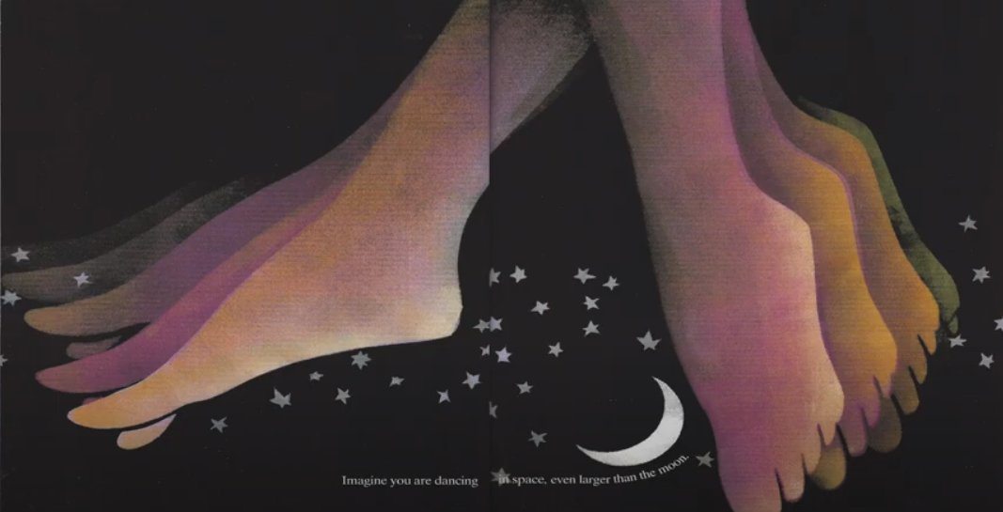

Slide 18
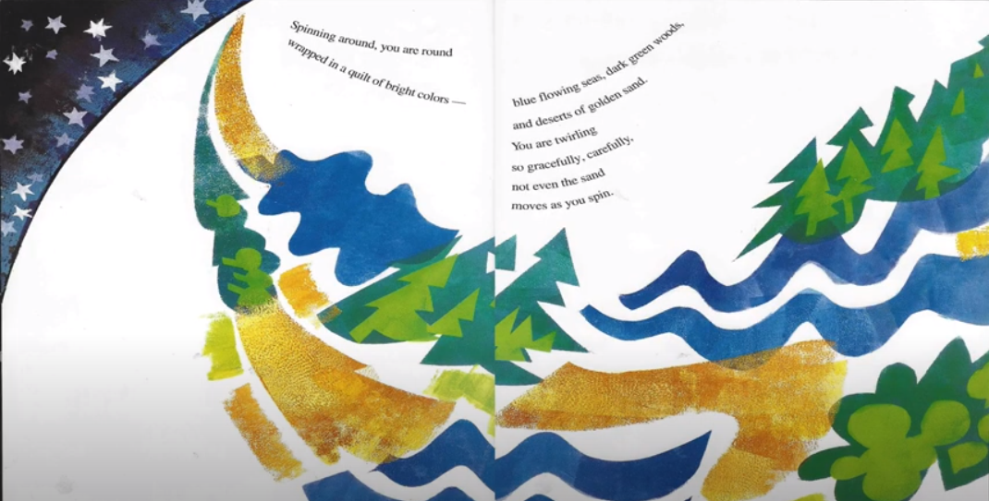

Slide 19
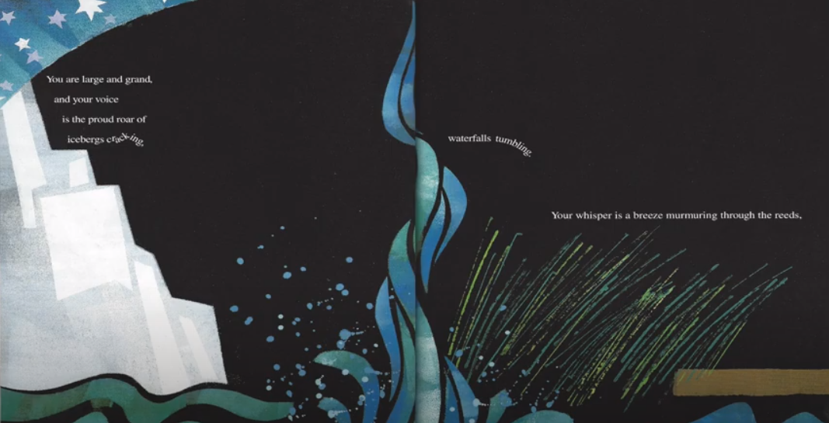
Notes:
You are large and grand and your voice is the proud roar of icebergs cracking, waterfalls trembling. Your whisper is a breeze murmuring through the reeds, a tiny wave lapping land.

Slide 20
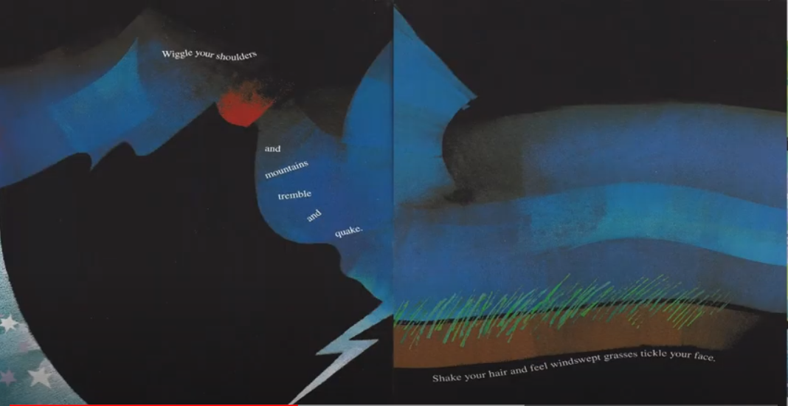

Slide 21
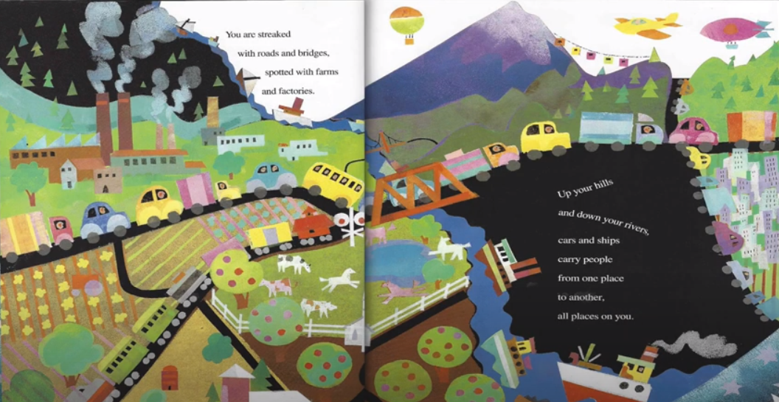

Slide 22
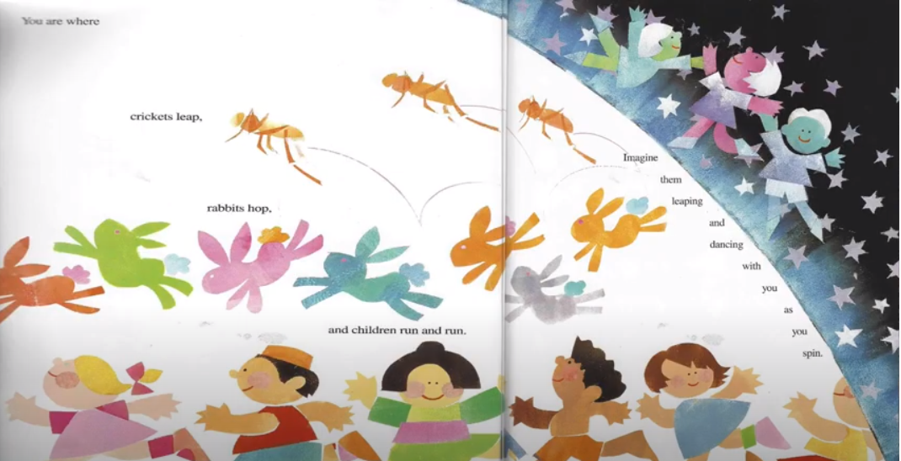
Notes:
When you get to page 15-16 tell the student to move as if the earth would while the following things were happening to them, would it tickle or hurt?

Slide 23
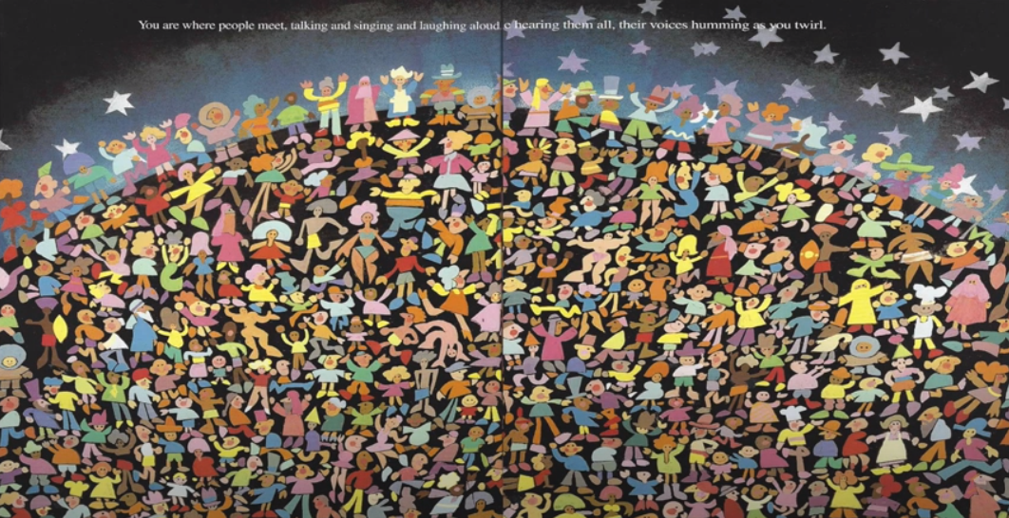

Slide 24
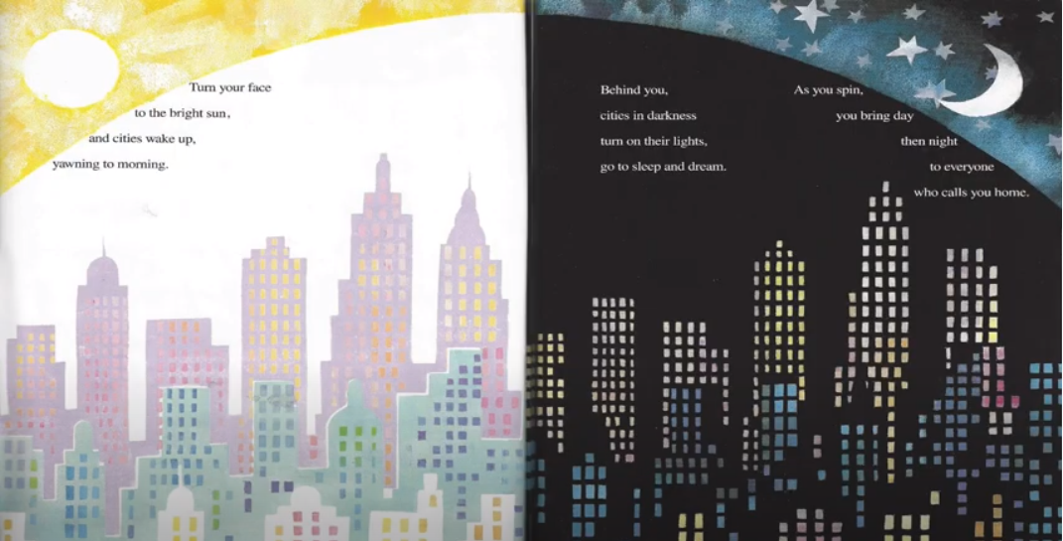

Slide 25
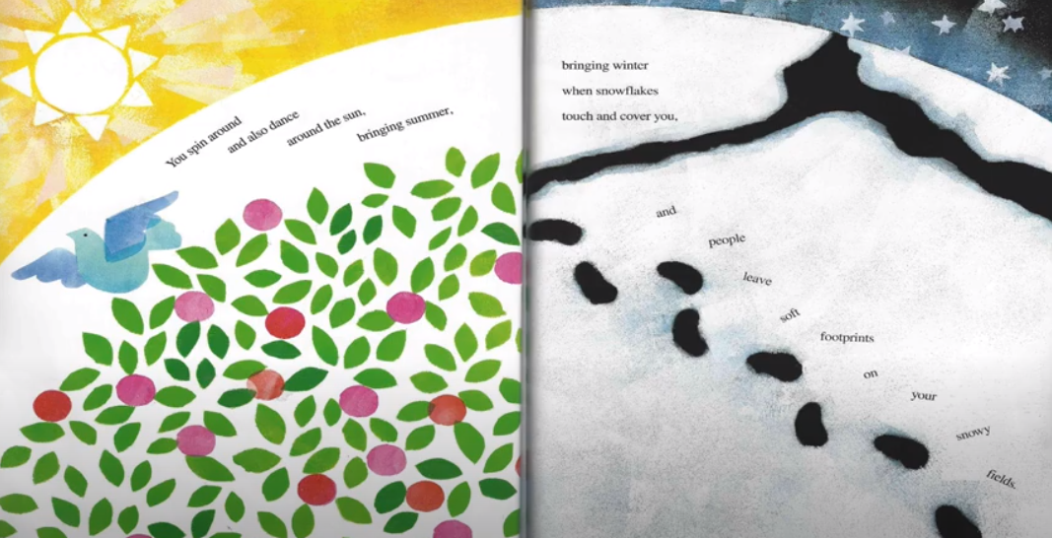

Slide 26
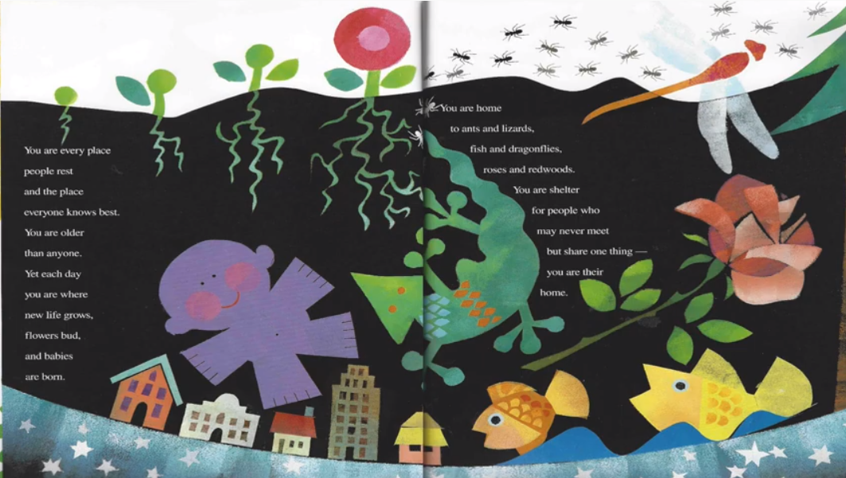

Slide 27
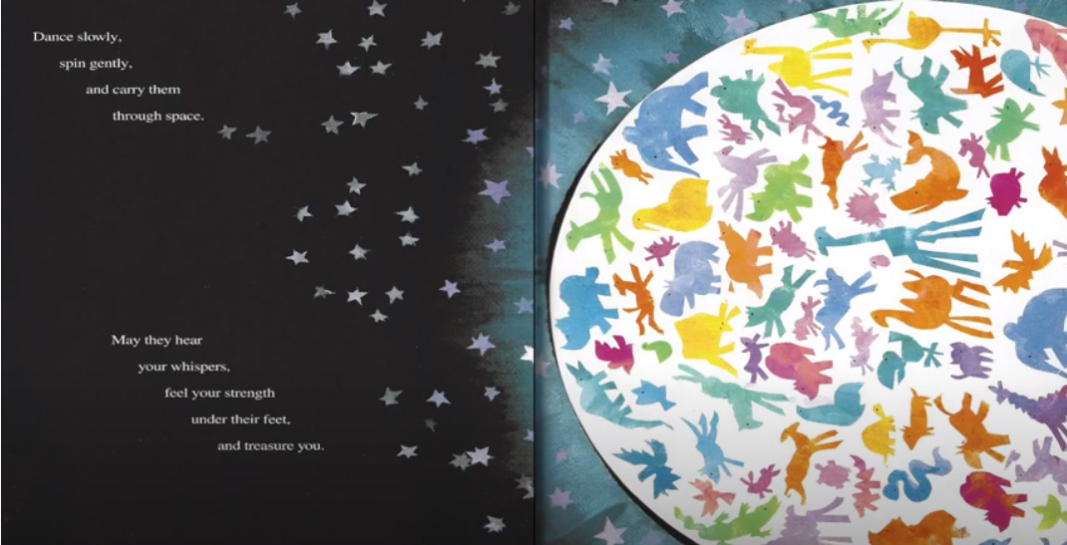

Slide 28
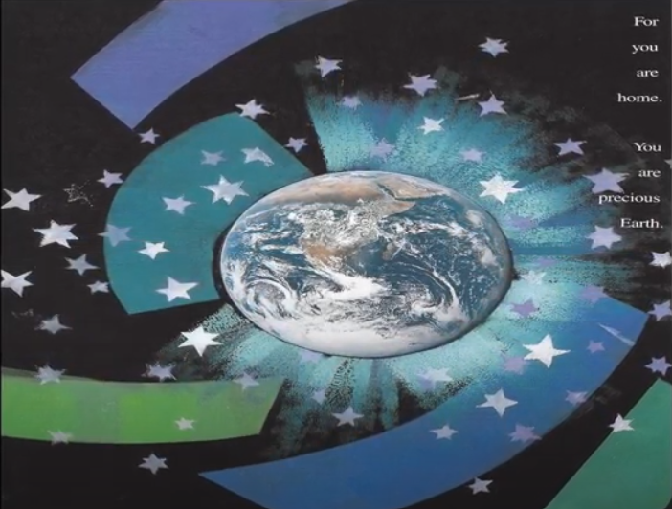

Slide 29
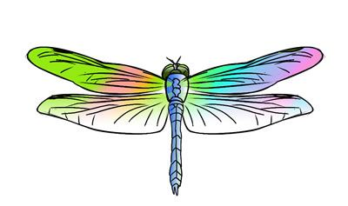
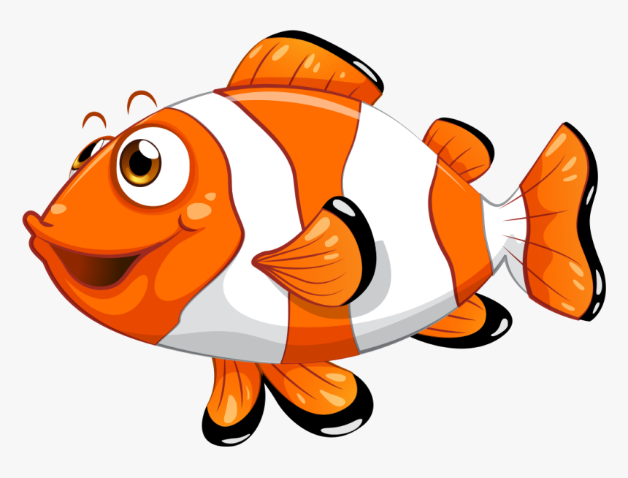
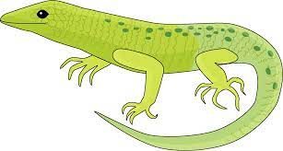
Many animals live on the earth such as insects, lizards and dragonflies.
Notes:
Can we each think of something interesting that you remember from the poem. For example I remember that…

Slide 30
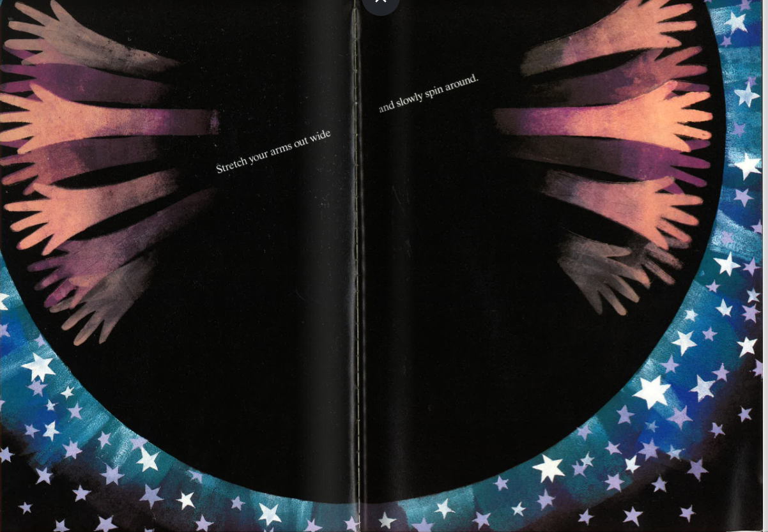
“Stretch your arms out wide, and slowly spin around.”
Why does the poet want the reader to spin around?
Notes:
Let’s focus on words and sentences in the poem. It will help us to understand the poem better. Think about the questions carefully, and discuss the questions in pairs.

Slide 31
“Spinning around you are round
wrapped in a quilt of bright colours -”
Which colours does the poet mention?

Slide 32
blue – sea
dark green – woods
gold – desert sand
Notes:
The poet mentions the blue which represent the flowing ocean, sea. Dark green reminds us of the woods and forests and trees, and gold represents the sand in the desert.

Slide 33
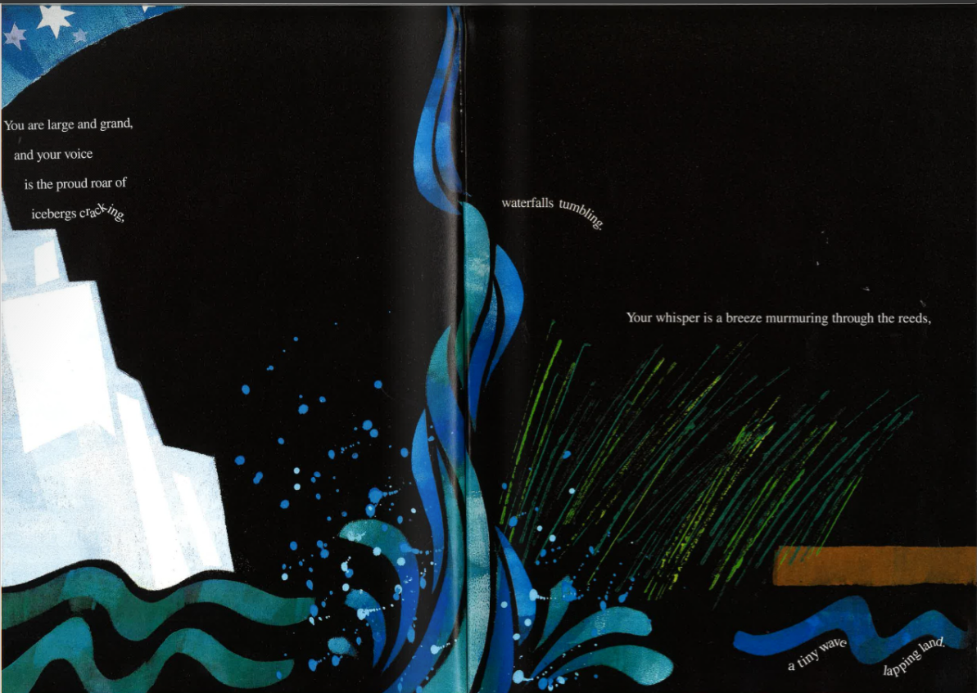
Find examples of onomatopoeia from this page.
roar
murmuring
cracking
whisper
tumbling
lapping
Notes:
The poet also makes use of onomatopoeic words. These are words that are supposed to sound like a real sound. The word itself sounds like the sound it is describing. Let me read this bit to you and together we can see if we find any onomatopoeic words.
You are large and grand and your voice is the proud roar of icebergs cracking, waterfalls trembling. Your whisper is a breeze murmuring through the reeds, a tiny wave lapping land.

Slide 34
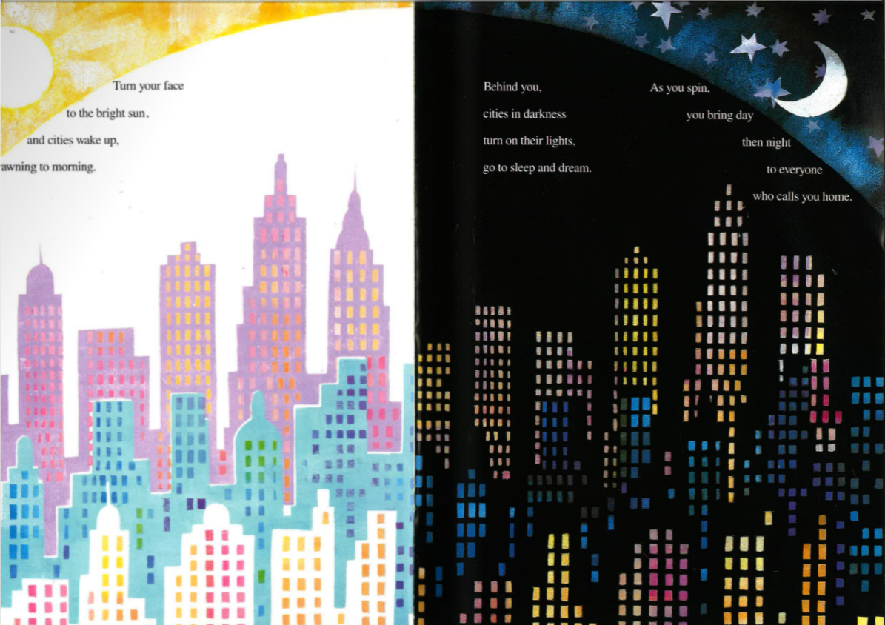
Look carefully at this page.
How are colours used to help us understand this part of the poem better?
Notes:
Here the poet is talking about day an night. On the left hand side it’s day, therefore we have the sun in yellow and the page is bright because it is morning. On the right hand side the poet talks about the night time “cities in darkness” because it is night so the illustrator uses the colour black to show us that it is dark – there’s a silvery moon shining brightly and the same buildings have coloured windows because at night we switch on the lights.

Slide 35
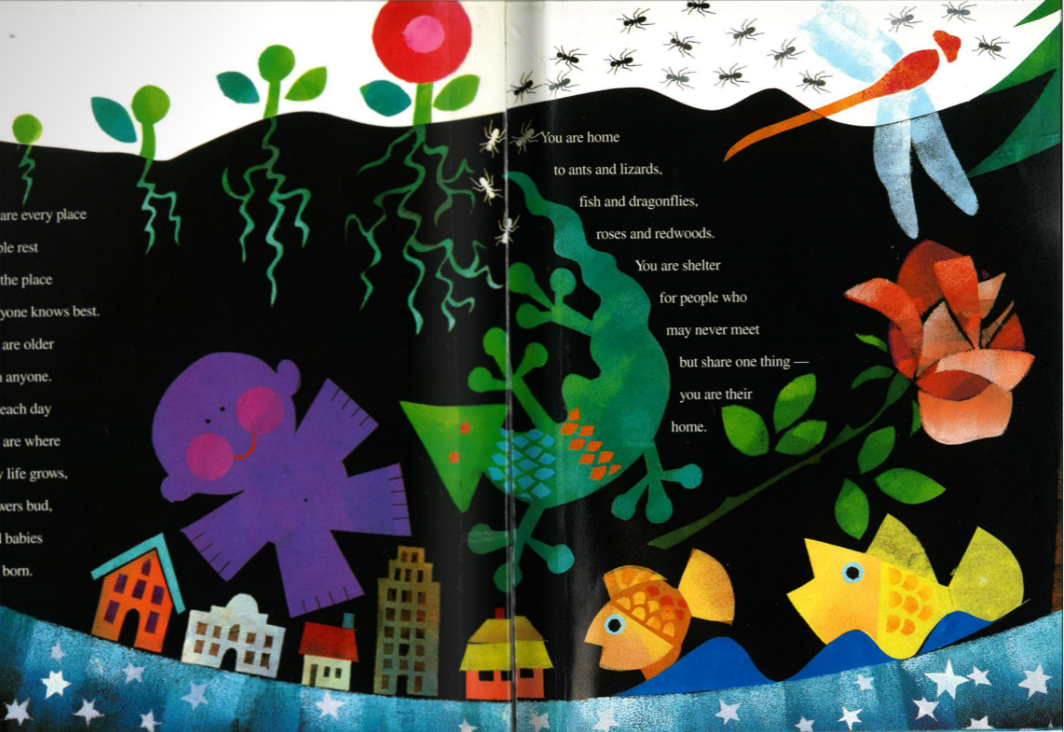
Earth is home to many creatures.
Can you mention some of them?
Notes:
Lizards, fish, ants, dragonflies

Slide 36
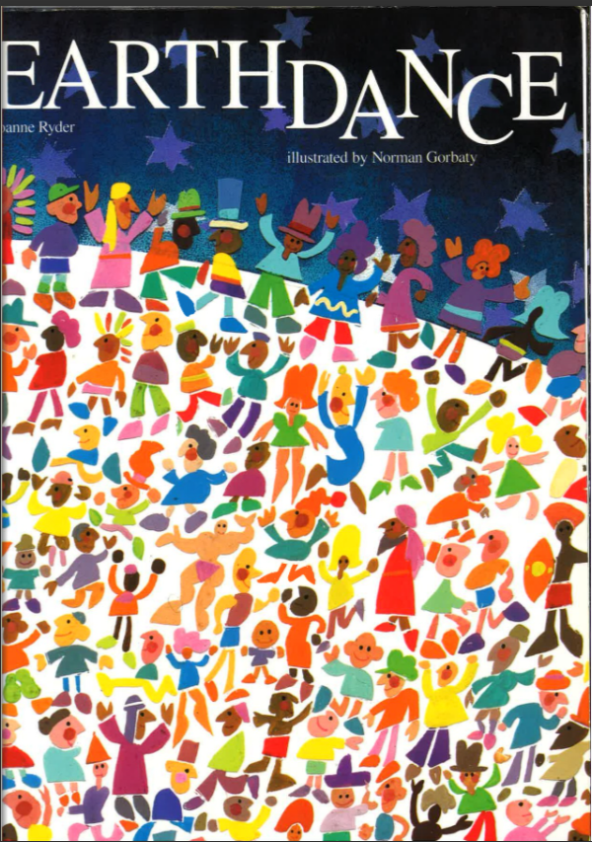
Why do you think the poet chose the name Earth Dance for this poem?

Slide 37
What do you see or imagine when you read this poem?
Notes:
Draw a sketch and write the words from the poem that helped you visualise the poem.

Slide 38
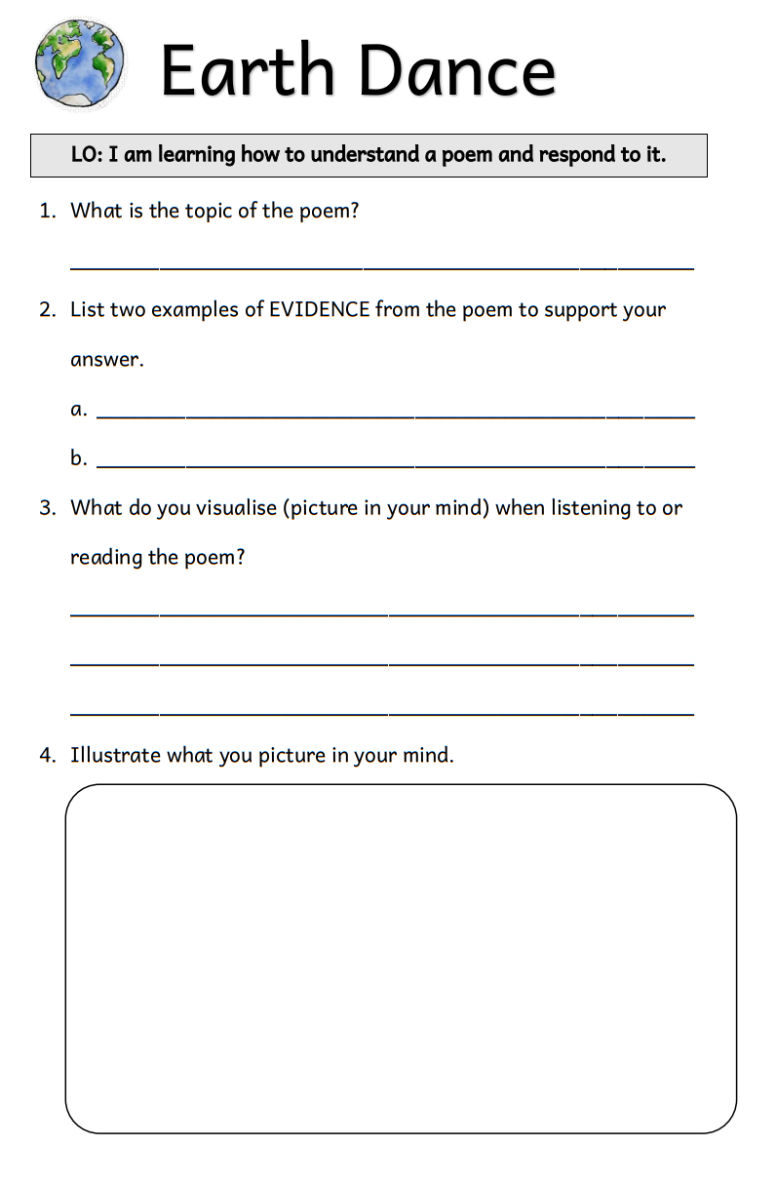
Notes:
Worksheet with questions about the poem.

Slide 39
Thank you for using this resource. Check out our latest resources below.

