Slide 1
Jobs and Occupations

Slide 2
Notes for the Educator
This lesson is pegged directly to Learning Outcome LS 5.2 I can understand audio-visual texts across a range of genres, identifying the main idea and specific information.
It also targets other language outcomes such as: LS 5.8 I can communicate my own experiences, likes and dislikes fluently and accurately with some allowance to self-correct in the process.
The material for this lesson was adapted from: learnenglishkids.britishcouncil.org/songs/people-work
Teachers are to refer to the Scheme of Work where each lesson is explained in more detail.
Effects are included to make the presentation more interactive. Please present the PowerPoint in Slideshow Mode.
Wherever possible we have included the use of online apps to enhance the teaching and learning experience.
The Notes section underneath the slides may contain some further points to help you during the lesson.
Teachers are encouraged to adapt and make the necessary changes to this document as required to meet the learners’ language needs.
Audio files or links to websites may be included.
The tasks included in the PowerPoint presentation are also being shared as handouts.
For any comments, feedback or suggestions please email us at: marie-claire.camilleri@ilearn.edu.mt; urieth.attard@ilearn.edu.mt; mary.jude.camilleri@ilearn.edu.mt. You may also call the office on: 25983683.

Slide 3
Pre-Task: Brainstorming
Create a word list or a word web with different jobs. How many jobs can you list down in 1 minute?
Notes:
Make it interactive: use OneNote, Whiteboard or whiteboard.fi to write word lists.

Slide 4
doctor
Notes:
You might wish to include further vocabulary related to each job: clinic, stethoscope, thermometer, etc…

Slide 5
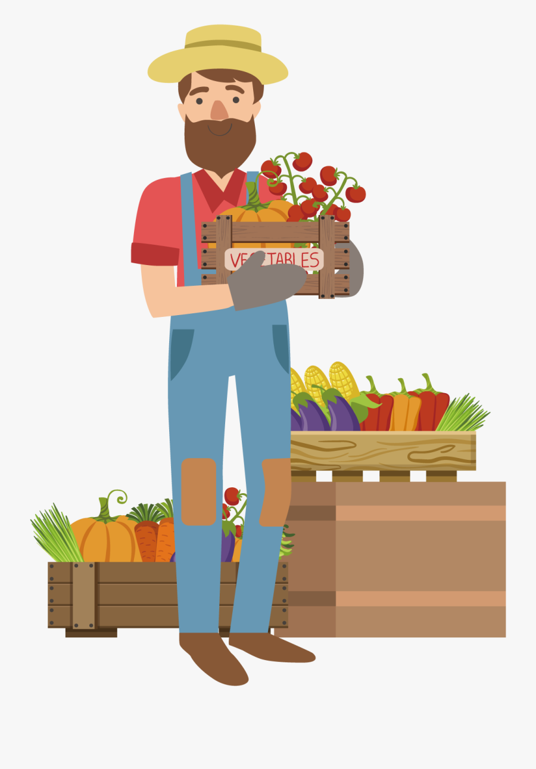
farmer

Slide 6
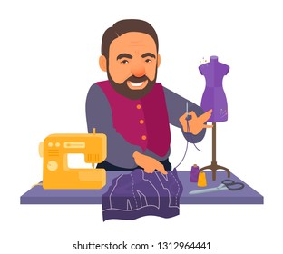
tailor

Slide 7
babysitter

Slide 8
dentist

Slide 9
fire
fighter

Slide 10
plumber

Slide 11
teacher

Slide 12
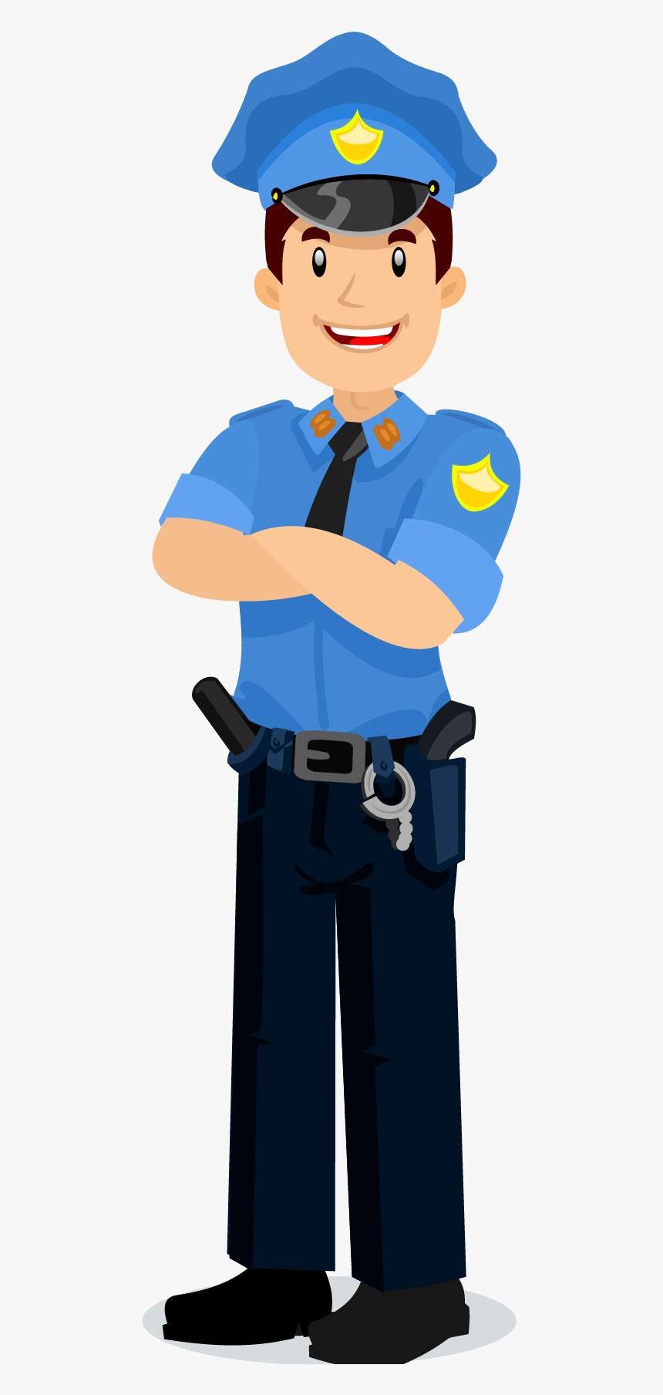
police
officer

Slide 13
engineer

Slide 14
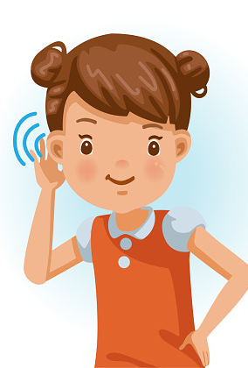
I am learning how to listen and respond to an audio-visual text.
I can understand the main idea.
I can listen to specific details and keywords.
I am able to complete the tasks.

Slide 15
1st Listening
In our first listening, listen very carefully to all the jobs that are mentioned.
https://www.dailymotion.com/video/x59lk7n

Slide 16
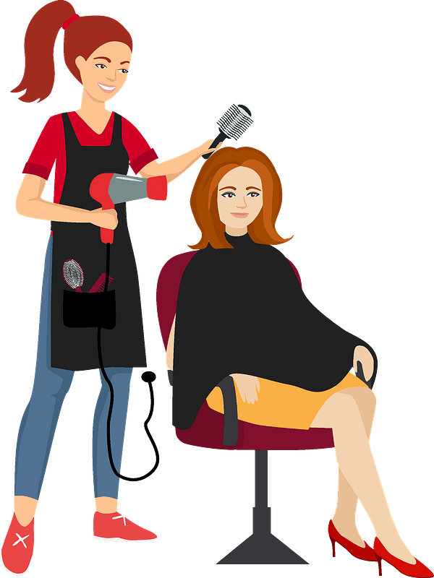
Circle 5 jobs which are mentioned in the song.

Slide 17
2nd Listening
This time, listen very carefully to what each person does.
https://www.dailymotion.com/video/x59lk7n

Slide 18
Task 2: Match the person with the right job.
Nigel Naylor
a farmer
Penny Proctor
a teacher
Peter Palmer
a tailor
Wendy Witter
a plumber
Mabel Meacher
a fireman
Gary Gummer
a dentist
Patty Prentice
a babysitter
Ronnie Ryman
a doctor

Slide 19
3rd Listening
Now, we are going to listen to the song for one last time. By now you should almost know it by heart! Listen very carefully to the description of each job. Do join in, if you know the words!
https://www.dailymotion.com/video/x59lk7n

Slide 20
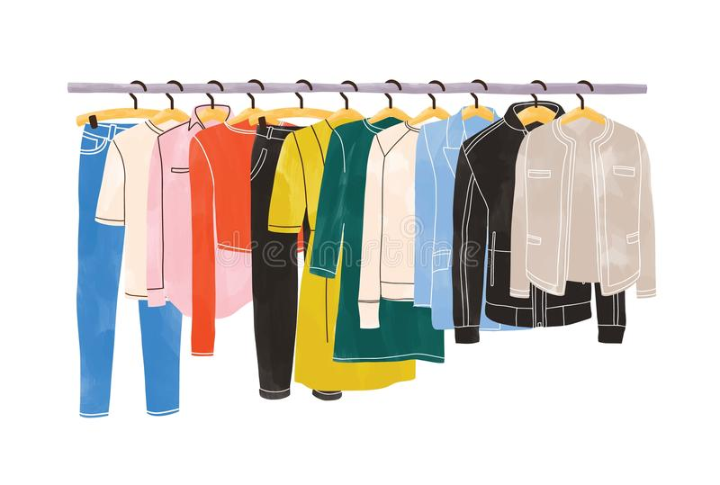
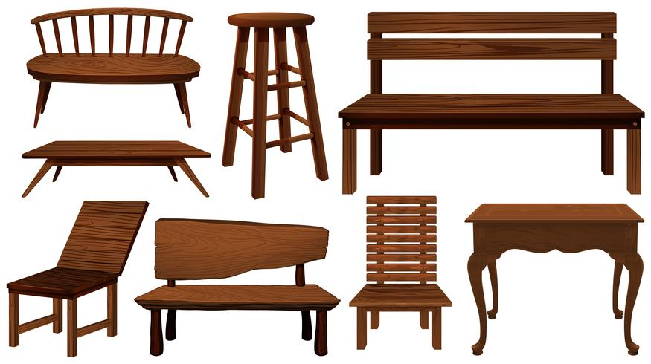
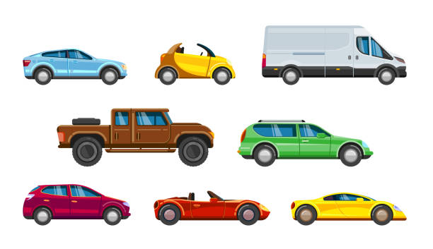
Task 3. Circle the correct answer.
A tailor makes and fixes _________.
clothes | furniture
cars | water pipes

Slide 21
A doctor helps you get better when you are ____________.
sad | happy
sick | sleepy

Slide 22
A farmer looks after ________.
adults | children
babies | animals

Slide 23
A teacher teaches children in a_______.
shop | school
clinic | house

Slide 24
A plumber fixes things like__________.
teeth | cars
pipes | roads

Slide 25
A dentist helps keep your __________ healthy.
teeth | body
clothes | food

