Slide 1
Health and Safety
Lesson 4 - Speaking

Slide 2
Notes for the Educator
This lesson is pegged directly to Learning Outcome LS 5.8 I can communicate my own experiences, likes and dislikes fluently and accurately with some allowance to self-correct in the process.
Teachers are to refer to the Scheme of Work where each lesson is explained in more detail.
Effects are included to make the presentation more interactive. Please present the PowerPoint in Slideshow mode.
Wherever possible we have included the use of online apps to enhance the teaching and learning experience.
The Notes section underneath the slides may contain some further points which can be developed during the lesson.
Teachers are encouraged to adapt this PowerPoint presentation to meet the learners’ language needs.
Tasks included in the PowerPoint presentation are also being shared as handouts.
For any comments, feedback or suggestions please email us at: marie-claire.camilleri@ilearn.edu.mt; urieth.attard@ilearn.edu.mt; mary.jude.camilleri@ilearn.edu.mt. You may also call the office on: 25983683.

Slide 3
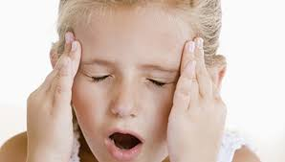
My head hurts. I’ve got a terrible….
headache
earache

Slide 4
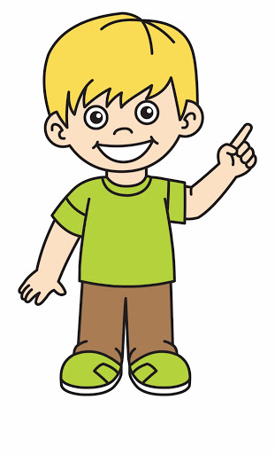
You should…
take an aspirin
play a video game
lie down

Slide 5
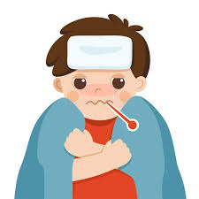
I feel really hot. I’ve got a ….
toothache
fever

Slide 6
You should…
go out
eat sweets and chocolate
stay in bed

Slide 7
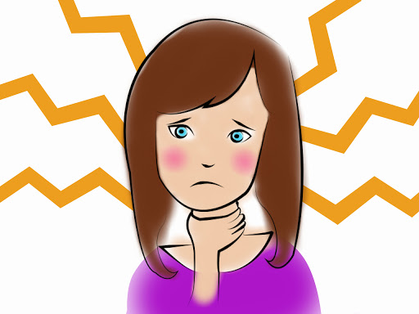
My throat hurts when I swallow. I’ve got a ….
stomach ache
sore throat

Slide 8
You should…
drink hot water with honey
wear warm clothes
have cold drinks

Slide 9
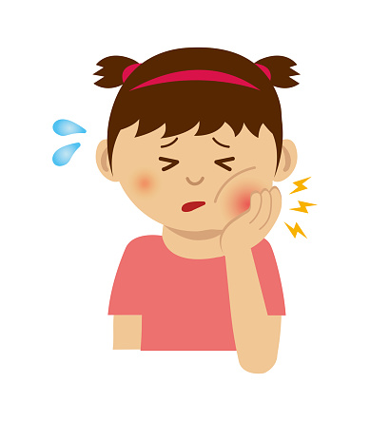
My tooth is sore. I’ve got a…
tooth ache
a cold

Slide 10
You should…
visit the dentist
drink lots of water
go out and play

Slide 11
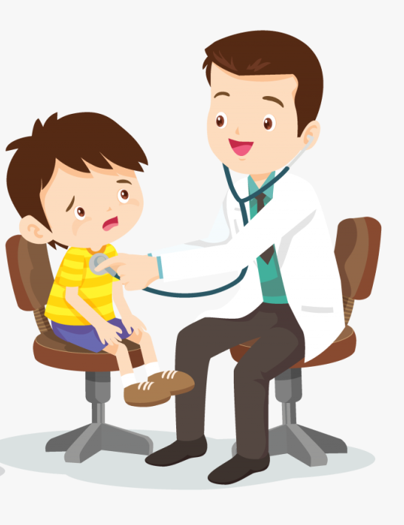
Role Play
A: Hello. What’s the matter?
B: Hello, doctor. I don’t feel well. My head hurts. I’ve got a headache.
A: A headache? You should take an aspirin and lie down. And remember! You shouldn’t play any video games today!
B: Thank you, doctor!
A: Take care! Hope you feel better soon!
B: Bye, doctor.
Notes:
Highlighted parts should be changed by the learners.

Slide 12
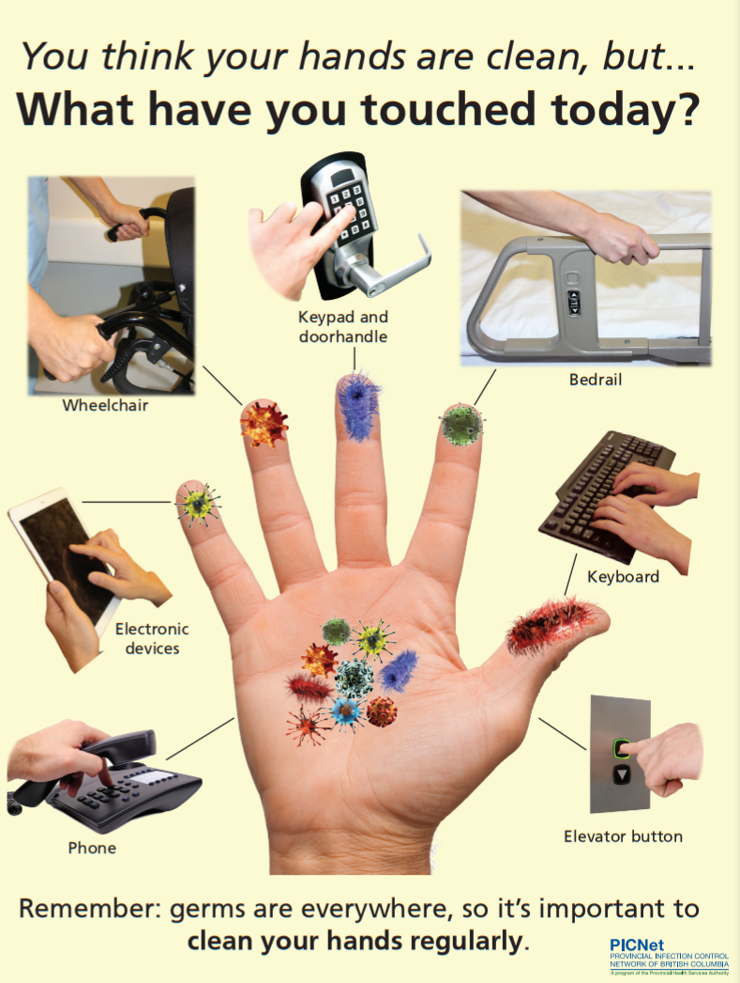
What do you notice about the way the words are written?
What is the message the writer wants to give to the reader?
How has the writer tried to grab the readers’ attention?
Where would you find this kind of poster?
What is the purpose of this poster (to persuade, to inform or to entertain)?
Who is it aimed for?
Why did the writer use pictures?
Why is it important to clean your hands regularly?

Slide 13
I am learning how to give instructions
I can say the instructions in order.
I can use bossy words in a sentence to tell others what to do.
I can self correct some mistakes I make while speaking.

Slide 14
I’m Little Miss Bossy and I tell you what to do. I use a verb near the beginning of my sentences to change them into a command.

Slide 15
turn

Slide 16
wet

Slide 17
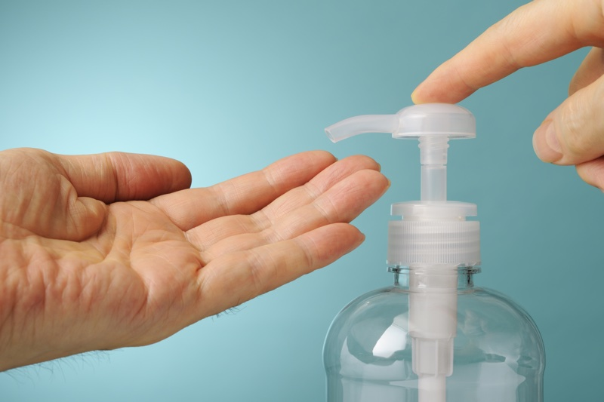
apply
put

Slide 18
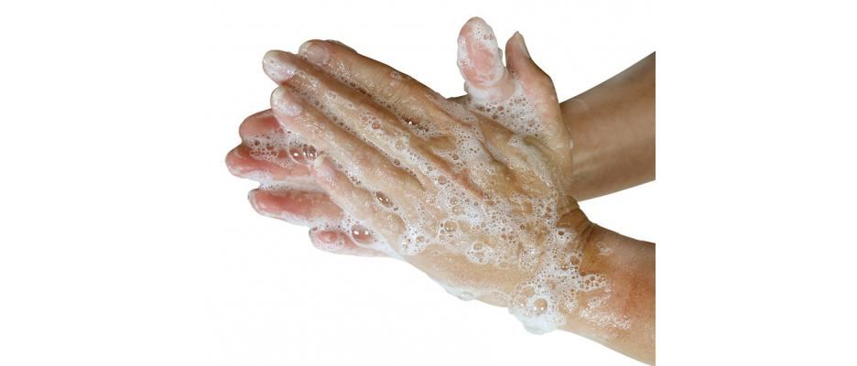
rub

Slide 19
turn

Slide 20
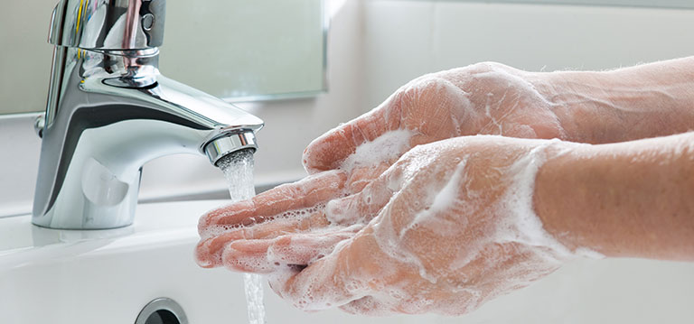
rinse

Slide 21
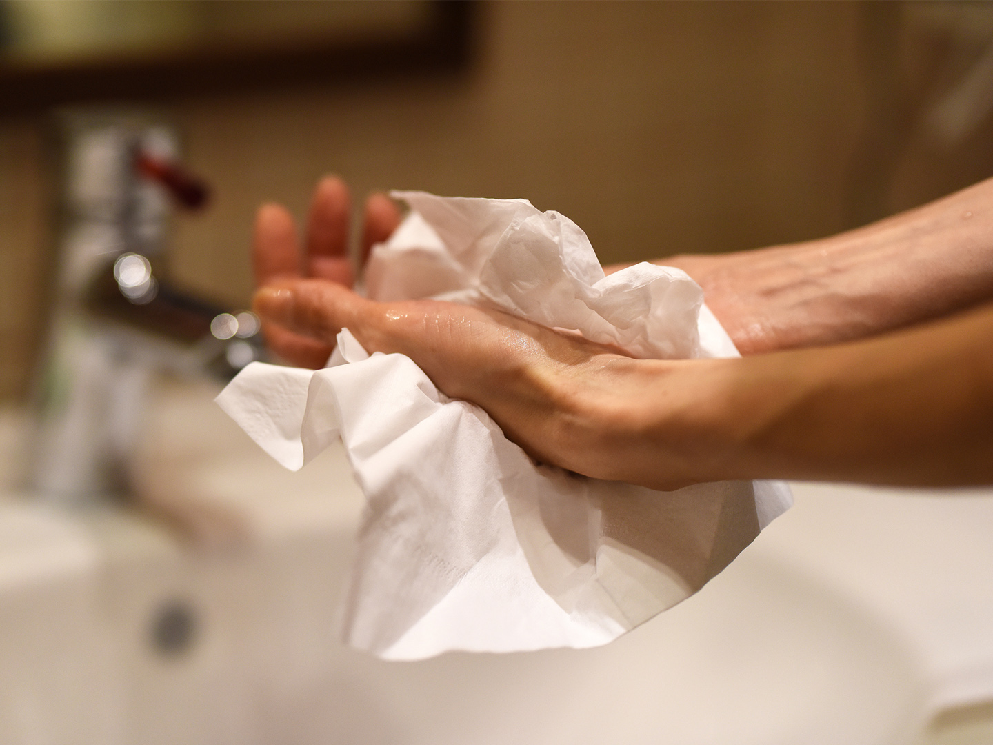
dry

Slide 22
First
Next
After that
Then
Finally

Slide 23
1
6
4
2
7
5
3

Slide 24
How well did the other person wash his/her hands?
Were your instructions clear enough?
Did you say them in order?

Slide 25
Thank you for using this resource. Check out our latest resources below.

