Slide 1
Being Healthy
Lesson 3 - Reading

Slide 2
Notes for the Educator
This lesson is pegged directly to Learning Outcome R 5.5 I can use a range of strategies to aid comprehension and find the required information in the text and R 5.7 I can make informed assumptions about a text or long work from its title and introductory material
Teachers are to refer to the Scheme of Work where each lesson is explained in more detail.
Effects are included to make the presentation more interactive. Please present the PowerPoint in Slideshow mode.
Wherever possible we have included the use of online apps to enhance the teaching and learning experience.
The Notes section underneath the slides may contain some further points which can be developed during the lesson.
Teachers are encouraged to adapt this PowerPoint presentation to meet the learners’ language needs.
Tasks included in the PowerPoint presentation are also being shared as handouts.
For any comments, feedback or suggestions please email us at: marie-claire.camilleri@ilearn.edu.mt; urieth.attard@ilearn.edu.mt; mary.jude.camilleri@ilearn.edu.mt. You may also call the office on: 25983683.

Slide 3
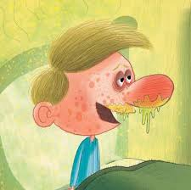
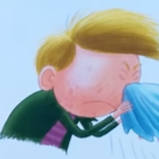
Think about the last lesson…
Notes:
Ask: Who was the main character? What was wrong with Simon? What does he do at the end?

Slide 4
What are instructions?
A step by step guide explaining how to make or do something.
Instructions can be spoken or written.
Sequence is important.

Slide 5
Types of instructions
Recipe books
Computer games
Craft books
Gardening guides
Science experiments
Sport games
Safety rules
Notes:
How many types of written instructions can learners think of?

Slide 6
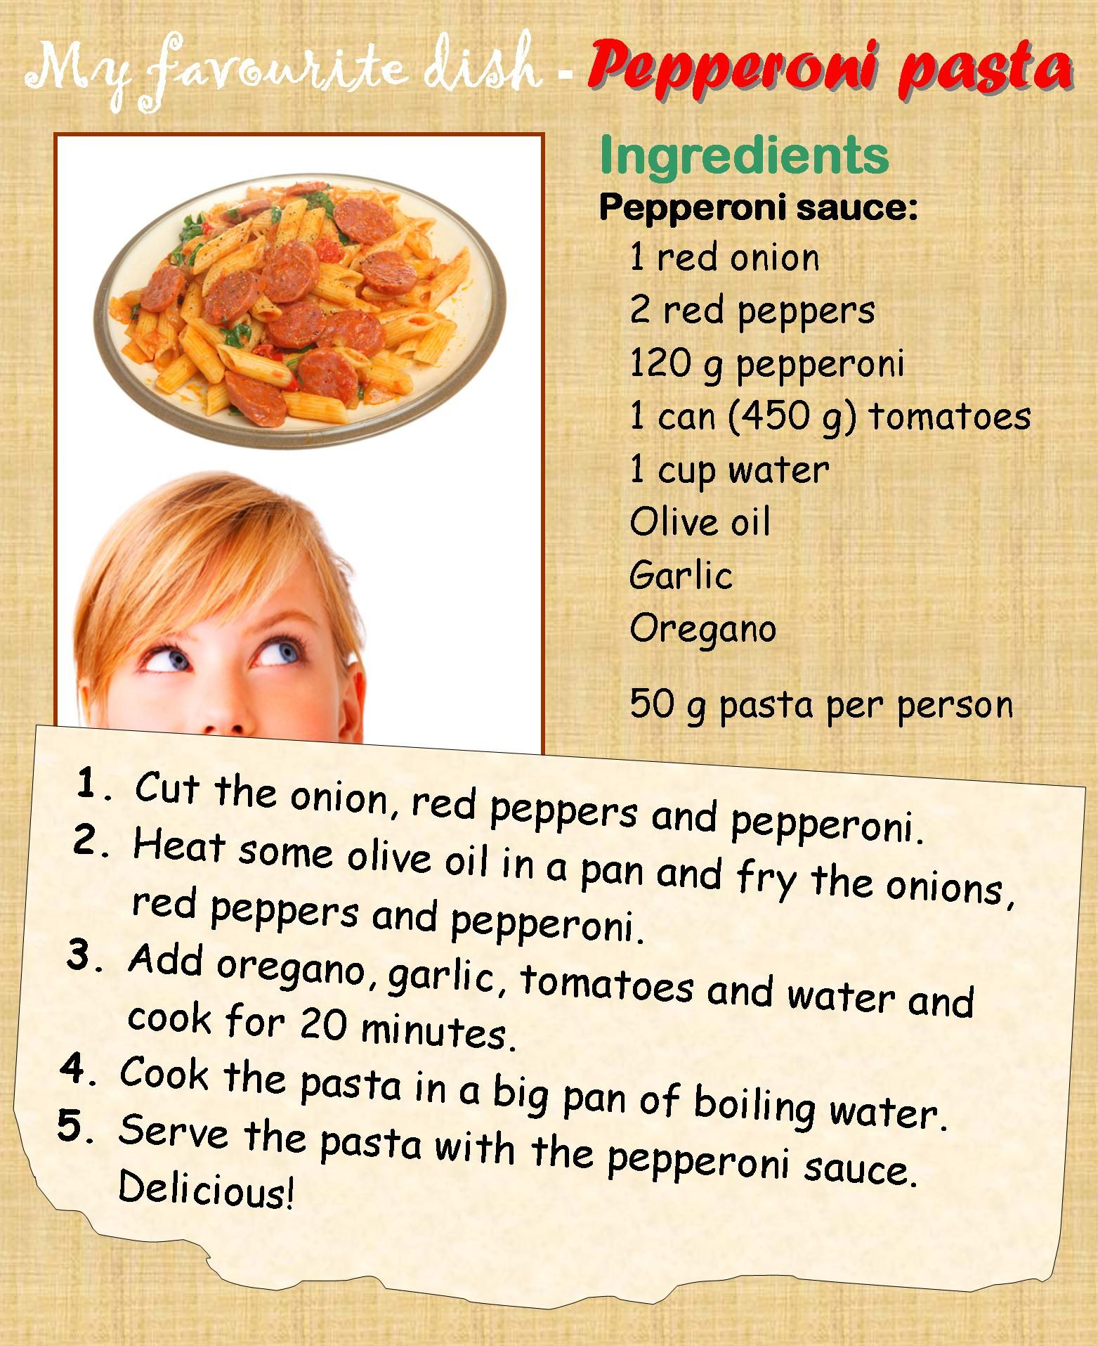

Slide 7
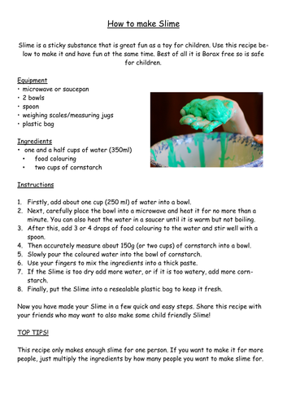

Slide 8
Features of Instructions
Title/ How to…
What you need (Ingredients/materials, etc.)
Method
Diagrams or Pictures
Words that show a sequence: First, Next, Then, After…
Bossy Words

Slide 9
sneeze
tissue

Slide 10
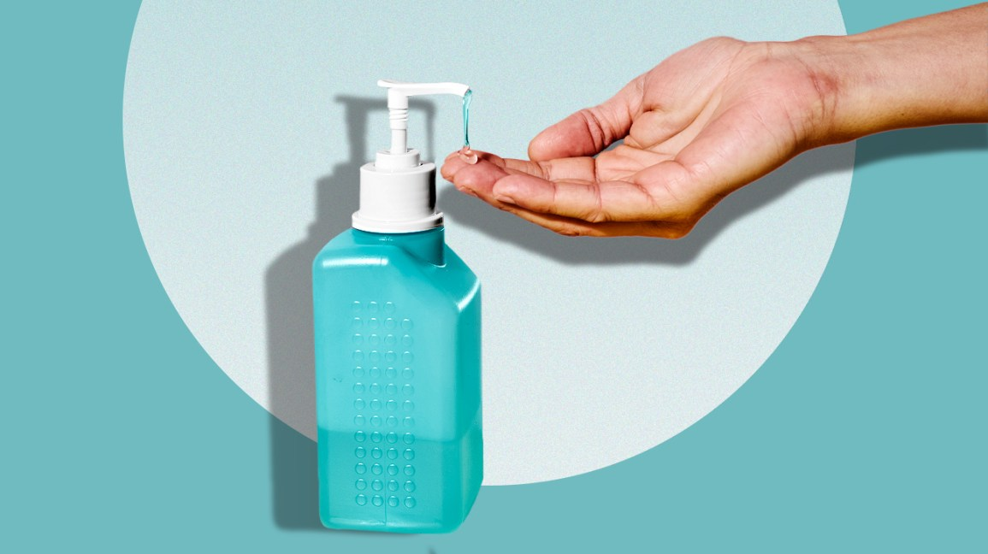
upper
sanitizer

Slide 11
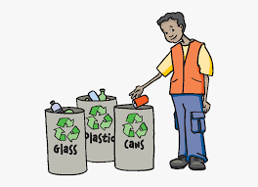
thoroughly
disposable

Slide 12
I am learning how to read a set of instructions.
I can point out the different parts of the instructions.
I can say what the text is about by looking at the pictures and title.
I can use different strategies to read and find information.

Slide 13
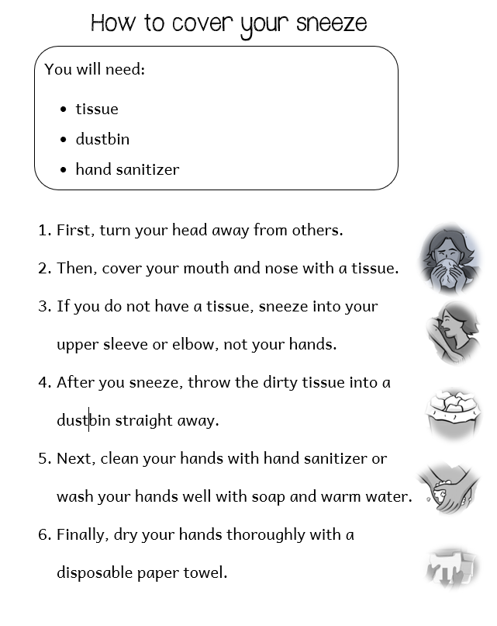
Title: How to….
List of things that you need
How to do the task in order
Pictures or drawings to help you understand the instructions better.

Slide 14
What are these instructions about?
Why has the author used numbers?
What words did the author use to show order?
What is the purpose of this text?
Where would you read this text?

Slide 15
1. What are these instructions about?
How to cover your sneeze.

Slide 16
2. Why has the writer of the instructions used numbers?
To show the order of how to carry out the task.

Slide 17
3. What words did the writer use to show order?
First, Then, After, Next and Finally

Slide 18
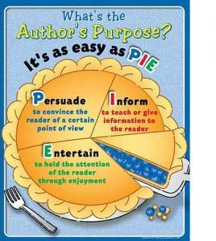
4. What was the author’s purpose in writing this text?
To entertain the reader with an interesting story.
To inform the reader or give more information.
✓
To persuade the reader to do or believe something.

Slide 19
5. Where would you find these instructions?
Displayed on a wall in a clinic.
✓
Displayed on a wall in a toyshop.
In a storybook.

Slide 20
Think about this text…
Go through the text again and underline all the verbs or bossy words.

Slide 21
verbs
bossy words
imperative

Slide 22
Task 2. Complete the instructions using your own imperative (bossy) verbs.
Turn
1. __________ your head away from other people.
2. __________ into a tissue or into your upper sleeve.
3. __________ the used tissue in a dustbin.
4. __________ your hands with soapy water.
Sneeze
Throw
Wash

Slide 23
1. What should you do in the beginning?
Turn your head away from other people.

Slide 24
2. Where shouldn’t you sneeze?
You shouldn’t sneeze in your hands.

Slide 25
3. What do you do with the paper towel after you dry your hands?
You should throw it away in a dustbin.

Slide 26
4. Why do you think the writer added pictures to the instructions?
To make it easier for the reader to understand.

Slide 27
Thank you for using this resource. Check out our latest resources below.

