Slide 1
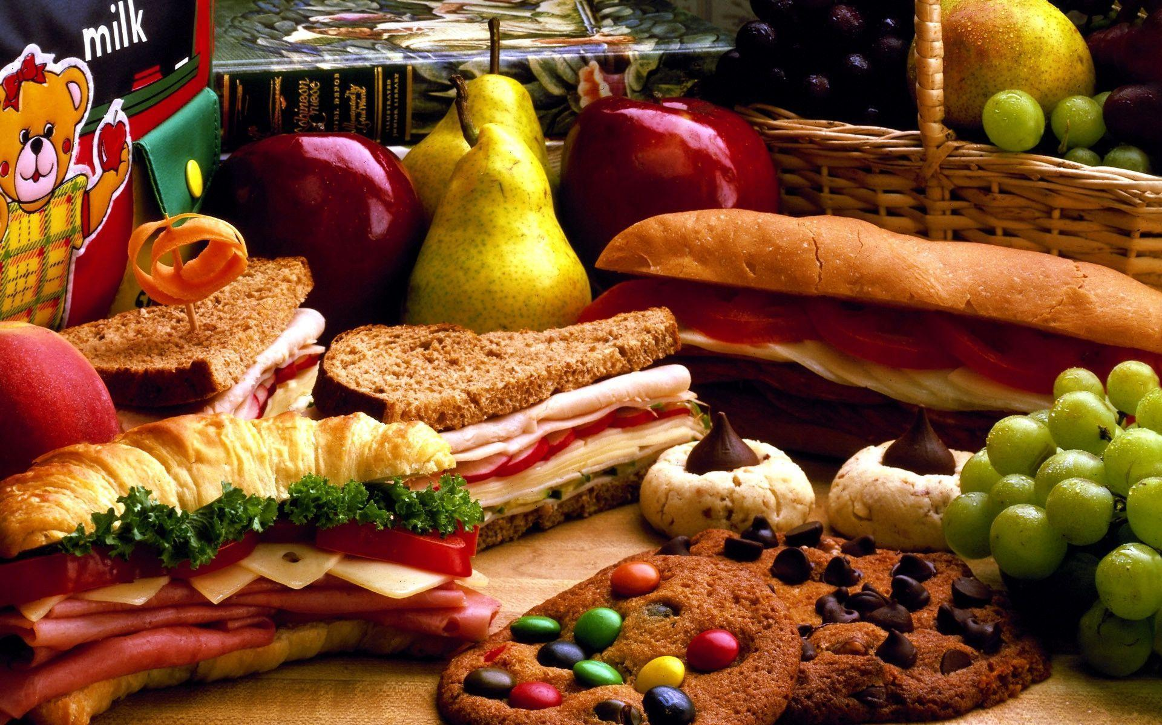
Let’s eat!
Lesson 2 - Reading
Notes:
Do you remember what we listened to in our first lesson?
What was the recipe for?

Slide 2
Notes for the Educator
This lesson is pegged directly to Learning Outcome R 5.5 I can use a range of strategies to aid comprehension and find the required information in the text and R 5.7 I can make informed assumptions about a text or long work from its title and introductory material
Teachers are to refer to the Scheme of Work where each lesson is explained in more detail.
Effects are included to make the presentation more interactive. Please present the PowerPoint in Slideshow mode.
Wherever possible we have included the use of online apps to enhance the teaching and learning experience.
The Notes section underneath the slides may contain some further points which can be developed during the lesson.
Teachers are encouraged to adapt this PowerPoint presentation to meet the learners’ language needs.
Audio files or links to websites may be included.
Tasks included in the PowerPoint presentation are also being shared as handouts.
For any comments, feedback or suggestions please email us at: marie-claire.camilleri@ilearn.edu.mt; urieth.attard@ilearn.edu.mt; mary.jude.camilleri@ilearn.edu.mt. You may also call the office on: 25983683.

Slide 4
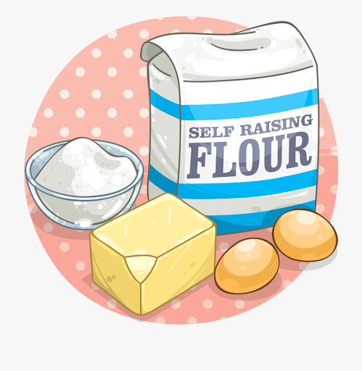
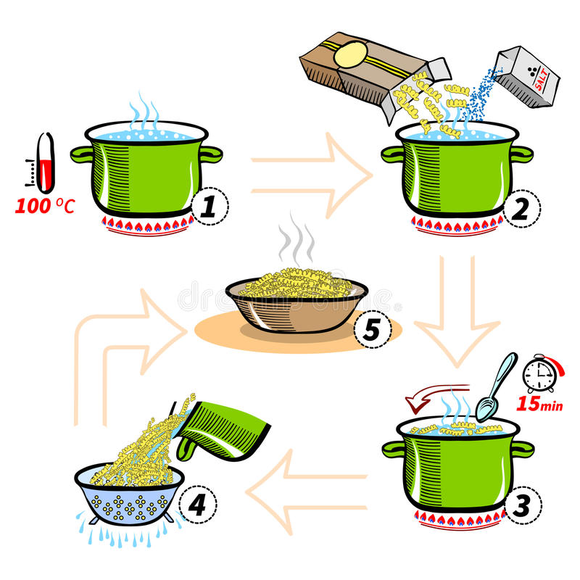
What is a recipe?
It explains how to prepare a dish.
It tells you what ingredients you need.
It may tell you what tools you need to use.
Notes:
Gives you an indication of how long it will take you to prepare the dish, how long you need to keep it in the oven for. Also might give you serving suggestions – that is for how many people the recipe is and some nutritional information.

Slide 6
What kind of food it is
Serving suggestion
Name of the recipe
Photo of the finished recipe
List of ingredients for this recipe
List of utensils needed
Ideas and tips on how you can vary the recipe
Page number
Notes:
Now, let’s see if you thought of the following things (follow slides)

Slide 7
Each step is put in a separate box to make it easier for the reader
numbers show the order
Action words are used to tell the reader what to do: press, place, put, roll…
Pictures help the reader understand better each step.

Slide 8
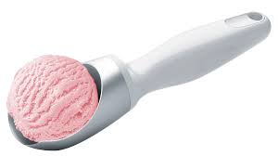
scoop

Slide 9
dessert

Slide 10
alternative

Slide 11
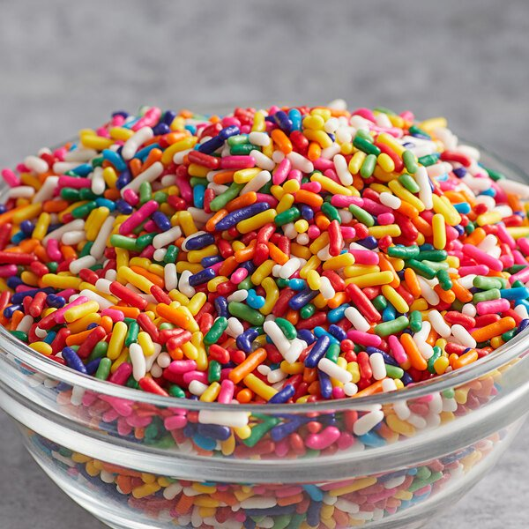
sprinkles

Slide 12
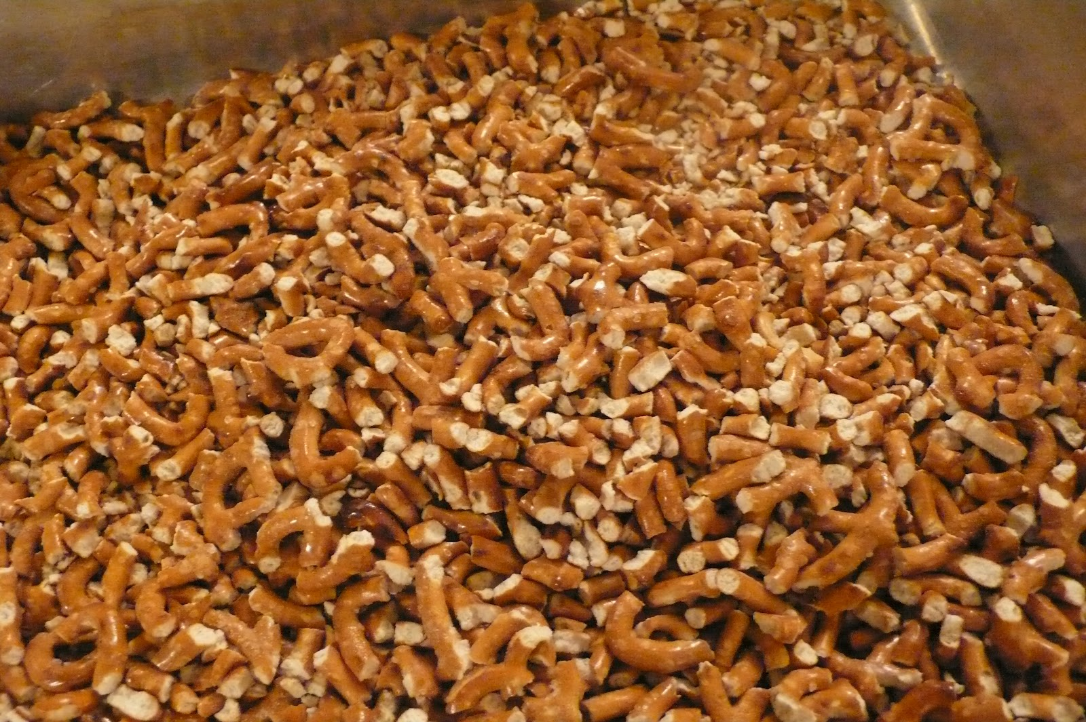
whole
crushed

Slide 13
enough
Notes:
Ask: What strategies can we use to read this word? How does the picture help you understand its meaning?

Slide 14
I am learning how to read and respond to a recipe.
I can identify the different parts of a recipe.
I can understand how the process is explained in different steps.
I can use different strategies to read and find information.

Slide 15
What is this recipe for?
Why is a list of tools included in the recipe?
How is this dessert like a sandwich?
How can you make this recipe healthier?

Slide 17
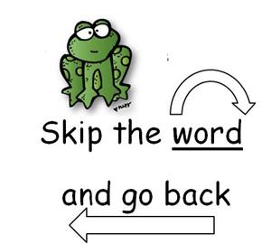
When I come across a tricky word, I can…
Skip and return
Chunk it
Stretch it out
Notes:
If you come across a difficult word you can use some of the strategies, we have been learning about such as: breaking it into smaller words or stretching it out. You can also try to skip it and read on and then come back to it at the end of the sentence. Sometimes we can understand what the word is from its meaning within a sentence.

Slide 18
1. What is this recipe for?
Ice Cream Cookie Sandwiches with Sprinkles

Slide 19
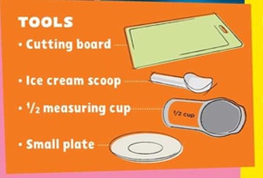
2. Why is a list of tools included in the recipe?
So the reader/cook can prepare all the equipment needed.

Slide 20
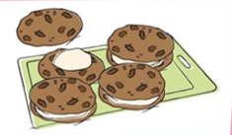
3. How is this dessert like a sandwich?
When you prepare a sandwich you usually put something between the two slices.

Slide 21
4. How can you make this recipe healthier?
You can replace the sprinkles with chopped pineapples or strawberries.

Slide 22
For how many people is this recipe?
What kind of recipe is this?
What do you need 1 pint of?
How many cookies do you need?
For how long do you need to let the ice-cream soften ?
How many scoops of ice-cream do you need to put on each cookie?
How many cups of sprinkles do you need?
For how long do you need to put the cookies in the freezer, at the end?
Notes:
Scanning the text: Let’s try finding the answers to these questions really quickly. We are looking for keywords here, a word or a short phrase that gives us the answer to our question.

Slide 23
Notes:
Click on question mark icon to go back to questions.(bottom right)

Slide 31
Which strategies did you use to find the answers quickly?
Identify keywords.
Look for keywords within the text.
Looking for bold print.
Don’t read full sentences.
Notes:
You can now proceed with the Tasks on your worksheet.
And that brings us to the end of this reading lesson. We learnt how to read a recipe and how to find information quickly. Now, why don’t you try out this recipe at home. You are likely to have the ingredients at home, already. Have fun, and do join me for our next lesson – Lesson 3, in which we will continue talking more about food. See you then!

Slide 32
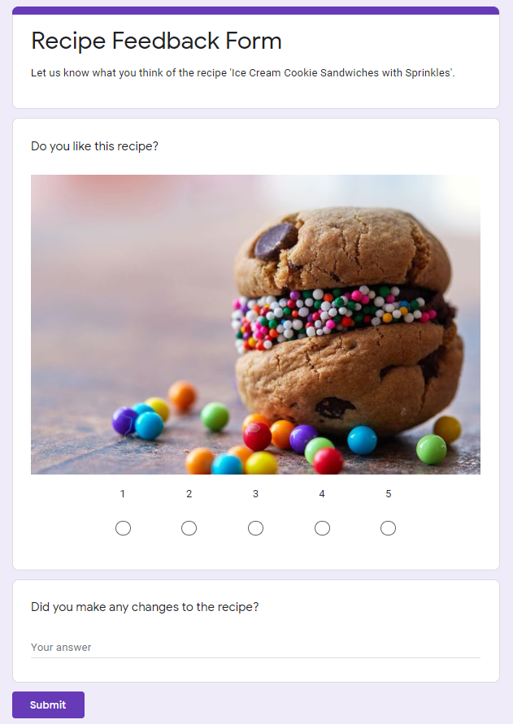
Notes:
Educators may create a similar form in which learners can give their feedback or recommendations.

Slide 33
Thank you for using this resource. Check out our latest resources below.

