Slide 1
Lesson 1 Reading
Year 5
English

Slide 2
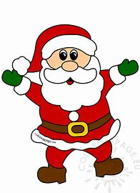
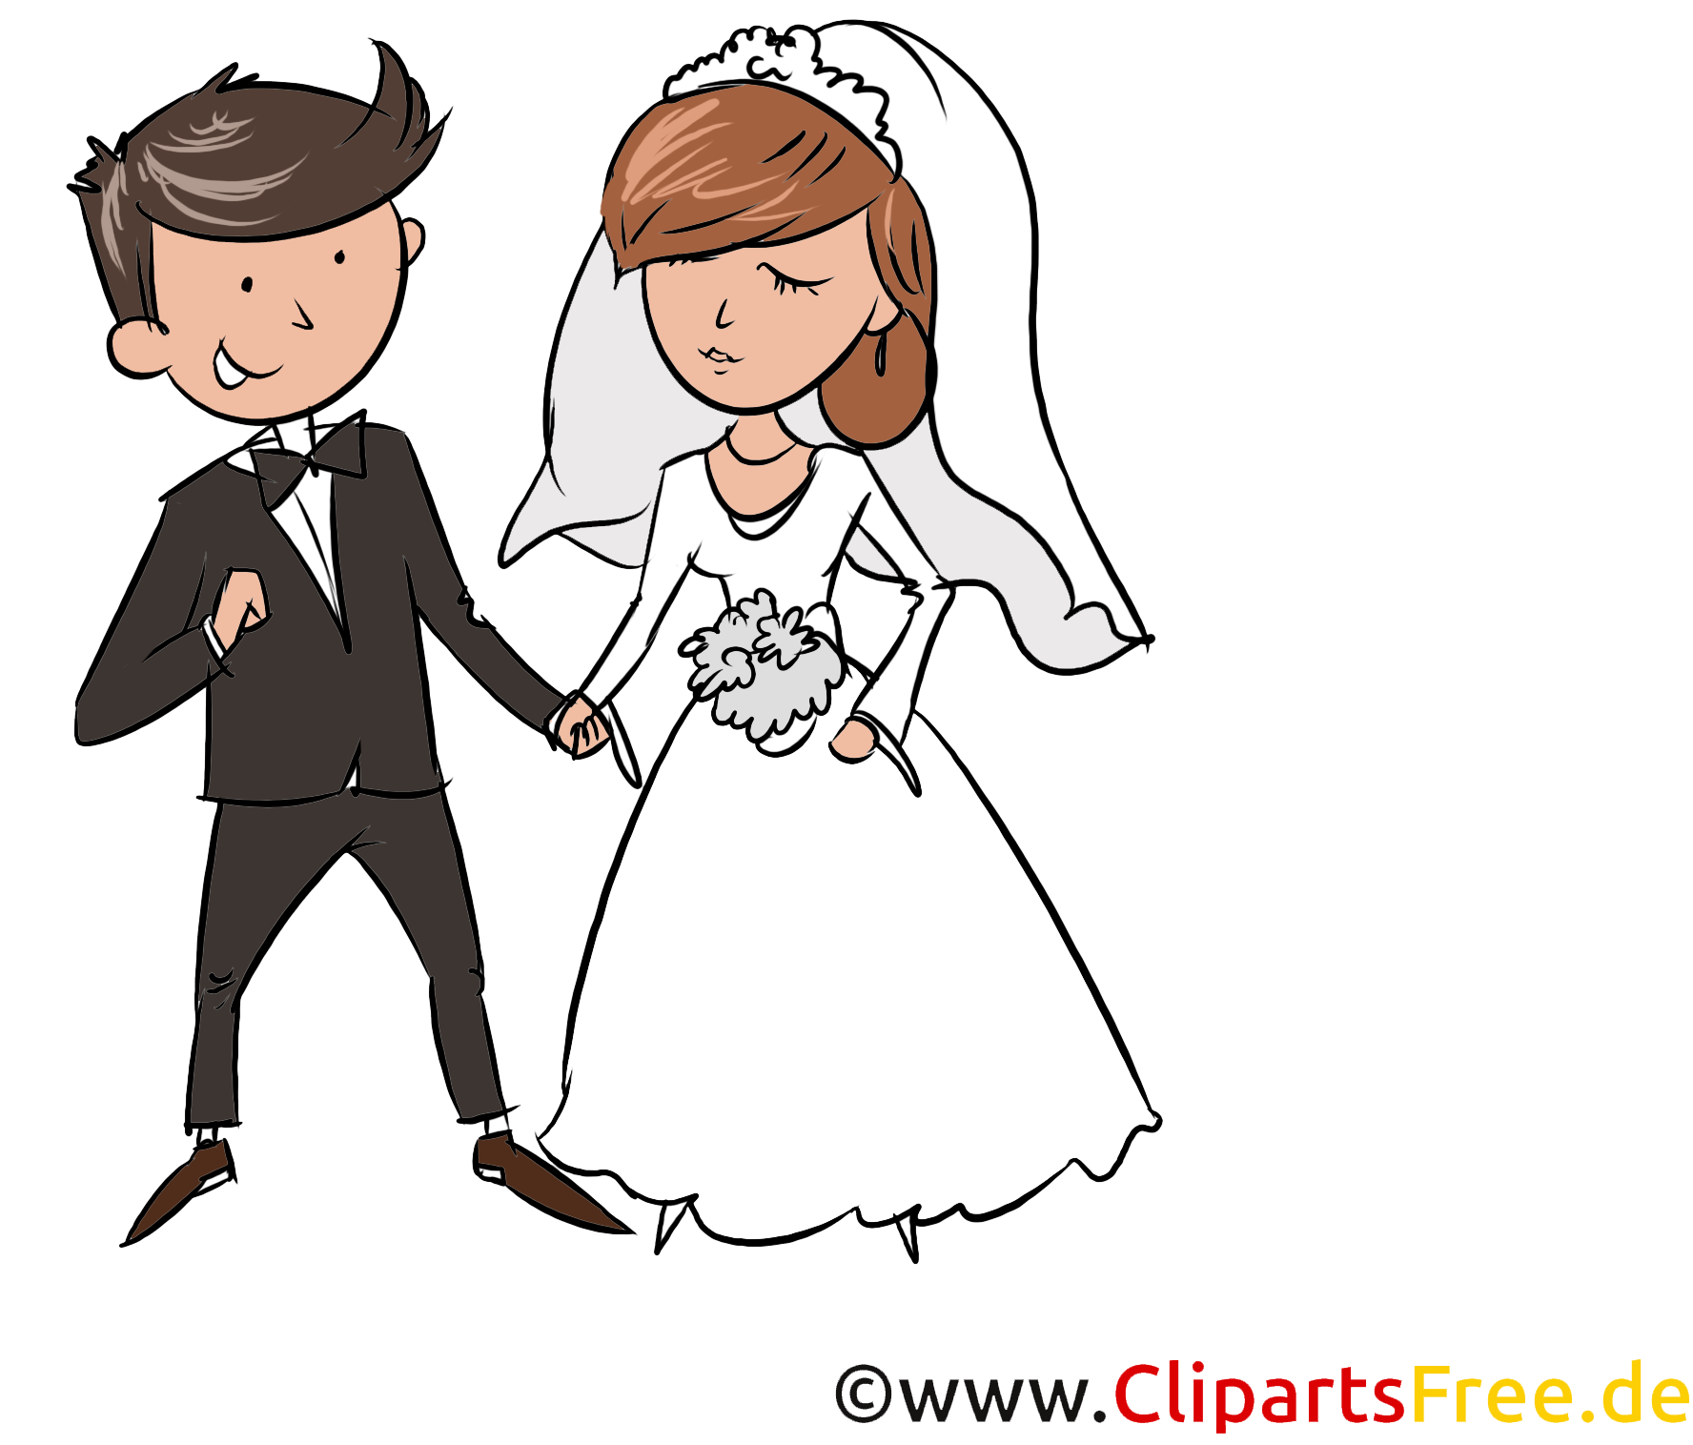
Weekly Theme
Feasts and Celebrations

Slide 3
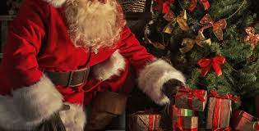
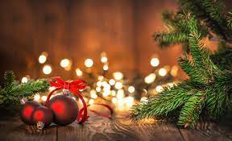
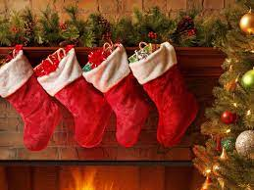
Guess today’s celebration

Slide 4
Lesson 1 Objectives
In Lesson 1 you will:
listen to a text being read aloud.
read a text silently and aloud.
answer questions about the text.
learn how to predict what the text is about.
learn how to recognise online texts.
learn about the history and traditions of Christmas.

Slide 5
Lesson Resources
Dictionary
Reading Text
Questions Worksheet
Answers Handout

Slide 6
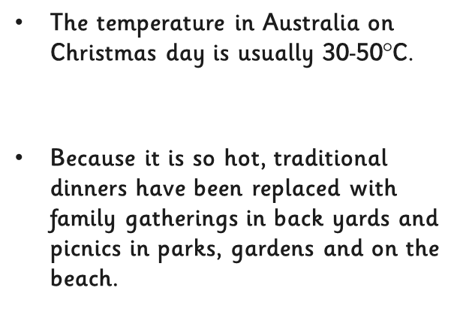

Slide 7
China

Slide 12
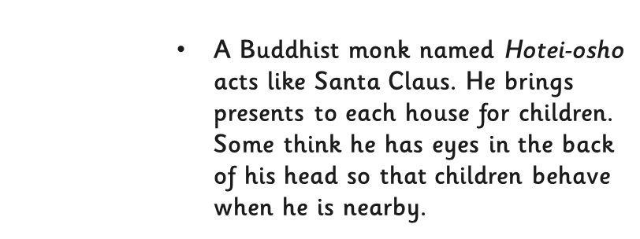

Slide 13
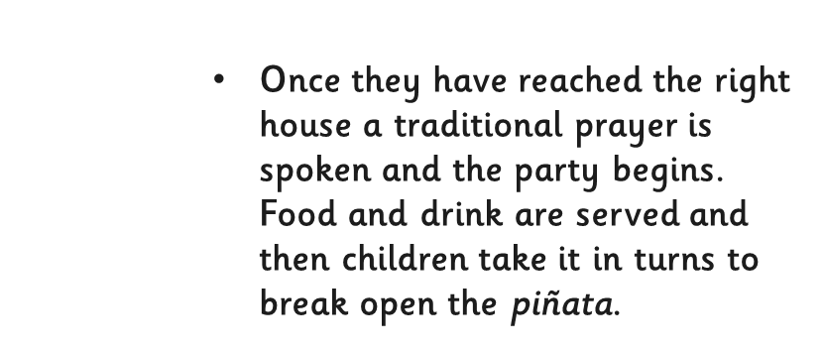
altar

Slide 16
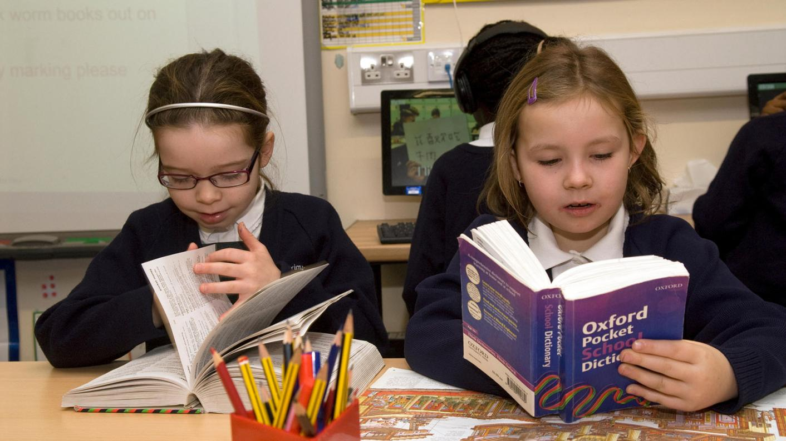
Using a dictionary!

Slide 17
New Words
bishop
mischievous
anthem
banned
Christian
Orthodox
abbreviation
historians
garlands
everlasting
evergreen
towering

Slide 18
New Words
a branch of Christianity
a shortened form of a word
(e.g. it’s)
Christians
Orthodox
abbreviation
students or writers of history
a wreath or chain made of flowers or leaves
lasting forever
everlasting
people who follow the teachings of Jesus Christ
historians
garland

Slide 19
New Words
rising high
a man who holds a high position in Christian churches
evergreen
towering
bishop
naughty
a song sung in church or with patriotic values
forbidden
banned
a plant that has trees throughout the year
mischievous
anthem

Slide 20
Step 1
Look at the title, sub-titles and pictures on the handout.
- What do you think the text is going to be about?
- Where do you think the text was taken from?

Slide 21
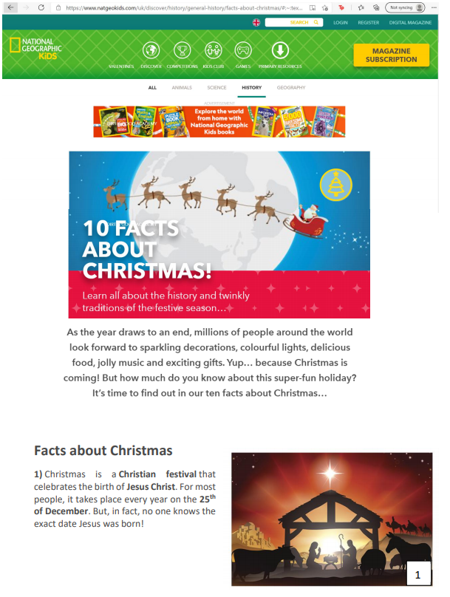
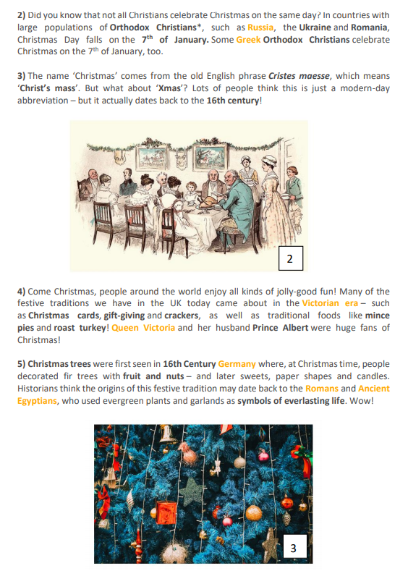
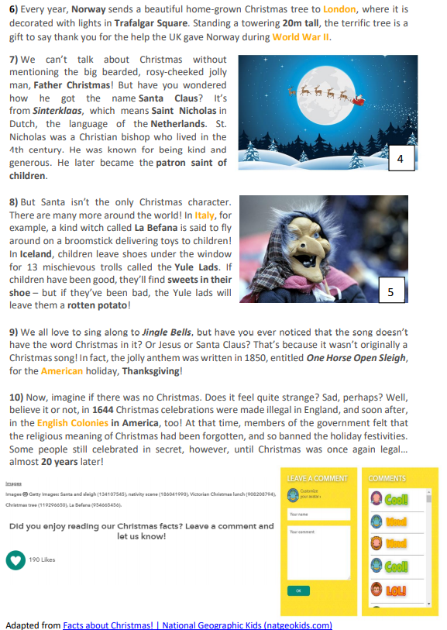

Slide 22
Step 2
READ the text and questions
and try to ANSWER the following question:
WHAT IS THE TEXT ABOUT?

Slide 23
Step 3
READ the text and questions again.
Then try to ANSWER the following questions:
Is Christmas always celebrated on the 25th of December?
Is ‘Xmas’ a modern or old word?
How did Germans decorate Christmas trees?
Where is the Christmas tree in Trafalgar Square from?
Mention three Christmas characters found in the text.
Why was Christmas banned in England?

Slide 24
Step 4: Discuss the questions
Is Christmas always celebrated on the 25th of December?
No. In countries with large populations of Orthodox Christians, such as Russia, the Ukraine and Romania, Christmas Day falls on the 7th of January. Some Greek Orthodox Christians celebrate Christmas on the 7th of January, too.
2. Is ‘Xmas’ a modern or old word?
It is an old word because it dates back to the 16th century.
3. How did Germans decorate Christmas trees?
Germans decorated fir trees with fruit and nuts – and later with sweets, paper shapes and candles.

Slide 25
Step 4: Discuss the questions
4. Where is the Christmas tree in Trafalgar Square from?
The Christmas tree in Trafalgar Square is from Norway.
5. Mention three Christmas characters found in the text.
Three Christmas characters are La Befana, Father Christmas and the Yule Lads.
6. Why was Christmas banned in England?
Christmas was banned because members of the government felt that the religious meaning of Christmas had been forgotten, and so banned the holiday festivities.

Slide 26
Step 5
LISTEN to me as I
READ the text ALOUD.

Slide 28
Step 6
READ the text ALOUD.

Slide 29
Step 7
Let’s DISCUSS
the questions.

Slide 30
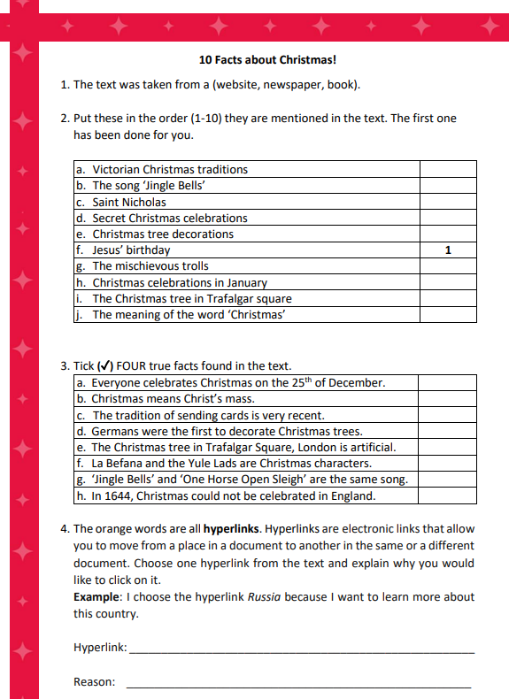
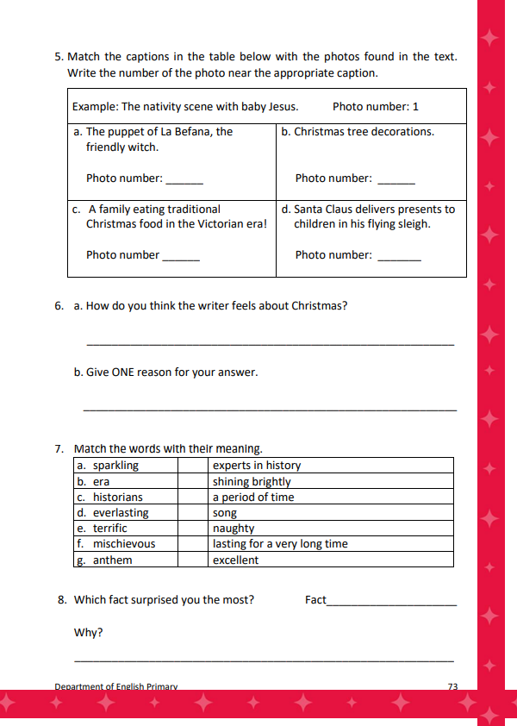

Slide 31
Step 8
WORK OUT the
Questions Worksheet.

Slide 32
Step 9

Slide 33
Step 10
CHECK your answers using the
Answers Handout.

Slide 34
Thank You!

