Slide 1
Lesson 2 Reading
Year 5
English

Slide 2
Lesson Objectives
You will:
learn what a newspaper article is.
learn how to use the dictionary to find the meaning of new words.
listen to a text being read aloud.
read a text silently and aloud.
express your opinion.
answer questions about the text.

Slide 3
Lesson Resources
Dictionary
Reading Text
Questions Worksheet
Answers Handout

Slide 4
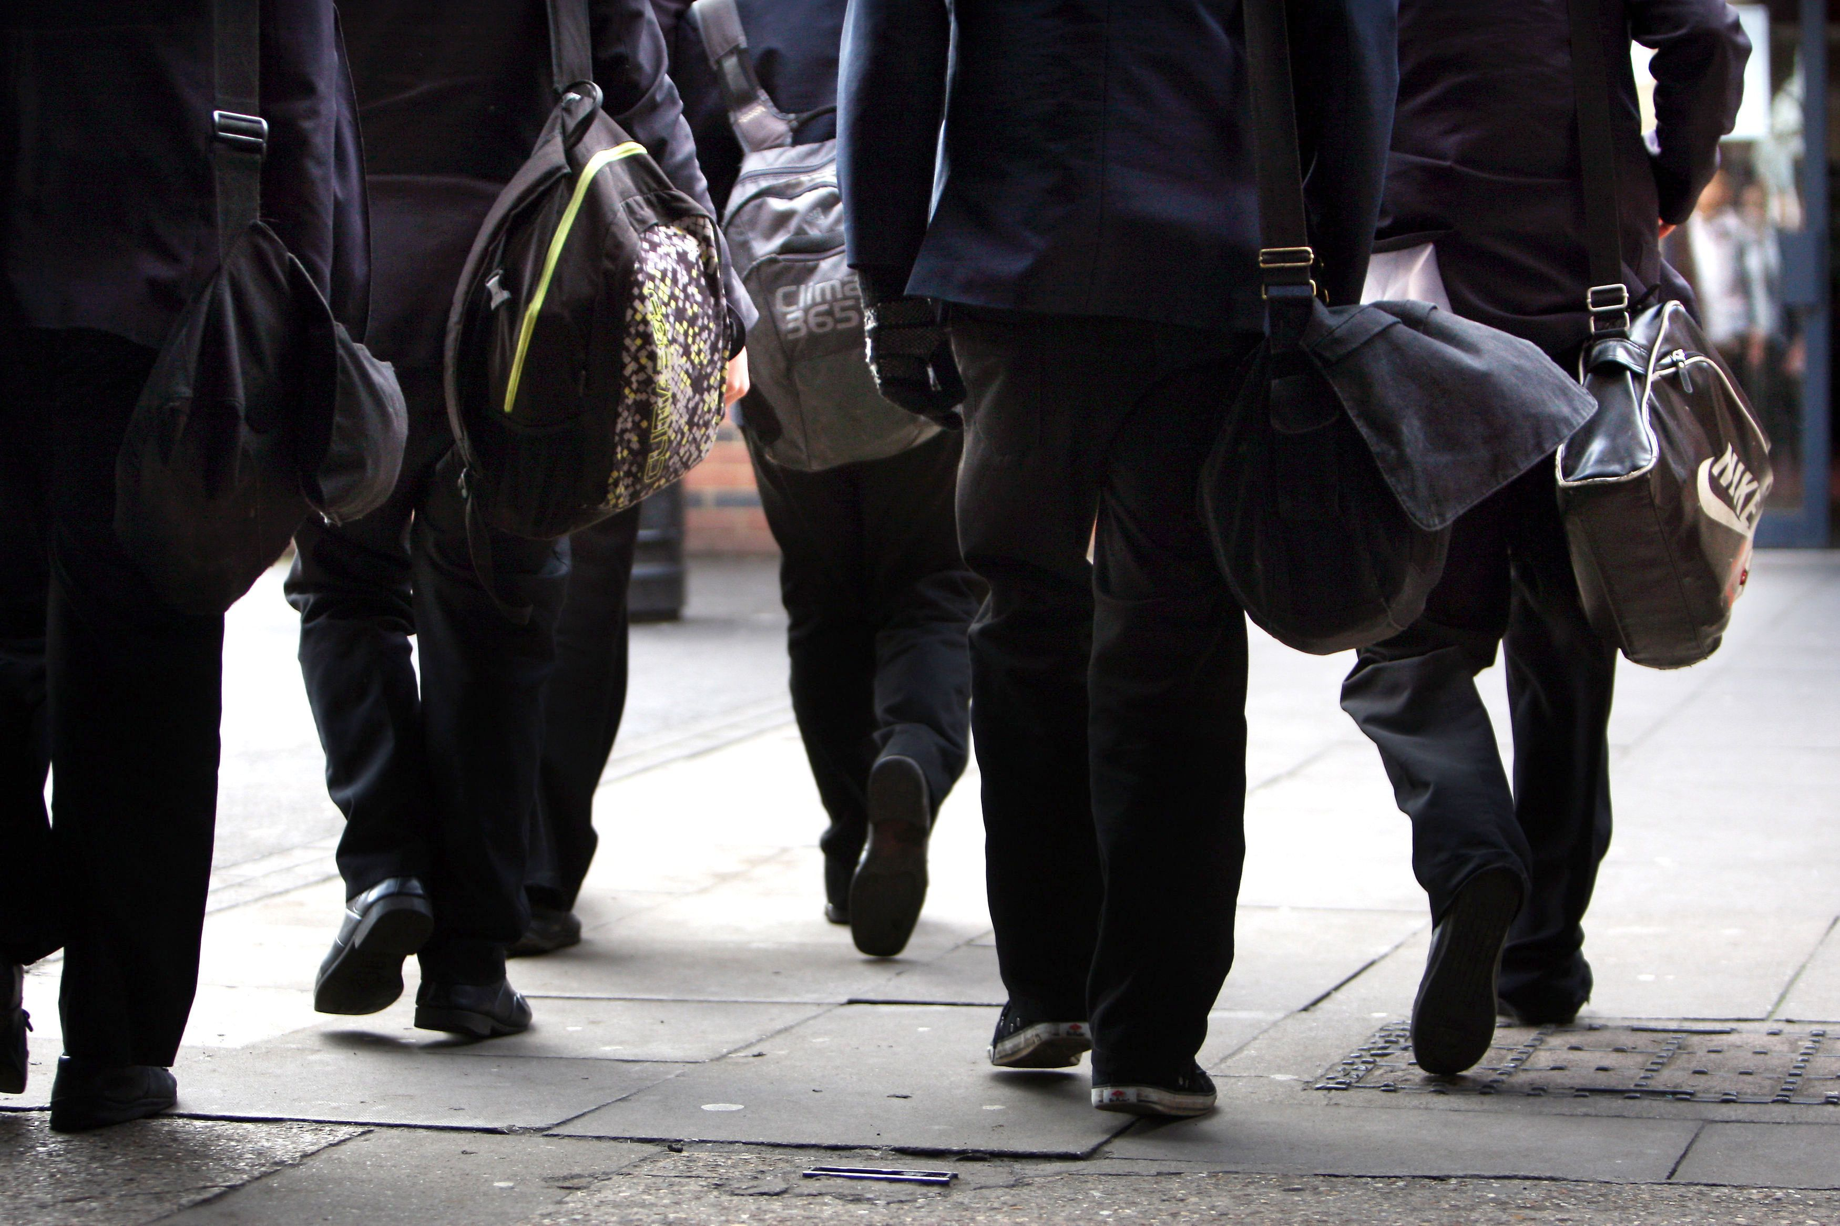
Let’s PREDICT
What do you think the text is about?
Why do you think so?
Where do you think the text was taken from?

Slide 5
Newspaper Article
Name of newspaper
Headline
Date
Direct and
Reported Speech
Picture with caption
Information about the story
Past Tense
Third person
Formal Language

Slide 6
Using a dictionary!

Slide 7
New Words
apologised
to say that you are sorry about something that you did or said

Slide 8
New Words
detention conforming
skintight appropriate tightening anticipated furious distressed
ridiculous livid tailored specific

Slide 9
Match
detention very tight-fitting
conforming being kept after school
skintight harden the rules
appropriate obey rules
tightening expected/predicted
anticipated suitable

Slide 10
Match
furious silly/crazy
distressed extremely angry
ridiculous extremely angry
livid feeling very anxious
tailored clearly defined
specific smart/fitted

Slide 11
Step 1
READ the text on the handout and the
questions on the worksheet.

Slide 12
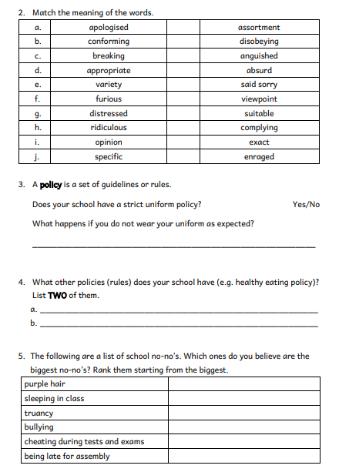
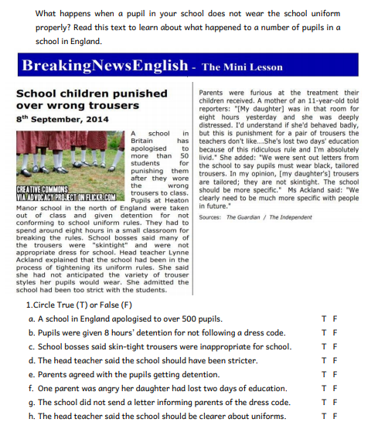

Slide 13
Step 1
After you read the text and questions you should be able to ANSWER the following question:
WHAT IS THE TEXT ABOUT?

Slide 14
Step 2: Discuss the question
What is the text about?
The text is a newspaper article. I can tell this because of the headline, the columns and the style of writing.
It is about how a particular school punished over fifty students because their trousers were not suitable for school. Parents were very angry at the school for the harsh punishment given for wearing the wrong pair of trousers. The school had to apologise to these students.

Slide 15
Step 3
READ the text and questions again.
Then try to ANSWER the following questions:
When was the article written?
Why did the school punish the students?
What punishment did the students receive?
How did the parents feel about the punishment?
How many people were interviewed in the article?

Slide 16
Step 4: Discuss the questions
When was the article written?
It was written on the 8th of September, 2014.
Why did the school punish the students?
The students wore skin-tight trousers which the school believed were not appropriate.
What punishment did the students receive?
They had to spend eight hours in a small room.
How did the parents feel about the punishment?
Parents were furious.
How many people were interviewed in the article?
Two people were interviewed. A parent and the headmistress.

Slide 17
Step 5
LISTEN to me as I
READ the text.

Slide 18
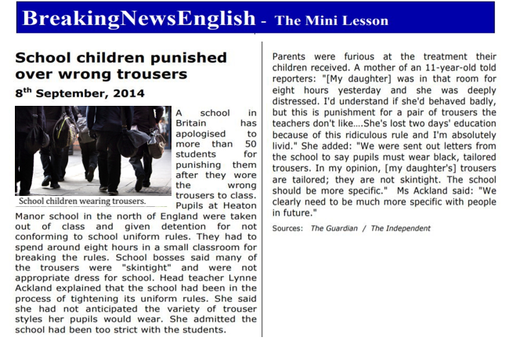

Slide 19
Step 6
READ the text ALOUD.

Slide 20
Step 7
Let’s DISCUSS
the questions.

Slide 21
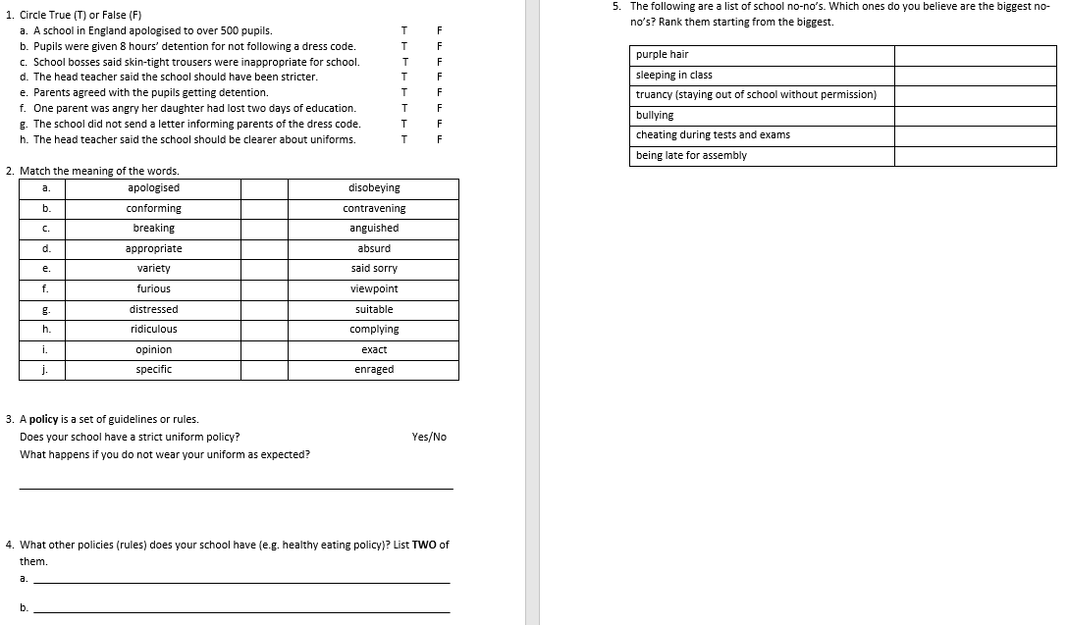

Slide 22
Step 8
WORK OUT the
Questions Worksheet.

Slide 23
Step 9

Slide 24
Step 10
CHECK your answers using the
Answers Handout.

Slide 25
Thank You!

