Slide 1
Lesson 3 Literature
Year 5
English

Slide 2
Lesson 3 Objectives
You will:
use the dictionary to find the meaning of new words.
read a poem silently and aloud.
listen to a poem being read aloud.
learn how to stay safe on the Internet.

Slide 3
Lesson Resources
Dictionary
Poem Handout
Questions Worksheet
Answers Handout

Slide 4
View the video!

Slide 5
NEW WORDS - Using a dictionary!

Slide 6
Internet Verbs
to browse to discover
to click to delete
to download to launch
to bookmark to freeze

Slide 7
to browse
to click
to download
to bookmark
to press a button or screen
to save a website or web page
to take information off the Internet
and store it on your computer
to look for information on the
Internet

Slide 8
to discover
to delete
to launch
to freeze
to remove
to start something new e.g. website
to suddenly stop working
to learn new things

Slide 9
Step 1
READ the poem silently.
After you read the text ANSWER the following questions:
WHAT IS THE POEM ABOUT?
HOW DID IT MAKE YOU FEEL?

Slide 10
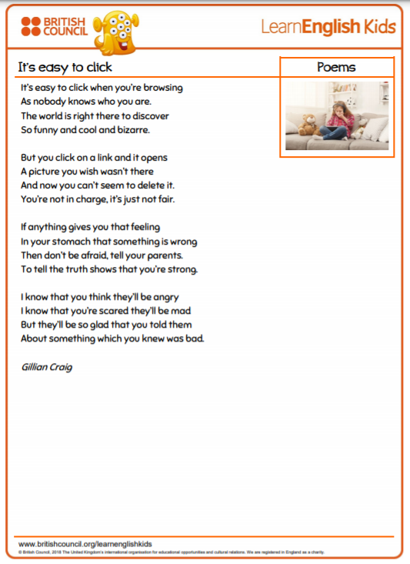
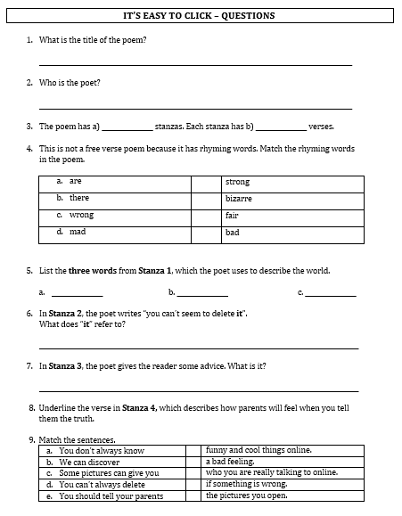

Slide 11
Step 2 - Discuss the question
What is the poem about?
The poem is about what you can come across when you go online.
Sometimes, you can discover funny, cool and bizarre information.
Other times, you can come across material, such as pictures, which can bother you.
When this happens you should inform an adult.

Slide 12
Step 3
READ the text again.
Then try to ANSWER the following questions.

Slide 13
Step 3: Answer these questions!
Who is the poet?
How many stanzas are there?
How many verses does each stanza have?
Which are the pairs of rhyming words in the poem?
What can happen when you click on a link?
What should you do if you see something online which makes you feel bad?
How will your parents feel when you tell them what you saw online?

Slide 14
Step 4 - Discuss the questions
Gillian Craig
Who is the poet?
2. How many stanzas are there?
Four stanzas
3. How many verses does each stanza have?
Four verses
4. Which are the pairs of rhyming words in the poem?
are – bizarre there – fair wrong – strong mad - bad
5. What can happen when you click on a link?
It can open a picture you wish wasn’t there.
6. What should you do if you see something online which makes you feel bad?
Tell an adult e.g. a parent.
How will your parents feel when you tell them what you
saw online?
Glad

Slide 15
Step 5
LISTEN and READ SILENTLY.
Then LISTEN to me while I EXPLAIN the worksheet.

Slide 17
Step 6
READ the text yourself.

Slide 18
Step 7
WORK OUT
the worksheet.

Slide 19
Step 8

Slide 20
Step 9
CHECK your answers using the
Answers Handout.

Slide 21
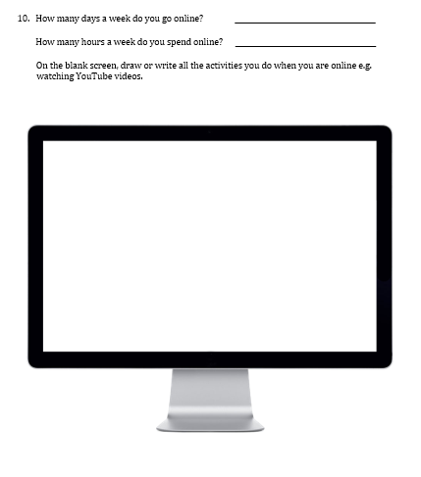
Final Activity!

Slide 22
Thank You!

