Slide 1
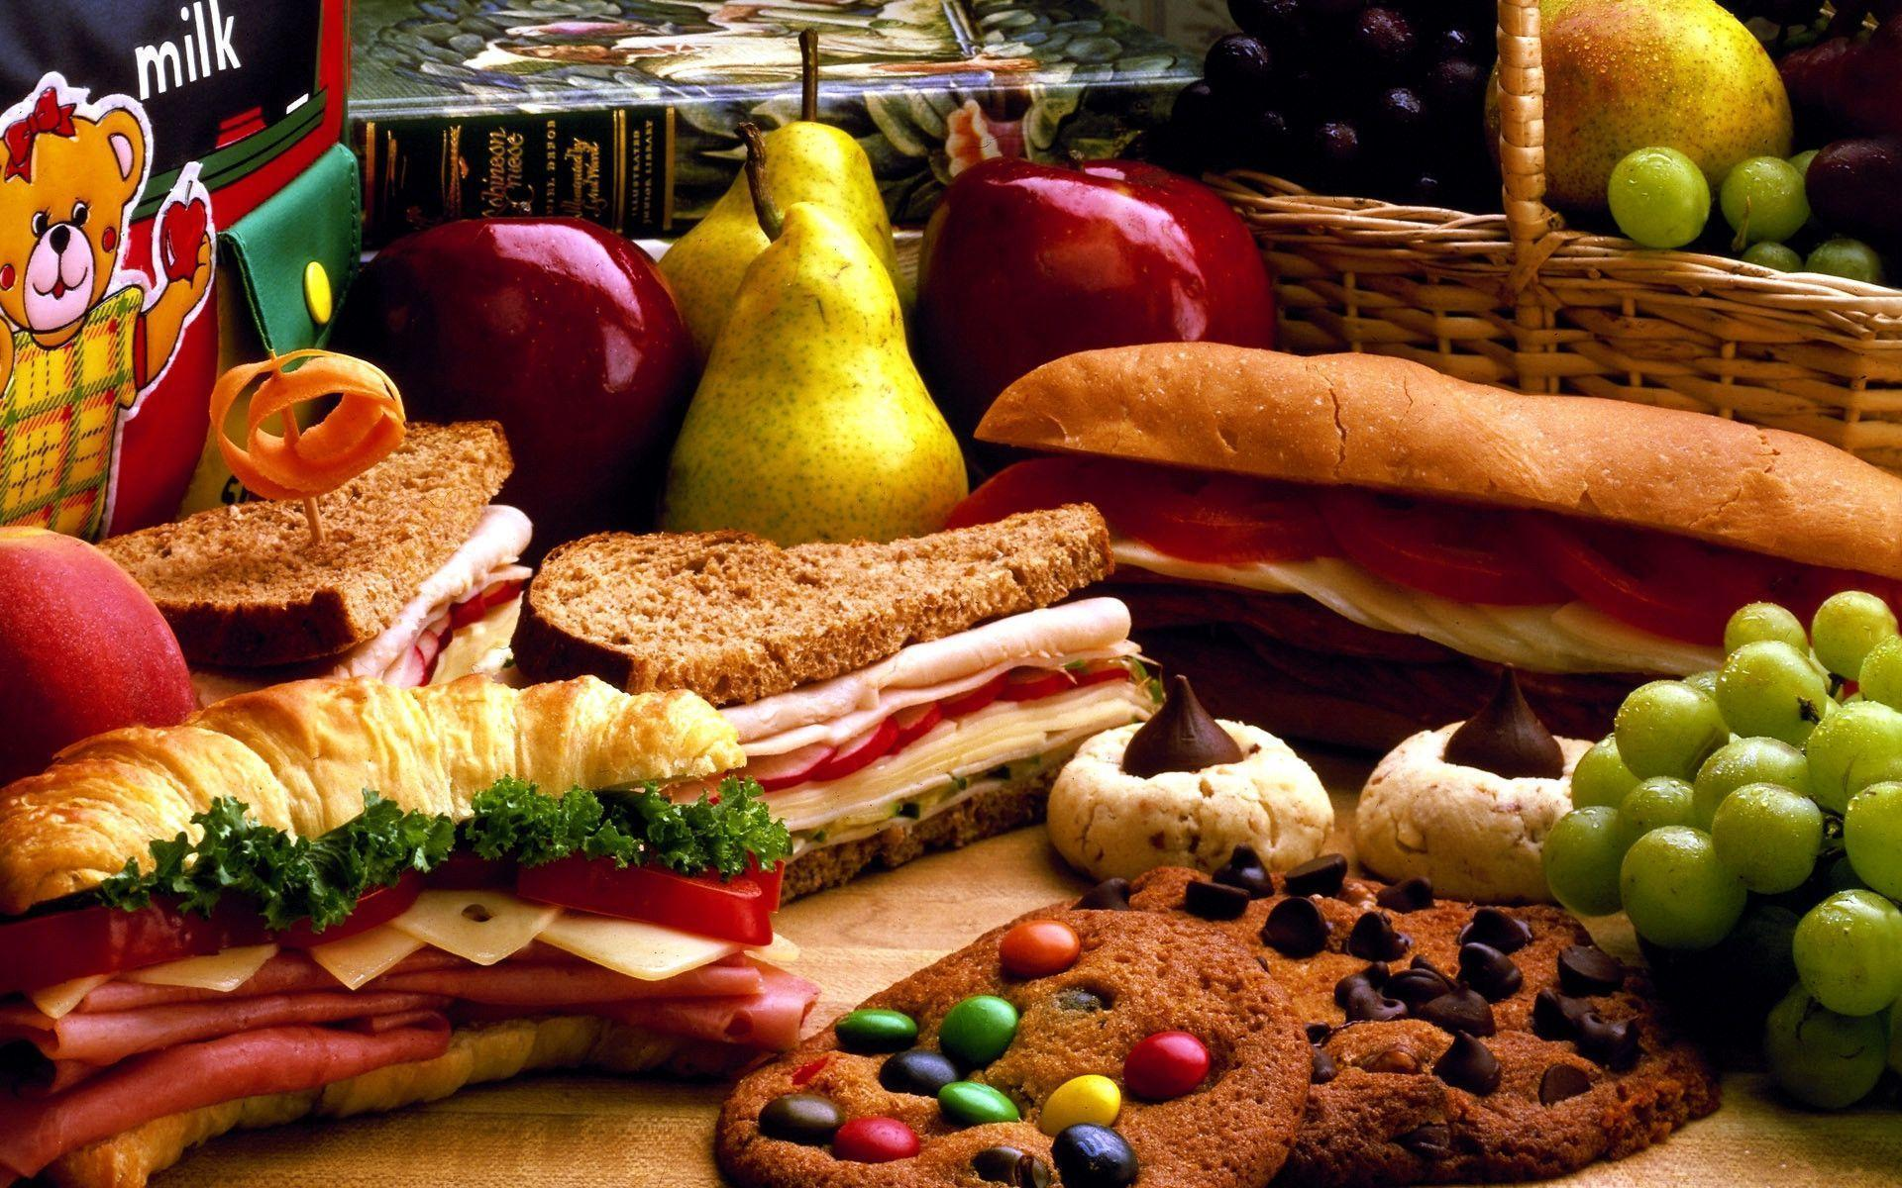
Let’s eat!
Lesson 5 - Writing

Slide 2
Notes for the Educator
This lesson is pegged directly to Learning Outcomes W 5.16 I can write instructions to explain the steps of a process, W5.12 I can make a text more interesting or more relevant to me by changing the vocabulary and W5.14 I can use resources to help me plan my written work and present it accurately.
Teachers are to refer to the Scheme of Work where each lesson is explained in more detail.
Effects are included to make the presentation more interactive. Please present the PowerPoint in Slideshow mode.
Wherever possible we have included the use of online apps to enhance the teaching and learning experience.
The Notes section underneath the slides may contain some further points which can be developed during the lesson.
Teachers are encouraged to adapt this PowerPoint presentation to meet the learners’ language needs.
Audio files or links to websites may be included.
Tasks included in the PowerPoint presentation are also being shared as handouts.
For any comments, feedback or suggestions please email us at: marie-claire.camilleri@ilearn.edu.mt; urieth.attard@ilearn.edu.mt; mary.jude.camilleri@ilearn.edu.mt. You may also call the office on: 25983683.

Slide 3
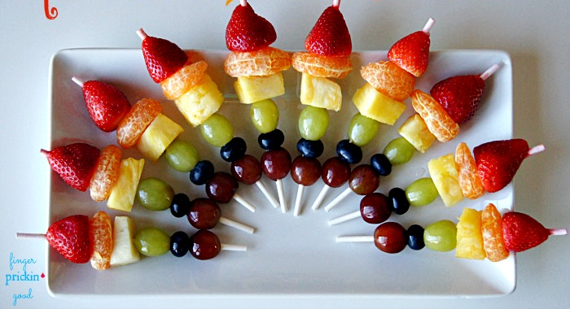
Recently, you prepared a special dish for a party you attended. It went down a storm and your friends are asking you for the recipe. Write the recipe so that your friends can prepare this mouth-watering treat.
Notes:
Let’s read the description of our task carefully and try to identify the genre, audience and purpose.

Slide 4
G
recipe
friends
to let them know how to prepare this dish
A
P

Slide 5
I am learning how to write a recipe.
I can use resources to help me plan my recipe.
I can write simple instructions to explains the steps of the recipe.
I can check my work, improve my writing and correct mistakes.

Slide 6
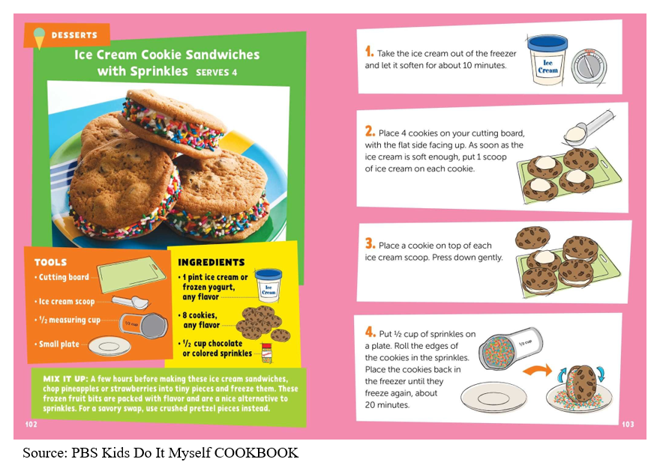
1. Name of the recipe
2. This recipe includes a picture of how the dessert will look in the end.
This part shows the method. It is a step by step guide to how to prepare the recipe.
2. Tools section indicates what utensils are needed
3. The ingredients tell the reader what food items are needed to prepare this recipe.
4. A little tip on how the reader can vary the recipe.

Slide 7
5. List down any words to describe the actions that you need to do
What are the steps for this recipe?
1. What is the name of this recipe?
2. What utensils do you need?
4. What tip can you include?
3. What ingredients do you need?

Slide 8
6. What are the steps for this recipe?
1. What is the name of this recipe?
5. List down any words to describe the actions that you need to do
Wash all the fruit
Prepare all the fruit: chop pineapple into small squares and cut tangerines into slices
Slide fruit onto kebab stick.
Arrange on plate in a rainbow shape
Rainbow Fruit Kebabs
wash
chop
push
slide
arrange
2. What utensils do you need?
Knife
Chopping board
Kebab sticks
Serving plate
4. What tip can you include?
3. What ingredients do you need?
strawberries, tangerine, pineapple, kiwi, blueberries, grapes
use seasonal fruits
Notes:
So now, keeping all these things in mind, we can start planning our recipe. I am going to use the same graphic organiser that I used for the speaking lesson. The recipe that I am going to write about is for these delicious and colourful fruit kebabs which kind of look like a rainbow because of their vibrant colours. That is why I decided to call these Rainbow fruit kebabs.

Slide 9
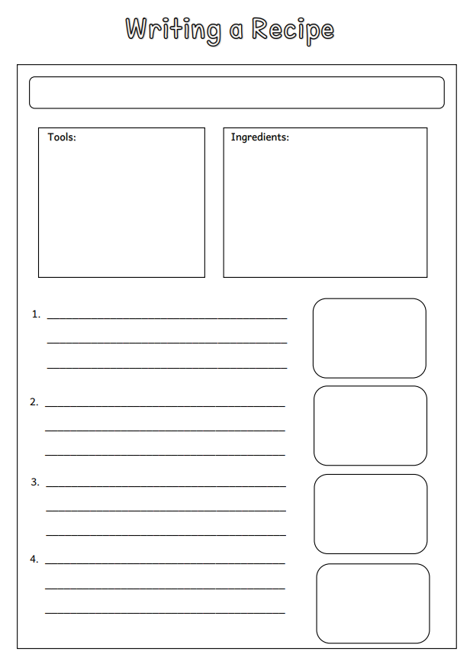
Name of the recipe
Utensils needed
Fruit that we need
We need to break down the recipe into 4 simple steps.
We need to draw a picture for each step.
Notes:
Right, now that we have a clear idea of what to include in our recipe, let’s take a look at the recipe writing frame that we will use for our writing.

Slide 10
Notes:
To help me write my recipe correctly, I can use the Writing a Recipe Word Mat and the Writing a Recipe Checklist.

Slide 11
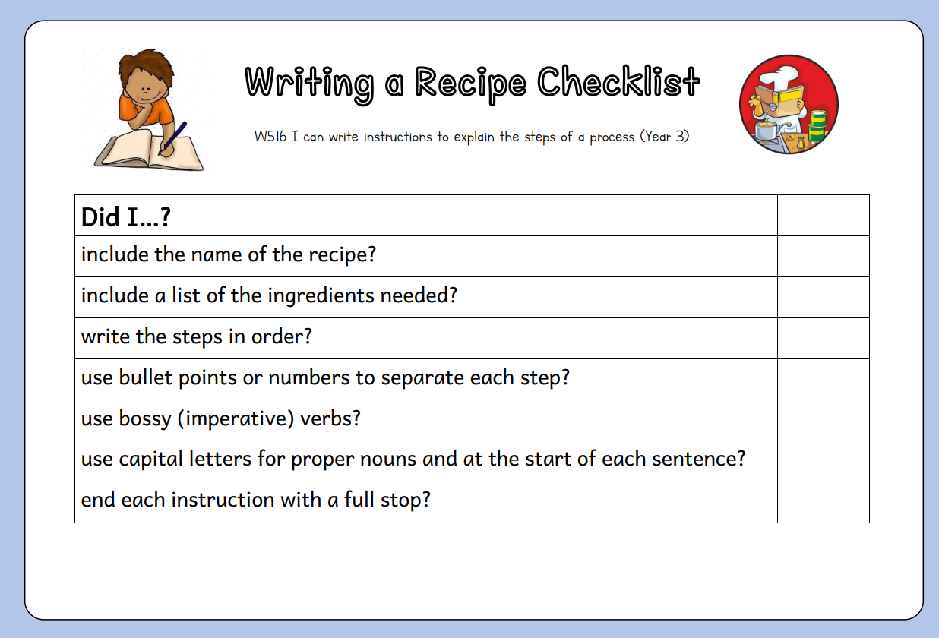

Slide 12
Step 1
Choose a favourite dessert.
Step 2
Plan the recipe.
Step 3
Write a draft of the recipe.
Step 4
Edit and revise the recipe.
Step 5
Rewrite recipe neatly and publish.
Notes:
So in this lesson, we have gone through the process of writing a recipe. Now, it’s your turn to plan and draft your recipe. You can refer to the writing template and the success criteria which you can download. Let’s quickly go through the steps that you need to follow.

Slide 13
Thank you for using this resource. Check out our latest resources below.

