Slide 1
Getting around
Lesson 2 - Reading

Slide 2
Notes for the Educator
This lesson is pegged directly to Learning Outcome R 5.5 I can use a range of strategies to aid comprehension and find the required information in the text and R 5.7 I can make informed assumptions about a text or long work from its title and introductory material
Teachers are to refer to the Scheme of Work where each lesson is explained in more detail.
Effects are included to make the presentation more interactive. Please present the PowerPoint in Slideshow mode.
Wherever possible we have included the use of online apps to enhance the teaching and learning experience.
The Notes section underneath the slides may contain some further points which can be developed during the lesson.
Teachers are encouraged to adapt this PowerPoint presentation to meet the learners’ language needs.
Audio files or links to websites may be included.
Tasks included in the PowerPoint presentation are also being shared as handouts.
For any comments, feedback or suggestions please email us at: marie-claire.camilleri@ilearn.edu.mt; urieth.attard@ilearn.edu.mt; mary.jude.camilleri@ilearn.edu.mt. You may also call the office on: 25983683.

Slide 3
birds
ambulance
helicopter
police car
camels
fire engine
tow truck
horses
rescue boat
dogs
animals
emergencies
bicycle
on the road
on foot
for work/cargo
Means of transport
lorry
car
taxi
van
dumper truck
long distance
cargo ship
hobbies/leisure
rocket ship
motorbike
cruise liner
trains
oil tanker
scooter
hoverboard
planes
bicycle
jet ski
speedboat

Slide 4
I am learning how to read and respond to an advert.
I can identify the purpose and the target audience.
I can talk about the language features used.
I can use different strategies to read and find information.

Slide 5
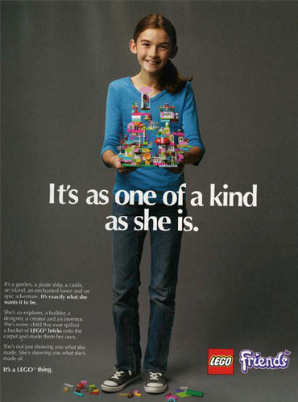
Happy expression on child’s face – makes us think that is how we will feel when we buy or use this product.
Object placed in the middle for attention
Words in bold to draw reader’s attention. White words against a dark background – they stand out more.
Compares the object to the person – ‘one of a kind’ – appeals to the parents who want to see their children happy
Catchy slogans and phrases: It’s a LEGO thing

Slide 6
Use of adjectives to describe hair: healthy and soft. You can almost visualise the hair.
Big picture of product in the middle part of the advert.
The name ‘Bubbles’ appeals to young readers. Children love bubbles and soap. The image of the whale also appeals to young children.
The use of the senses: orange scent
Promises the reader that there will be no tears and hair will be free of knots.
Notes:
Now, let’s look carefully at the 2nd advertisement. What is it trying to sell? Who is the target audience? What can you tell about the colours used? Why do you think there is the picture of the whale?

Slide 7
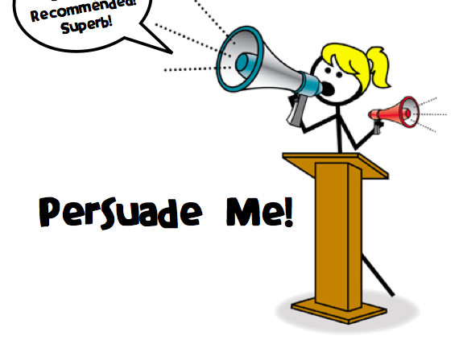
What are adverts?
Persuade people to do or try something.
Catch the attention of the reader through words, pictures, logos and colour.
Give a positive image about the product or service being advertised
Notes:
So now that we have looked at some adverts and discussed some of their features, lets’ understand better what adverts are.

Slide 8
adjustable
Notes:
Adjustable - something that can be adjusted fixed, for example adjust the height of the chair – make it higher or lower

Slide 9
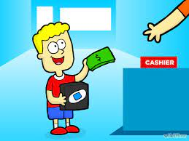
purchase
Notes:
To purchase means to buy something

Slide 10
brand new
Notes:
Something that has never been used before

Slide 11
award winner
Notes:
When you win something like a medal or a cup.

Slide 12
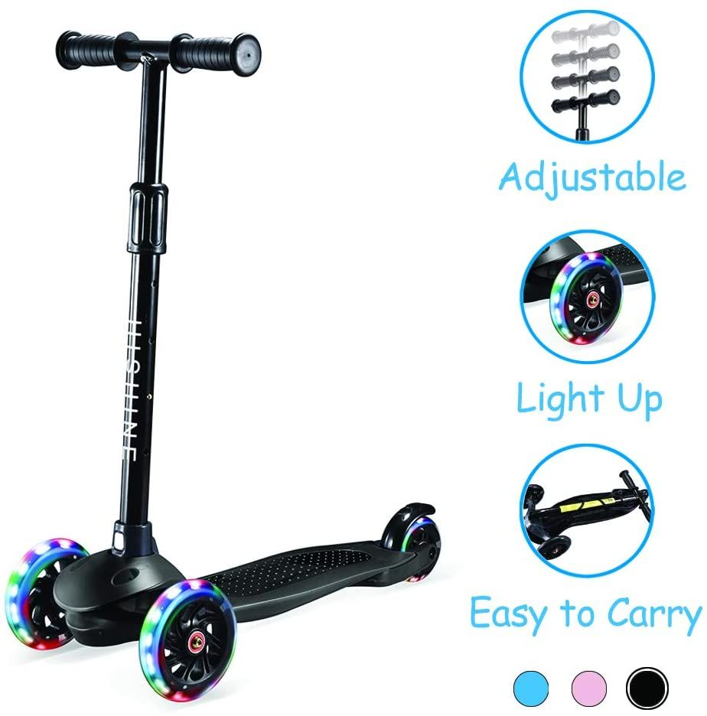
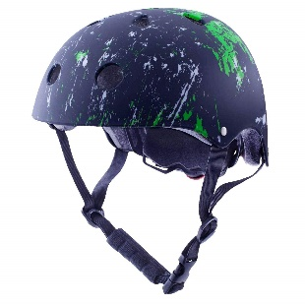
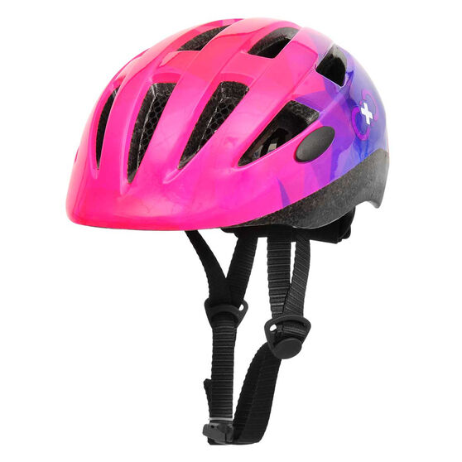
Are you tired of always following your parents around on foot?
Starts off with a rhetorical question to hook you in.
There is another way…
Use carefully chosen language to appeal to the interest of their target audience..
99
Use a mix of facts and persuasive language.
Get a new FREE helmet with your purchase!!
Use word play to come up with catchy slogan: Repetition and Alliteration
The COOLEST and FASTEST way to get around!
Get it Now from The Toy Room!
Notes:
Let’s look at the advert we will be reading today. Take some time to really look at it and make any notes/comments under it on the paper.

Slide 13
What is this text?
Who is it trying to persuade? How do we know?
Does this advert make you want to buy the scooter/find out more? Why? Why not?
Notes:
You are going to hear me read the text aloud, first. As I go through it, I would like you to think about the following key questions:

Slide 14
Are you tired of always following your parents around on foot?
There is another way…
99
Get a new FREE helmet with your purchase!!
The COOLEST and FASTEST way to get around!
Get it Now from The Toy Room!
Notes:
Listen to me as I read the advert aloud. Next, I would like you to read the text silently on your own. If you come across a difficult word you can use some of the strategies, we have been learning about such as: breaking it into smaller words or stretching it out. You can also try to skip it and read on and then come back to it at the end of the sentence. Sometimes we can understand what the word is from its meaning within a sentence.

Slide 15
1. What is this text?
An advert for a scooter

Slide 16
2. Who is it trying to persuade? How do we know?
Young readers
Children

Slide 17
3. Does this advert make you want to buy the scooter?
YES! I would love to see the wheels light up while I ride it.

Slide 18
Complete the chart. Find examples from the advert.
Examples of advertisement features
Questions | Adjectives | Facts
Persuasive Language | Product information | Special Offers
brand new
coolest
fastest
free
adjustable height
glowing wheels
easy to carry
availabe at the toy room
Are you tired of always following your parents around on foot?
There is another way.
Top Fun
Get it Now
€99
New helmet when you buy the scooter – offer valid only for a week
Notes:
Let’s try to complete the chart by finding examples for each advert feature. We need to support our answers with evidence from the advert.

Slide 19
Thank you for using this resource. Check out our latest resources below.

