Slide 1
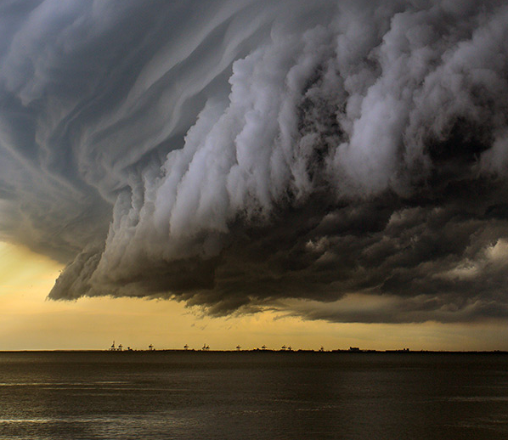
Lesson 2:
Reading
Topic:
Weather and Natural Disasters
Year:
4

Slide 2
Lesson Objectives:
During this lesson I will:
learn about natural disasters.
learn the meaning of new words.
listen to a text being read aloud.
read a text silently and aloud.
answer questions about a text.

Slide 3
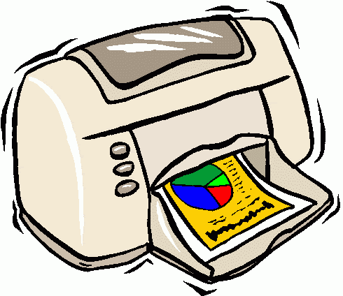
Download these resources:
Reading Text Handout
Questions Worksheet
Answers Handout

Slide 4
What are NATURAL DISASTERS?
VISIT the webpage:
https://www.weatherwizkids.com/?page_id=91#
CLICK on the tab:
NATURAL DISASTERS
CLICK on the different natural disasters.
READ the information about them.

Slide 5
Pre-Teaching of Words:
catastrophes = sudden disasters
economy = a country’s use of money and goods
uninhabited = a place where people do not live
landslides = movement of rock, debris and earth down a
slope
destruction = damage to something that cannot be repaired
predicted = estimated to happen in the future
warnings = advance notices of something

Slide 6
Step 1:
a. READ the text on the handout.
READ the exercises on your worksheet.
After you read the text and questions ANSWER this question:
What is the text about?

Slide 7
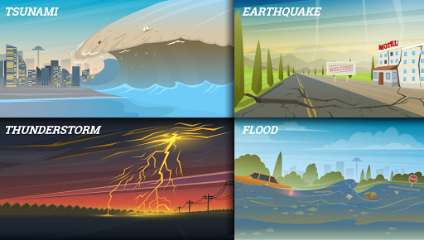
Step 2: What is the text about?
The text explains what natural disasters are.

Slide 8
Step 3 : READ the text and questions again. Then try to ANSWER these questions:
1. What are natural disasters?
2. How bad can a tsumani be if it takes place on an uninhabited
island?
3. When can landslides happen?
4. Can natural disasters be predicted?

Slide 9
Step 4: Let’s DISCUSS the questions.
1. What are natural disasters?
They are catastrophes that occur in nature or by natural processes.
2. How bad can a tsumani be if it takes place on an uninhabited island?
Since no one lives on the island, it is not a disaster because nothing will be destroyed and no lives will be lost .
3. When can landslides happen?
These can be caused by earthquakes, heavy rain or snow, or by other disasters.
4. Can natural disasters be predicted?
Yes, some can be predicted ahead of time.

Slide 10
Step 5:
LISTEN to me as I READ the text and
the questions aloud.
FOLLOW your text and READ it
silently.

Slide 11
Step 6:
READ the text ALOUD.

Slide 12
Step 7:
WORK OUT the Questions Worksheet.

Slide 13
Step 8:
Revise your answers.

Slide 14
Step 9:
Check your work using the Answers Handout.

Slide 15
Post-task: Choose one natural disaster. At home, carry out some research on it. The research will be useful for the Writing Lesson.

