Slide 1
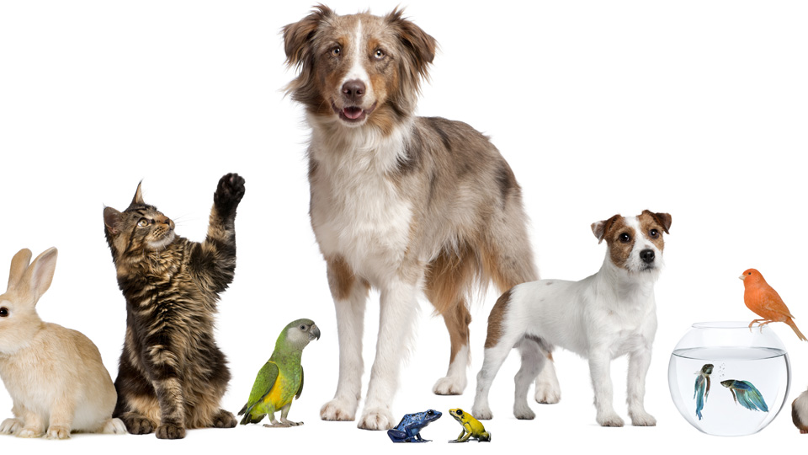
Pets
Lesson 3: Reading an email
Notes:
Hello again children. I’m so happy to have you here with me for our reading lesson. Today’s reading lesson is packed with interesting reading material.
Do you remember the teenagers from our Listening Lesson – do you remember where they were? If you said the National Pet Show, then you are right! In this lesson we are going to pretend that we are going to attend the National Pet Show, too! What a fun day out it will be!

Slide 2
Notes for the Educator
This lesson is pegged directly to Learning Outcome R 5.5 I can use a range of strategies to aid comprehension and find the required information in the text and R 5.7 I can make informed assumptions about a text or long work from its title and introductory material
Teachers are to refer to the Scheme of Work where each lesson is explained in more detail.
Effects are included to make the presentation more interactive. Please present the PowerPoint in Slideshow mode.
Wherever possible we have included the use of online apps to enhance the teaching and learning experience.
The Notes section underneath the slides may contain some further points which can be developed during the lesson.
Teachers are encouraged to adapt this PowerPoint presentation to meet the learners’ language needs.
Audio files or links to websites may be included.
Tasks included in the PowerPoint presentation are also being shared as handouts.
For any comments, feedback or suggestions please email us at: marie-claire.camilleri@ilearn.edu.mt; urieth.attard@ilearn.edu.mt; mary.jude.camilleri@ilearn.edu.mt. You may also call the office on: 25983683.

Slide 3
I am learning how to read an email.
I can identify the different parts of an email.
I can tell what the main idea is.
I can use different strategies to read and find information.
Notes:
Learning Intention and Success criteria.

Slide 4
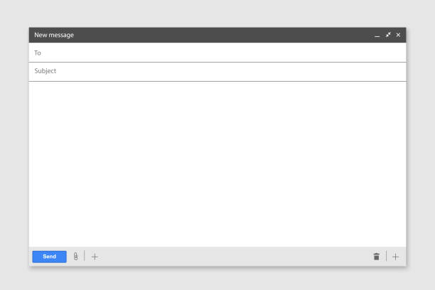
What is an email?
Have you ever sent an email?
To whom and what was it about?
Why do we use emails?
What do you need to have in order to send an email?

Slide 5
Email address of person receiving email
oliver@gmail.com
What the email is about
Join us!
Email address of the person sending the email
kai@ilearn.edu.mt
for photos or documents
greeting
Dear Oliver,
I hope you are well. My family and I are planning to visit the National Pet Show on Sunday 1st November. Would you like to join us? I know that you love animals, too!
I am attaching the timetable with all the activities that will be held at the Kids’ Zone on Sunday. There are many interesting activities. I’m really looking forward to handling the snakes and seeing Mojo the poodle perform some awesome tricks. Which activities would you prefer to see?
Let me know if you can make it. By the way, Mum said that I can take care of your pet while you are away.
Best regards,
Kai
opening
main paragraph
closing
signature
Notes:
Before actually reading the text, we need to discuss how an email looks and some of its important features. This is how the email that we are going to read looks like. The first thing you need to know is the different parts of an email, and these are:

Slide 6
oliver@gmail.com
Join us!
kai@ilearn.edu.mt
Dear Oliver
I hope you are well. My family and I are planning to visit the National Pet Show on Sunday 1st November. Would you like to join us? I know that you love animals, too!
I am attaching the timetable with all the activities that will be held at the Kids’ Zone on Sunday. There are many interesting activities. I’m really looking forward to handling the snakes and seeing Mojo the poodle perform some awesome tricks. Which activities would you prefer to see?
Let me know if you can make it. By the way, Mum said that I can take care of your pet while you are away.
Best regards,
Kai
Notes:
We can immediately see how the email is structured: each paragraph is well defined with a space in between. This means that I can tell where a paragraph starts and finishes.

Slide 7
oliver@gmail.com
Join us!
kai@ilearn.edu.mt
Dear Oliver
I hope you are well. My family and I are planning to visit the National Pet Show on Sunday 1st November. Would you like to join us? I know that you love animals, too!
I am attaching the timetable with all the activities that will be held at the Kids’ Zone on Sunday. There are many interesting activities. I’m really looking forward to handling the snakes and seeing Mojo the poodle perform some awesome tricks. Which activities would you prefer to see?
Let me know if you can make it. By the way, Mum said that I can take care of your pet while you are away.
Best regards,
Kai
Notes:
Now, we are going to look at how certain parts of an email can be written. Let’s start with the greeting. This email starts with ‘Dear Oliver’.

Slide 8
The Greeting
Hi Oliver,
Hello Oliver,
Dear Oliver,
Notes:
In order to start your email you can use different expressions, which are very easy to remember:
Hi Oliver,
Hello Oliver,
Dear Oliver,
Don’t forget to put a comma right after the name and then you start the opening paragraph in a new line.

Slide 9
oliver@gmail.com
Join us!
kai@ilearn.edu.mt
Dear Oliver
I hope you are well. My family and I are planning to visit the National Pet Show on Sunday 1st November. Would you like to join us? I know that you love animals, too!
I am attaching the timetable with all the activities that will be held at the Kids’ Zone on Sunday. There are many interesting activities. I’m really looking forward to handling the snakes and seeing Mojo the poodle perform some awesome tricks. Which activities would you prefer to see?
Let me know if you can make it. By the way, Mum said that I can take care of your pet while you are away.
Best regards,
Kai
Notes:
Next is the Opening paragraph. Here is where you say the purpose for writing the email. It is a good idea to start off your opening paragraph by asking the reader how they are feeling. In order to do so, you can use a number of different expressions. Here we have some examples:

Slide 10
The Opening Paragraph
Hope you are doing well.
I hope you are well.
How are you (doing)?
How are things (going)?

Slide 11
The Opening Paragraph – replying to an email
Thanks for your email.
It’s good to hear from you.
I’m glad to hear that… (sorry)
Thanks a lot for writing.

Slide 12
The Opening Paragraph – purpose
I am writing to let you know…
I am writing to ask you...
I would like to invite you…
Would you like…
Notes:
Immediately after, you should state the purpose for writing the email. You can do so in different ways such as:

Slide 13
oliver@gmail.com
Join us!
kai@ilearn.edu.mt
Dear Oliver
I hope you are well. My family and I are planning to visit the National Pet Show on Sunday 1st November. Would you like to join us? I know that you love animals, too!
I am attaching the timetable with all the activities that will be held at the Kids’ Zone on Sunday. There are many interesting activities. I’m really looking forward to handling the snakes and seeing Mojo the poodle perform some awesome tricks. Which activities would you prefer to see?
Let me know if you can make it. By the way, Mum said that I can take care of your pet while you are away.
Best regards,
Kai
Notes:
Next, we continue by writing the main paragraph or paragraphs. Here the person writing the email elaborates further on the reason for writing. The author adds more details to the main idea behind the email. You can also ask questions that you would like the reader to answer. Here you need to use connectors to join your ideas together.

Slide 14
The Main Paragraph/s
Give details and ask questions
Use connectors to link ideas: and, but, however, by the way, moreover, because

Slide 15
oliver@gmail.com
Join us!
kai@ilearn.edu.mt
Dear Oliver
I hope you are well. My family and I are planning to visit the National Pet Show on Sunday 1st November. Would you like to join us? I know that you love animals, too!
I am attaching the timetable with all the activities that will be held at the Kids’ Zone on Sunday. There are many interesting activities. I’m really looking forward to handling the snakes and seeing Mojo the poodle perform some awesome tricks. Which activities would you prefer to see?
Let me know if you can make it. By the way, Mum said that I can take care of your pet while you are away.
Best regards,
Kai
Notes:
In the closing paragraph the authors starts saying goodbye to the addressee and to ask for a response to your email. So we can use the following expressions:

Slide 16
The Closing Paragraph
Anyway, I have to go now.
Well, it’s time to go.
I really hope to hear from you soon.
I’m looking forward to hearing from you.
I hope you write back soon.

Slide 17
oliver@gmail.com
Join us!
kai@ilearn.edu.mt
Dear Oliver
I hope you are well. My family and I are planning to visit the National Pet Show on Sunday 1st November. Would you like to join us? I know that you love animals, too!
I am attaching the timetable with all the activities that will be held at the Kids’ Zone on Sunday. There are many interesting activities. I’m really looking forward to handling the snakes and seeing Mojo the poodle perform some awesome tricks. Which activities would you prefer to see?
Let me know if you can make it. By the way, Mum said that I can take care of your pet while you are away.
Best regards,
Kai
Notes:
Saying goodbye
There are many ways in English to close an informal email. The most frequently used ones are the following:

Slide 18
Saying Goodbye
Love,
Lots of love,
See you soon,
Best regards,
Notes:
Notice how there is a comma (,) after each of the phrases. Also, after writing any of these sentences, make sure you write your name on a different line. And write your name without a full stop!

Slide 19
oliver@gmail.com
Join us!
Read the email.
What is the main idea?
kai@ilearn.edu.mt
Dear Oliver
I hope you are well. My family and I are planning to visit the National Pet Show on Sunday 1st November. Would you like to join us? I know that you love animals, too!
I am attaching the timetable with all the activities that will be held at the Kids’ Zone on Sunday. There are many interesting activities. I’m really looking forward to handling the snakes and seeing Mojo the poodle perform some awesome tricks. Which activities would you prefer to see?
Let me know if you can make it. By the way, Mum said that I can take care of your pet while you are away.
Best regards,
Kai
Notes:
This is called skimming. You want to read the text to find the general idea. Think about the most important point in the email. Find evidence from the text to support this. Then find additional details that support the main idea.

Slide 20
The author is visiting the National Pet show on Sunday and is inviting his friend Oliver.
Detail 1:
The author is sending the timetable with activities planned for Sunday
Detail 2:
The author looks forward to handling snakes and Mojo the poodle
Detail 3:
The author can take care of his friend’s pet while he will be away
Main idea
Details
Notes:
Let’s organise this information.

Slide 21
Thank you for using this resource. Check out our latest resources below.

