Slide 1
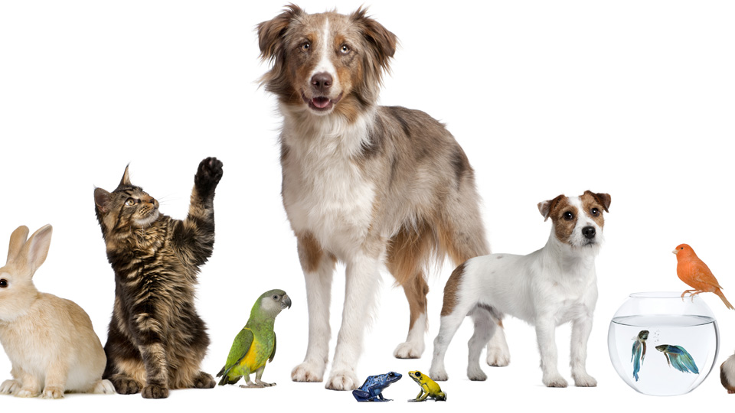
Pets
Lesson 2 – Reading a Ti
Notes:
Hello again children. I’m so happy to have you here with me for our reading lesson. Today’s reading lesson is packed with interesting reading material.
Do you remember the teenagers from our Listening Lesson – do you remember where they were? If you said the National Pet Show, then you are right! In this lesson we are going to pretend that we are going to attend the National Pet Show, too! What a fun day out it will be!

Slide 2
Notes for the Educator
This lesson is pegged directly to Learning Outcome R 5.5 I can use a range of strategies to aid comprehension and find the required information in the text and R 5.7 I can make informed assumptions about a text or long work from its title and introductory material
Teachers are to refer to the Scheme of Work where each lesson is explained in more detail.
Effects are included to make the presentation more interactive. Please present the PowerPoint in Slideshow mode.
Wherever possible we have included the use of online apps to enhance the teaching and learning experience.
The Notes section underneath the slides may contain some further points which can be developed during the lesson.
Teachers are encouraged to adapt this PowerPoint presentation to meet the learners’ language needs.
Audio files or links to websites may be included.
Tasks included in the PowerPoint presentation are also being shared as handouts.
For any comments, feedback or suggestions please email us at: marie-claire.camilleri@ilearn.edu.mt; urieth.attard@ilearn.edu.mt; mary.jude.camilleri@ilearn.edu.mt. You may also call the office on: 25983683.
Notes:
Right, let’s look at the word cloud I have created with the words I thought of. What words can you see?
Can you create your own word cloud using the words you have thought about? You can put the words horizontally and vertically.

Slide 3
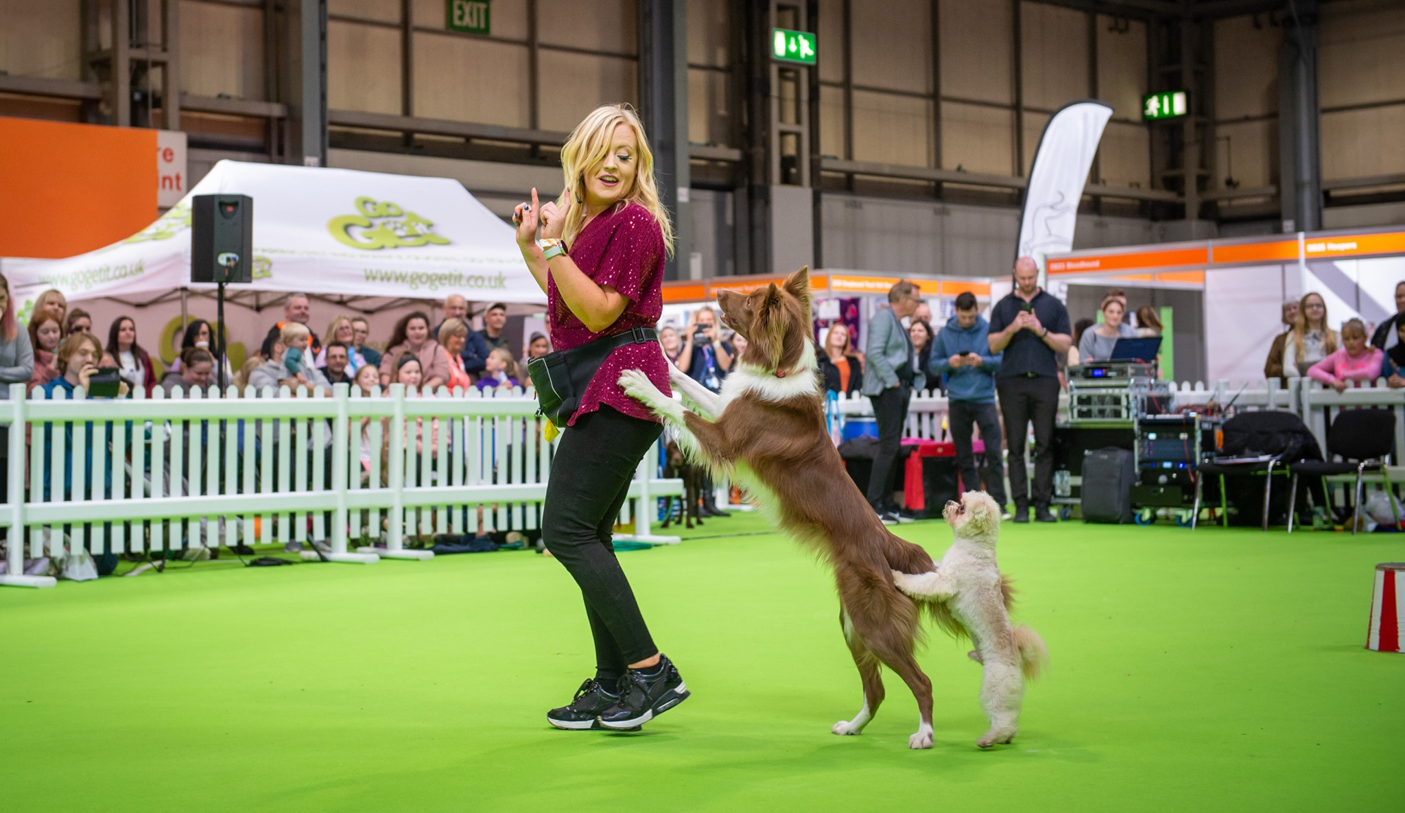
live show
tricks
performances
clever

Slide 4
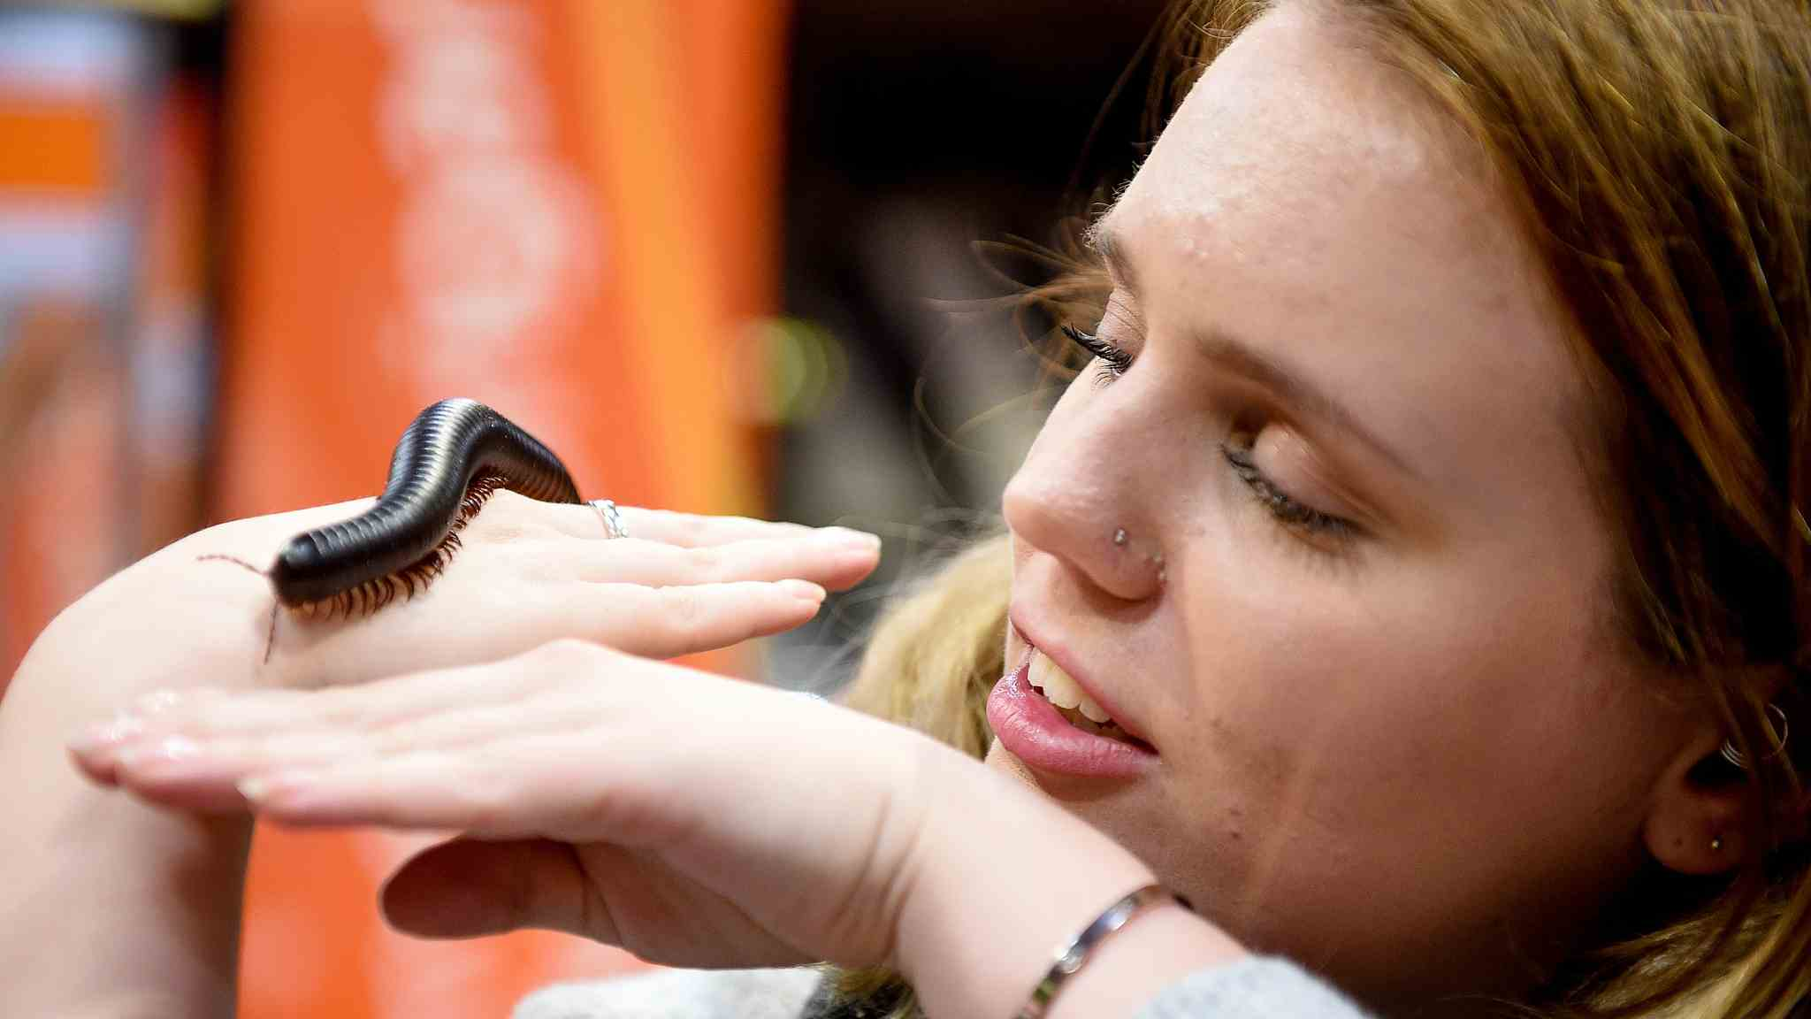
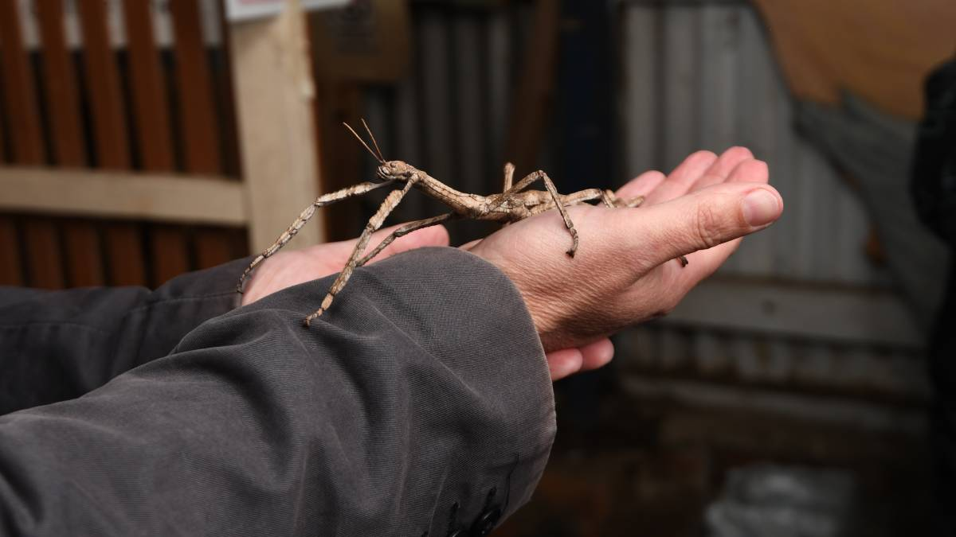
tickles
stick insect
millipede
camouflage

Slide 5
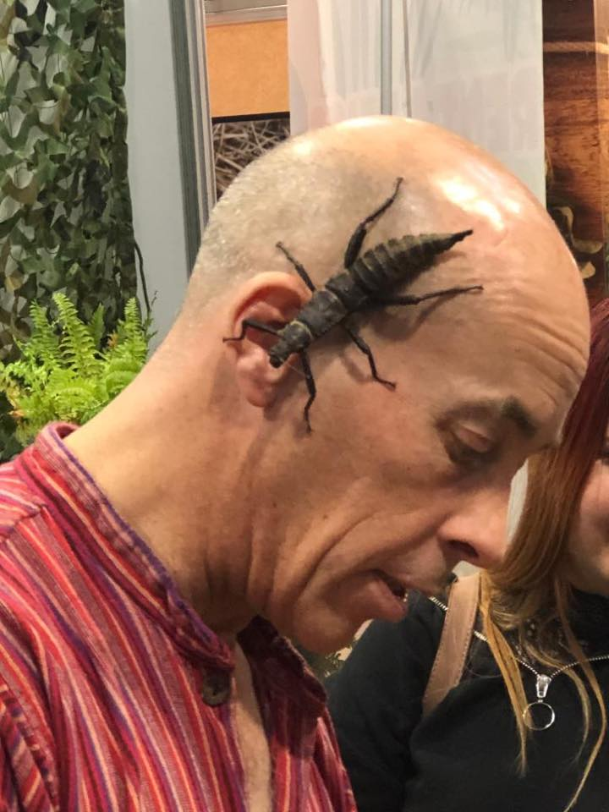
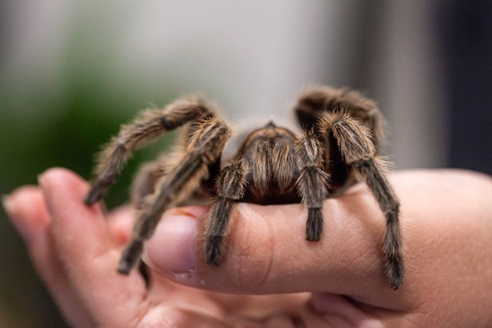
tarantula
minibeast

Slide 6
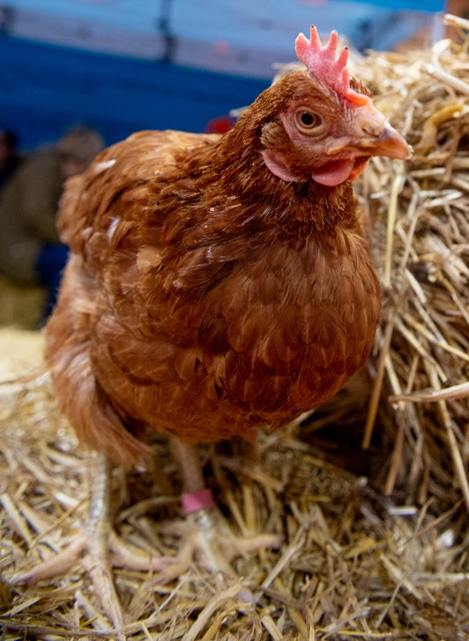
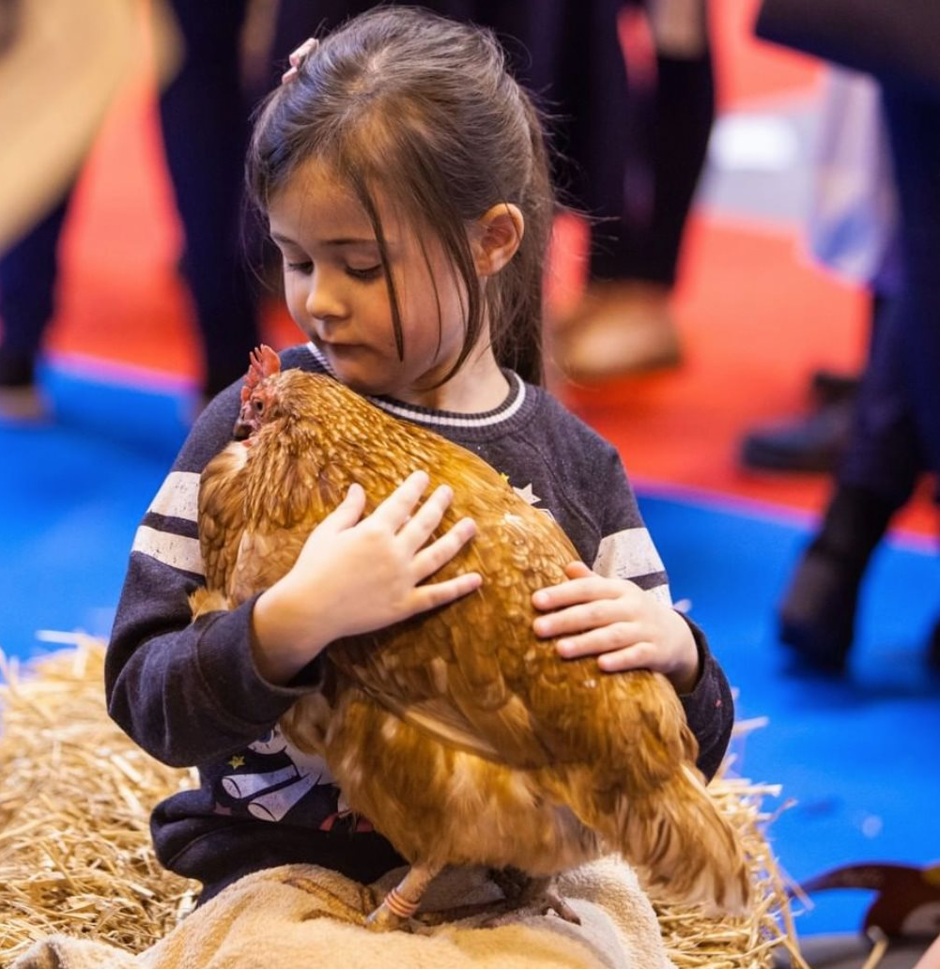
holding
hens

Slide 7
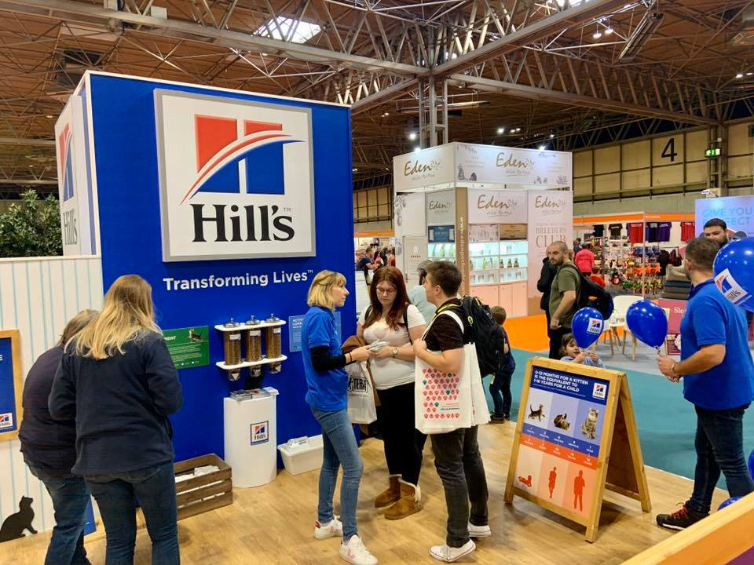
exhibition
food
stalls
information

Slide 8
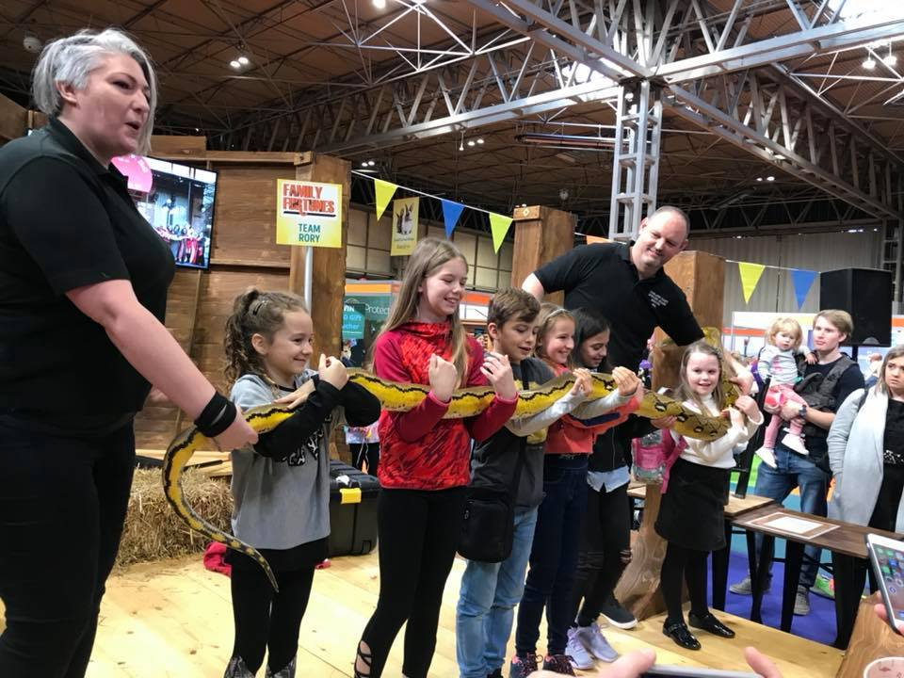
snakes
scaly skin
long body
pattern

Slide 9
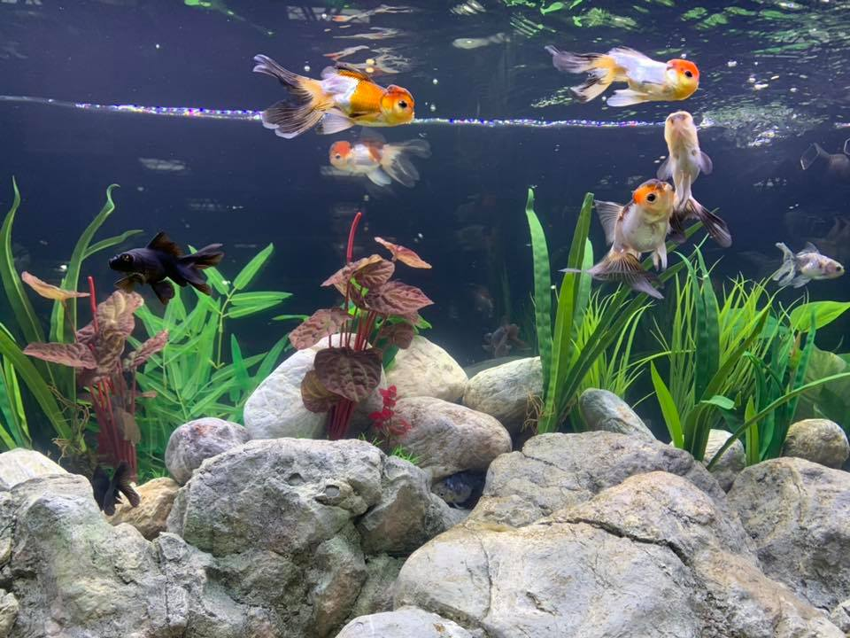
fish
aquarium

Slide 10
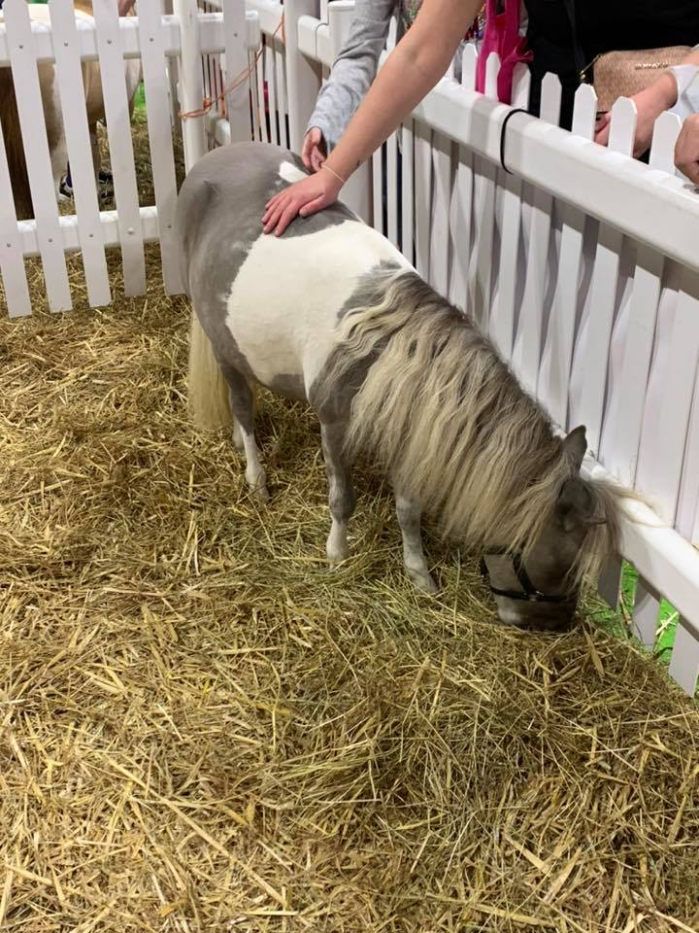
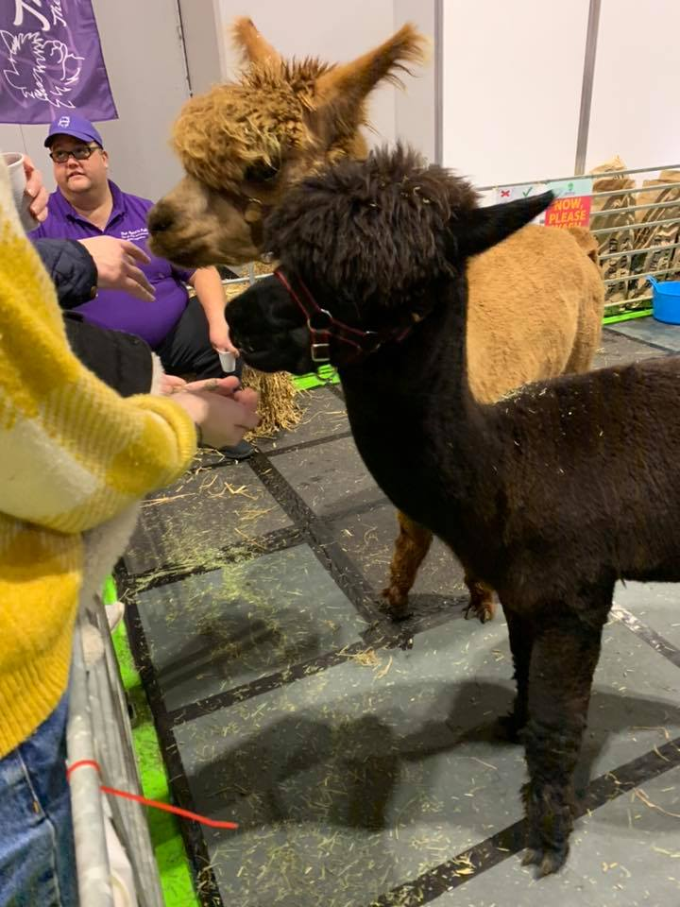
ponies
alpacas
Notes:
The alpacas look like a llama but they are generally smaller than the llamas.

Slide 11
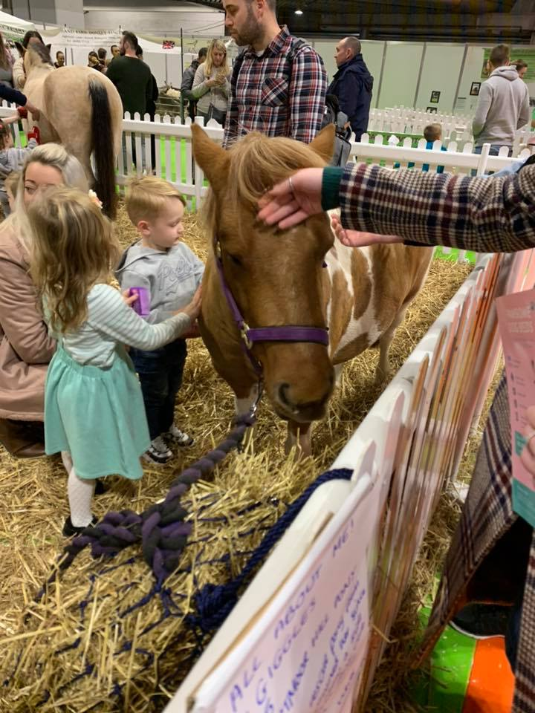
friendly
stroking
hay

Slide 12
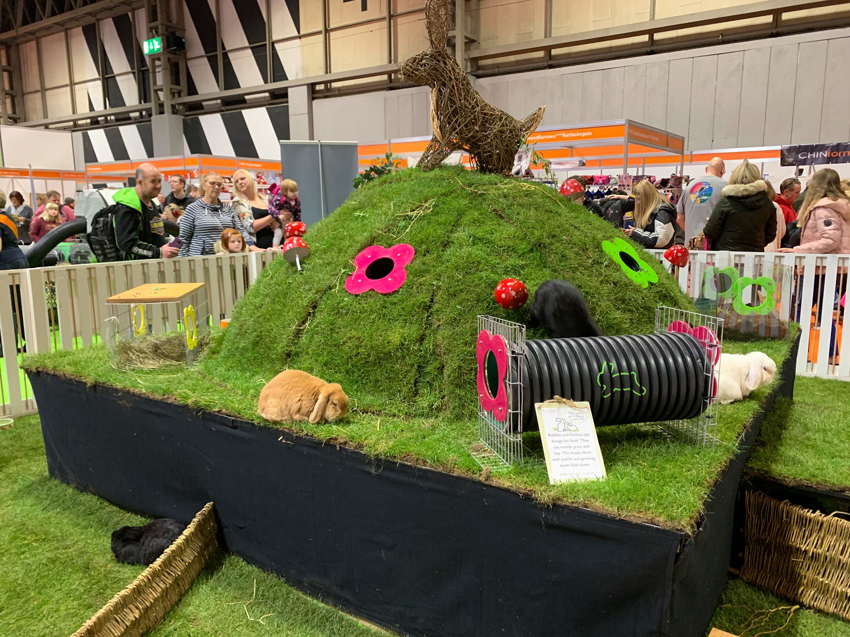
rabbit
mountain
tunnels
Notes:
Rabbit Mountain:, the garden features everything rabbits enjoy including a mound with tunnels and entrances/exits for running in and out of, hollow logs with peep holes, and willow jumps amongst pots of herbs for nibbling on.

Slide 13
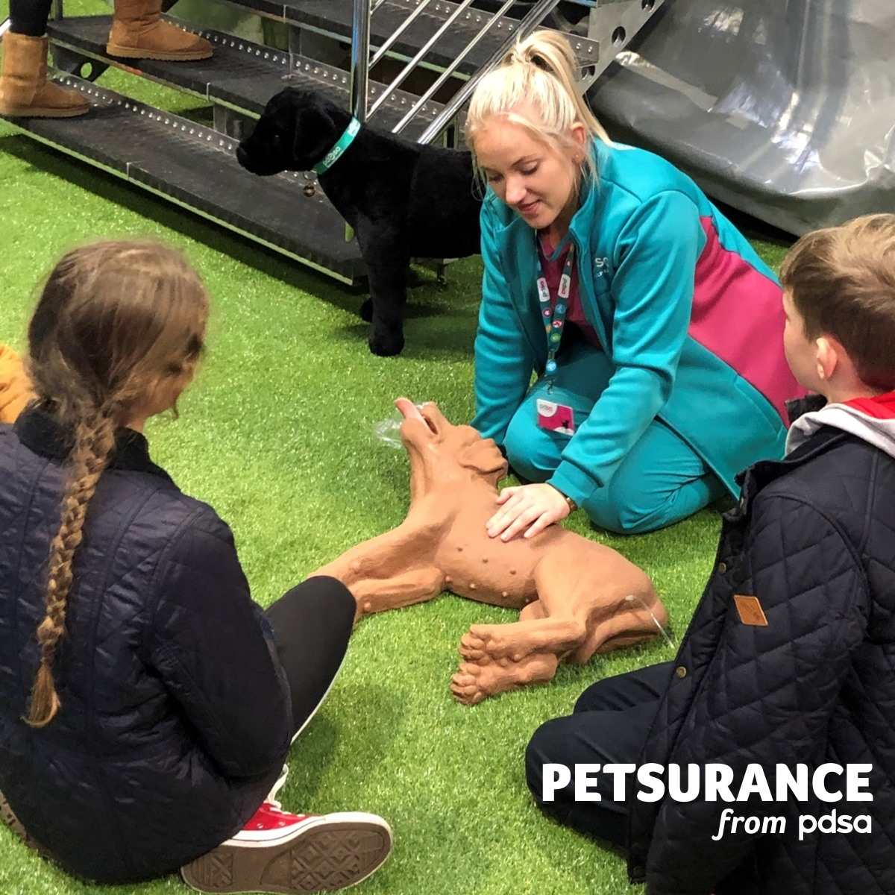
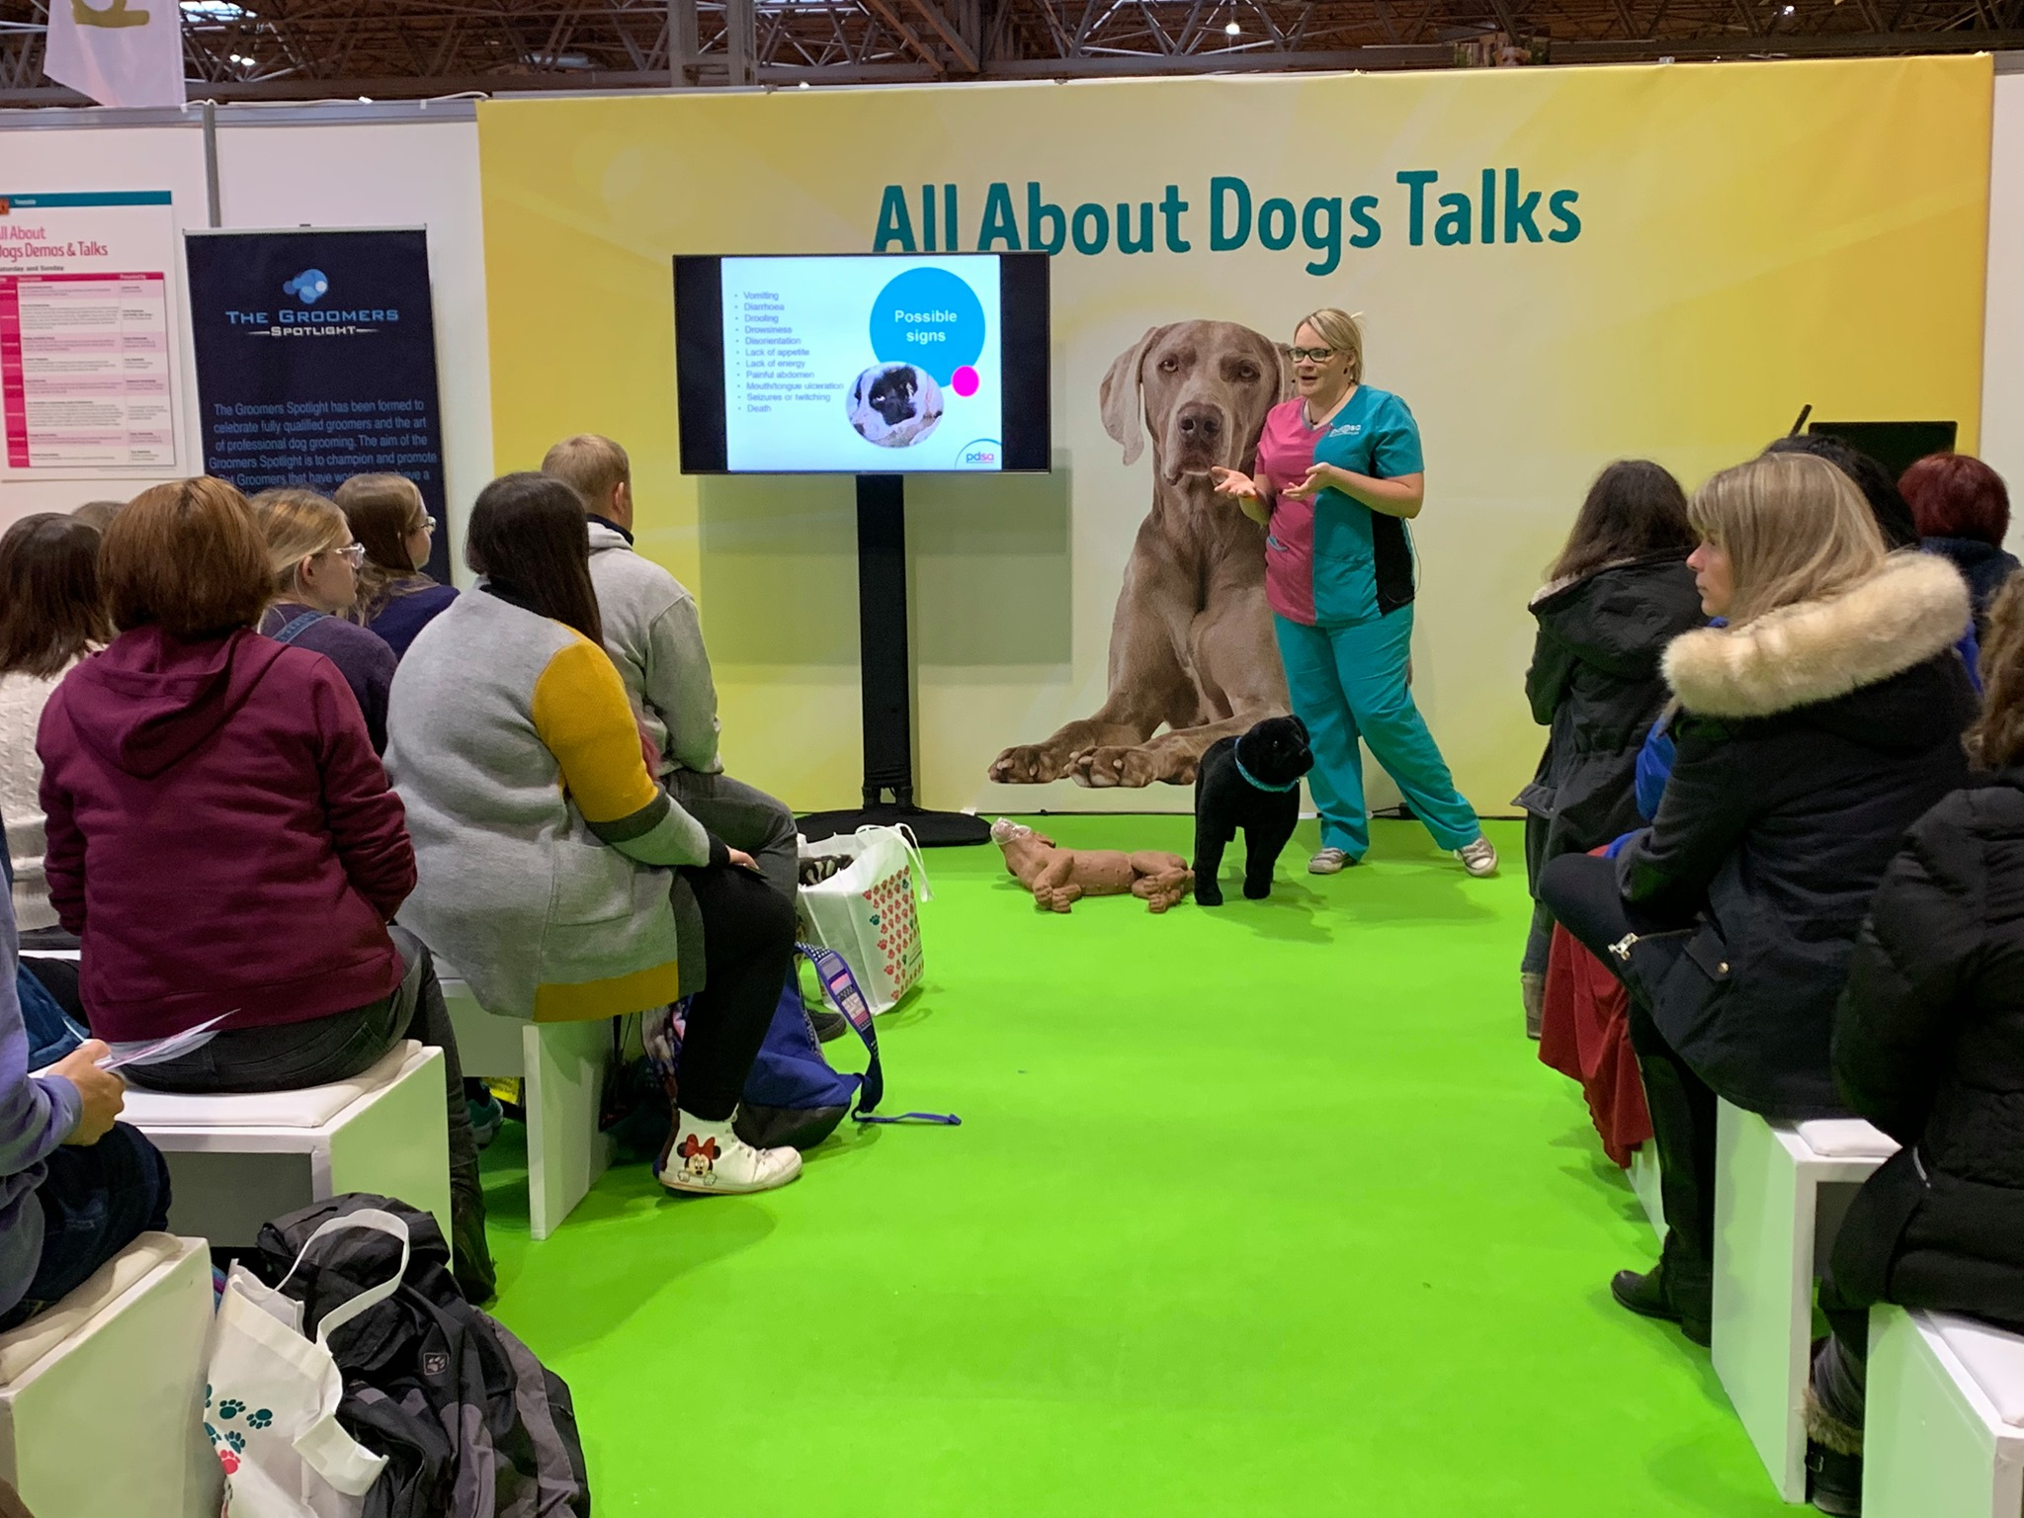
informative talks
pet rescue
Notes:
Giving first aid to your pet

Slide 14
What would you see at the show?
What interesting things would you learn?
What could you buy?
Mention three (3) things that you can do at the show.

Slide 15
What are timetables?
Shows a list of things that are going to happen.
Shows the time when the activity will start and sometimes the place.
Can include some other information or details.
Notes:
After going through the photos, you find the online show guide to find out what’s on at the show. You are especially interested in what’s going on in the Kids’ Zone, an area at the show aimed at children. Have you ever read a timetable?

Slide 16
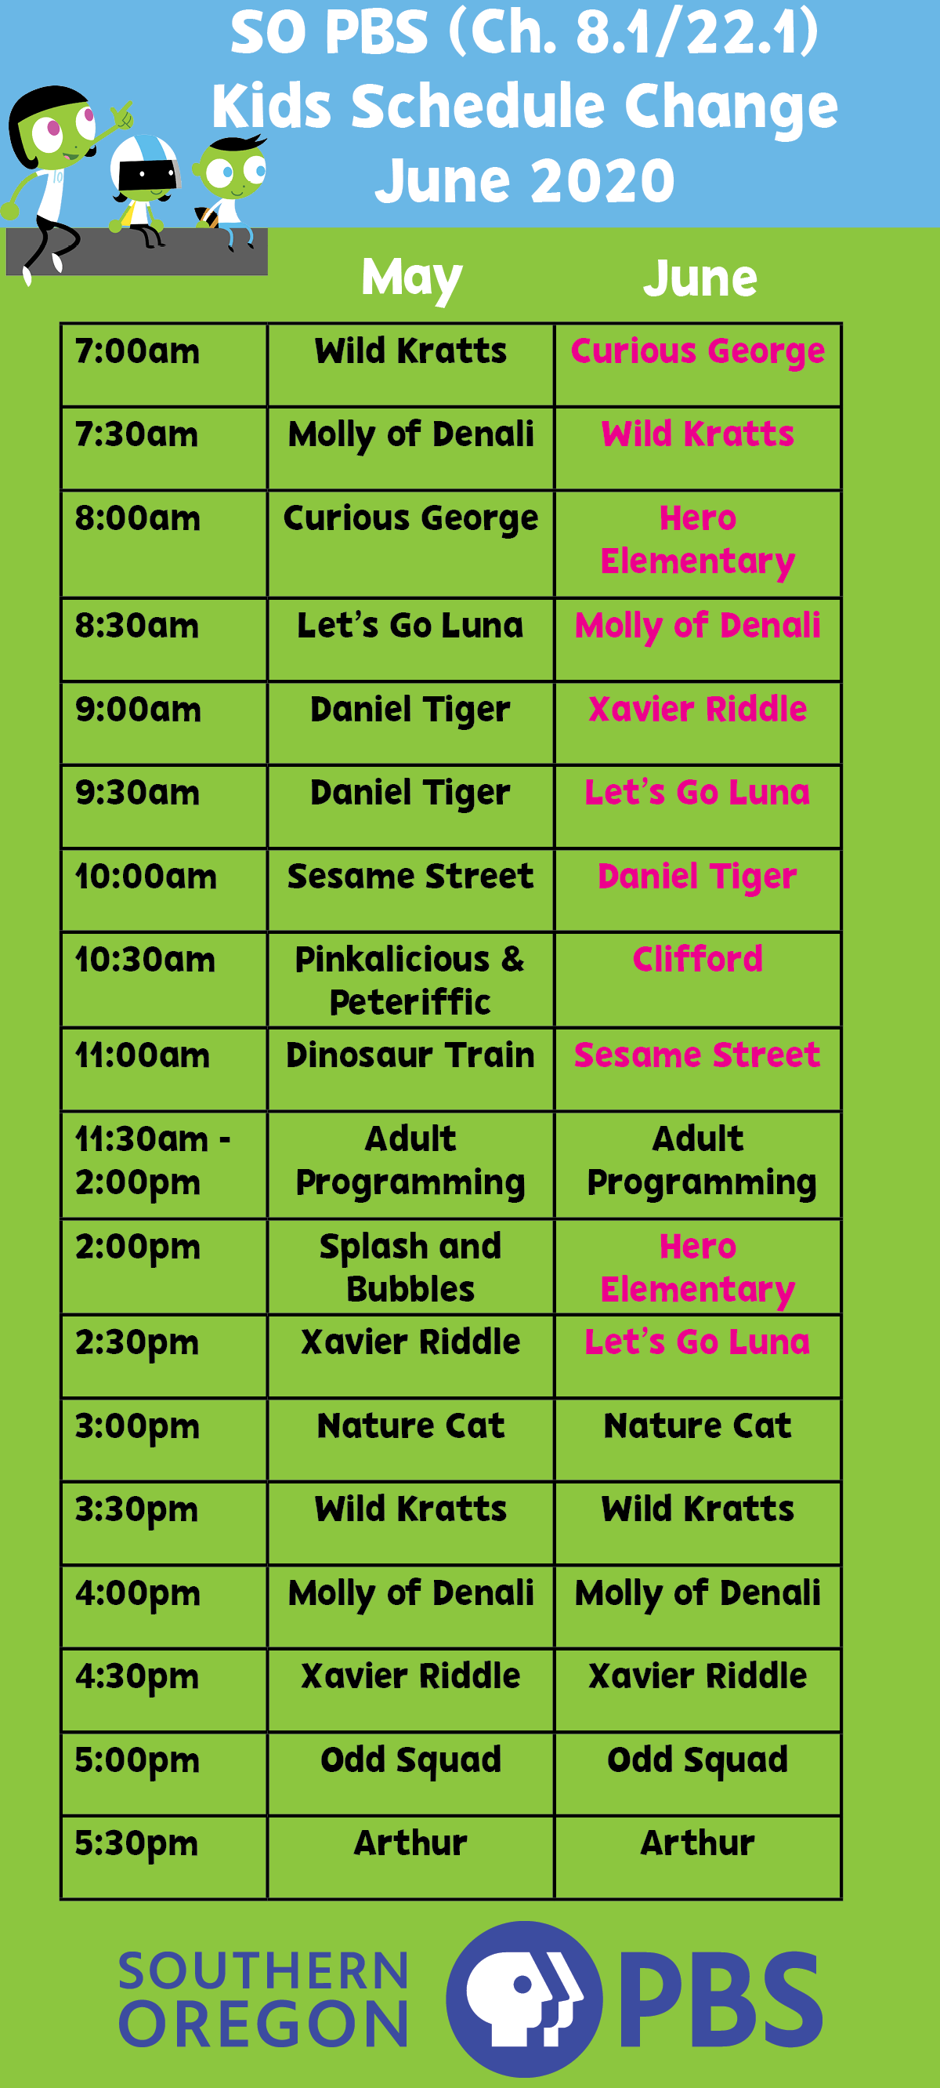
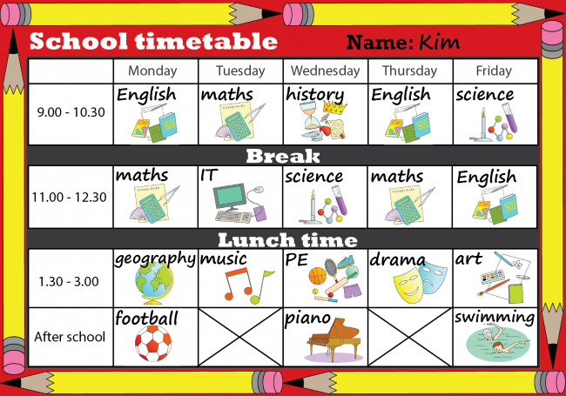
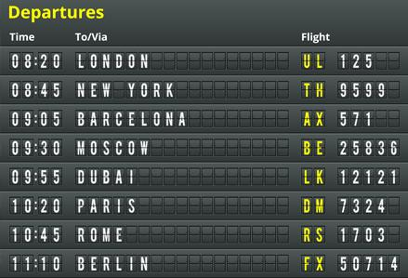
Types of instructions
Types of timetables
Notes:
How many types of written instructions can learners think of?

Slide 17
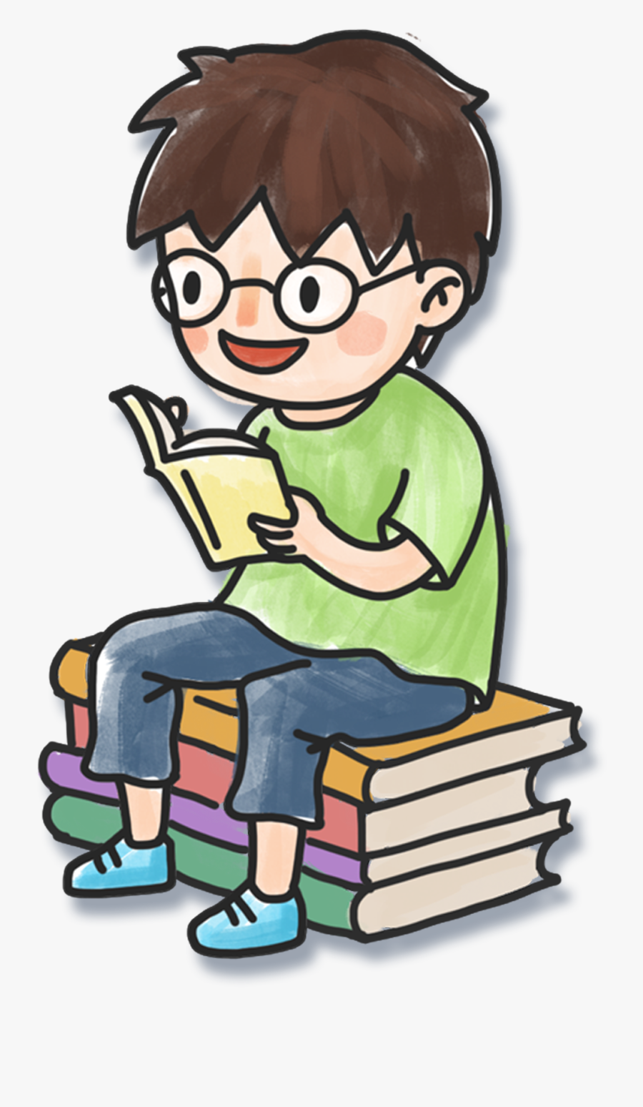
I am learning how to read a timetable.
I can identify the different parts of a timetable.
I can understand how information is displayed in columns and rows.
I can use different strategies to read and find information.
Notes:
Share success criteria for looking at timetables.

Slide 18
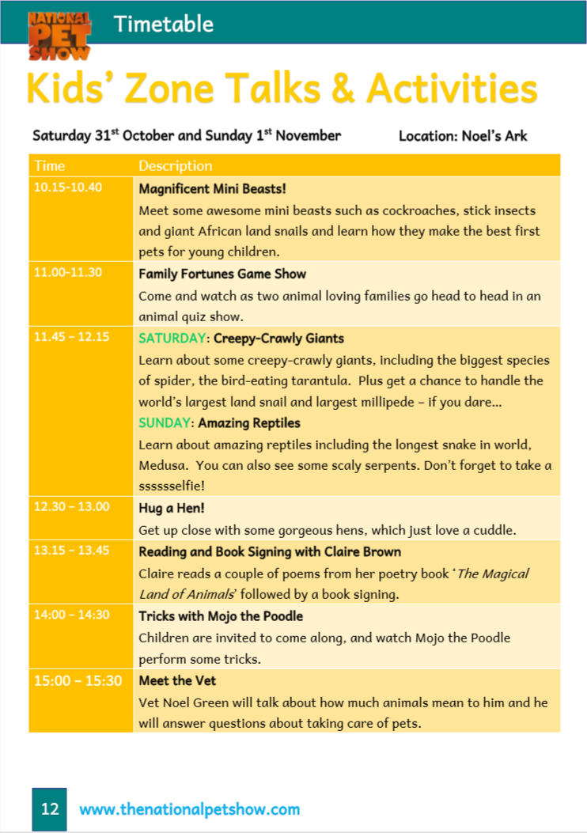
Look at the timetable and note down things that you notice about the way the text is. You can write down points on your copy.
Notes:
This is what the timetable for the Kids Zone looks like. Let’s look at it carefully and discuss the way it looks and how to make sense of it.

Slide 19
Dates of the event
Starting and ending times
Place where activities will be
Subheadings: names of activities
Online link and page number

Slide 20
millipede
reptiles
minibeast
scaly
stick insect

Slide 21
Who would need this timetable and why?
What information do we get from this timetable?
What is the purpose of this timetable?
Why is there a webpage address?
Which activity would you really like to attend and why?
Notes:
Next, I will be reading the timetable aloud to you. As I am reading, please keep in mind the following questions. We will have the opportunity to discuss them later.

Slide 22
Follow along as I read the text aloud.
Notes:
Now that I have read the timetable, take some time to read it. You can read out loud or silently. Make sure that there is an adult beside you to help out.

Slide 23
1. Who would need this timetable?
Children or persons attending the National Pet Show.
Why do they need it?
To know what activities there will be at the Kids Zone.

Slide 24
2. What information do we get from this timetable?
Start and finish times of activities,
What the activities will be about,
Names of important speakers
A webpage address if we want to find out more.

Slide 25
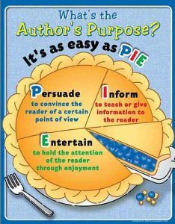
3. What is the purpose of this timetable?
To inform the reader about the activities
To appeal to the reader and encourage them to attend the event.

Slide 26
4. Why is there a webpage address?
To invite readers to go on their website to find more information.

Slide 27
5. Which activity would you like to attend? Give reasons.
Tricks with Mojo the Poodle. I love dogs and how clever they are.

Slide 28
Where will the activities be held?
On which days of the week will these activities be held?
What time does the first activity start?
Which minibeasts can you see?
What does the tarantula eat?
What is the name of the longest snake?
Who wrote the book ‘The Magical Land of Animals’?
What is the name of the poodle?
What is the surname of the vet?
Noel’s Ark
Saturday and Sunday
10:15
stick insect
snail
birds
Medusa
Claire Brown
Mojo
Green
Notes:
We are looking for keywords here, a word or a short phrase that gives us the answer to our question.

Slide 29
Which strategies did you use to find the answers quickly?
Identify keywords.
Look for keywords within the text.
Looking for bold print.
Don’t read full sentences.

Slide 30
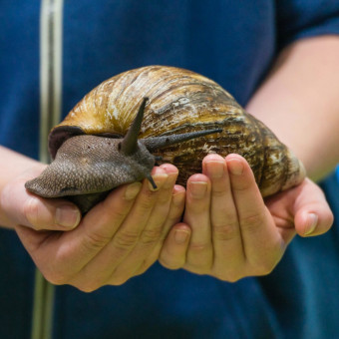
Task 2: Match the photo to the heading
Magnificent Mini Beasts
Hug a Hen!
Meet the Vet
Amazing Reptiles

Slide 31
Task 3: Are these sentences True or False?
 |  | True | False
1. | Magnificent Mini Beasts is the first activity in the Kids’ Zone area.
2. | In the Family Fortunes Quiz Show, three families answer questions about animals.
3. | You can learn about snakes on Sunday.
4. | Claire Brown’s “The Magical Land of Animals” contains stories.
5. | You can talk to Vet Noel Green before seeing Mojo the Poodle.
Notes:
Right, moving on, let’s see whether these sentences are True or False. When doing True or False tasks, we also need to go back to the text to find the evidence. We don’t have to read all the text again, we just need to look for keywords – just like we did in the first task.

Slide 32
Thank you for using this resource. Check out our latest resources below.

