Slide 1
The World Around Us
Lesson 2: Reading

Slide 2
Notes for the Educator
This lesson is pegged directly to Learning Outcome R 5.5 I can use a range of strategies to aid comprehension and find the required information in the text and R 5.7 I can make informed assumptions about a text or long work from its title and introductory material
Teachers are to refer to the Scheme of Work where each lesson is explained in more detail.
Effects are included to make the presentation more interactive. Please present the PowerPoint in Slideshow mode.
Wherever possible we have included the use of online apps to enhance the teaching and learning experience.
The Notes section underneath the slides may contain some further points which can be developed during the lesson.
Teachers are encouraged to adapt this PowerPoint presentation to meet the learners’ language needs.
Audio files or links to websites may be included.
Tasks included in the PowerPoint presentation are also being shared as handouts.
For any comments, feedback or suggestions please email us at: marie-claire.camilleri@ilearn.edu.mt; urieth.attard@ilearn.edu.mt; mary.jude.camilleri@ilearn.edu.mt. You may also call the office on: 25983683.

Slide 3
I am learning how to read and respond to a non-fiction text.
I can identify the purpose and who it is aimed for.
I can use different strategies to read and find information.
I can answer questions about the text.

Slide 4
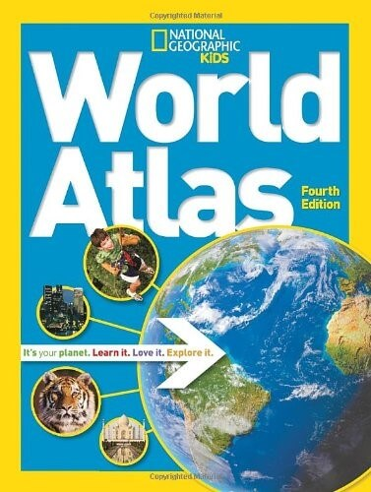

Slide 7
activities
stickers
NON-FICTION

Slide 8
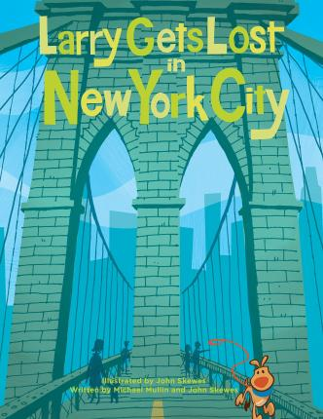
character - dog
Written by/ illustrated
FICTION

Slide 9
facts
real photos
NON-FICTION

Slide 10
Author
Illustrator
FICTION

Slide 11
Not a story
Travel guide - tips
NON-FICTION

Slide 12
A real person
Photos from real life
Information about how Cassio spends his day
NON-FICTION

Slide 13
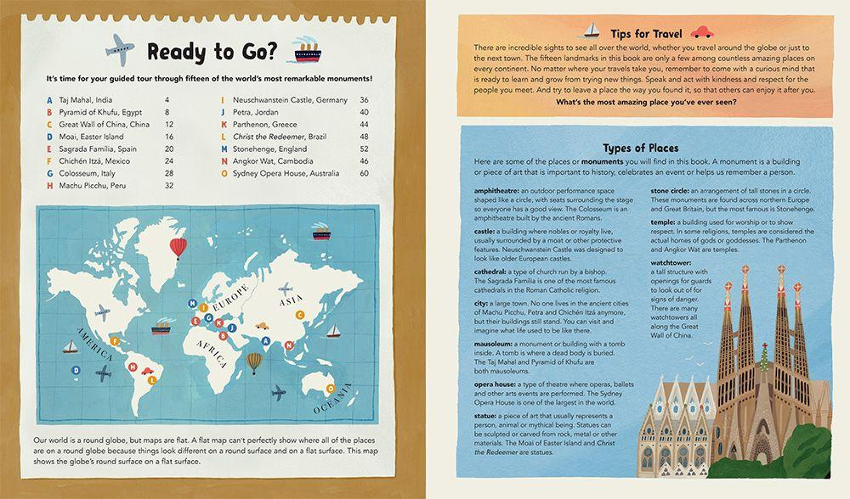
Inside a Non-Fiction Book
text
heading
glossary
contents
page numbers
illustration
caption
Notes:
Great, so now that we have identified the Fiction from the non-fiction, let’s have a look at how Non-Fiction books look from the inside. These two pages are taken from a book called Amazing Places. Let’s see what important information these two pages contain.
The contents is a list of topics covered in the book. It shows you the way the book is organised and gives you an indication of what you will be reading in the different chapters of the book.

Slide 14
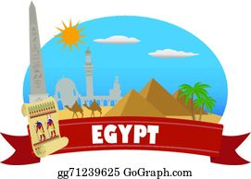
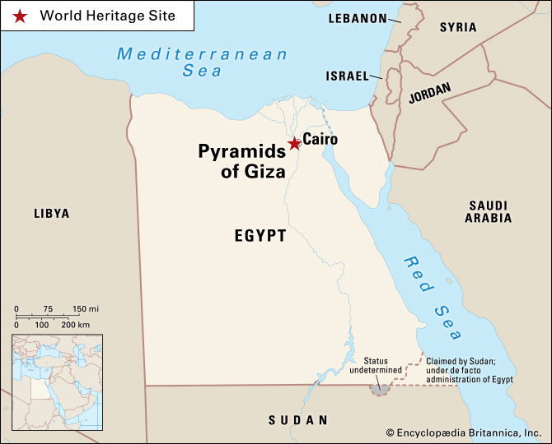
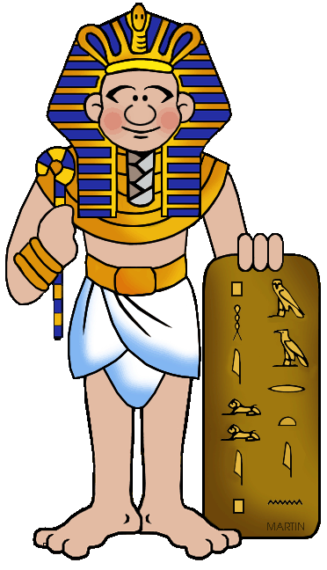

Slide 15
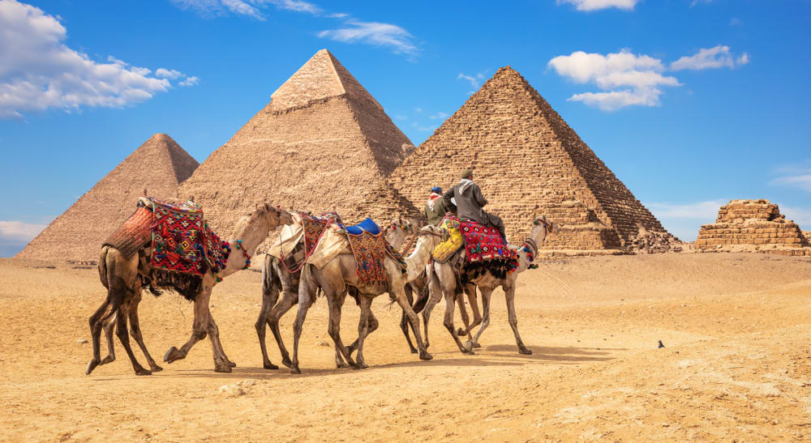
Notes:
Here you can see the pyramids of Giza. The Egyptians were great engineers and skilled builders. They were also very religious so they build huge temples dedicated to their deities. Do you know why pyramids were built? They used to build big pyramids because they believed that the Pharoah’s body needs to be safe and protected. That is how the Ancient Egyptians started to make mummies – they wrapped the King’s body to keep it safe. Then they buried in a tomb inside the pyramid along with precious things they thought he would need in the afterlife. This included gold, food and other valuable things.

Slide 16
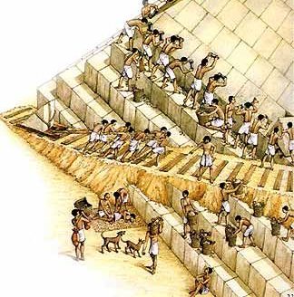
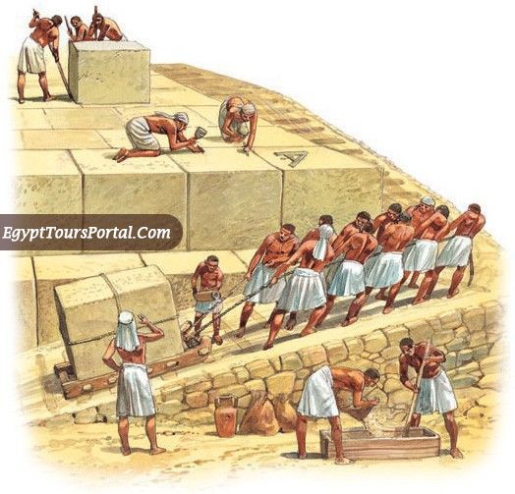

Slide 17
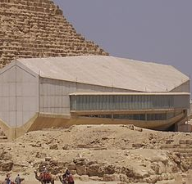
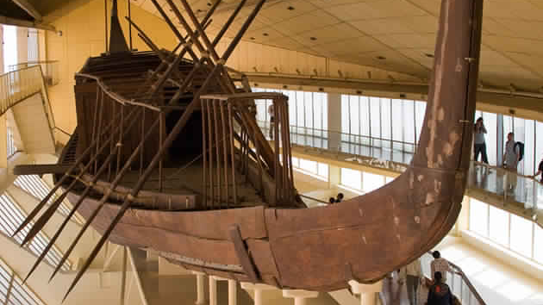
Notes:
This is the Giza Solar Boat Museum. Inside it there is an old ship which was discovered at the foot of the pyramids. It was reassembled and it can now be enjoyed by tourists. This also means that the ancient Egyptians used boats and ships to travel on water.

Slide 18
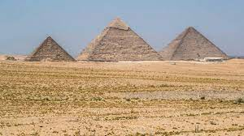
pyramids

Slide 19
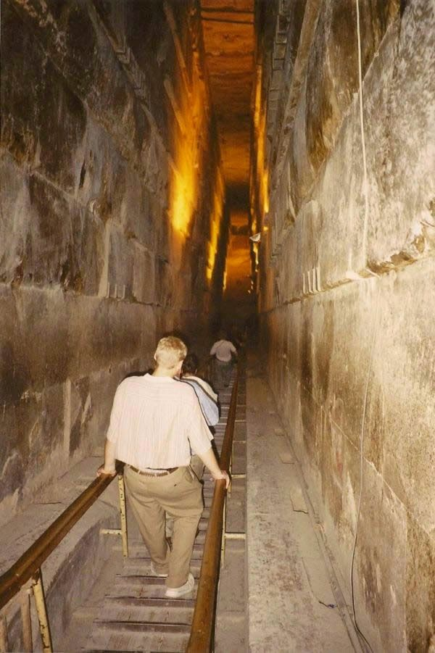
corridor

Slide 20
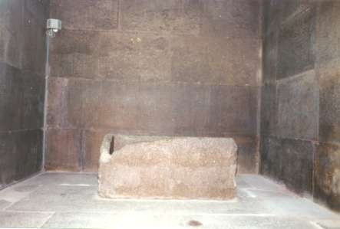
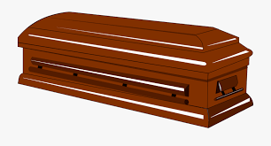
coffin

Slide 21
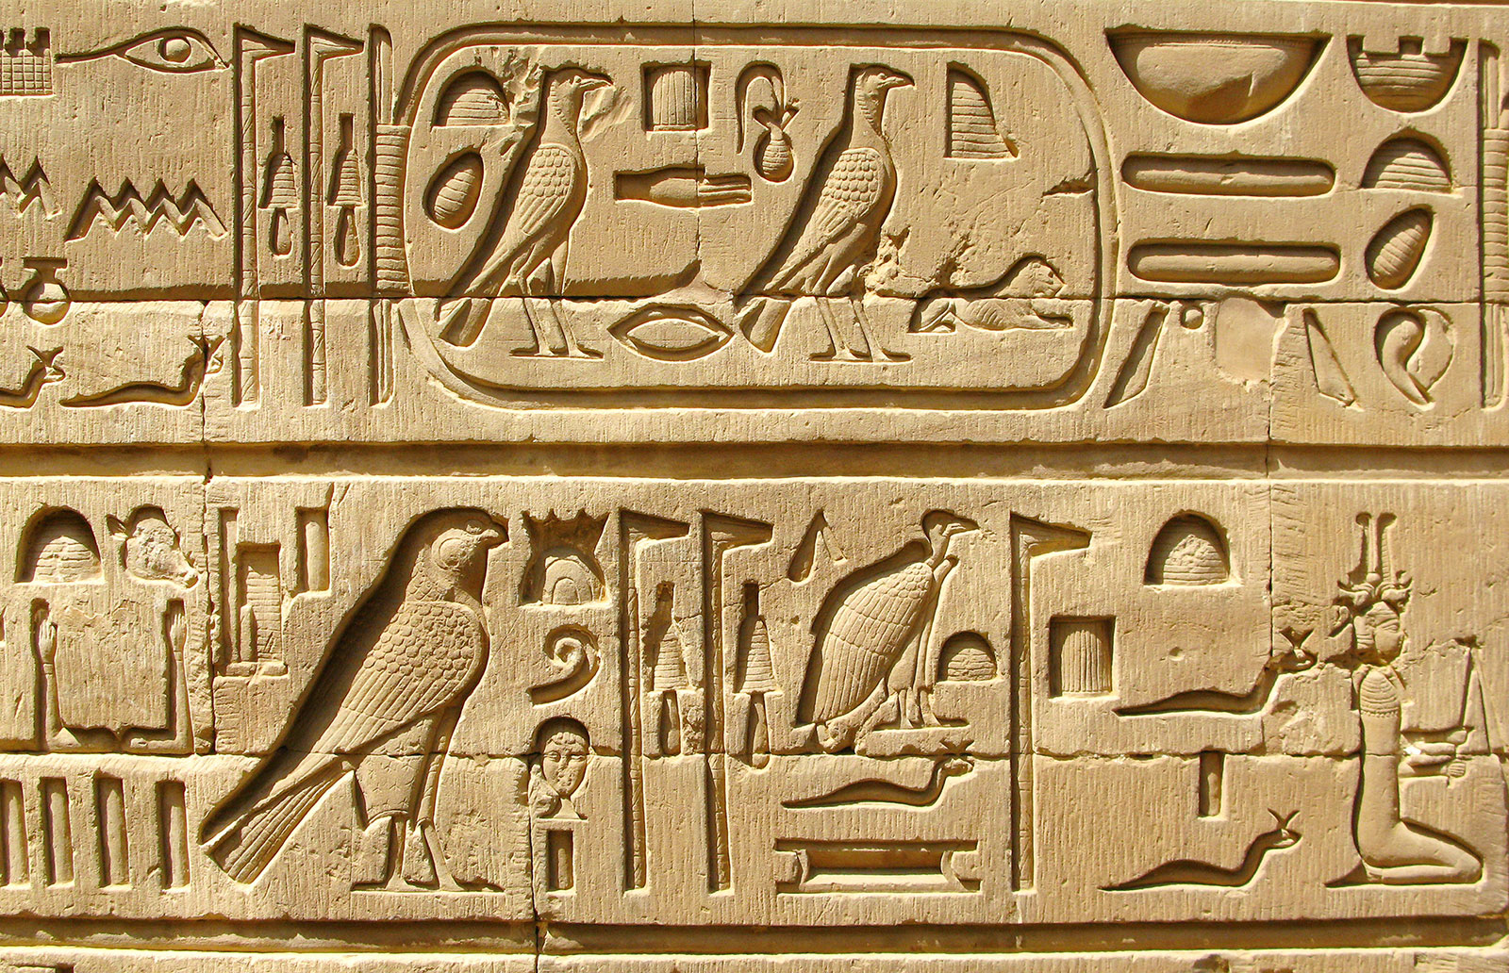
symbols

Slide 22
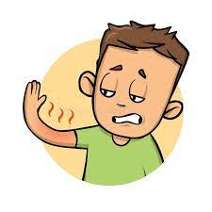
sunburn

Slide 23
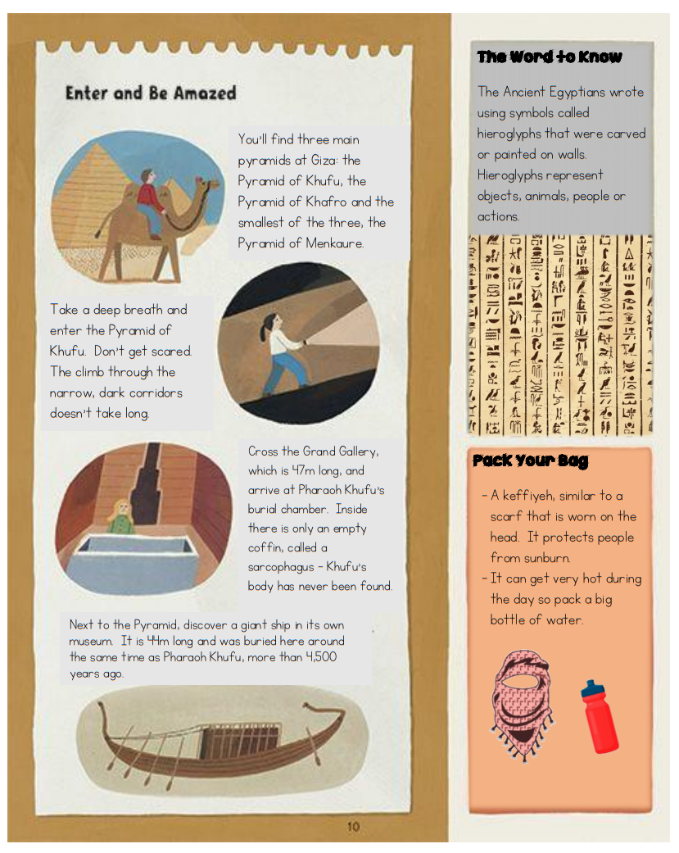
Notes:
Let’s look at the text which we are going to read. This page is taken from the book which I showed you earlier. Just by looking at the pictures, you can immediately tell which country we are going to talk about.

Slide 24
Is this a fiction or a non-fiction text?
Why has the author written this text?
Who is most likely to read this text?
Notes:
As I read please think carefully about the following questions.

Slide 26
1. Is this a fiction or a non-fiction text?
Non-fiction

Slide 27
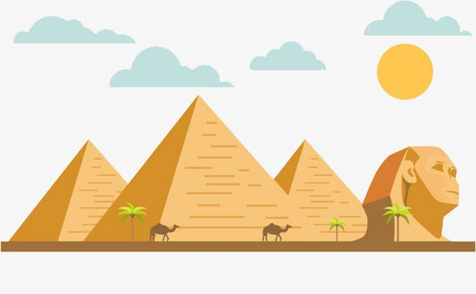
2. Why did the author write this text?
To inform the reader about the pyramids of Giza.

Slide 28
3. Who is most likely to read this text?
Young children who want to learn about the pyramids or the Egyptians.

Slide 29
Which are the three main pyramids of Giza?
How are the corridors in the pyramid of Khufu?
How long is the Grand Gallery?
Why is the sarcophagus empty?
Where can you see a giant ship?
What do hieroglyphs represent?
Pyramid of Khufu
Pyramid of Khafro
Pyramid of Menkaure
narrow
dark
47 m
The body has never been found.
Next to the pyramid of Khufu.
objects, animals, people or actions.
Notes:
In the next task, I would like you to quickly scan the text looking for answers to these questions. They key here is to listen to the key words and look in the text for that word or group of words.

Slide 30
Task 3. Match the words that have the same meaning.
small
tight
narrow
void
dark
massive
empty
old
giant
shadowy
ancient
tiny

Slide 31
Thank you for using this resource. Check out our latest resources below.

